Slide 1
Data dive 2
Initial Question : What genres did each age group have a tendency to watch?
By Aaron Vong, Austin Fine, Colby Luttrell, Ryan Tran

Slide 2
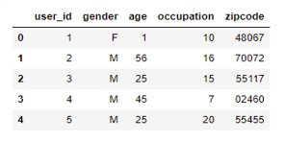
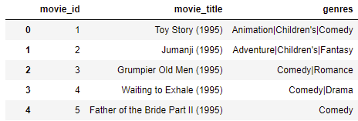
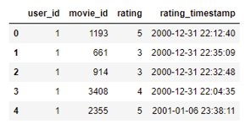
Dat files Insight
users.dat
movies.dat
In order to determine this question, we first:
Establish connection between files
When it comes to the ratings dataset, something to note was the amount of movie ids per user id.
ratings.dat

Slide 3
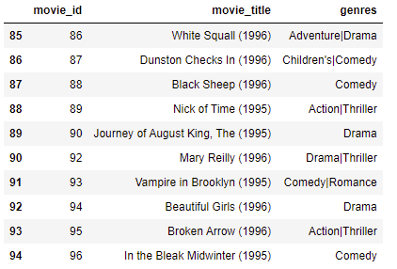
Finding inconsistencies within the dataset
Inconsistencies exist but are not detrimental

Slide 4
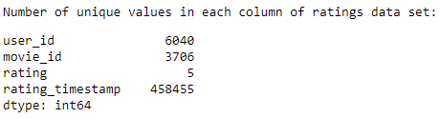
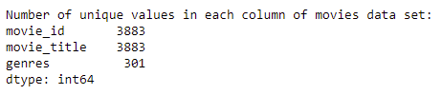
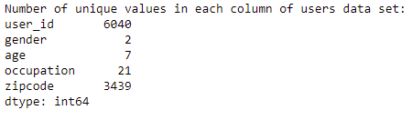
DATA FILE INSIGHT
Gathered number of unique values per data set
Took a count of total of unique values and missing values per data set.

Slide 5
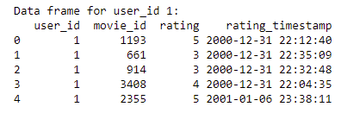
Acquiring data
Made a list of data frames containing movies and rating for each user

Slide 6
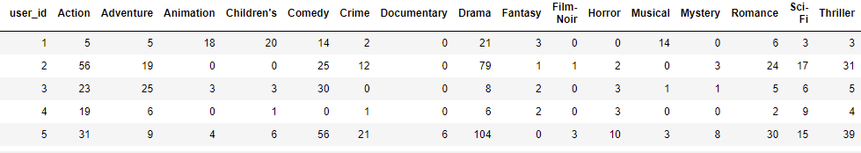
Acquiring data
Created data frame for total number of movies per genre per user_id
Most popular genre: Comedy
Least popular genre: Documentary

Slide 7
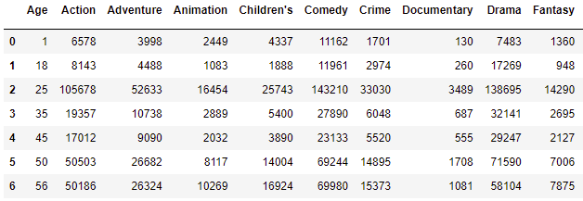
Comparing Age groups
Finally, this allowed us to create a data frame of what each age group watched

Slide 8
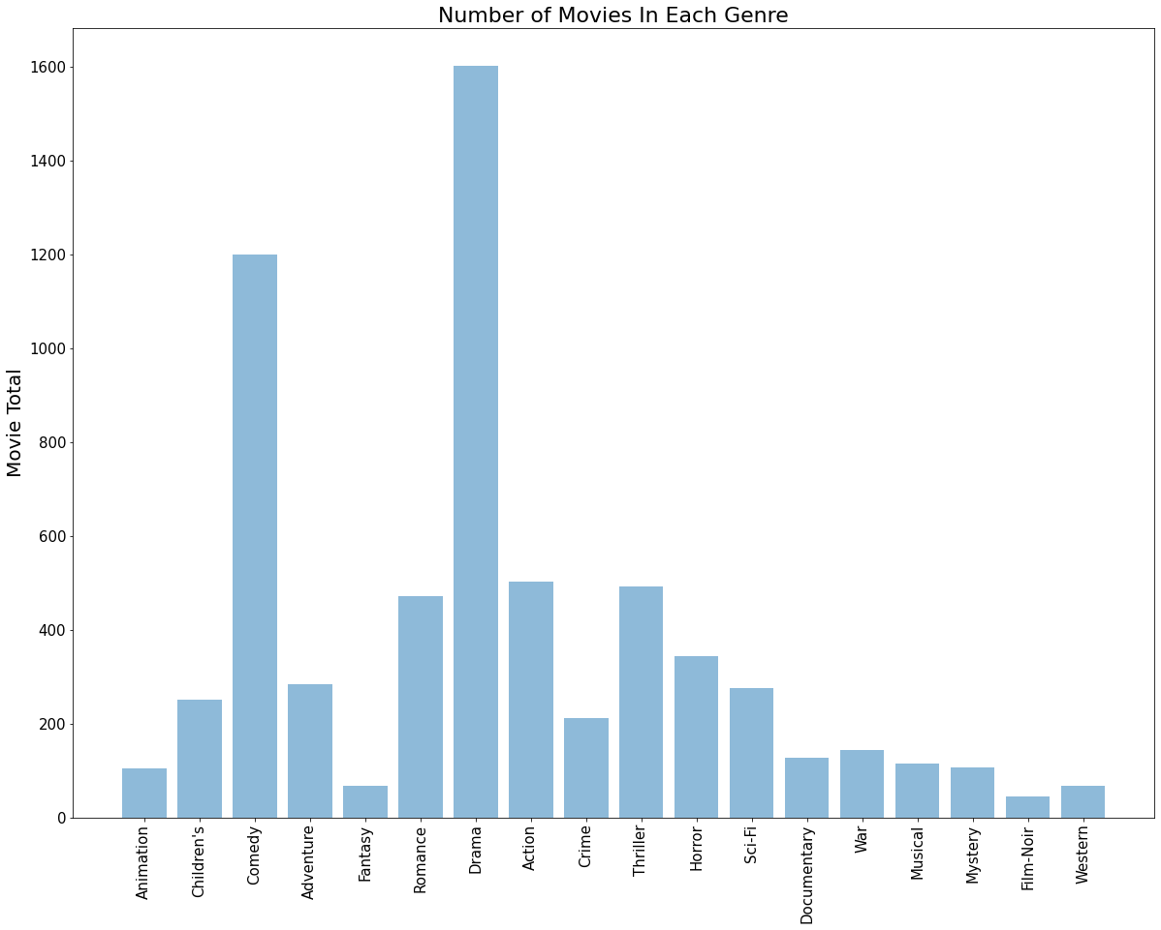
Movies per Genre
Bar chart of number of movies per genre
A few categories stand out by an exceedingly large amount.

Slide 9
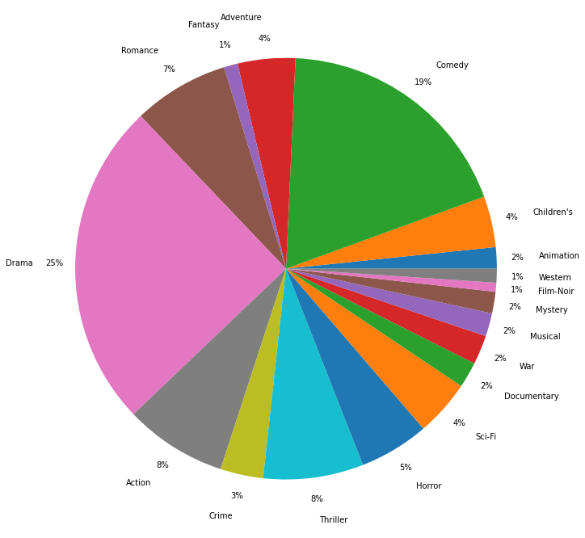
Notice distribution of movie genres

Slide 10
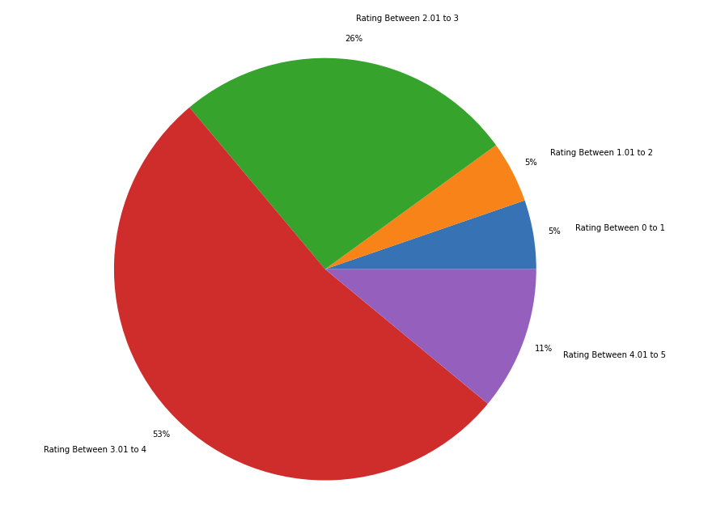
Mean rating

Slide 11
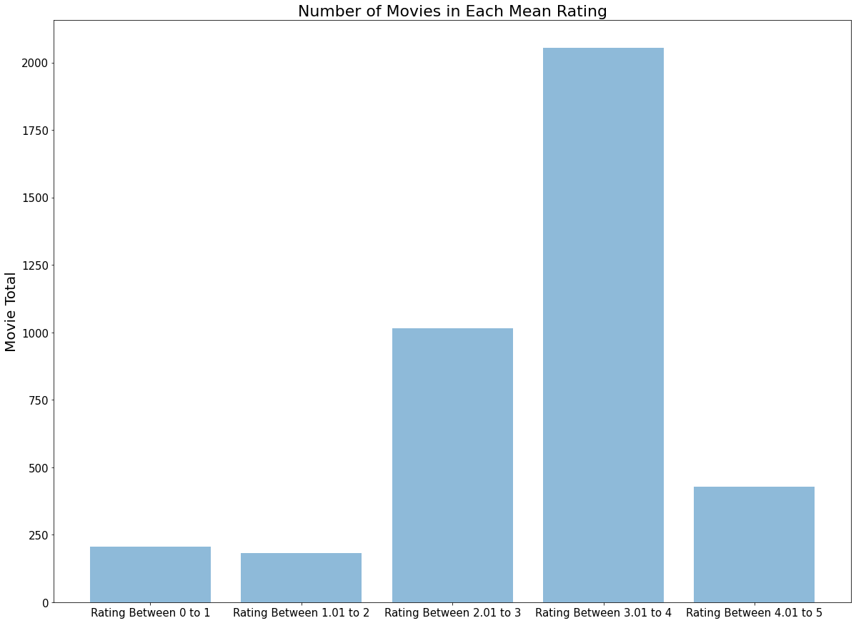

Slide 12
MOVIES PER AGE GROUP
Final findings

Slide 13
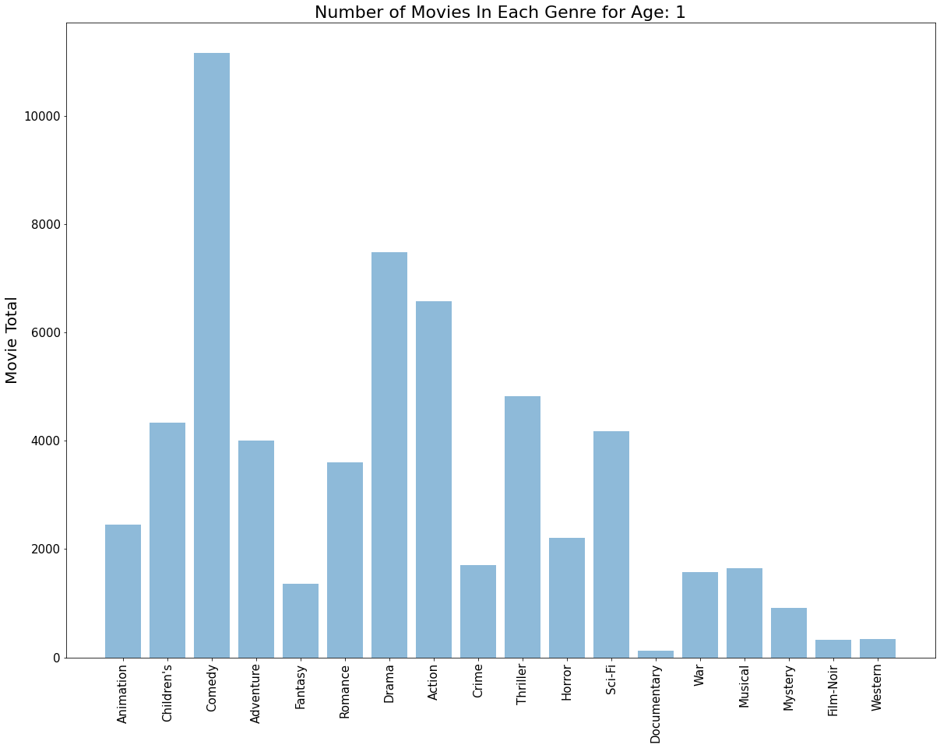
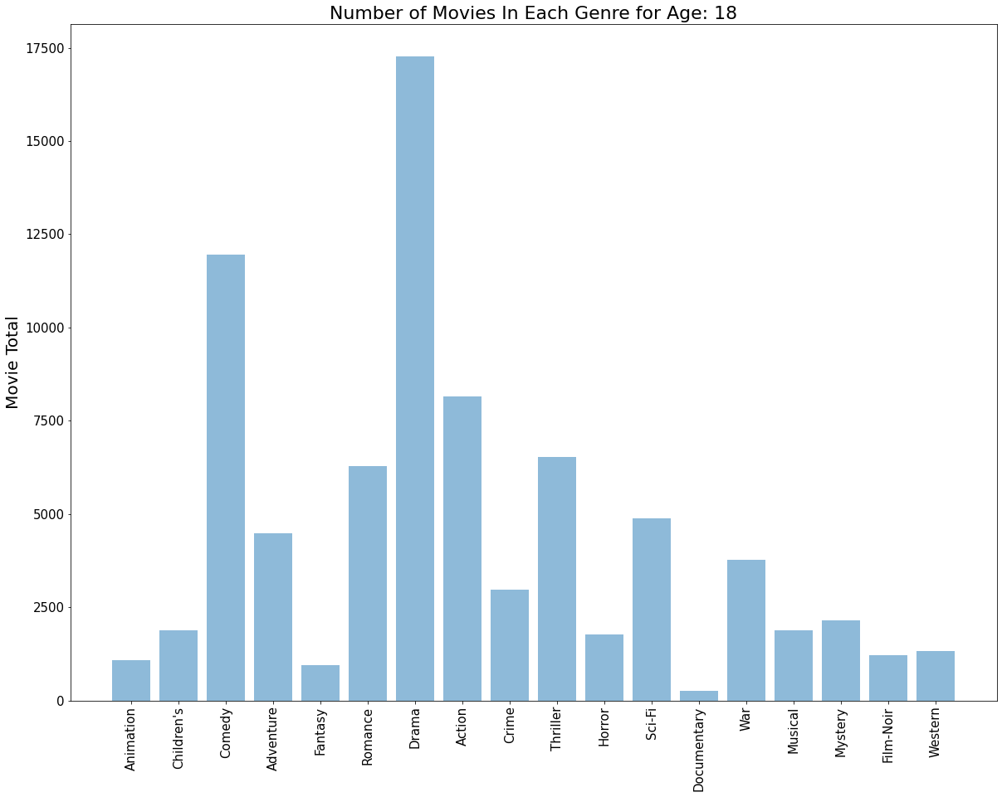

Slide 14
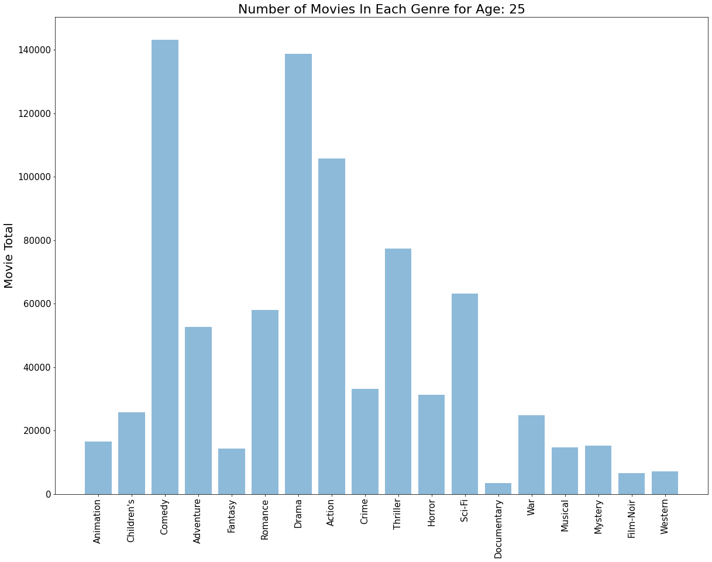
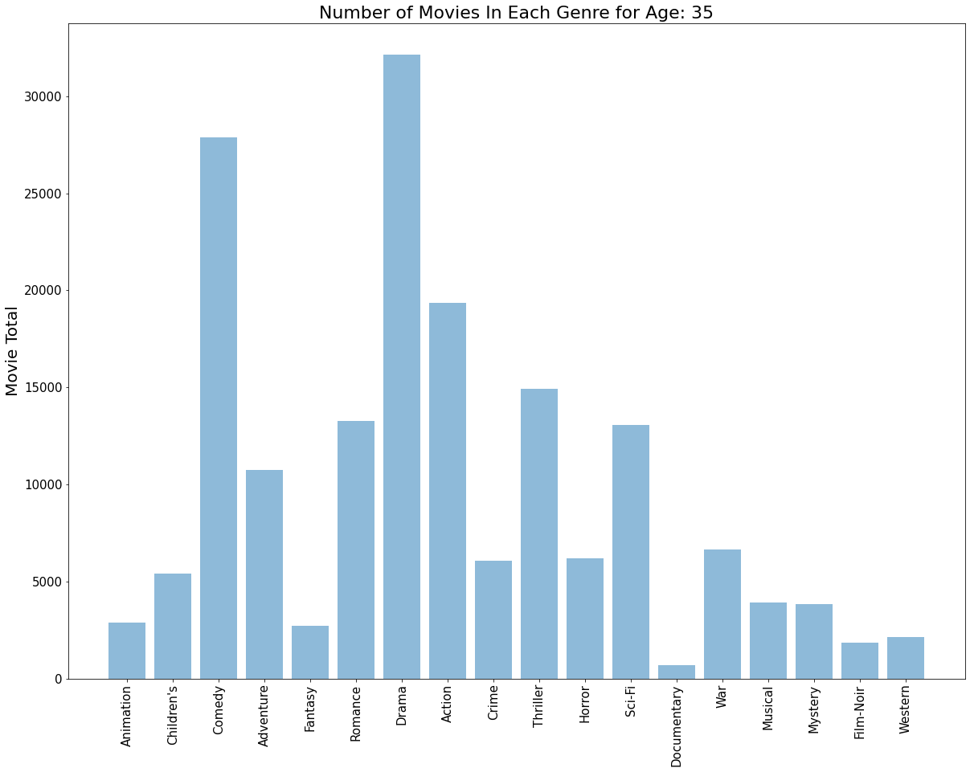

Slide 15
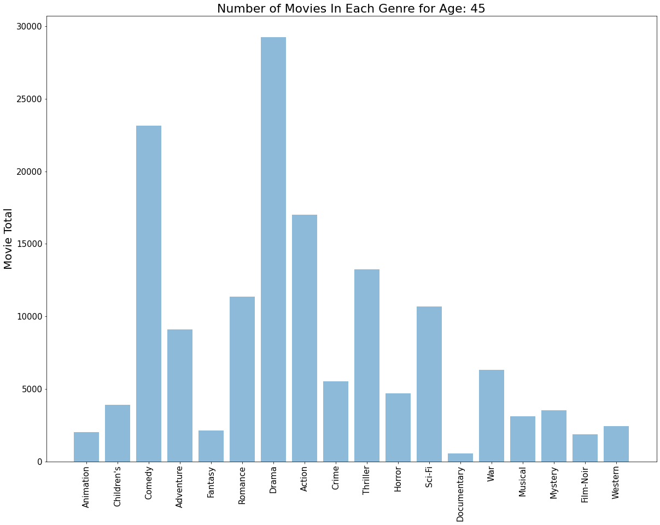
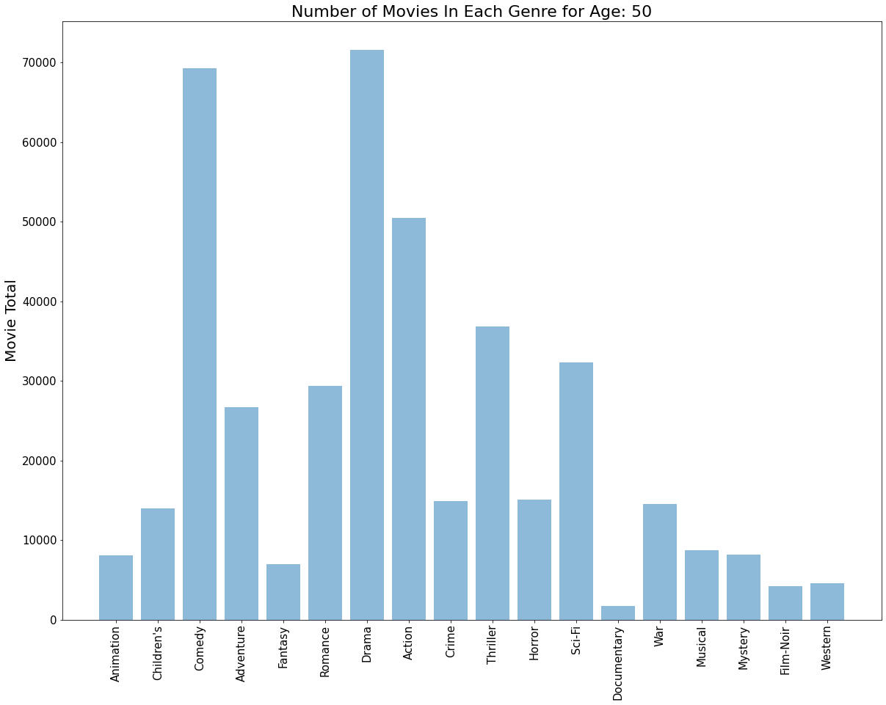

Slide 16
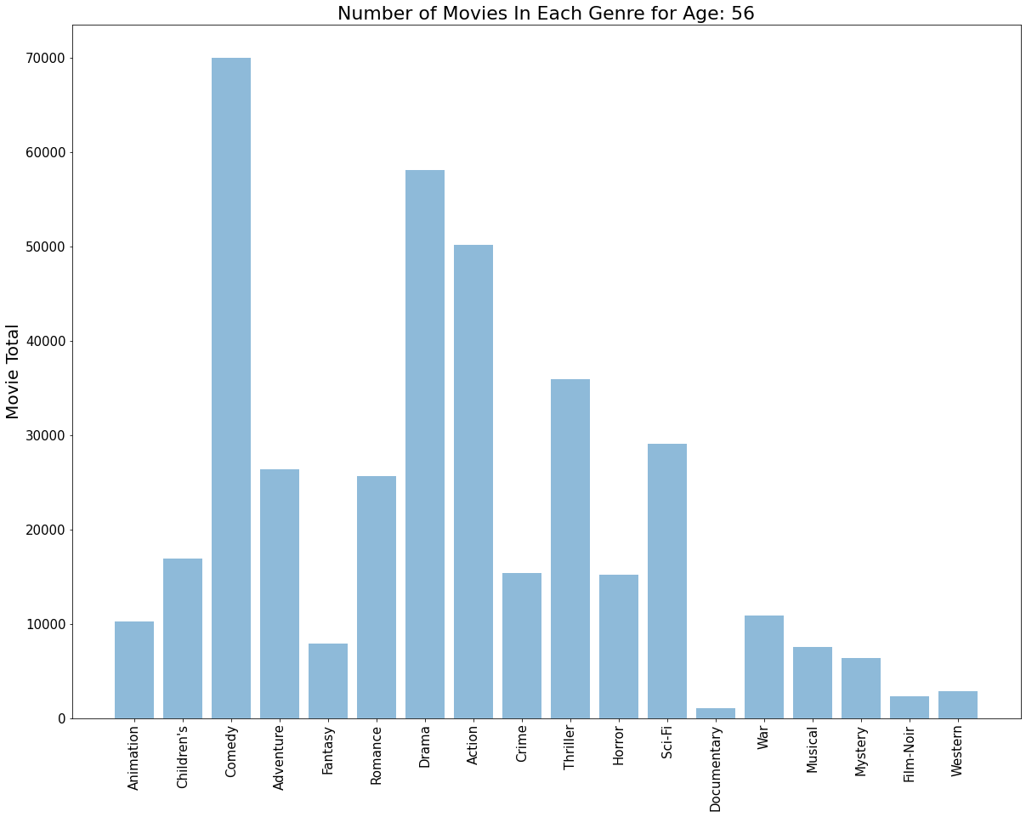
Conclusion
The most popular genres among Age Groups:
Ages 1-17: Comedy
Ages 18-24: Drama
Ages 25-34: Comedy
Ages 34-45: Drama
Ages 45-50: Drama
Ages 51-55: Drama
Ages 56+: Comedy

