Slide 1

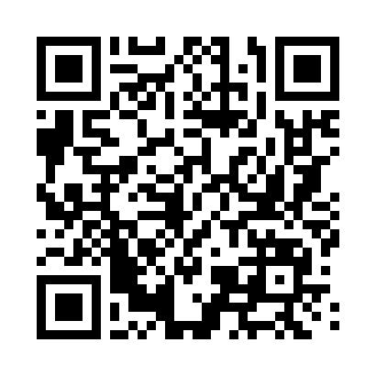
HiPy At The Movies
SCAN FOR MORE INFO AND TO REGISTER
FREE CODING EVENT FOR ALL STUDENTS AND STAFF
WED 5 NOV 2025.
5 – 7PM. UNIVERSITY OF LIVERPOOL

