Slide 1
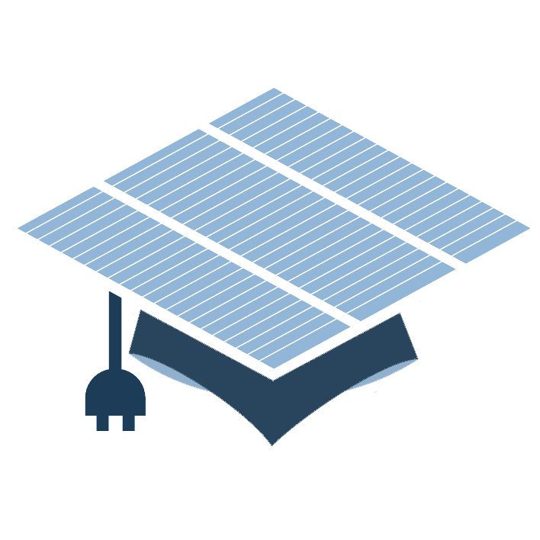

Fundamentals of Photovoltaics
Nov 5th – 7th 2014

Slide 2


i
Course Overview
Wed Nov 5
1. The Sun – Mauritzio Salaris, JMU
2. Solar spectrum and basic device response – R. Treharne
3. Detailed Balance – R. Treharne
Thu Nov 6
4. Semiconductors 101 – R. Treharne
5. Junctions – R. Treharne
6. Junction Characterisation – R. Treharne
Fri Nov 7
7. Materials Stability – K. Durose
8. Optical properties of semiconductors – T. Veal
9. Advanced characterisation of band phenomena – V. Dhanak
10. Photovoltaics – Current and future PV technologies – K. Durose
Mon Nov 10
EXAM

Slide 3

ii
Questions?
#cdtpvC1

Slide 4
Lecture 1
Solar spectrum and basic device response
R. Treharne
Nov 5th 2014

Slide 5
L2 1
Lecture Outline
Super speedy history of solar
The photovoltaic effect
AM1.5 spectrum
Solar simulators and ratings
The ideal diode equation + equivalent circuits
J-V curves and important device parameters
Parasitic resistances
External quantum efficiency (EQE)

Slide 6
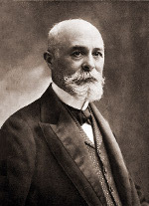
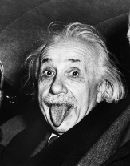
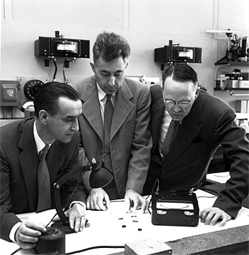
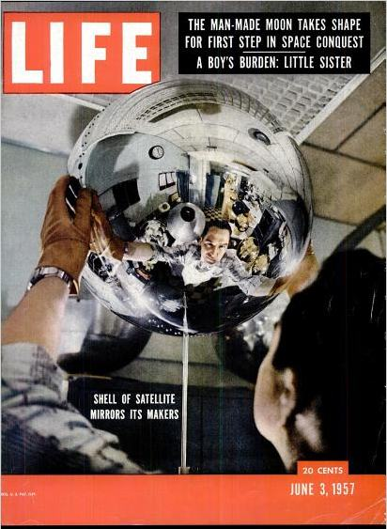
L2 2
SS History of Solar
1839:
Edmund Bequerel discovers photovoltaic effect in electrolytic cell
1873:
Willoughby Smith observes photoconductivity in Selenium
1905:
Einstein publishes paper on photoelectric effect (not photovoltaic effect!)
1954:
First PV cell made at Bell Labs, USA. Used to power telephone repeaters – 4% efficient.
Daryl Chapin, Calvin Fuller, Gerald Pearson. .
1958:
First PV cell in space. Vanguard Satellite. Max power 1W! Followed Explorer VI and VII satellities (1959)
1960:
Hoffman Electronics achieves 14% PV cells!
https://www1.eere.energy.gov/solar/pdfs/solar_timeline.pdf
http://jongertner.net/idea-factory/

Slide 7
L2 3
SS History of Solar
1839:
Edmund Bequerel discovers photovoltaic effect in electrolytic cell
1873:
Willoughby Smith observes photoconductivity in Selenium
1905:
Einstein publishes paper on photoelectric effect (not photovoltaic effect!)
1954:
First PV cell made at Bell Labs, USA. Used to power telephone repeaters – 4% efficient.
Daryl Chapin, Calvin Fuller, Gerald Pearson. .
1958:
First PV cell in space. Vanguard Satellite. Max power 1W! Followed Explorer VI and VII satellities (1959)
1960:
Hoffman Electronics achieves 14% PV cells!

Slide 8
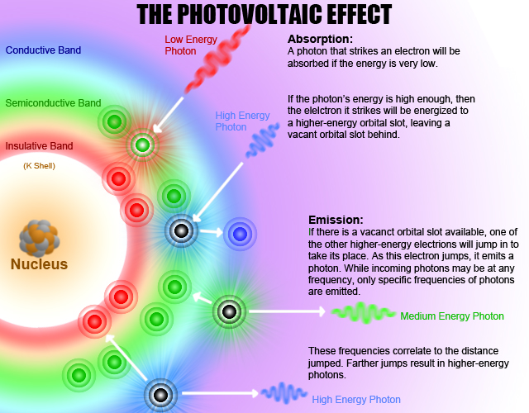
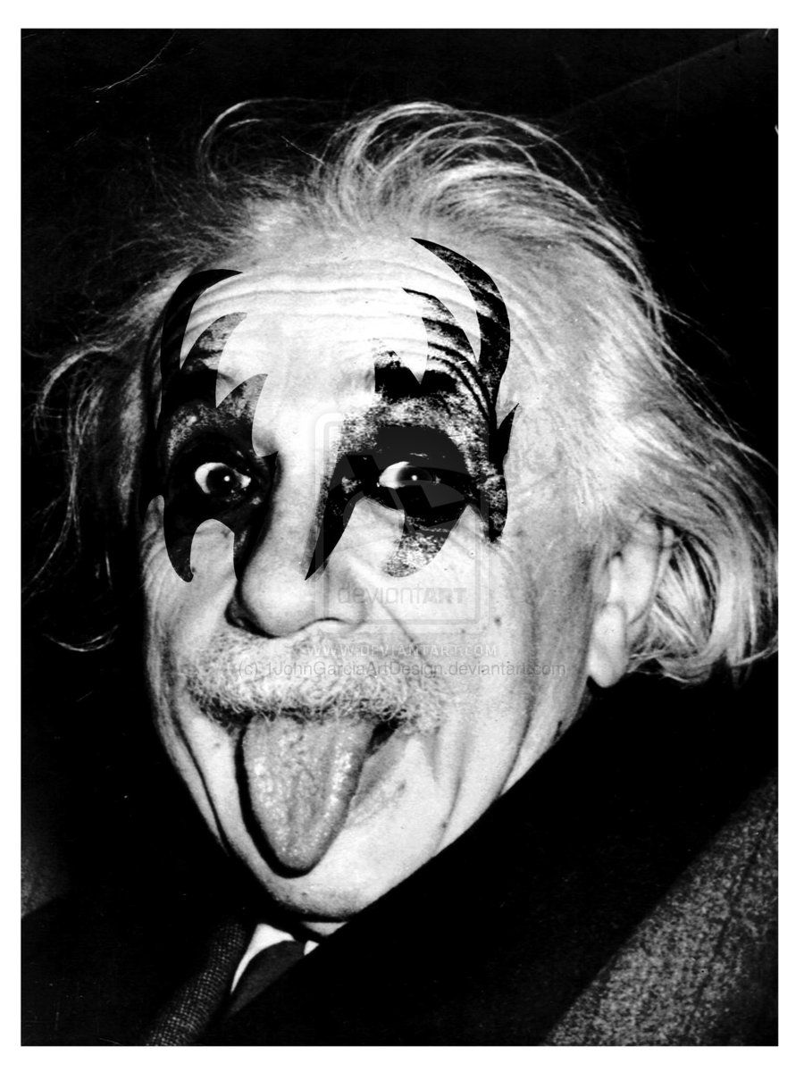
L2 4
Photovoltaic Effect
Do you know the difference between the photoelectric and photovoltaic effects?
http://sargosis.com/articles/science/how-pv-modules-work/the-photoelectric-and-photovoltaic-effects/

Slide 9
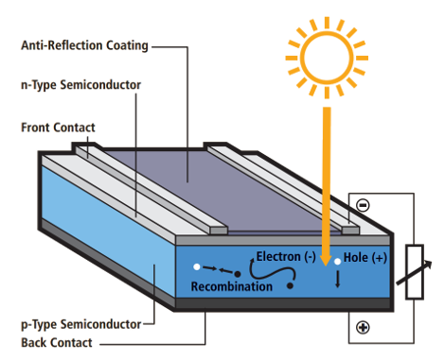
L2 5
Photovoltaic Effect
How do we use the PV effect to do work?
Must separate generated electron-hole pair
Prevent recombination
Need internal field
How? JUNCTION!
Hold in your excitement until L5

Slide 10
L2 6
Photovoltaic Effect
Basic qualitative description:

Slide 11
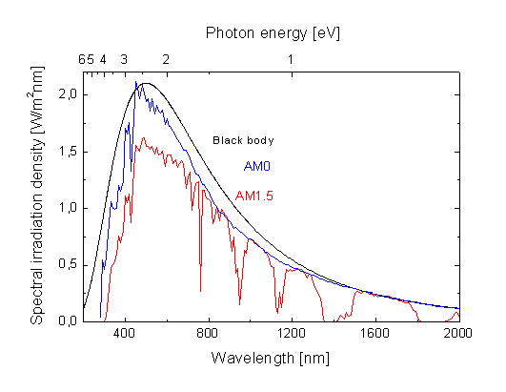
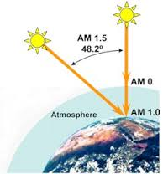
L2
AM1.5 Spectrum

Slide 12
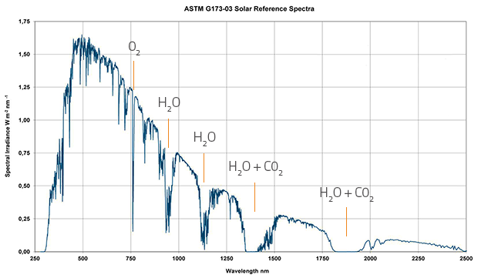
L2
AM1.5 Spectrum
http://rredc.nrel.gov/solar/spectra/am1.5/

