Slide 1
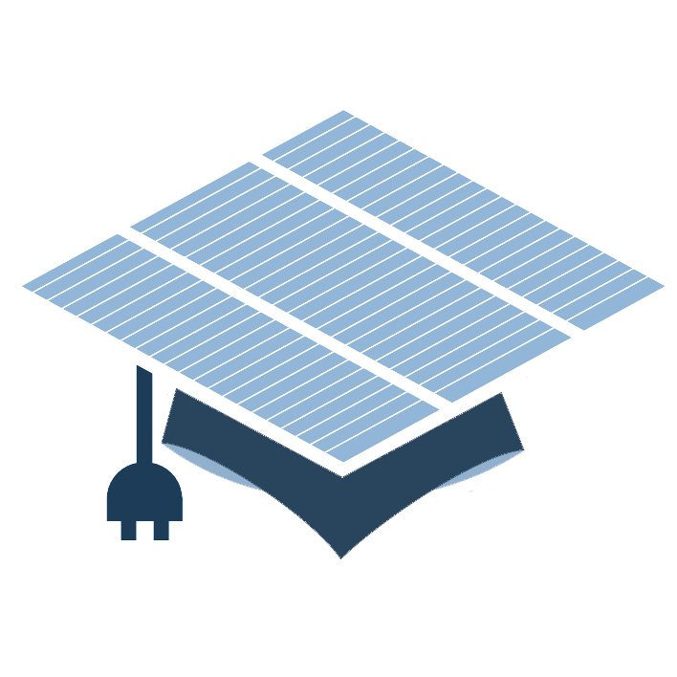

Fundamentals of Photovoltaics
Nov 5th – 7th 2014

Slide 2


i
Course Overview
Wed Nov 5
1. The Sun – Mauritzio Salaris, JMU
2. Solar spectrum and basic device response – R. Treharne
3. Detailed Balance – R. Treharne
Thu Nov 6
4. Semiconductors 101 – R. Treharne
5. Junctions – R. Treharne
6. Junction Characterisation – R. Treharne
Fri Nov 7
7. Materials Stability – K. Durose
8. Optical properties of semiconductors – T. Veal
9. Advanced characterisation of band phenomena – V. Dhanak
10. Photovoltaics – Current and future PV technologies – K. Durose
Mon Nov 10
EXAM

Slide 3

ii
Questions?
#cdtpvC1

Slide 4
Lecture 1
Solar spectrum and basic device response
R. Treharne
Nov 5th 2014

Slide 5
L2
Lecture Outline
Super speedy history of PV
The photovoltaic effect
AM1.5 spectrum
Solar simulators and ratings
The ideal diode equation + equivalent circuits
J-V curves and important device parameters
Parasitic resistances
External quantum efficiency (EQE)

Slide 6




L2
SS History of PV
1839:
Edmund Bequerel discovers photovoltaic effect in electrolytic cell
1873:
Willoughby Smith observes photoconductivity in Selenium
1905:
Einstein publishes paper on photoelectric effect (not photovoltaic effect!)
1954:
First PV cell made at Bell Labs, USA. Used to power telephone repeaters – 4% efficient.
Daryl Chapin, Calvin Fuller, Gerald Pearson. .
1958:
First PV cell in space. Vanguard Satellite. Max power 1W! Followed Explorer VI and VII satellities (1959)
1960:
Hoffman Electronics achieves 14% PV cells!
https://www1.eere.energy.gov/solar/pdfs/solar_timeline.pdf
http://jongertner.net/idea-factory/

Slide 7
L2
SS History of PV
1839:
Edmund Bequerel discovers photovoltaic effect in electrolytic cell
1873:
Willoughby Smith observes photoconductivity in Selenium
1905:
Einstein publishes paper on photoelectric effect (not photovoltaic effect!)
1954:
First PV cell made at Bell Labs, USA. Used to power telephone repeaters – 4% efficient.
Daryl Chapin, Calvin Fuller, Gerald Pearson. .
1958:
First PV cell in space. Vanguard Satellite. Max power 1W! Followed Explorer VI and VII satellities (1959)
1960:
Hoffman Electronics achieves 14% PV cells!

Slide 8

L2
SS History of PV

Slide 9


L2 4
Photovoltaic Effect
Do you know the difference between the photoelectric and photovoltaic effects?
http://sargosis.com/articles/science/how-pv-modules-work/the-photoelectric-and-photovoltaic-effects/

Slide 10

L2 5
Photovoltaic Effect
How do we use the PV effect to do work?
Must separate generated electron-hole pair
Prevent recombination
Need internal field
How? JUNCTION!
Hold in your excitement until L5

Slide 11


L2
AM1.5 Spectrum
http://en.wikipedia.org/wiki/Air_mass_(solar_energy)

Slide 12

L2
AM1.5 Spectrum
http://rredc.nrel.gov/solar/spectra/am1.5/

Slide 13
L2
Solar Simulators
The light from a solar simulator is controlled in 3 dimensions:
  Spectral content
  Spatial uniformity
  Temporal stability
Classification | Spectral Match (each interval) | Irradiance Spacial Non-Uniformity | Temperal Instability
A | 0.75-1.25 | 2% | 2%
B | 0.6-1.4 | 5% | 5%
C | 0.4-2.0 | 10% | 10%
http://en.wikipedia.org/wiki/Solar_simulator

Slide 14
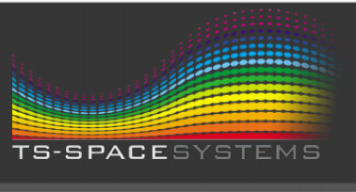


L2
Solar Simulators

Slide 15
L2
Ideal Diode Equation

Slide 16
L2
Diode J-V

Slide 17
L2
Ideal diode for solar cell

Slide 18
L2
Light JV response

Slide 19
L2
Device Parameters

Slide 20
L2
Conversion Efficiency

Slide 21
L2
Parasitic Resistances

Slide 22
L2
Calculating Series Resistance

Slide 23
L2
Calculating Shunt Resistance

Slide 24
L2
Estimating J₀

Slide 25
L2
Diode Ideality Factor

Slide 26
L2
Quantum Efficiency

Slide 27
L2
IQE and EQE

Slide 28
L2
Responsivity

