Slide 1


Fundamentals of Photovoltaics
Nov 5th – 7th 2014

Slide 2


i
Course Overview
Wed Nov 5
1. The Sun – Mauritzio Salaris, JMU
2. Solar spectrum and basic device response – R. Treharne
3. Detailed Balance – R. Treharne
Thu Nov 6
4. Semiconductors 101 – R. Treharne
5. Junctions – R. Treharne
6. Junction Characterisation – R. Treharne
Fri Nov 7
7. Materials Stability – K. Durose
8. Optical properties of semiconductors – T. Veal
9. Advanced characterisation of band phenomena – V. Dhanak
10. Photovoltaics – Current and future PV technologies – K. Durose
Mon Nov 10
EXAM

Slide 3

ii
Questions?
#cdtpvC1

Slide 4
Lecture 1
Solar spectrum and basic device response
R. Treharne
Nov 5th 2014

Slide 5
L2
Lecture Outline
Super speedy history of PV
The photovoltaic effect
AM1.5 spectrum
Solar simulators and ratings
The ideal diode equation + equivalent circuits
J-V curves and important device parameters
Parasitic resistances
External quantum efficiency (EQE)

Slide 6




L2
SS History of PV
1839:
Edmund Bequerel discovers photovoltaic effect in electrolytic cell
1873:
Willoughby Smith observes photoconductivity in Selenium
1905:
Einstein publishes paper on photoelectric effect (not photovoltaic effect!)
1954:
First PV cell made at Bell Labs, USA. Used to power telephone repeaters – 4% efficient.
Daryl Chapin, Calvin Fuller, Gerald Pearson. .
1958:
First PV cell in space. Vanguard Satellite. Max power 1W! Followed Explorer VI and VII satellities (1959)
1960:
Hoffman Electronics achieves 14% PV cells!
https://www1.eere.energy.gov/solar/pdfs/solar_timeline.pdf
http://jongertner.net/idea-factory/

Slide 7
L2
SS History of PV
1839:
Edmund Bequerel discovers photovoltaic effect in electrolytic cell
1873:
Willoughby Smith observes photoconductivity in Selenium
1905:
Einstein publishes paper on photoelectric effect (not photovoltaic effect!)
1954:
First PV cell made at Bell Labs, USA. Used to power telephone repeaters – 4% efficient.
Daryl Chapin, Calvin Fuller, Gerald Pearson. .
1958:
First PV cell in space. Vanguard Satellite. Max power 1W! Followed Explorer VI and VII satellities (1959)
1960:
Hoffman Electronics achieves 14% PV cells!

Slide 8

L2
SS History of PV

Slide 9


L2 4
Photovoltaic Effect
Do you know the difference between the photoelectric and photovoltaic effects?
http://sargosis.com/articles/science/how-pv-modules-work/the-photoelectric-and-photovoltaic-effects/

Slide 10

L2 5
Photovoltaic Effect
How do we use the PV effect to do work?
Must separate generated electron-hole pair
Prevent recombination
Need internal field
How? JUNCTION!
Hold in your excitement until L5

Slide 11


L2
AM1.5 Spectrum
http://en.wikipedia.org/wiki/Air_mass_(solar_energy)

Slide 12

L2
AM1.5 Spectrum
http://rredc.nrel.gov/solar/spectra/am1.5/
Integrated Irradiance = 1000 Wm² for AM1.5

Slide 13
L2
Solar Simulators
The light from a solar simulator is controlled in 3 dimensions:
  Spectral content
  Spatial uniformity
  Temporal stability
Classification | Spectral Match (each interval) | Irradiance Spacial Non-Uniformity | Temperal Instability
A | 0.75-1.25 | 2% | 2%
B | 0.6-1.4 | 5% | 5%
C | 0.4-2.0 | 10% | 10%
http://en.wikipedia.org/wiki/Solar_simulator

Slide 14



L2
Solar Simulators

Slide 15

L2
Ideal Diode Equation
Often called the Shockley equation:
J₀ – Dark saturation current.
V – applied voltage across the terminals of the diode
e – Electronic charge
k_{B} – Boltzmann's constant
T – Absolute temperature (K)
William Shockley:
Co-inventor of the transistor with Bardeen and Brattain 1948
Nobel Prize: 1956
(Also a eugenicist)
Might derive this later for fun! (L5)

Slide 16

L2
Ideal dark JV curve
J₀ = 1 x 10⁻¹⁰ A/cm²
http://pveducation.org/pvcdrom/pn-junction/diode-equation

Slide 17

L2
Ideal diode for solar cell
Sign convention: Lets say that the direction of a generated photo-current J_{L} is positive with respect to a negative dark current J_{dark}
Equivalent Circuit:
Ideal solar cell

Slide 18

L2
Light JV response
Performance of cell can be described by three important parameters
  Short circuit current – J_{SC}
  Open circuit voltage – V_{OC}
  Fill factor = FF

Slide 19
L2
Short Circuit Current - J_{SC}
J_{SC}
What is J_{SC} dependent on?
  Intensity
  Optical properties – REFLECTION!
  Lifetime (L5)
  Band gap
For ideal case:
J_{L} = J_{SC}
(but not true in reality)

Slide 20


L2
Short Circuit Current - J_{SC}

Slide 21
L2
Fill Factor - FF
Estimating V_{OC}
V_{OC}
Most significant parameter that affects the size of V_{OC}

Slide 22

L2
Fill Factor - FF
Fill factor defines the “squareness” of the J-V curve
J, P
Jmp
V

Slide 23
L2
Efficiency, η
AM1.5!
Note: Units OK because J measured in Am⁻².
i.e. m⁻² cancel (Be careful)

Slide 24
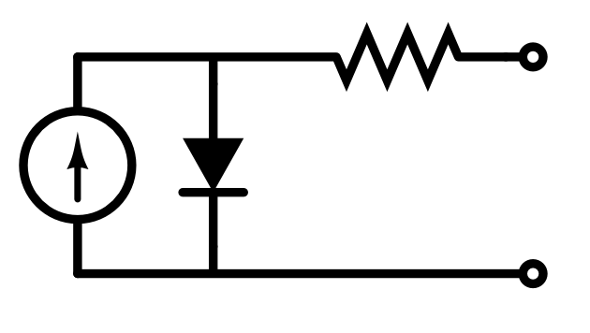
L2
Series Resistance, R_{s}
Origin of series resistance in solar cell:
  Simply a property of real materials – i.e. non infinite mobility
  Resistances associated with back and front contacts to cell
Can represent sum of series resistance effects in equivalent circuit using a single resistor in series:
R_{s}
Uh oh!
Recursive Equation!

Slide 25
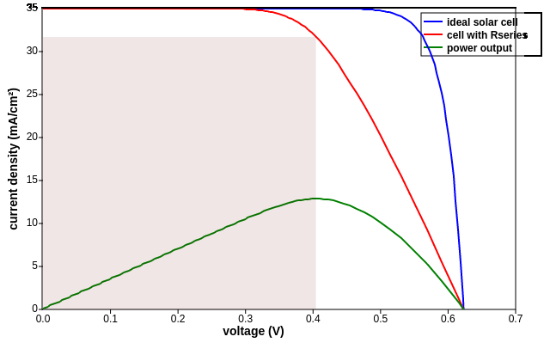
L2
Series Resistance
Effect of R_{s} on shape of JV curve:
  V_{OC} reduced
  FF reduced
Effect of R_{s} on shape of JV curve:
  V_{OC} reduced
  FF reduced
η decreases!
For moderate R_{s}
http://pveducation.org/pvcdrom/solar-cell-operation/series-resistance

Slide 26
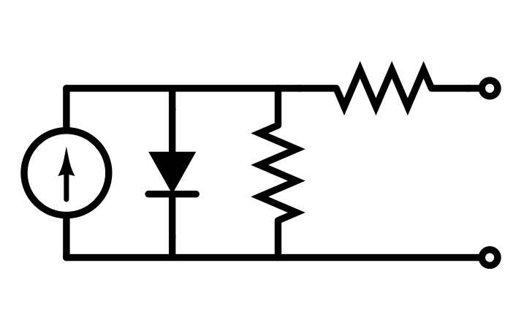
L2
Shunt Resistance, R_{SH}
Origin of shunt resistance in solar cell:
  Usually the result of poor fabrication methods
  Short circuit paths between electrodes of cell
Can represent sum of shunts in equivalent circuit using a single resistor in parallel to diode:

Slide 27
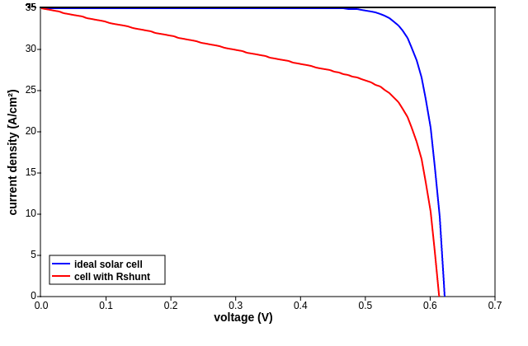
L2
Shunt Resistance, R_{SH}
Effect of R_{SH} on shape of JV curve:
  FF decreases
  V_{OC} decreases for very low R_{SH} (<50 Ω cm²)
http://pveducation.org/pvcdrom/solar-cell-operation/impact-of-both-resistances

Slide 28
L2
Ideality Factor
No such thing as an ideal diode
n – typically takes values of between 1 and 2 (but can be higher)
Originally used as a fudge factor for empirical data
Now understood to be related to quality of SC material
Related to carrier recombination (L4)

Slide 29
L2
Diode Ideality Factor
IDEA:
Increase n to increase V_{OC} (and efficiency)!
Hooray! You've just solved all our problems. And we'll be home in time for tea.

Slide 30

L2
Diode Ideality Factor
Nice Try
n and J₀ inextricably linked
Increase n increase in J₀
Net effect: decrease in V_{OC} (not increase, D'oh!)

Slide 31
L2
Quantum Efficiency

Slide 32
L2
IQE and EQE

Slide 33
L2
Responsivity

