Slide 1


Fundamentals of Photovoltaics
Nov 5th – 7th 2014

Slide 2


i
Course Overview
Wed Nov 5
1. The Sun – Mauritzio Salaris, JMU
2. Solar spectrum and basic device response – R. Treharne
3. Detailed Balance – R. Treharne
Thu Nov 6
4. Semiconductors 101 – R. Treharne
5. Junctions – R. Treharne
6. Junction Characterisation – R. Treharne
Fri Nov 7
7. Materials Stability – K. Durose
8. Optical properties of semiconductors – T. Veal
9. Advanced characterisation of band phenomena – V. Dhanak
10. Photovoltaics – Current and future PV technologies – K. Durose
Mon Nov 10
EXAM
Download Lectures Overview here!

Slide 3

ii
Questions?
#cdtpvC1

Slide 4
Lecture 2
Solar spectrum and basic device response
R. Treharne
Nov 5th 2014

Slide 5
L2
Lecture Outline
Super speedy history of PV
The photovoltaic effect
AM1.5 spectrum
Solar simulators and ratings
The ideal diode equation + equivalent circuits
J-V curves and important device parameters
Parasitic resistances
External quantum efficiency (EQE)

Slide 6




L2
SS History of PV
1839:
Edmund Bequerel discovers photovoltaic effect in electrolytic cell
1873:
Willoughby Smith observes photoconductivity in Selenium
1905:
Einstein publishes paper on photoelectric effect (not photovoltaic effect!)
1954:
First PV cell made at Bell Labs, USA. Used to power telephone repeaters – 4% efficient.
Daryl Chapin, Calvin Fuller, Gerald Pearson. .
1958:
First PV cell in space. Vanguard Satellite. Max power 1W! Followed Explorer VI and VII satellities (1959)
1960:
Hoffman Electronics achieves 14% PV cells!
https://www1.eere.energy.gov/solar/pdfs/solar_timeline.pdf
http://jongertner.net/idea-factory/

Slide 7


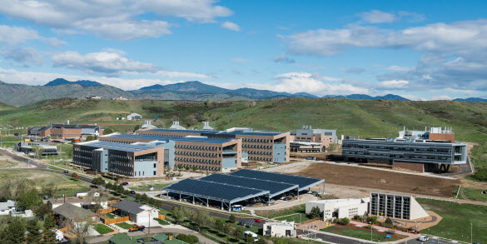
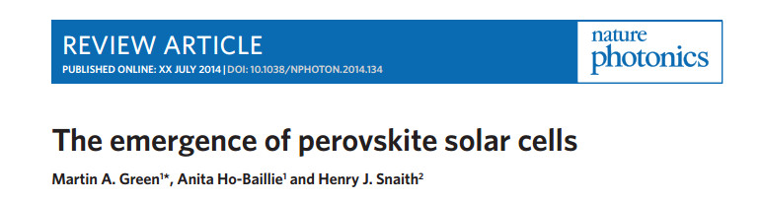
L2
SS History of PV
2008:
Peak in Si cost as production of SC grade Si slows.
Thin film gets excited
1994:
GaAs solar cells
> 30%
NREL
2008:
Peak in Si cost as production of SC grade Si slows.
Thin film gets excited
1977:
U.S. DOE launches Solar Energy Research Institute. Now NREL.
Total PV manufacturing capacity exceeds 500 kW
1982:
First MW capacity solar plant goes online.
Hisperia, California
1992:
CdTe solar cell
15.9% efficient
Univ. South Florida.
2000:
First Solar starts production
2010:
Global installed PV capacity reaches 40GW
2012:
Emergence of high-efficiency perovskite cells.

Slide 8

L2
SS History of PV
http://en.wikipedia.org/wiki/Solar_cell_efficiency

Slide 9


L2 4
Photovoltaic Effect
Do you know the difference between the photoelectric and photovoltaic effects?
http://sargosis.com/articles/science/how-pv-modules-work/the-photoelectric-and-photovoltaic-effects/

Slide 10

L2 5
Photovoltaic Effect
How do we use the PV effect to do work?
Must separate generated electron-hole pair
Prevent recombination
Need internal field
How? JUNCTION!
Hold in your excitement until L5

Slide 11


L2
AM1.5 Spectrum
http://en.wikipedia.org/wiki/Air_mass_(solar_energy)

Slide 12

L2
AM1.5 Spectrum
http://rredc.nrel.gov/solar/spectra/am1.5/
Integrated Irradiance = 1000 Wm² for AM1.5

Slide 13
L2
Solar Simulators
The light from a solar simulator is controlled in 3 dimensions:
  Spectral content
  Spatial uniformity
  Temporal stability
Classification | Spectral Match (each interval) | Irradiance Spacial Non-Uniformity | Temperal Instability
A | 0.75-1.25 | 2% | 2%
B | 0.6-1.4 | 5% | 5%
C | 0.4-2.0 | 10% | 10%
http://en.wikipedia.org/wiki/Solar_simulator

Slide 14



L2
Solar Simulators
You will get to use this! Be excited.

Slide 15

L2
Ideal Diode Equation
Often called the Shockley equation:
J₀ – Dark saturation current.
V – applied voltage across the terminals of the diode
e – Electronic charge
k_{B} – Boltzmann's constant
T – Absolute temperature (K)
William Shockley:
Co-inventor of the transistor with Bardeen and Brattain 1948
Nobel Prize: 1956
(Also a eugenicist)
Might derive this later for fun! (L5)
If every you need some inspiration: Read this!
http://books.google.co.uk/books/about/The_Idea_Factory.html?id=uOMt_XCo81QC&redir_esc=y

Slide 16

L2
Ideal dark JV curve
J₀ = 1 x 10⁻¹⁰ A/cm²
http://pveducation.org/pvcdrom/pn-junction/diode-equation

Slide 17

L2
Ideal diode for solar cell
Sign convention: Lets say that the direction of a generated photo-current J_{L} is positive with respect to a negative dark current J_{dark}
Equivalent Circuit:
Ideal solar cell

Slide 18

L2
Light JV response
Performance of cell can be described by three important parameters
  Short circuit current – J_{SC}
  Open circuit voltage – V_{OC}
  Fill factor = FF

Slide 19
L2
Short Circuit Current - J_{SC}
J_{SC}
What is J_{SC} dependent on?
  Intensity
  Optical properties – REFLECTION!
  Lifetime (L5)
  Band gap
For ideal case:
J_{L} = J_{SC}
(but not true in reality)

Slide 20


L2
Short Circuit Current - J_{SC}

Slide 21
L2
Fill Factor - FF
Estimating V_{OC}
V_{OC}
Most significant parameter that affects the size of V_{OC}

Slide 22

L2
Fill Factor - FF
Fill factor defines the “squareness” of the J-V curve
J, P
Jmp
V

Slide 23
L2
Efficiency, η
AM1.5!
Note: Units OK because J measured in Am⁻².
i.e. m⁻² cancel (Be careful)

Slide 24
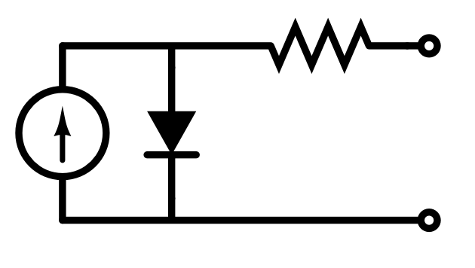
L2
Series Resistance, R_{s}
Origin of series resistance in solar cell:
  Simply a property of real materials – i.e. non infinite mobility
  Resistances associated with back and front contacts to cell
Can represent sum of series resistance effects in equivalent circuit using a single resistor in series:
R_{s}
Uh oh!
Recursive Equation!

Slide 25
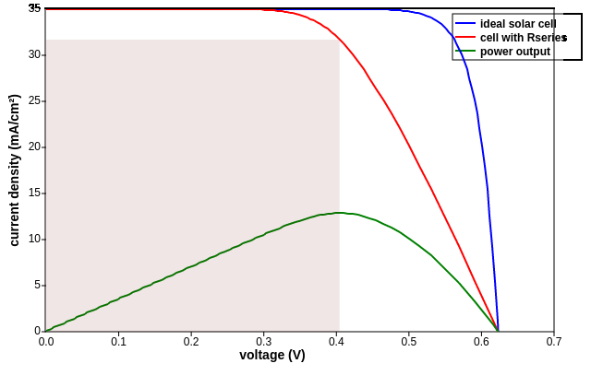
L2
Series Resistance
Effect of R_{s} on shape of JV curve:
  V_{OC} reduced
  FF reduced
Effect of R_{s} on shape of JV curve:
  V_{OC} reduced
  FF reduced
η decreases!
For moderate R_{s}
http://pveducation.org/pvcdrom/solar-cell-operation/series-resistance

Slide 26
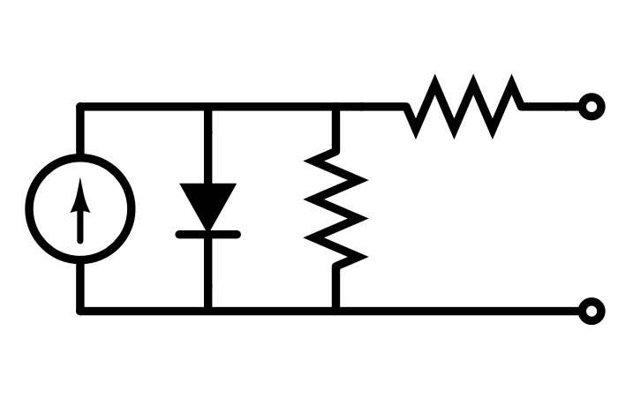
L2
Shunt Resistance, R_{SH}
Origin of shunt resistance in solar cell:
  Usually the result of poor fabrication methods
  Short circuit paths between electrodes of cell
Can represent sum of shunts in equivalent circuit using a single resistor in parallel to diode:

Slide 27
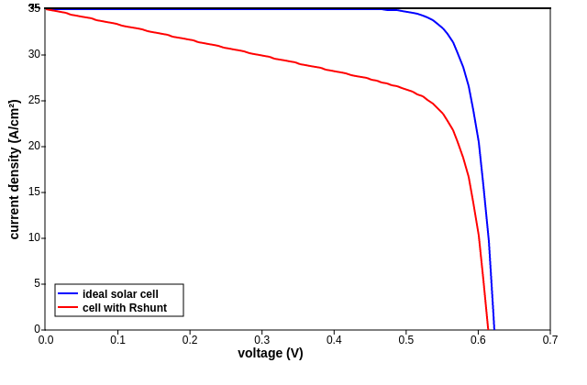
L2
Shunt Resistance, R_{SH}
Effect of R_{SH} on shape of JV curve:
  FF decreases
  V_{OC} decreases for very low R_{SH} (<50 Ω cm²)
http://pveducation.org/pvcdrom/solar-cell-operation/impact-of-both-resistances

Slide 28
L2
Ideality Factor
No such thing as an ideal diode
n – typically takes values of between 1 and 2 (but can be higher)
Originally used as a fudge factor for empirical data
Now understood to be related to quality of SC material
Related to carrier recombination (L4)

Slide 29

L2
Diode Ideality Factor
IDEA:
Increase n to increase V_{OC} (and efficiency)!
Hooray! You've just solved all our problems. And we'll be home in time for tea.

Slide 30

L2
Diode Ideality Factor
Nice Try
n and J₀ inextricably linked
Increase n increase in J₀
Net effect: decrease in V_{OC} (not increase, D'oh!)
http://pveducation.org/pvcdrom/pn-junction/diode-equation

Slide 31
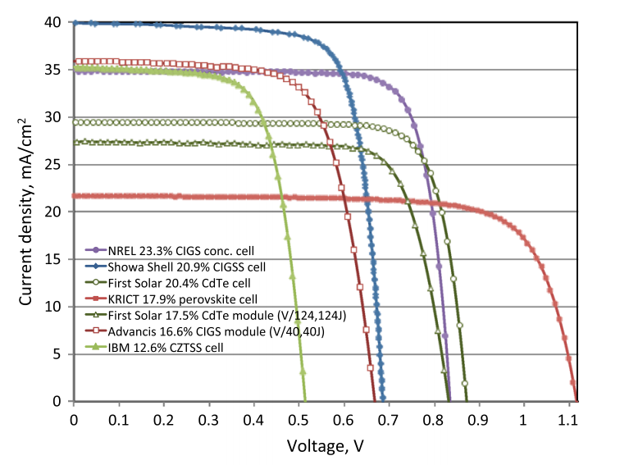
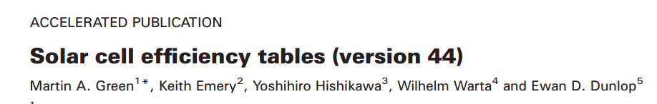
L2
JV Examples
GO READ THIS!

Slide 32
L2
Quantum Efficiency
External Quantum Efficiency (EQE)
The ratio of charge carriers collected to the number of incident photons (of a given energy)
For a given photon energy:
Shape of EQE curve (i.e. plot over energy range) depends on:
  The material's absorption coefficient
  The recombination rate of free carriers (lifetime!)

Slide 33
L2
Quantum Efficiency
Internal Quantum Efficiency (EQE)
Only accounts for photons that make it into the absorber. i.e. accounts for reflection and transmission
For a given photon energy:
i.e. to maximise EQE need to minimise R and T. How?
  Anti-reflection coatings
  Increasing optical path lengths through absorbers
  Back reflectors

Slide 34
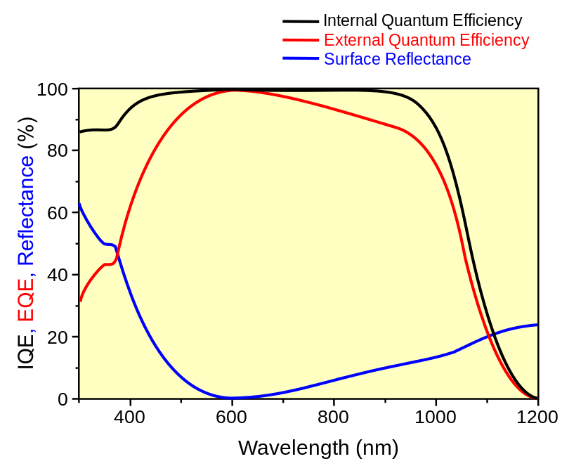
L2
IQE and EQE
Example: Si cell
http://en.wikipedia.org/wiki/Quantum_efficiency

Slide 35
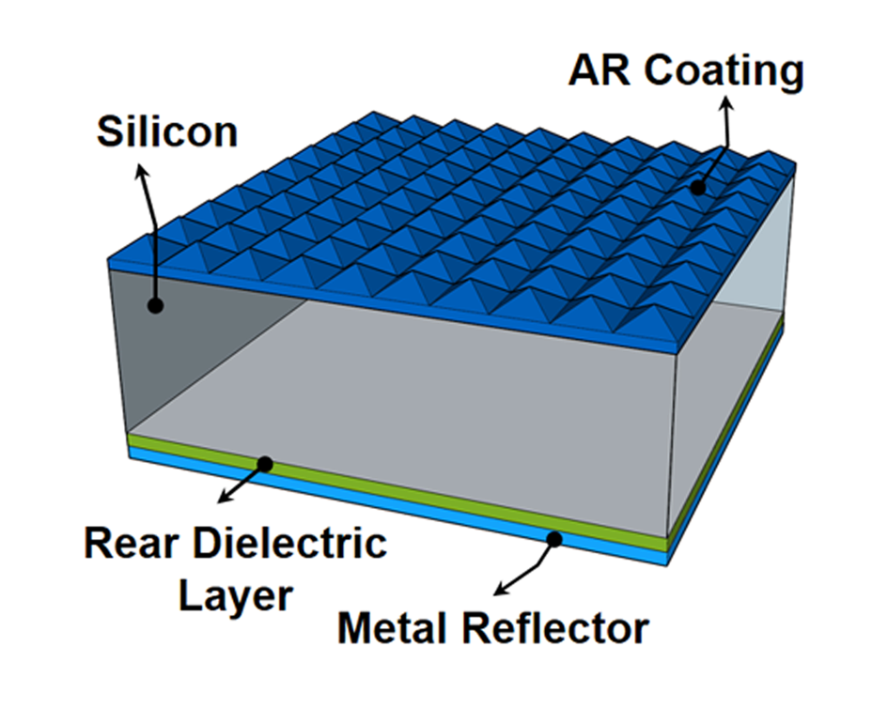
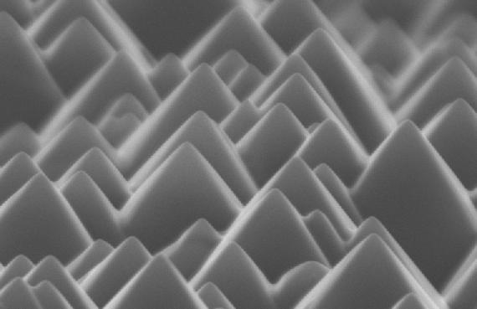
L2
Increasing EQE
Classic crystalline Si cell design - “pyramids”
SEM micrograph of Si surface
What about thin-film PV?

Slide 36
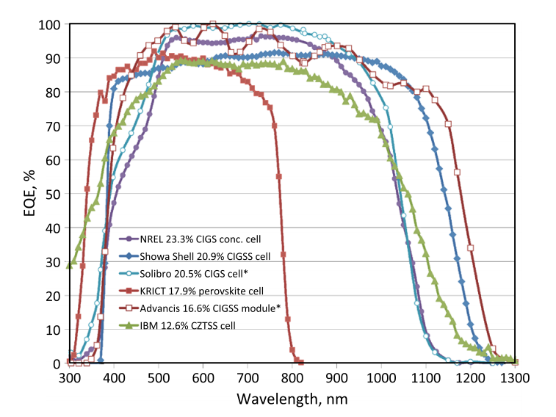
L2
Example EQE

Slide 37
L2
Summary
Super speedy history of PV
The photovoltaic effect
AM1.5 spectrum
Solar simulators and ratings
The ideal diode equation + equivalent circuits
J-V curves and important device parameters
Parasitic resistances
External quantum efficiency (EQE)

