Slide 1


Lecture 3
Fundamental Limitations of Solar Cells
R. Treharne
Nov 5th 2014

Slide 2


L3
Key Question
Why can't a solar cell have a 100% efficiency?
(Or even close to 100%?)
Can you answer this?

Slide 3
L3
Lecture Outline
Black Body Radiation
Detailed Balance
The Shockley-Queisser Limit
Requirements for real physical systems
Exceeding the SQ limit (funky solar)

Slide 4


L3
Black Body Radiation
A black body absorbs all radiation regardless of frequency or angle of incidence.
A black body in thermal equilibrium emits radiation according to Planck's Law.

Slide 5
L3
Planck's Law
Photon Flux – Number of photons of energy E per unit area per second
Units – Number of photons of energy E per unit area per second

Slide 6
L3
Planck's Law
Photon Flux density from a spherical black body
Look familiar?
c.f. Ideal diode
Units – Number of photons of energy E per unit area per second

Slide 7
L3
Planck's Law
Photon Flux – Number of photons of energy E per unit area per second
What the heck is this?
Units – Number of photons of energy E per unit area per second

Slide 8
L3
Planck's Law
Geometrical factor
A
B
Black body

Slide 9
L3
Irradiance
Irradiance - Emitted energy flux density
This is what solar spectrum data is measured in

Slide 10
L3
Irradiance
Irradiance - Emitted energy flux density
This is what solar spectrum data is measured in
Power Density given by

Slide 11
L3
Irradiance
Irradiance - Emitted energy flux density
This is what solar spectrum data is measured in
Power Density given by
Stefan-Boltzmann Law
Stefan's constant

Slide 12
L3
The Sun (again)
The sun is a black body emitter with a temperature of 5760K
At its surface, the Power density is:
P_{S} = 62 MW m⁻²
what is the power density of the Sun's emitted radiation at the Earth's surface, P_{E}?
~ 1353 m⁻²

Slide 13
L3
Detailed Balance
What are we doing?
  Counting all photons going in
  Counting all photons going out
  Difference must be converted into electrical
  (electrochemical potential)
Key Assumptions
  Mobility of carriers is infinite
  All absorbed photons promote electrons
  Only one interface absorbs/emits – other side contacted to a “perfect reflector”

Slide 14
L3
Detailed Balance
In equillibrium (i.e. in the dark)
ambient photon flux (thermal photons)
b_{a}(E)
hypothetical solar absorbing material
perfect reflector
Ambient emits like black-body

Slide 15
L3
Detailed Balance
In equillibrium (i.e. in the dark)
ambient photon flux (thermal photons)
b_{a}(E)
Reflectance
Absorbance
Ambient emits like black-body
Absorbed ambient results in an
equivalent current density

Slide 16
L3
Detailed Balance
In equillibrium (i.e. in the dark)
emitted photon flux
ambient photon flux (thermal photons)
b_{a}(E)
Reflectance
Emissivity
Device emits like black-body too!
Can think of as current in opposite direction to j_{abs}

Slide 17
L3
Detailed Balance
In equillibrium (i.e. in the dark)
spontaneous emission
absorption
hν
hν
Absorption Rate = Spontaneous Emission Rate

Slide 18
L3
Detailed Balance
Under Illumination (still steady state)
emitted photon flux
b_{s}(E)
ambient photon flux (thermal photons)
b_{a}(E)
But does emitted flux change? - YOU BETCHA!
Why?
(if emitted flux remained the same as under thermal equilibrium conditions then you could have a solar cell with 100% efficiency)

Slide 19
L3
Detailed Balance
Under illumination part of the electron population has raised electrochemical potential energy – i.e. Δμ > 0
This means that spontaneous emission is increased!
The emitted flux is increased by:
This is the reason why absorbed solar radiant energy can never be fully utilised in a solar cell.
RADIATIVE RECOMBINATION
This is all a bit abstract – I hope this will become more obvious when we talk about junctions.
Max efficiency ~ 86%

Slide 20
L3
Two Level System
thermalisation
Conduction Band (empty)
hν > E_{g}
spontaneous emission
hν = E_{g}
E_{g}
Valence Band (full)
What sort of materials do we use for solar cells?
Semiconductors
Why?
Because they have a band gap!
No longer a perfect system because of:
THERMALISATION

Slide 21
L3
Key Point
THERMALISATION:
  Photons with E > E_{g} promote carriers that relax to bottom of conduction band through scattering interactions with phonons (transfer of kinetic energy – heat!)
  Absorbed photon with E > E_{g} achieves the same result as E = E_{g}
  Thermalisation is the most dominant loss mechanism that limits the efficiency

Slide 22
L3
Photocurrent
Photo-current is due to the net absorbed flux due to the sun.
Can calculate by integrating j_{abs} over all photon energies:
Probability that promoted carriers are collected to “do work”

Slide 23
L3
Photocurrent
Photo-current is due to the net absorbed flux due to the sun.
Can calculate by integrating j_{abs} over all photon energies:
Probability that promoted carriers are collected to “do work”
LOOK FAMILIAR?
This is the Quantum Efficiency (external)

Slide 24
L3
Photocurrent
Photo-current is due to the net absorbed flux due to the sun.
Can calculate by integrating j_{abs} over all photon energies:
Probability that promoted carriers are collected to “do work”
LOOK FAMILIAR?
This is the Quantum Efficiency (external)

Slide 25
L3
Photocurrent
Photo-current is due to the net absorbed flux due to the sun.
Can calculate by integrating j_{abs} over all photon energies:
Probability that promoted carriers are collected to “do work”
LOOK FAMILIAR?
This is the Quantum Efficiency (external)
Now you know how to calculate J_{SC} from an EQE curve (hint hint)

Slide 26
L3
Photocurrent
In a perfect world:
and
therefore
so
In other words J_{SC} is dependent only on the band gap of the material
(for a given spectrum)

Slide 27
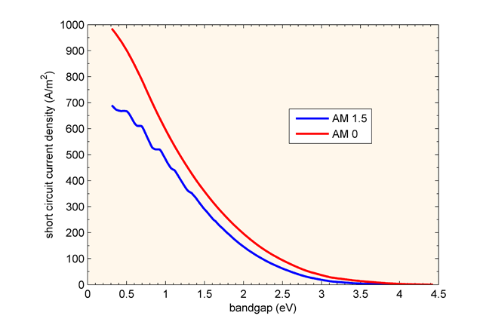
L3
Photocurrent
From last lecture

Slide 28
L3
V_{OC}
Is the V_{OC} related to the band gap too? - Heck Yes!
Remember from diode equation
This is much more sensitive to E_{g} than J_{SC} is.
Level of dark current with respect to V is directly related to rate of stimulated emission.
The rate of stimulated emission depends on the size of the chemical potential of carriers deltamu
For a semiconductor deltamu is equivalent (almost) to the band gap /q
From the detailed balance
where
http://www.sciencedirect.com/science/article/pii/0927024895800042

Slide 29
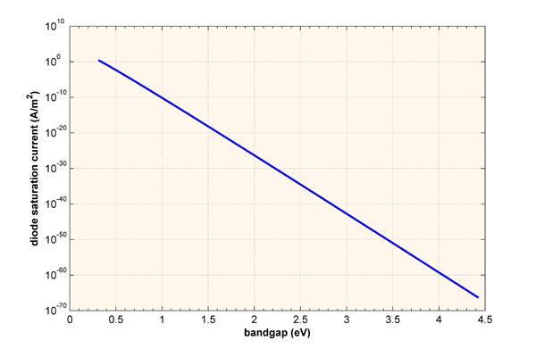
L3
V_{OC}
J₀ decreases exponentially with respect to band gap

Slide 30
L3
V_{OC}
Therefore:
V_{OC} increases with E_{g}

Slide 31
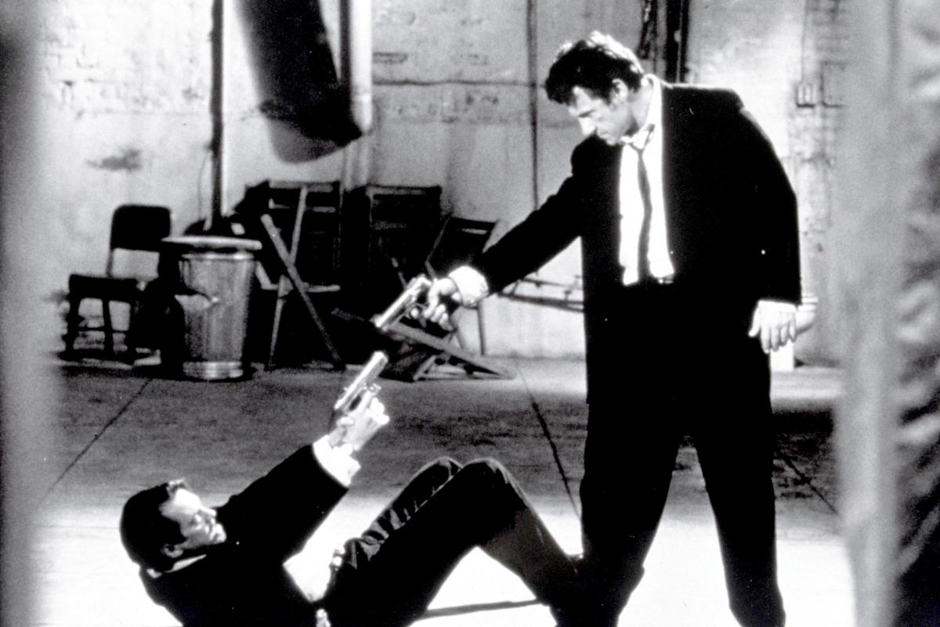
L3
Limiting Efficiency
V_{OC}
J_{SC}

Slide 32
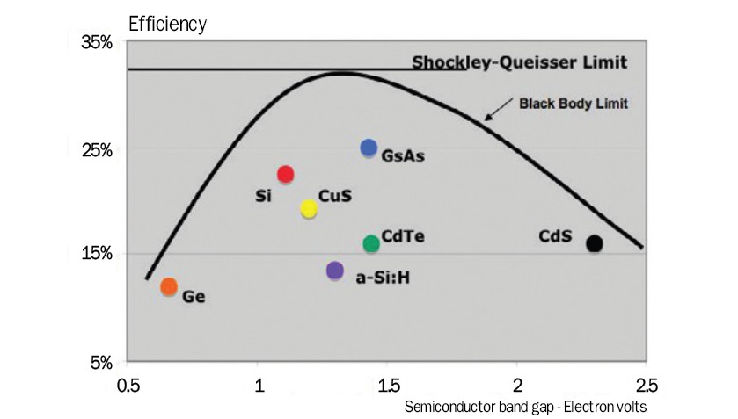
L3
Limiting Efficiency
W. Shockley and H. Queisser, Detailed Balance Limit of Efficiency of p-n Junction Solar Cells”, JAP, 32(3) 0.510 (1961)

Slide 33
L3
Requirements for ideal PV devices
PV material has energy gap
All incident light with E > E_{G} is absorbed
1 photon = 1 electron-hole pair
Radiative recombination only (i.e. spontaneous emission)
Generated charges are completely separated
Charge is transported to external circuit without loss
J. Nelson, “The Physics of Solar Cells”, pp 35 - 39

Slide 34
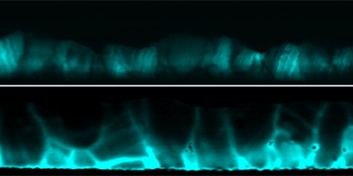
L3
Real World Device Limitations
Incomplete absorbtion: C(E) < 1 and R(E) > 0
Non-radiative recombination. (L4)
Lossless transport? No such thing as perfect conductor.
Electron Beam Induced Current (EBIC) imaging of CdTe/CdS solar cell cross section. Grain Boundaries = Recombination!
C. Li et al., Phys. Rev. Lett. 112, 156103 (2014)

Slide 35
L3
Beating the SQ limit
Tandem Cells
Multi-junctions
Concentrator PV
Hot Carrier solar cells
Down and up conversion

Slide 36

L3
Beating the SQ limit

Slide 37


L3
Tandem Cells
Tandem Cells
Why have one junction when you can have two?
GaAs/InGaP
T. Takamoto et. al. “Over 30% Efficient InGaP/GaAs tandem solar cells”, APL, 70 381 (1997)

Slide 38

L3
Tandem Cells
Detailed balance calculations for two band gap system:
Maximum theoretical efficiency ~ 46%

Slide 39
L3
Tandem Cells
Disadvantages of tandems based on III-V's
  High precision fabrication required
  Materials balance (tunnel junction)
  High cost (materials + deposition)
  Not practical for concentrator systems
Are there other strategies?

Slide 40


L3
Tandem Cells
Inorganic/Organic Hybrid Tandems
  Cheap
  Easy to make (non-vacuum dep)
  Can apply to existing Si technology
Watch this space
c-Si efficiency boosted by 20% (by using perovskites)

Slide 41

L3
Multi-junctions
Why have two junctions when you can have three (or more)?
Ge/InGaAs/InGaP – Max η ~ 35%

Slide 42

L3
Multi-junctions
S. P. Bremner et. al. Prog. PV. 16:225-233 (2008)

Slide 43


L3
Concentrators
Fresnel Lenses
200 – 300 suns
1 axis tracking

Slide 44


L3
Concentrators
Parabolic Mirror Array
~ 500 suns
25kW output
2 axis tracking

Slide 45

L3
Concentrators
Increase photon flux increase efficiency
Theoretical prediction for two junction system @ T = 320K

Slide 46



L3
Concentrators
44.7%!
  Four junction cell based on III-V
  Fraunhofer Institute

Slide 47
L3
Concentrators
Disadvantages of concentrator PV
  Need to deal with high Temperatures
  i.e. cooling required
  High installation cost
  Need direct sunlight
  Don't put one on your roof in UK.

Slide 48

L3
Hot Carrier Solar Cells
Can we get the promoted carriers out before they thermalise?
Use “selective” contacts that allow “hot” carriers to be collected before they thermalise (picoseconds!) to bottom of C.B. through scattering with phonon modes

Slide 49
L3
Hot Carrier Solar Cells
Advantages of Hot Carrier Solar Cells
  Max efficiency ~63%
Disadvantages
  They don't exist!
  Completely Theoretical to date
  Lots of computational DFT studies
  Expect real devices soon!

Slide 50

L3
Hot Carrier Solar Cells
WOW!
Real hot carrier device demonstrated this 2014
http://scitation.aip.org/content/aip/journal/apl/104/23/10.1063/1.4883648

Slide 51

L3
Up and down conversion
Take Parts of the spectrum that are not used by the device and covert to wavelengths/energies that are. How?

Slide 52



L3
Lecture Summary
Luminescent Dyes
Quantum Dots/nanowires
Aluminium dots on GaAs solar cell
“Lego Brick” Structure.
Plasmonic Enhancement
http://www.nature.com/srep/2013/131007/srep02874/full/srep02874.html

Slide 53
L3
Lecture Summary
Black Body Radiation
Detailed Balance
The Shockley-Queisser Limit
Requirements for real physical systems
Exceeding the SQ limit (funky solar)

Slide 54
L3
Key Question
Why can't a solar cell have a 100% efficiency?
(Or even close to 100%?)
Can you answer this?

