Slide 1


Lecture 5
Junctions!
R. Treharne
Nov 6th 2014

Slide 2


L5
Lecture Outline
Drawing Junctions
Junction Formation – A Physical Picture
Abrupt Junction
Deriving Important Junction parameters
Deriving diode equation
Ideality Factor - Recombination

Slide 3
L5
Metal-Semiconductor
Schottky Junction
metal
SC (n-type)
qχ
qφ_{n}
qφ_{m}
E_{C}
E_{F}
E_{G}
E_{V}
E_{V}

Slide 4
L5
Metal-Semiconductor
metal
SC (n-type)
One Rule!
  Fermi level must be in equilibrium
qχ
qφ_{n}
qφ_{m}
E_{C}
E_{F}
E_{F}
E_{G}
E_{V}
E_{V}

Slide 5
L5
Metal-Semiconductor
“Intimate Contact”
metal
SC (n-type)
metal
SC (n-type)
qχ
qφ_{n}
qφ_{m}
qχ
qφ_{n}
qφ_{m}
E_{C}
E_{C}
E_{F}
E_{F}
E_{G}
E_{G}
E_{V}
E_{V}
E_{V}
E_{V}

Slide 6
L5
Metal-Semiconductor
BAND BENDING!
metal
SC (n-type)
metal
SC (n-type)
qχ
qφ_{n}
qφ_{m}
qχ
qφ_{n}
qφ_{m}
qV_{bi}
E_{C}
qφ_{B}
E_{C}
E_{F}
E_{F}
E_{G}
E_{G}
E_{V}
E_{V}
E_{V}
E_{V}
“Built-in Voltage”
V_{bi} = φ_{m} - φ_{s}
φ_{B} = φ_{m} - χ
Barrier Height

Slide 7
L5
Metal-Semiconductor
metal
SC (p-type)
qχ
qφ_{p}
qφ_{m}
E_{C}
E_{G}
E_{F}
E_{V}
E_{V}

Slide 8
L5
Metal-Semiconductor
metal
SC (p-type)
metal
SC (p-type)
qχ
qφ_{p}
qχ
qφ_{p}
qφ_{m}
E_{C}
qφ_{m}
E_{C}
E_{G}
E_{G}
E_{F}
qφ_{B}
E_{V}
E_{V}
E_{F}
qV_{bi}
E_{V}
E_{V}
V_{bi} = φ_{m} - φ_{p}
φ_{B} = E_{G}/q - (φ_{m} - χ)

Slide 9

L5
Metal-Semiconductor
φ_{B} = φ_{m} - χ
Why doesn't this rule hold?
Metal – SC interface effects
  Lattice Mis-match
  High density of defects
  Interface states in gap

Slide 10
L5
Semiconductor-Semiconductor
p-n homojunction
p
n
qχ_{p}
qφ_{p}
qχ_{n}
qφ_{n}
E_{C}
E_{F}
E_{G}
E_{G}
E_{F}
E_{V}

Slide 11
L5
Semiconductor-Semiconductor
p-n homojunction
p
n
qχ_{p}
qφ_{p}
qχ_{n}
qφ_{n}
E_{C}
E_{F}
E_{G}
E_{G}
E_{F}
E_{F}
E_{F}
E_{V}

Slide 12
L5
Semiconductor-Semiconductor
p-n homojunction
p
n
p
n
qχ_{p}
qφ_{p}
qχ_{p}
qφ_{p}
qχ_{n}
qφ_{n}
E_{C}
qχ_{n}
qφ_{n}
E_{C}
E_{F}
E_{G}
E_{G}
E_{C}
E_{G}
E_{F}
E_{F}
E_{F}
E_{V}
E_{G}
E_{V}
E_{V}

Slide 13


L5
Semiconductor-Semiconductor
p-n homojunction
p
n
p
n
qχ_{p}
qφ_{p}
qχ_{n}
qφ_{n}
qV_{bi}
E_{F}
E_{G}
E_{G}
E_{F}
E_{F}
E_{F}
E_{V}

Slide 14

L5
Semiconductor-Semiconductor
p-n homojunction
p
n
p
n
qχ_{p}
qφ_{p}
qχ_{n}
qφ_{n}
qV_{bi}
E_{F}
E_{i}
E_{G}
E_{G}
E_{F}
E_{F}
E_{F}
E_{i}
E_{V}

Slide 15
L5
Semiconductor-Semiconductor
Defining Electrostatic potential, Ψ, for a SC
  Difference between E_{i} and E_{f}
p-n homojunction
p
n
p
n
Electrostatic Potential, Ψ
Electron energy, E
qχ_{p}
qφ_{p}
qχ_{n}
qφ_{n}
qV_{bi}
E_{F}
E_{i}
qΨ_{p}
E_{G}
E_{G}
E_{F}
E_{F}
E_{F}
qΨ_{n}
E_{i}
E_{V}
V_{bi} = Ψ_{n} - Ψ_{p}
KNOW HOW TO DRAW THIS!
Coming back here shortly to get a more physical picture

Slide 16



L5
Semiconductor-Semiconductor
Everybody's favourite homojunction - Silicon
Extrinsically doped
Every bit of electronics you own is jam packed with silicon homojunctions
p-type
n-type
iPhone 5:
1 billion transistors!
~ 45 nm wide
Mono-C solar cells
~750 μm thick
cell size = 1 cm²
http://electronics.howstuffworks.com/diode1.htm

Slide 17
L5
Semiconductor-Semiconductor
p-n heterojunction: Different band gaps
1. Align the Fermi level. Leave some space for transition region.
p
n
qχ_{p}
qφ_{p}
qχ_{n}
qφ_{n}
ΔE_{C}
E_{Fn}
E_{F}
E_{Fp}
ΔE_{V}
wide gap
narrow gap

Slide 18
L5
Semiconductor-Semiconductor
p-n heterojunction: Different band gaps
2. Mark out ΔE_{C} and ΔE_{C} at mid-way points
p
n
qχ_{p}
qφ_{p}
qχ_{n}
qφ_{n}
ΔE_{C}
ΔE_{C}
E_{Fn}
E_{F}
E_{Fp}
ΔE_{C}
ΔE_{V}
wide gap
narrow gap

Slide 19

L5
Semiconductor-Semiconductor
p-n heterojunction: Different band gaps
3. Connect the C.B. and V.B. keeping the band gap constant in each material
p
n
Difference in band gaps give rise to discontinuities in band diagrams. This limits the carrier transport by introducing potential barriers at the junction
qχ_{p}
qφ_{p}
qχ_{n}
qφ_{n}
ΔE_{C}
E_{Fn}
E_{F}
E_{Fp}
ΔE_{V}
wide gap
narrow gap
Barrier to hole transport

Slide 20

L5
Semiconductor-Semiconductor
Examples of p-n heterojections
Most thin-film PV technologies
http://pubs.rsc.org/en/content/articlehtml/2013/ee/c3ee41981a#cit111

Slide 21

L5
Semiconductor-Semiconductor
Examples of p-n heterojections
III-V multi-junction devices
Being able to control the band offsets of a material can help eliminate barriers

Slide 22

L5
Physical Picture
Drawing band schematics for junctions all day is fun, but what is actually going on here?
http://www.youtube.com/watch?v=JBtEckh3L9Q
Excellent qualitative description
6:27 – Didactic Model of Junction formation

Slide 23

L5
Physical Picture
Equilibrium Fermi Levels – Explained – our one rule for drawing band schematics!
In thermal equilibrium, i.e. steady state: not net current flows
notice position of “metallurgical” junction. Usually call this x=0
http://en.wikipedia.org/wiki/File:Pn-junction-equilibrium.png

Slide 24
L5
Physical Picture
Lets look at hole current first:

Slide 25
L5
Physical Picture
Lets look at hole current first:
mobility:
hole distribution:
e-field:
diffusion coefficient
OK to use Boltzmann as approx to Fermi-Dirac
Einstein relation
will use this shortly

Slide 26
L5
Physical Picture
Condition for steady state

Slide 27
L5
Physical Picture
TA DA!
The same is true from consideration of net electron current, J_{n}

Slide 28

L5
Abrupt Junction
outside depletion region:
p = N_{A} and n = N_{D}
charge density
Space-charge condition
N_{A}w_{p} = N_{d}w_{n}
i.e. areas of rectangles must be the same
electric field
Max field (at x=0):
ξ_{m} = qN_{D}x_{n}/ε_{s} = qN_{A}x_{p}/ε_{s}
Area = V_{bi}
ξ_{m}
electrostatic
potential
I've already called this V_{bi}
Hook & Hall, “Soild State Physics”, 2nd ed. Chap 6, p. 171

Slide 29
L5
Abrupt Junction
outside depletion region:
p = N_{A} and n = N_{D}
charge density
Space-charge condition
N_{A}w_{p} = N_{d}w_{n}
i.e. areas of rectangles must be the same
electric field
Max field (at x=0):
ξ_{m} = qN_{D}x_{n}/ε_{s} = qN_{A}x_{p}/ε_{s}
Lets derive this!
(but skip if I'm being slow)
Area = V_{bi}
ξ_{m}
electrostatic
potential
I've already called this V_{bi}
Hook & Hall, “Soild State Physics”, 2nd ed. Chap 6, p. 171

Slide 30
L5
Abrupt Junction
From Earlier:
What is in p and n regions away from junction?
Here
and
S. M. Sze, “Semiconductor Devices: Physics and Technology”, Chap 4, p.90

Slide 31
L5
Abrupt Junction
Hence:
want to know what this is for Si?
Go to: http://pveducation.org/pvcdrom/pn-junction/intrinsic-carrier-concentration
Next Question:
How do I calculate in the depletion region? (And why would I want to?)
Must solve Poisson's Equation
Go read some electrostatics if you're interested

Slide 32
L5
Abrupt Junction
INTEGRATE ONCE
INTEGRATE TWICE

Slide 33
L5
Abrupt Junction
using result:
and with some jiggery pokery:
V_{bi}

Slide 34
L5
Under Bias
What happens to our ideal p-n junction if we put a forward or reverse bias across it?

Slide 35
L5
Under Bias
ZERO BIAS
p
n
W
V_{bi}
E_{F}
-w_{p}
0
w_{n}

Slide 36
L5
Under Bias
+
-
FORWARD BIAS
p
n
W
V_{bi} - V
E_{F}
E_{F}
Electron energy levels in p side lowered relative to those in n side
Energy barrier qV_{bi} reduced
Flow of electrons from n to p increases
Flow of holes from p to n increases
Depletion width decreases
-w_{p}
0
w_{n}

Slide 37

L5
Under Bias
-
+
REVERSE BIAS
p
n
W
V_{bi} + V
E_{F}
E_{F}
Electron energy levels in p side raised relative to those in n side
Energy barrier qV_{bi} increase by V
Flow of electrons from n to p reduced
Junction width increases
-w_{p}
0
w_{n}

Slide 38
L5
Under Bias
Of course, you already know all about this:

Slide 39
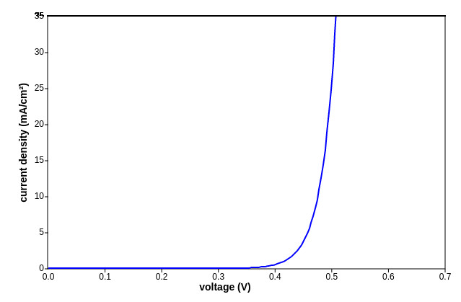
L2
Ideal dark JV curve
J₀ = 1 x 10⁻¹⁰ A/cm²
http://pveducation.org/pvcdrom/pn-junction/diode-equation

Slide 40
L2
Ideal dark JV curve
J₀ = 1 x 10⁻¹⁰ A/cm²
Lets derive this by considering our band schematic. Fun fun fun!
http://pveducation.org/pvcdrom/pn-junction/diode-equation

Slide 41
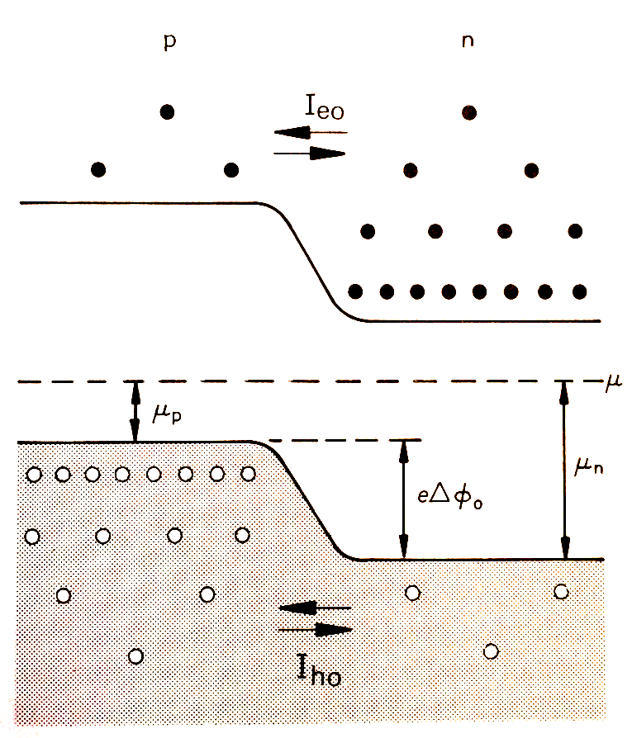
L5
Deriving Shockley Equation
Steady State again (i.e. no bias)
Consider electron drift current
– I_{eo} from p to n

Slide 42
L5
Deriving Shockley Equation
Steady State again (i.e. no bias)
Consider electron drift current
– I_{eo} from p to n
L_{e}
W

Slide 43
L5
Deriving Shockley Equation
Steady State again (i.e. no bias)
Consider electron drift current
– I_{eo} from p to n
L_{e}
number of electrons on p side
electron lifetime
diffusion length
W

Slide 44
L5
Deriving Shockley Equation
Steady State again (i.e. no bias)
Consider electron drift current
– I_{eo} from p to n
By assuming that all acceptors on
p side are ionized:
L_{e}
can re-write J_{e0} as:
W

Slide 45
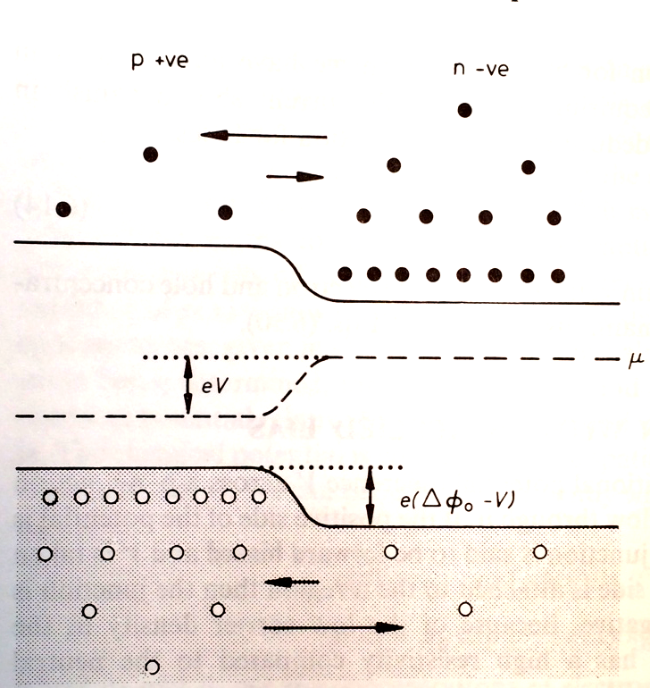
L5
Deriving Shockley Equation
What happens under forward bias?
Drift (p to n)? - Nothing. No potential barrier in this direction
Diffusion (n to p)? - Increases by exponential factor:
If we assume occupation of states in CB is given by Boltzmann distribution

Slide 46
L5
Deriving Shockley Equation
What happens under forward bias?
Drift (p to n)? - Nothing. No potential barrier in this direction
Diffusion (n to p)? - Increases by exponential factor:
If we assume occupation of states in CB is given by Boltzmann distribution
Net electron current:

Slide 47
L5
Deriving Shockley Equation
Can do the same for the net hole current:
where

Slide 48
L5
Deriving Shockley Equation
Can do the same for the net hole current:
where
Therefore: Net Current!
ideal diode equation
reverse saturation current,
a.k.a “dark current”

Slide 49
L5
Deriving Shockley Equation
Previous derivation ignores the recombination and generation of carriers within the depletion layer itself!

Slide 50
L5
Deriving Shockley Equation
Previous derivation ignores the recombination and generation of carriers within the depletion layer itself!
ideality factor – a complete FUDGE
Worth reading up about – but don't stress out about it.
S. M. Sze, “Semiconductor Devices”, 2nd ed. Chap 4, pp 109 – 113
Hook & Hall “Solid State Physics”, 2nd ed. Chap 6, pp 178 – 179
I have these books if you want them.

Slide 51
L5
Lecture Summary
Drawing Junctions
Junction Formation – A Physical Picture
Abrupt Junction
Deriving Important Junction parameters
Deriving diode equation
Ideality Factor - Recombination

