Slide 1
Physics of Large Area Thin-film Devices:
Nonuniformities,
Interfacial Layers,
Reach-through Effects
V. G. Karpov
Department of Physics and Astronomy,University of Toledo
There really is a physics of thin film PV

Slide 2
Contributors
Diana Shvydka,
Yann Roussillon,
A. D. Compaan,
D. M. Geolando,
J. Drayton

Slide 3
TF PV: characteristic features
Forgiving: different technologies do comparably
Variability: cell to cell and module to module
Sensitivity: weather, daytime, etc.
Degradation kinetics: some are extremely stable
Super-additive effects: ..acting on front and back..

Slide 4
Physics specific to thin-film PV
Small thickness and structural disorder do it
Lateral nonuniformities
Surface state induced depletion/accumulation
Reach-through effects (acting through the film)
Shunting-like phenomena

Slide 5
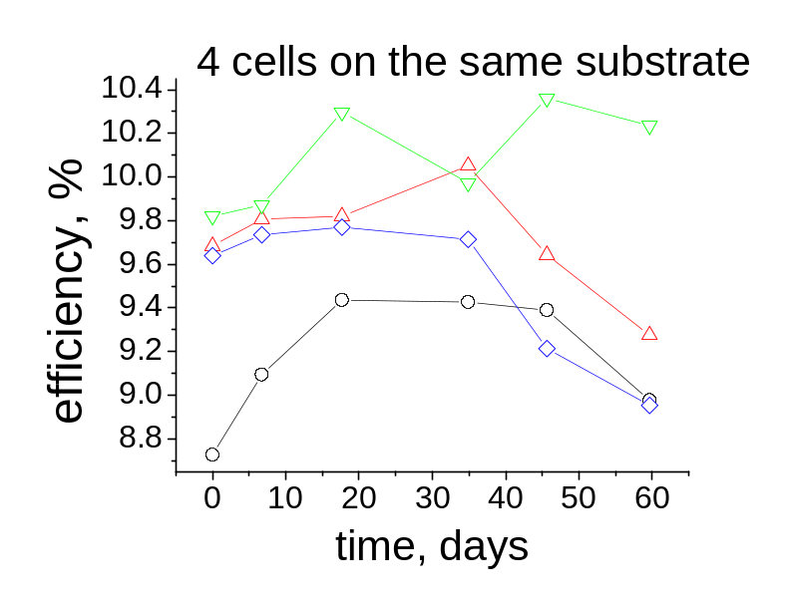
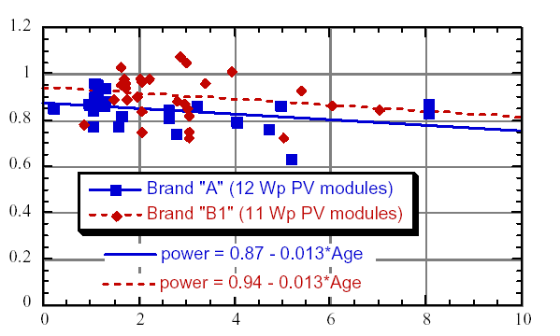
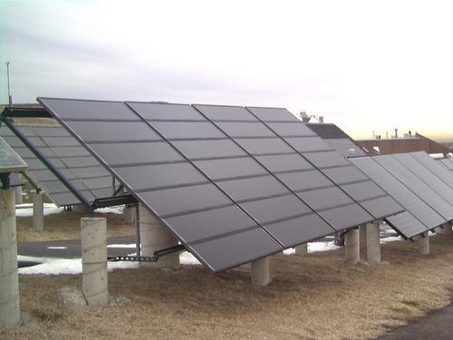
Lateral Nonuniformities at a glance
1 cm
Variability
in
both cells
and
R. D. Duke et. al., www.socrates.berkley.edu/~rael/aSikenya.html
modules
PV output
Module age (years)

Slide 6
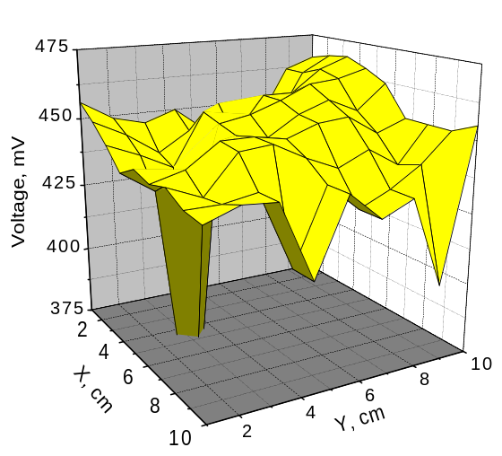
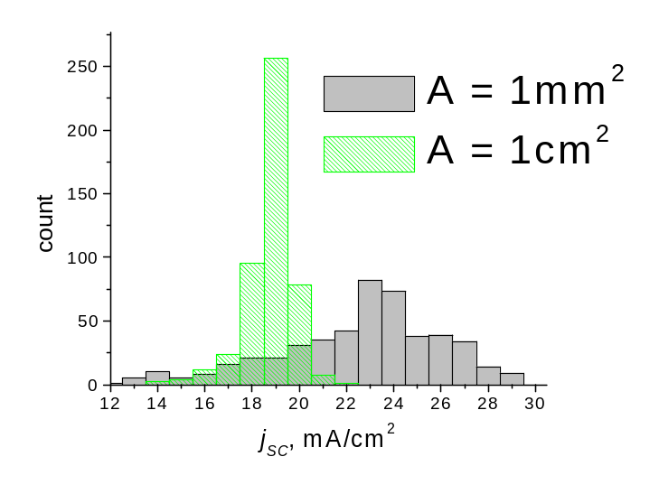
Examples of nonuniformity observations
probe
V
Back wall
Light
Electric potential variations
(highly resistive electrode)
Current statistics:
large and small cells
Other: OBIC; EBIC; PL (micro-PL); EL ; Thermography

Slide 7
Random diodes
Light
TCO
n
p
P-n junction
+
metal
Polycrystalline cell = random micro-diodes = random diode
Glass
TCO
CdS
CdTe
metal
Current loss
Weak (low Voc) diode under forward bias shunts the system,
Create loss and variability, concentrate stresses…

Slide 8
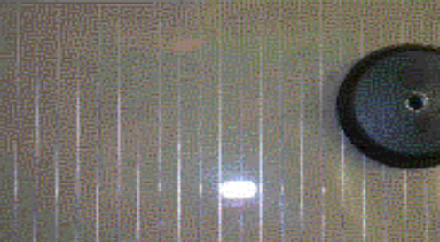
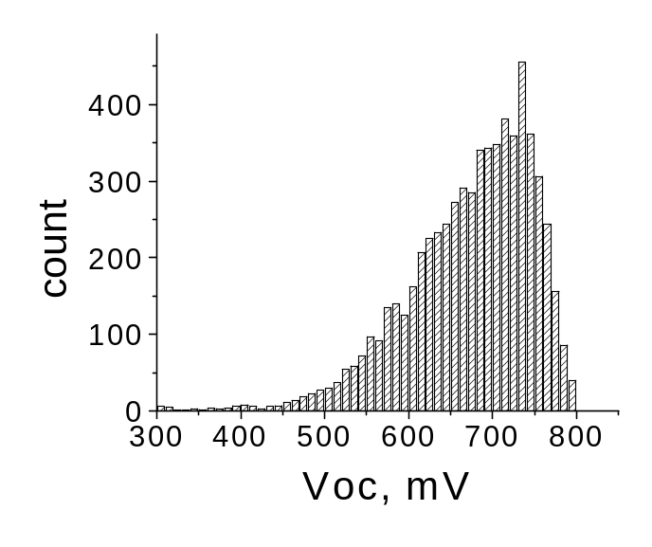
Modules, Random Diode Arrays, Losses
Linear cells (modules)
1 cm
V
1 cm
Glass substrate
Random
diodes
TCO
Scribe Resistance
Analytical estimates and numerical routine developed.
Nonuniformity loss up to 30%

Slide 9
Nonuniformity self-healing
Electrochemistry at nonuniform Surface Photo-Voltage
Creates nonuniform IFL balancing the original nonuniformity
Electrolyte
-
-
+
-
-
-
-
-
-
-
-
SPV
+
-
+
-
Before
treatment
+
+
+
+
+
+
+
+
semiconductor
light
After
treatment
SPV
Treatment conditions derived
Composition designed

Slide 10
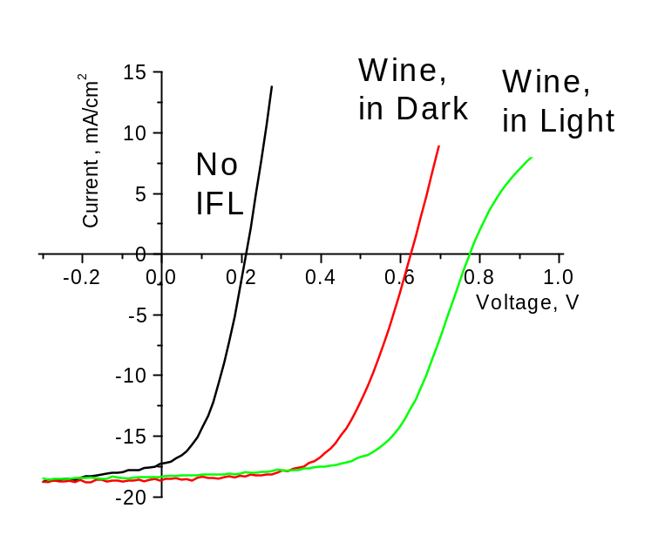
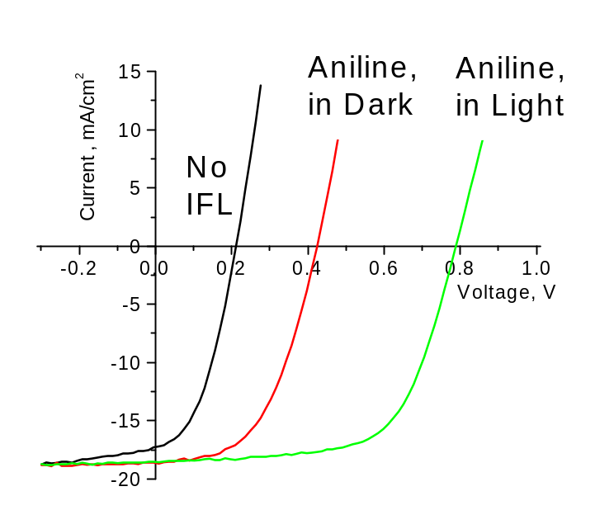
Self-healing examples
Red wine
Aniline based solution
Self-healing alone increased CdTe PV efficiency
From 2-3% (untreated) To 10-11% (treated cells)
Patent application filed

Slide 11
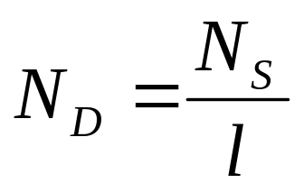
Interfacial states and effects in TF
High equivalent bulk doping
l - film thickness,
N_{s} (cm⁻²) - surface state density
Example. CdS: l=10⁻⁵ cm, N_{S}=10¹² cm⁻², N_{D} = 10¹⁷ cm⁻³
Similar changes by
E_{C}
l
E_{F}
Chemical doping (Cu)
E_{F}
or
E_{F}
N_{D}
Surface treatment (IFL,
“buffer”, deposition)
N_{S}
E_{V}

Slide 12
MIS model of CdTe PV
Model:
M interacts with S (CdTe)
through I (CdS):
Reach-through band bending.
CdS Depletion (I):
through doping or surface
TCO
&
buffer
CdS
CdTe
M
I
S
Observations:
Proper “Buffer” without Cu generates Voc=830mV.
Adding Cu does not affect Voc
Expectations:
Cu free
Efficient cell
Superior stability

Slide 13
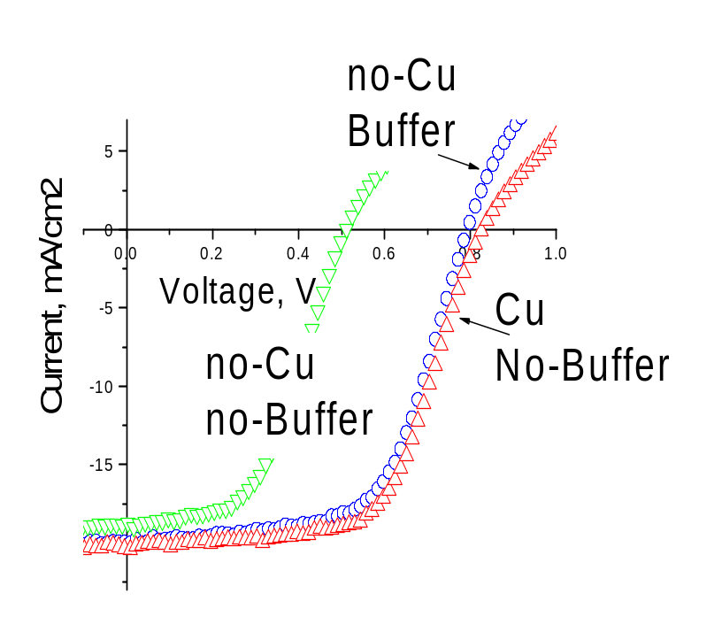
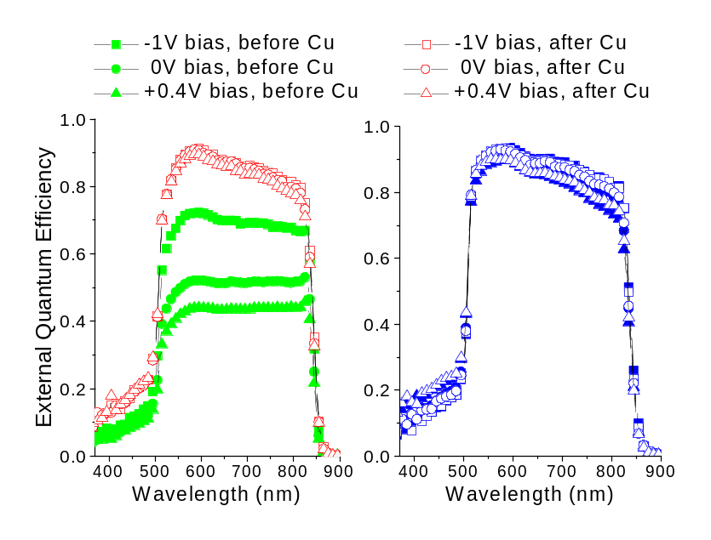
Verifying MIS model: examples
No Buffer;
Cu vs. no-Cu
Buffer;
Cu vs. no-Cu
Buffer and Cu make equally strong junction.
Adding Cu to “buffer” samples does not do anything.

Slide 14
MIS model of CdTe PV (consequences)
Deposition technique matters: surface states.
Example 1: “same” CVD and sputtered HTR act differently.
Example 2: CdS deposition is crucial.
Interfacial treatments matter: IFL, “buffer”, etch…
Cu is not necessary when the deposition is “right”.
Major degradation not through Cu reactions in CdTe.
Suspected degradation modes:
(a) In Cu doped samples:
Cu – related shunting through CdS;
Back contact deterioration through Cu electromigration;
(b) In Cu free samples:
Other shunting; Interface degradation; Metal delamination;

Slide 15
Back Diode (BD) vs. Reach-through (RT)
Low back barrier;
BD regime
J
Physics
of
back contact (BC)
RT
High back barrier;
blocked regime
BD
High back barrier;
V>V_{RT}, RT regime
V
V_{RT}
V_{OC}
Mystery resolved: BC treatments having strong effect on Voc.
Rare (RT) spots of strong back barrier ruin Voc.
V_{RT} instead of V_{oc}.
Explains microscopic nature of weak diodes.
V_{RT} depends on both back and front barriers: super-additive

Slide 16
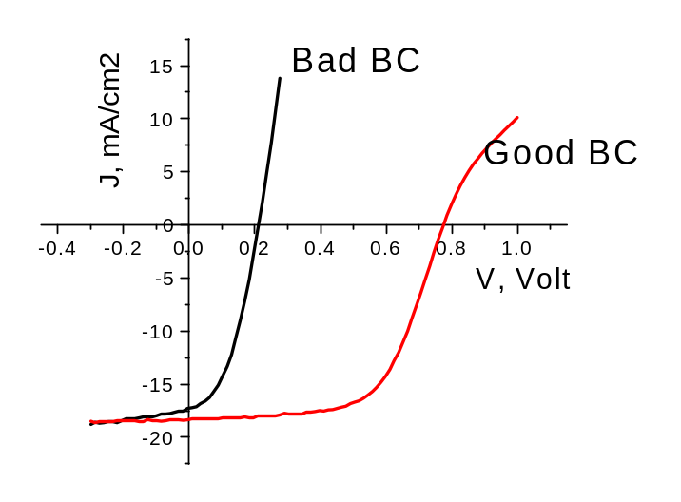
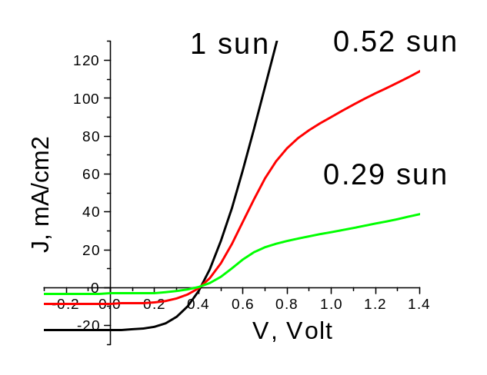
BD vs. RT (continued)
Self-healing treatment
improves BC:
RTD spots healed
Bad sample J-V steeper,
no rollover
Bad BC :
Abnormally high current
Space charge region J ~ V

Slide 17
BD vs. RT: predictions - verified
Low Voc independent of light intensity;
Low efficiency
No rollover;
High forward current;
Repealing metal leaves surface with high Voc;
No such for low Voc devices: Voc<“V_{RT}”.

Slide 18
Cu-free efficient stable CdTe cell
Glass/TCO/HRT/CdS/CdTe/aniline/Au
13% efficient (with 100 nm CdS),
superior stability (preliminary)
1cm² CSS deposited,
Sputtered HRT,
Cold evaporated Au, no post-metal heat

Slide 19
Conclusions
Physical concepts specific to thin film PV are proposed:
Lateral nonuniformity;
High surface/volume ratio: strong interfacial effects;
Reach-through effects: electric field reaching through the film;
Shunting-like phenomena (in progress)
Practical implications:
Self-healing electrochemistry levels out the nonuniformity;
Surface treatments instead of doping: Cu –free device;
Cold evaporated Au back contact with Cu – free recipe;
Efficient (preliminary) stable thin-film CdTe solar cell.

Slide 20
MAJOR FY 2004 PUBLICATIONS
[1] V. G. Karpov, A. D. Compaan, and Diana Shvydka, Random diode arrays and mesoscale physics of large-area devices, Phys. Rev B 69, 045325, (2004).
[2] V. G. Karpov, Critical disorder and phase transitions in RDA, Phys. Rev. Lett., 91, 226806 (2003).
[3] Y. Roussillon, D. Giolando, Diana Shvydka, A. D. Compaan, and V. G. Karpov, Blocking thin film nonuniformities: photovoltaic self-healing, Appl. Phys. Lett. 84, 616 (2004).
[4] V. G. Karpov, Diana Shvydka,Yann Roussillon, and A. D. Compaan, The mesoscale physics of large-area photovoltaics, Proceedings of 3^{d} World Conference on Photovoltaic Energy Conversion, Osaka, Japan, 2003
[5] Y. Roussillon, D. Giolando, Diana Shvydka, A. D. Compaan, and V. G. Karpov, Reach-through band bending in semiconductor thin films, Appl. Phys. Lett. October 25 (2004).
[ 6] D. Shvydka, J.P. Rakotoniaina, O. Breitenstein, Lock-in thermography and nonuniformity modeling of thin-film CdTe solar cells, Appl. Phys. Lett. 84, 729, (2004)
[7] Y. Roussillon, V. G. Karpov, D. Shvydka, J. Drayton, and A. D. Compaan Back contact and reach-through diode effects in thin-film photovoltaics, J. Appl. Phys. December 01 (2004)
[8] V. G. Karpov, D. Shvydka, and Y. Roussillon E² phase transitions: thin-film breakdown and Schottky barrier suppression, Phys. Rev. B, October 15 (2004)

