Slide 1
Calling external programs (BLAST) and BioPython
LIFE733
Andy Jones

Slide 2
Calling other programs from Python
It is easy to call other programs from Python
  Wait for program to finish, get some output and do something with it in Python
You may have come across a few command line programs already
  dir (windows) or ls (Linux)
  cd
  perhaps “copy” or “move” (cp or mv on Linux or Mac)
  Lots of bioinformatics programs are command line driven, so you can use Python to tag these together into pipelines

Slide 3
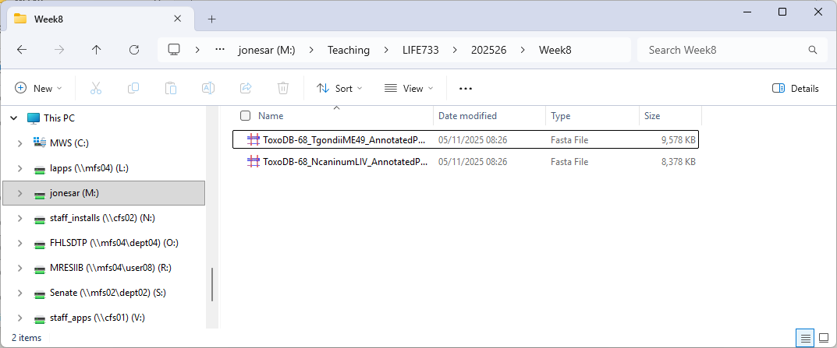
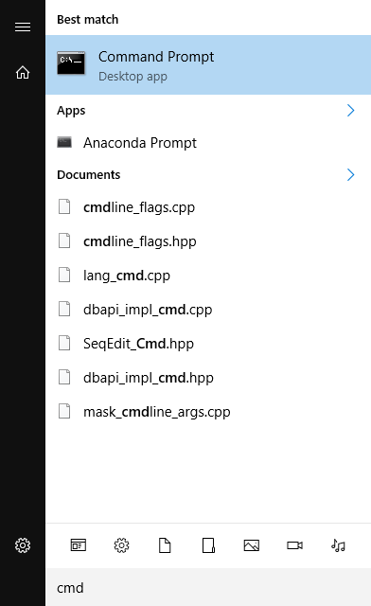
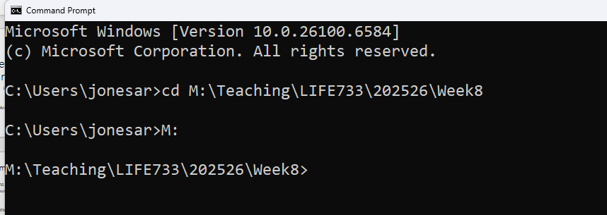
Command line basics (Windows)
Click here to get the path to this folder
1. Type “cmd” and click here
2. Using a file explorer window, find the location of your working directory
3. Copy and paste this into the command line prompt (right click to paste in window)
“cd [PASTE IN HERE]”
4. If you happen to be on the wrong drive, say C drive, you move to the M drive by typing “M:”, then press enter

Slide 4
Call “dir” from Python – os.system() function
import os
command = 'dir' #Change to ls on Mac!!
os.system(command)
Output
…
Volume in drive M is user08
Volume Serial Number is C000-022B
Directory of M:\Teaching\LIFE733\202526\Week8
05/11/2025 13:27 <DIR> .
05/11/2025 13:23 <DIR> ..
05/11/2025 08:26 9,807,394 ToxoDB-68_TgondiiME49_AnnotatedProteins.fasta
05/11/2025 08:26 8,578,464 ToxoDB-68_NcaninumLIV_AnnotatedProteins.fasta
2 File(s) 18,385,858 bytes
2 Dir(s) 8,716,083,200 bytes free

Slide 5
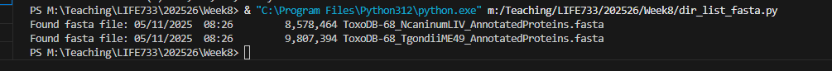
Capturing output Piping output to a temporary file
Here is the folder containing my script
import os
listing_filename = 'MyDirectoryListing.txt'
# Change 'dir' to 'ls' on Linux or Max
command = 'dir > ' + listing_filename
os.system(command)
f= open(listing_filename,'r')
for line in f:
line = line[:-1] #remove EOL
if(line.find('.fasta') != -1):
print("Found fasta file:",line)
dir > list.txt is a windows command to send the directory listing to the named file
Change to:
ls > filename.txt on Linux or mac
Output

Slide 6
BLAST
Basic Local Alignment Search Tool
Software tool for searching sequence databases
Aligns a DNA or protein sequence with every database sequence
Outputs the most closely matching sequence
  Takes into account how sequences evolve over time
Altschul SF et al. J Mol Biol. 1990 215(3):403-10.

Slide 7
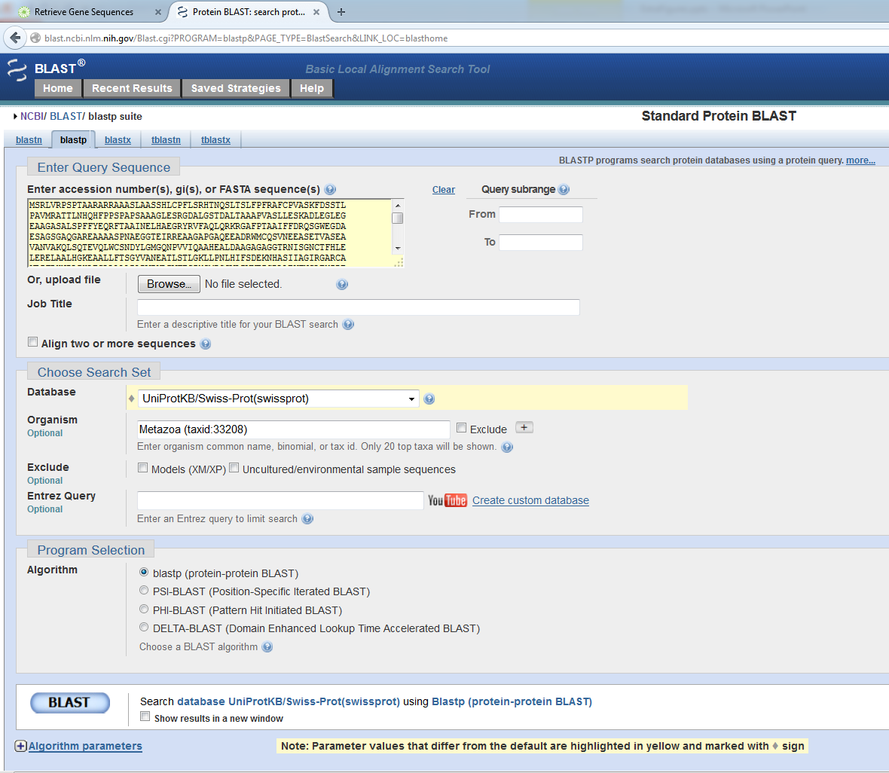
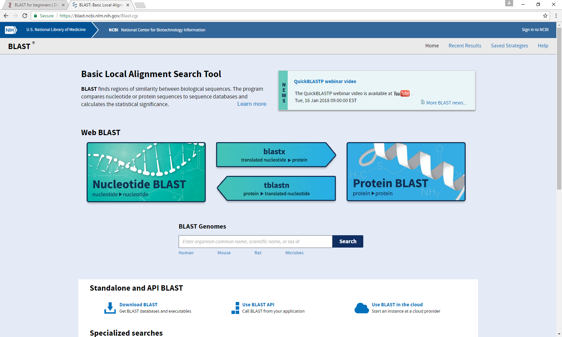
http://blast.ncbi.nlm.nih.gov/Blast.cgi
  BLAST tutorial: http://digitalworldbiology.com/tutorial/blast-for-beginners

Slide 8
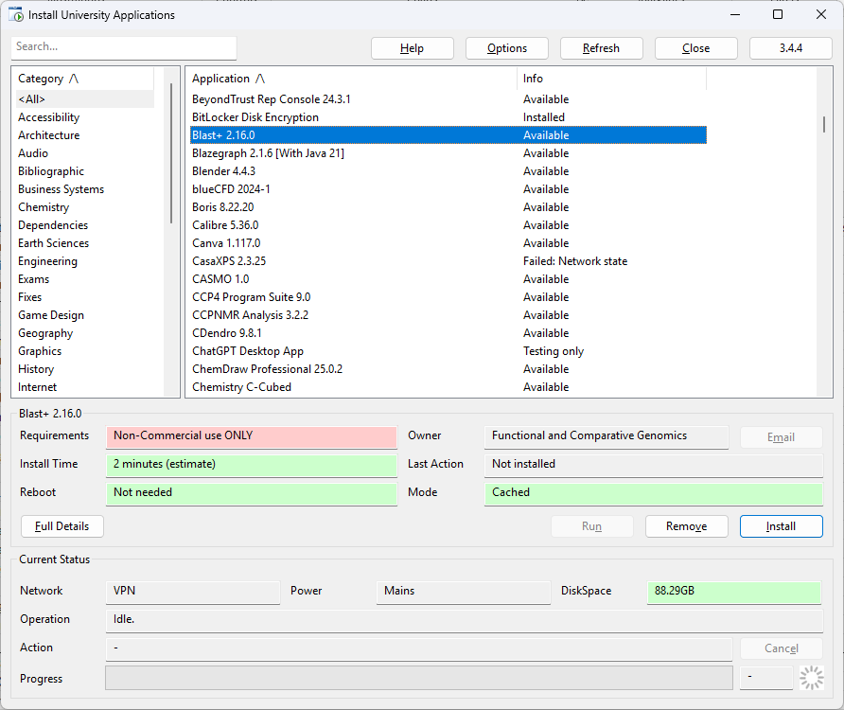
Command line BLAST
On University computers, you may need to install from here (hopefully pre-installed)
The BLAST program can be run fairly simply from the command line
For own machines - Install blast+ from https://ftp.ncbi.nlm.nih.gov/blast/executables/blast+/LATEST/
You can download an example database to search from Canvas, or get a fasta file from somewhere on the web e.g. UniProt, Ensembl, NCBI etc

Slide 9
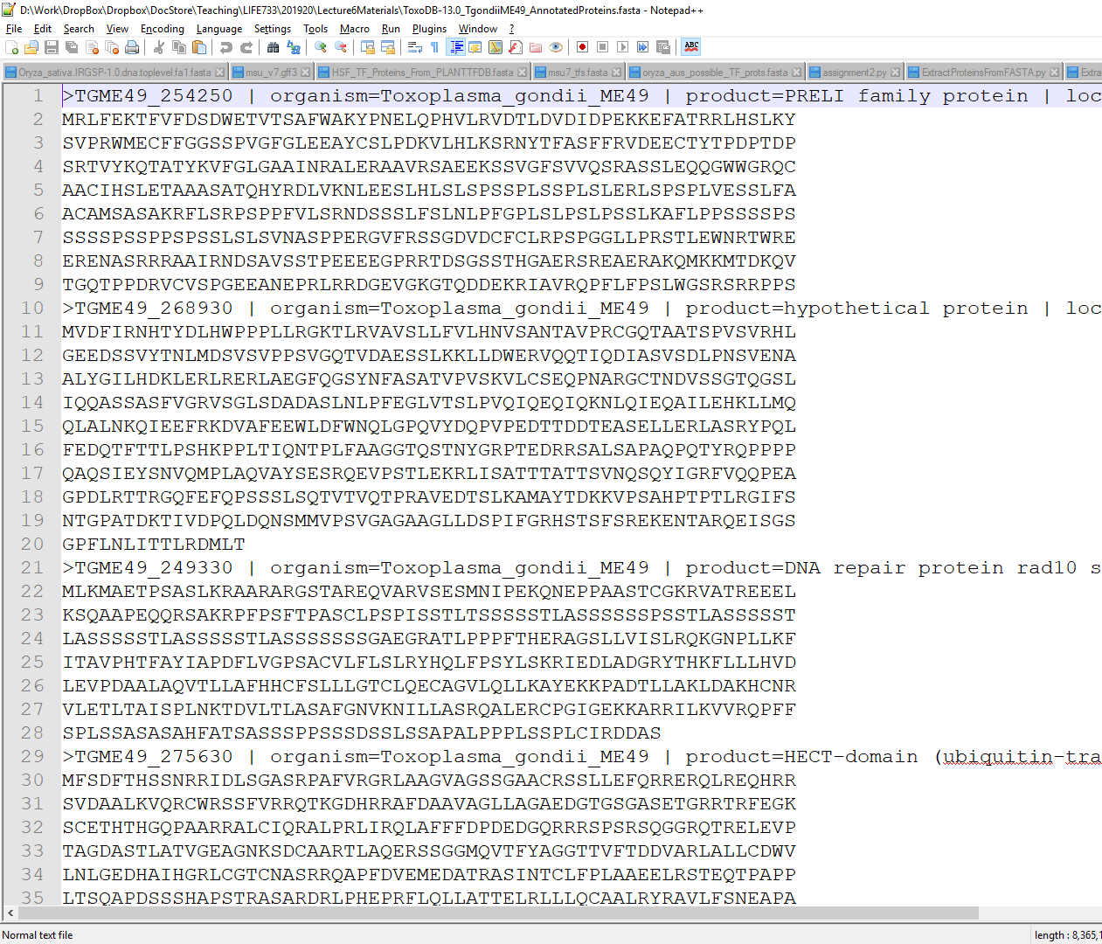
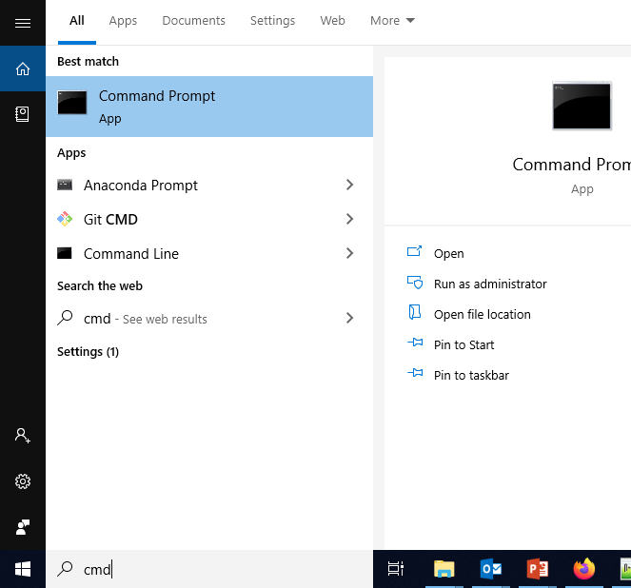
Background notes on BLAST
For running BLAST on the local machine (not via the web), the first thing we need is a “database”. In this context, a database is just a FASTA file containing DNA or protein sequences, we want to run a query against.
However, BLAST doesn’t like to search the FASTA file directly, it first needs to “configure” it – this means processing it and building some other files containing indexes, over which it can search fast.
Instructions
Download the FASTA file from VITAL, and put it in a folder on your hard drive
Then, “navigate” to this folder on the command line (“cmd”)
d: #to change to your D drive if you have one
cd D:\python_testing #or whatever is your location

Slide 10
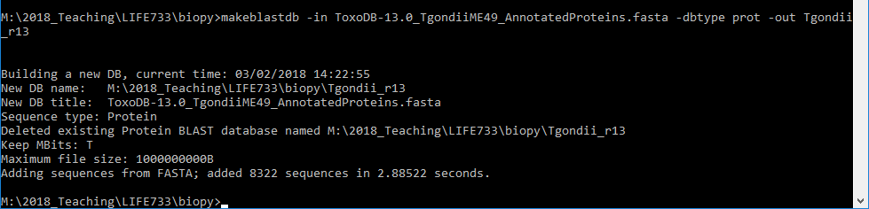
Configure database to search
makeblastdb -in ToxoDB-68_TgondiiME49_AnnotatedProteins.fasta -dbtype prot -out Tgondii_prots
Your own name for this database to be used later on in the search
FASTA file to index
(this will be your database)
Database type

Slide 11
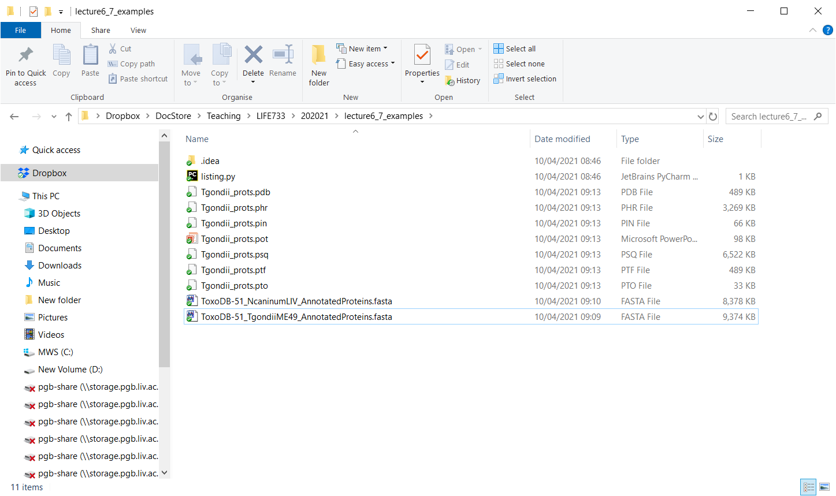
Various indexed files get created, which blast will search later on. Don’t move them!!
BLAST doesn’t actually use the FASTA file that you put in this folder

Slide 12
makeblastdb -help
USAGE
makeblastdb.exe [-h] [-help] [-in input_file] [-input_type type]
-dbtype molecule_type [-title database_title] [-parse_seqids]
[-hash_index] [-mask_data mask_data_files] [-mask_id mask_algo_ids]
[-mask_desc mask_algo_descriptions] [-gi_mask]
[-gi_mask_name gi_based_mask_names] [-out database_name]
[-blastdb_version version] [-max_file_sz number_of_bytes]
[-logfile File_Name] [-taxid TaxID] [-taxid_map TaxIDMapFile] [-version]
DESCRIPTION
Application to create BLAST databases, version 2.11.0+
REQUIRED ARGUMENTS
-dbtype <String, `nucl', `prot'>
Molecule type of target db
OPTIONAL ARGUMENTS
-h
Print USAGE and DESCRIPTION; ignore all other parameters
-help
Print USAGE, DESCRIPTION and ARGUMENTS; ignore all other parameters
-version
Print version number; ignore other arguments
…..
For help and parameters, type makeblastdb -help at the command line

Slide 13
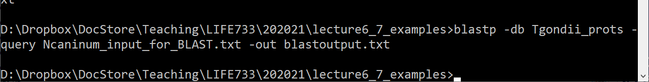
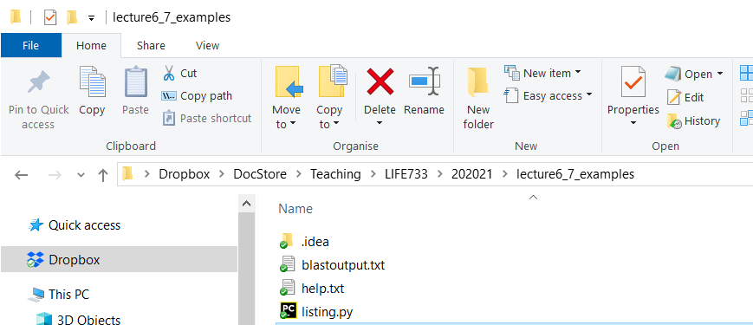
Command line search with BLAST
blastp -db Tgondii_prots -query Ncaninum_input_for_BLAST.txt -out blastoutput.txt
Database to search (name you used in makeblastdb)
Input file (also FASTA) containing sequences you want to search
Output file
Result file appears here if everything has gone okay

Slide 14
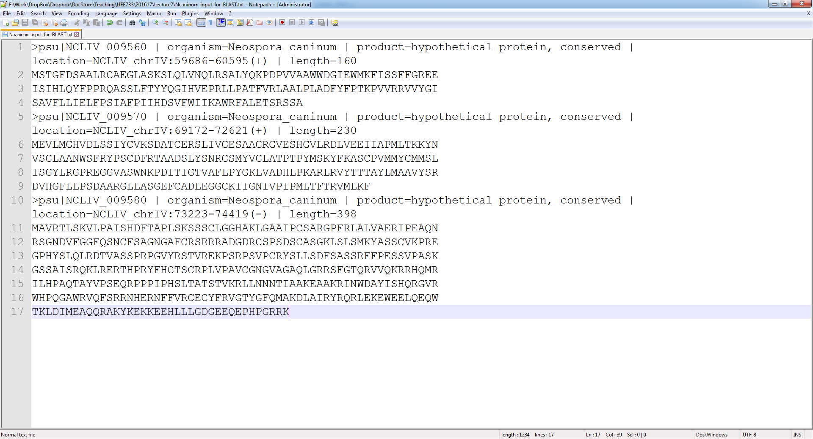
Input File for search
The input to the search is also in FASTA format.
Try opening it in Notepad++ so you can see how it is formatted

Slide 15
Now let’s look at the results file that was created

Slide 16
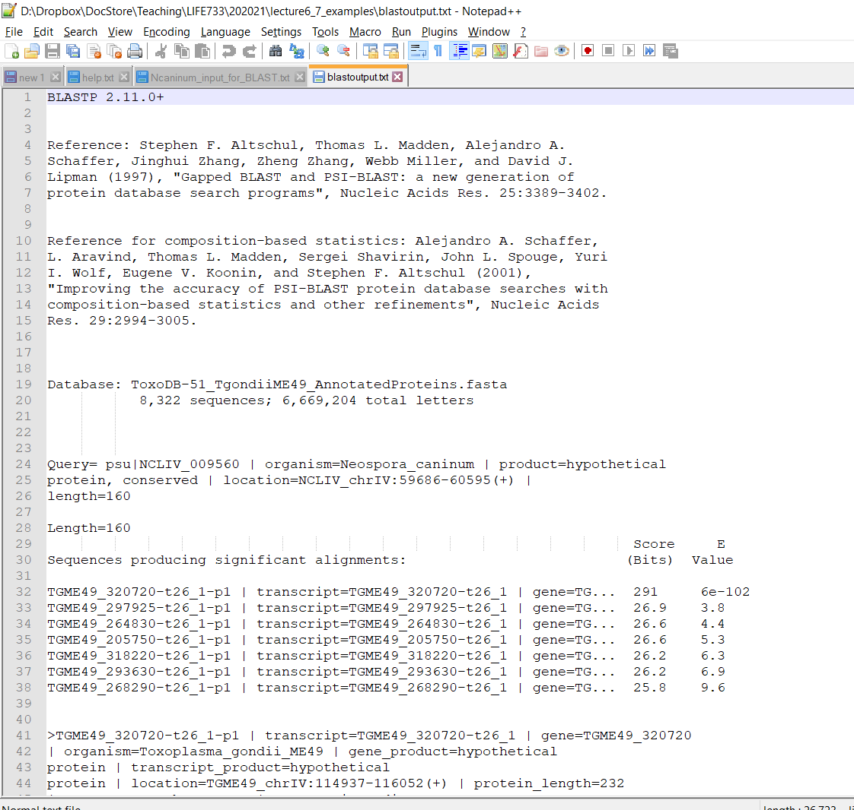
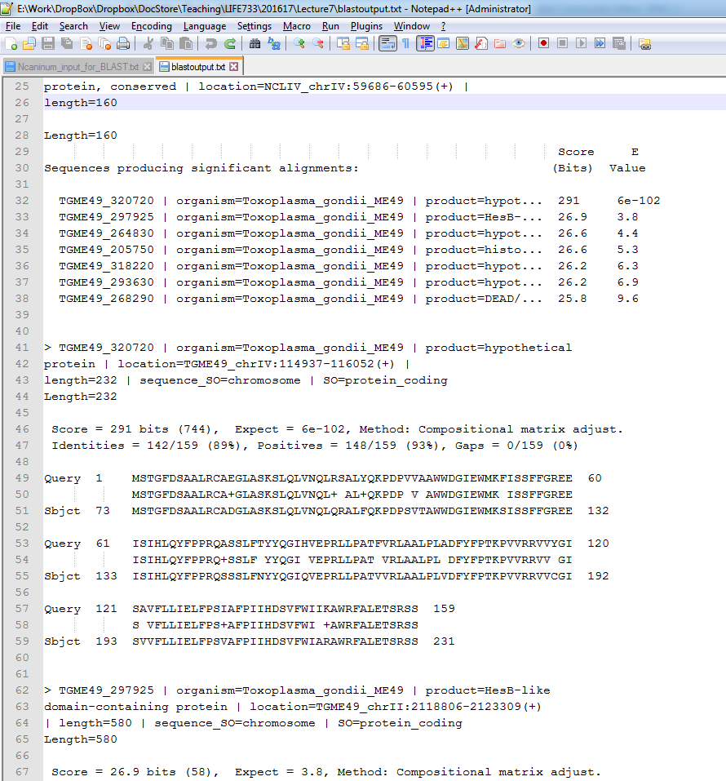
Alignment between query and hit
Input seq
Ranked hits
blastoutput.txt

Slide 17
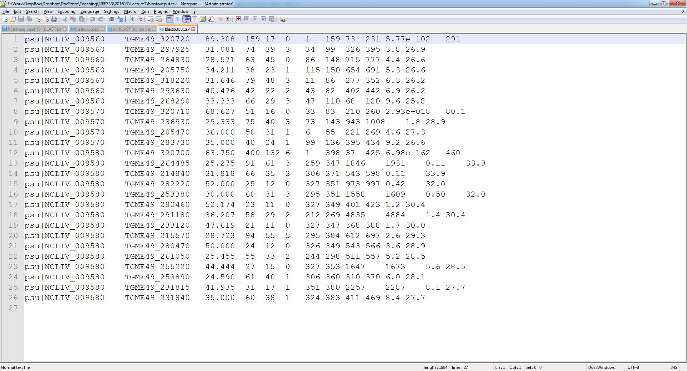
Easier to process output…
New file extension not needed, but for my own file tracking
This gives tab separated output
blastp -db Tgondii_prots -query Ncaninum_input_for_BLAST.txt -out blastoutput.tsv -outfmt 6

Slide 18
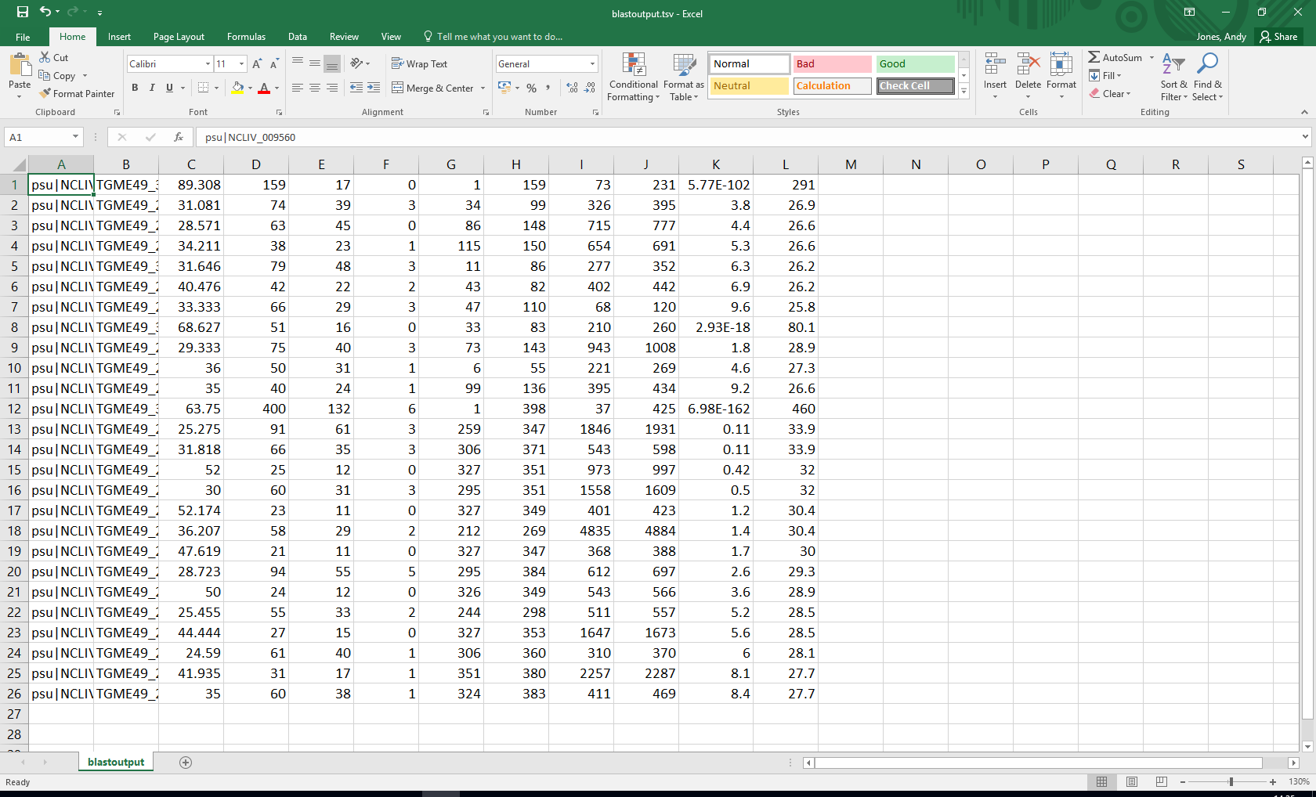
TSV files can also be loaded in Excel

Slide 19
import os
blast_result_file = 'blastoutput.tsv'
command = 'blastp -db Tgondii_prots -query Ncaninum_input_for_BLAST.txt -out ' \
+ blast_result_file + ' -outfmt 6'
os.system(command)
f= open(blast_result_file,'r')
for line in f:
data_row = line.strip().split('\t')
query = data_row[0]
hit = data_row[1]
e_value = float(data_row[10])
percent_match = float(data_row[2])
if(e_value < 1e-05):
print("Query: {0}, hit: {1}, percent match {2:2.2f}, e-value: {3:.2e}"
.format(query, hit, percent_match, e_value))
You can figure out what columns are by comparing back to the native format of BLAST
Here is an example of the recommended way of doing string formatting, including rounded printing:
https://www.digitalocean.com/community/tutorials/how-to-use-string-formatters-in-python-3
Output
Query: psu|NCLIV_009560, hit: TGME49_320720, percent match 89.31, e-value: 5.77e-102
Query: psu|NCLIV_009570, hit: TGME49_320710, percent match 68.63, e-value: 2.93e-18
Query: psu|NCLIV_009580, hit: TGME49_320700, percent match 63.75, e-value: 6.98e-162

Slide 20
Object oriented coding in python

Slide 21
Objects
So far you have dealt with variable types:
  String, Boolean, list, dictionary etc
  An object is another type of variable
An object is a more flexible type of variable, which can wrap up both properties and functions
As for other variables, we can name them how we like
We use the dot notation for accessing a property of an object:
  id = my_student.id
And for calling functions on objects:
  timetable_m = my_student.timetable("Monday") #E.g. send an argument of the data to a function
  print("Student:", id , "timetable for Monday", timetable_m)
If you want to learn about how to write your own objects, here is some background: https://www.datacamp.com/community/tutorials/python-oop-tutorial
For now, just follow the examples and we will go into more theory later!
Note: these aren’t real examples of working code, but could be if someone had written a student’s timetable package in python

Slide 22
BioPython
BioPython is a set of useful libraries for bioinformatics in python
Code includes functions for:
  Sequence analysis (BLAST, multiple sequence alignment)
  File format input / output (parsing)
  Phylogenetics
  pdb and protein structures
  Querying genbank / pubmed
  Graphical plotting for bioinformatics
http://biopython.org
Tutorials here: https://biopython.org/docs/latest/Tutorial/index.html

Slide 23
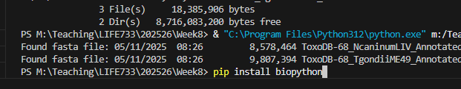
Install biopython on own laptop
Via VS Code terminal

Slide 24
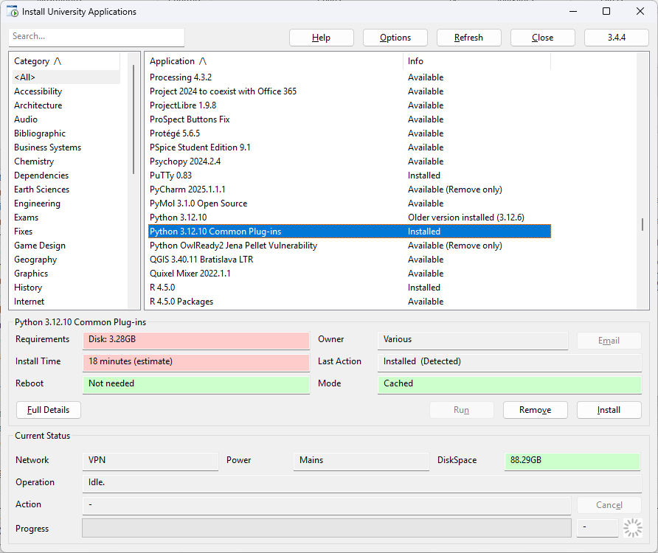
Install biopython on University machine
If this isn’t already installed in the given cluster, make sure to run it. This will install biopython and some other packages you will need later.

Slide 25
The Sequence object in BioPython
Seq object
Sequence string
A normal python string type

Slide 26
repr() is a useful python function for printing out the contents of an object as a string to help you understand what it contains
from Bio.Seq import Seq
my_seq = Seq("AGTACACTGGT")
print("1: ",repr(my_seq))
print("2:",my_seq)
Seq object
Sequence string
+ Various functions for biological sequence manipulation
Output
1: Seq('AGTACACTGGT')
2: AGTACACTGGT
Understanding sequence objects: https://biopython.org/docs/latest/Tutorial/chapter_seq_objects.html

Slide 27
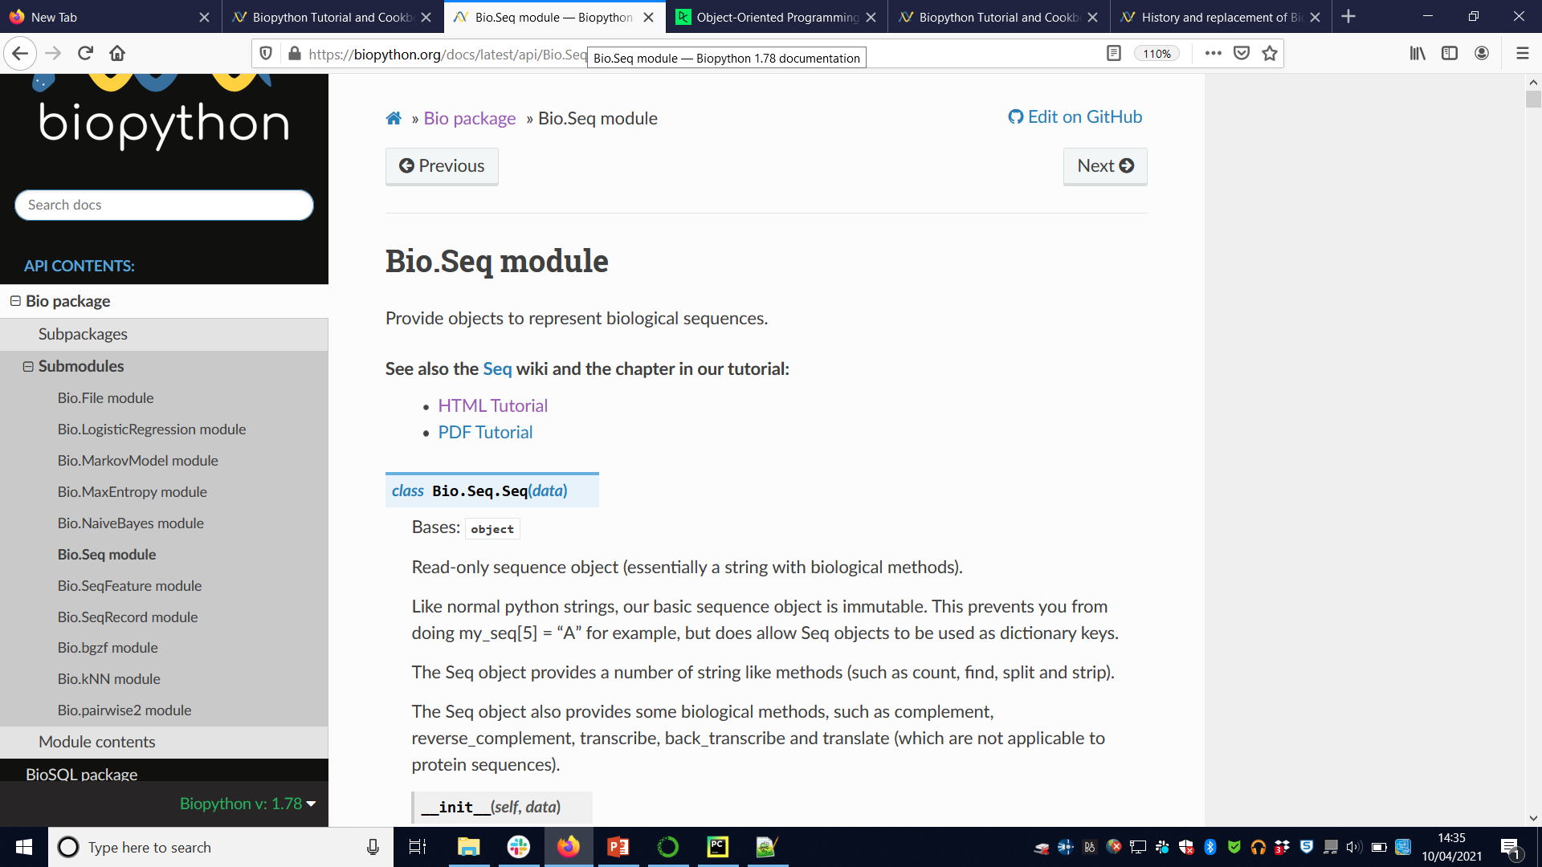
https://biopython.org/docs/latest/api/Bio.Seq.html

Slide 28
Access characters in Seq like String
from Bio.Seq import Seq
my_seq = Seq("AGTACACTGGT")
print(my_seq[0])
print(my_seq[1])
print(my_seq[4])
A
G
C
Syntax for accessing an individual element
In a Seq object is just like strings, i.e.,
[<index>]

Slide 29
Sequences can be sliced like strings
from Bio.Seq import Seq
my_seq = Seq("AGTACACTGGT")
new_seq = my_seq[1:4]
print(new_seq)
You can slice a Seq object just like
a string capturing and create a
new Seq object
Output
GTA

Slide 30
Concatenating sequences
from Bio.Seq import Seq
my_seq = Seq("AGUACACUGGU")
polyA_seq = Seq("AAAAAAAA")
new_seq = my_seq + polyA_seq
print(new_seq)
print(type(new_seq))
Output
AGUACACUGGUAAAAAAAA
<class 'Bio.Seq.Seq'>
To concatenate two Seq objects simply use +

Slide 31
Other operations on Seq object
See formal documentation: https://biopython.org/docs/1.75/api/index.html
Many python string methods have also been implemented to work in the same way on Seq – examples:
  find()
  startswith()
  split()
But… has biological methods as well:
  Transcribe (DNA -> RNA)
  Reverse Complement (as you have implemented yourself using basic python)
https://biopython.org/docs/latest/Tutorial/index.html

Slide 32
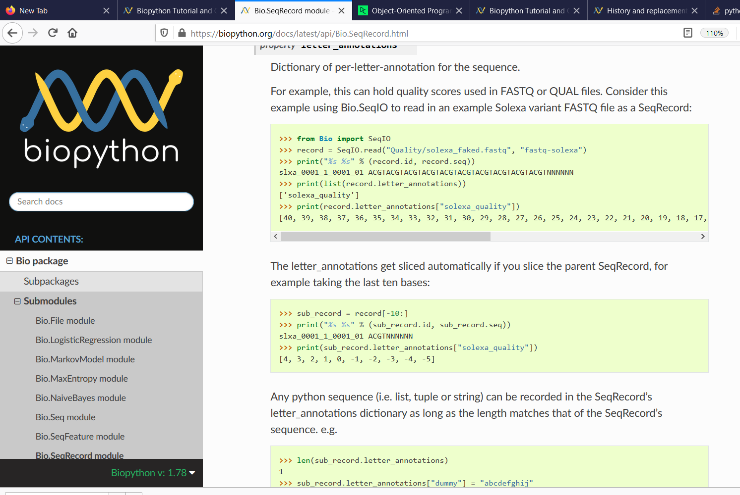
Sequence Records
https://biopython.org/docs/latest/api/Bio.SeqRecord.html
Sequence Record
Seq object
Sequence string
description
name
….

Slide 33
Sequence Records
from Bio.Seq import Seq
from Bio.SeqRecord import SeqRecord
record = SeqRecord(Seq("MKQHKAMIVALIVICITAVVAALVTRKDLCEVHIRTGQTEVAVF"),
id="YP_025292.1", name="HokC",
description="toxic membrane protein")
print("ID: ",record.id)
print("sequence ",record.seq)
Sequence Record
Seq object
Sequence string
description
Output
ID: YP_025292.1
sequence MKQHKAMIVALIVICITAVVAALVTRKDLCEVHIRTGQTEVAVF
name
….

Slide 34
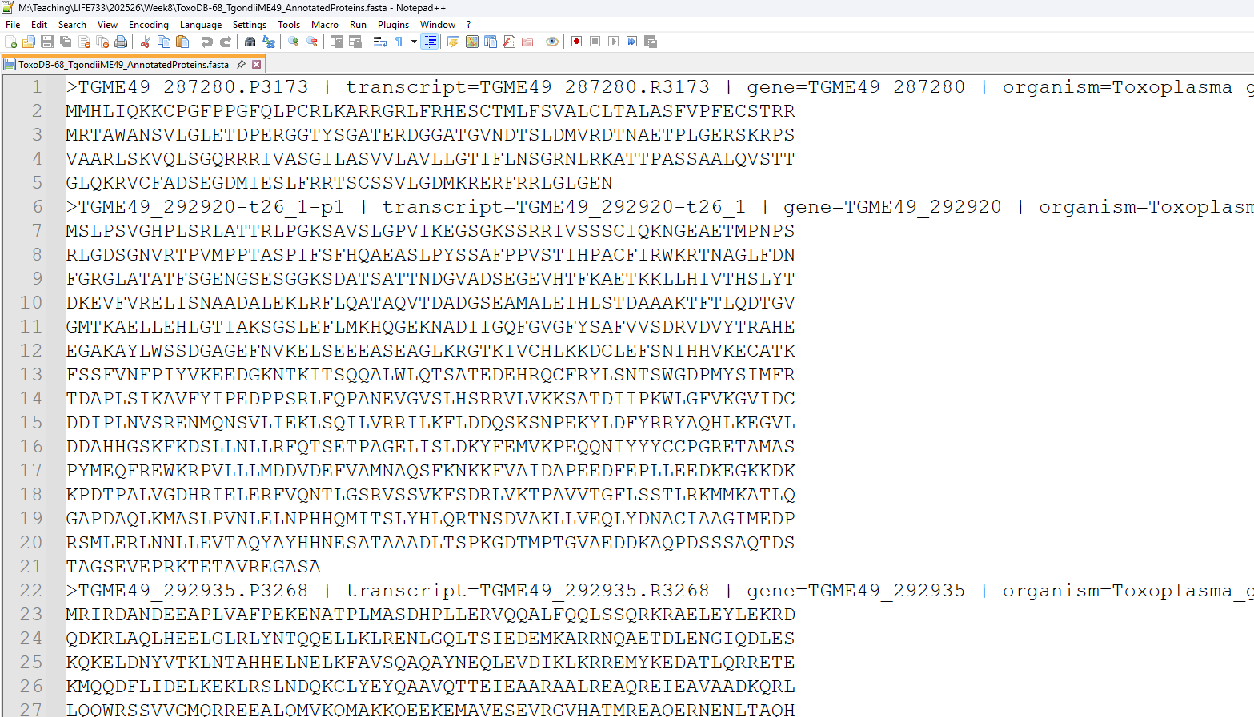
Take a look at the FASTA file we have been searching

Slide 35
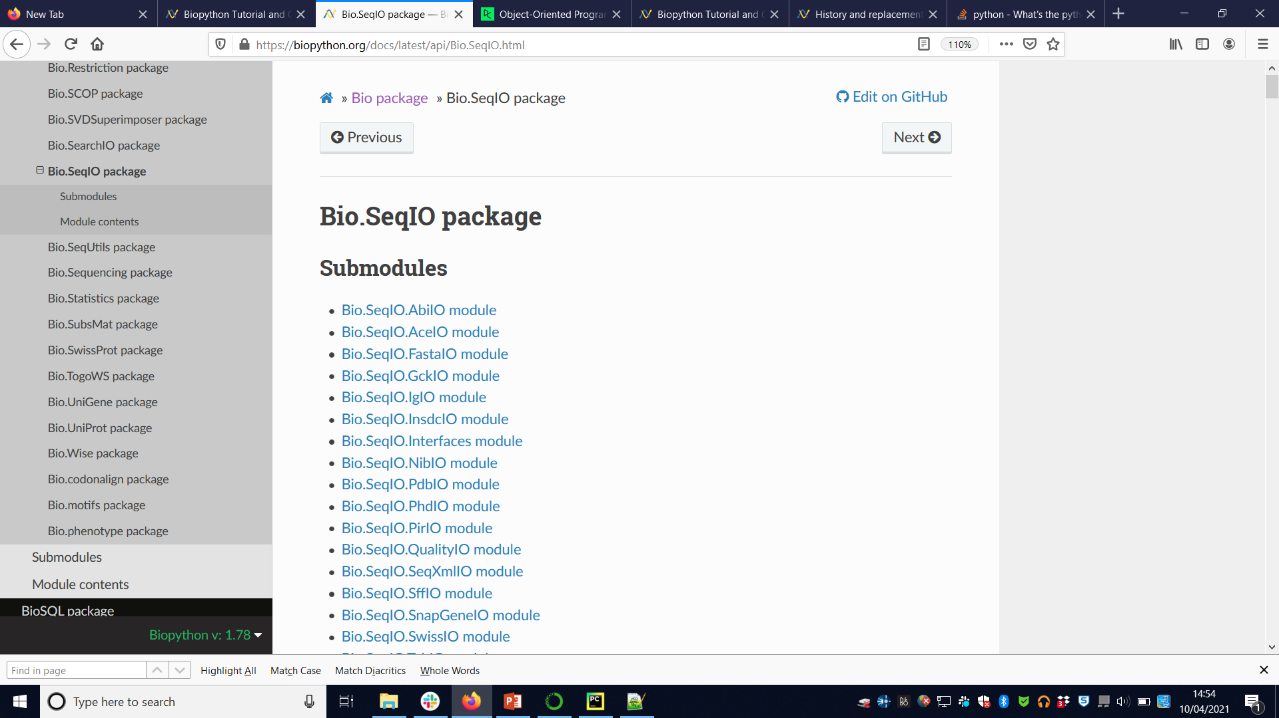
Formal documentation: https://biopython.org/docs/latest/api/Bio.SeqIO.html

Slide 36
This call process the entire file, and returns a list of Sequence Records
from Bio import SeqIO
records = list(SeqIO.parse("ToxoDB-68_TgondiiME49_AnnotatedProteins.fasta", "fasta"))
record_id = records[0].id #get first record
record_seq = records[0].seq
record_desc = records[0].description
print("First record is", record_id, " \ndescription: ", record_desc)
print("First 10 amino acids: ",record_seq[0:10] )
Output
PS M:\Teaching\LIFE733\202526\Week8> & "C:\Program Files\Python312\python.exe" m:/Teaching/LIFE733/202526/Week8/read_fasta.py
First record is TGME49_287280.P3173
description: TGME49_287280.P3173 | transcript=TGME49_287280.R3173 | gene=TGME49_287280 | organism=…
First 10 amino acids: MMHLIQKKCP
http://biopython.org/DIST/docs/tutorial/Tutorial.html#sec51

Slide 37
from Bio import SeqIO
import re
records = SeqIO.parse("ToxoDB-68_TgondiiME49_AnnotatedProteins.fasta", "fasta")
pattern = re.compile('AN.{2}DY') #example motif with 2 wildcard positions
for record in records:
sequence = str(record.seq)
m = pattern.search(sequence)
if(m):
print('Sequence motif found in ' + record.id)
print('Matching sequence: ' + m.group())
Now let’s parse the FASTA file, and search for a sequence motif of interest
Output
Sequence motif found in TGME49_319640-t26_1-p1
Matching sequence: ANLLDY
Sequence motif found in TGME49_284530.P3107
Matching sequence: ANVLDY
Sequence motif found in TGME49_500435.P334
Matching sequence: ANLTDY
…..
Strange quirk…
Unlike on previous slide, we could get away with just using the record.seq as a string, here the code will crash if we don’t convert explicitly to a string.
record.seq gives us back a Bio.Seq.seq object, need to convert to Python string
http://biopython.org/DIST/docs/api/Bio.Seq.Seq-class.html

Slide 38
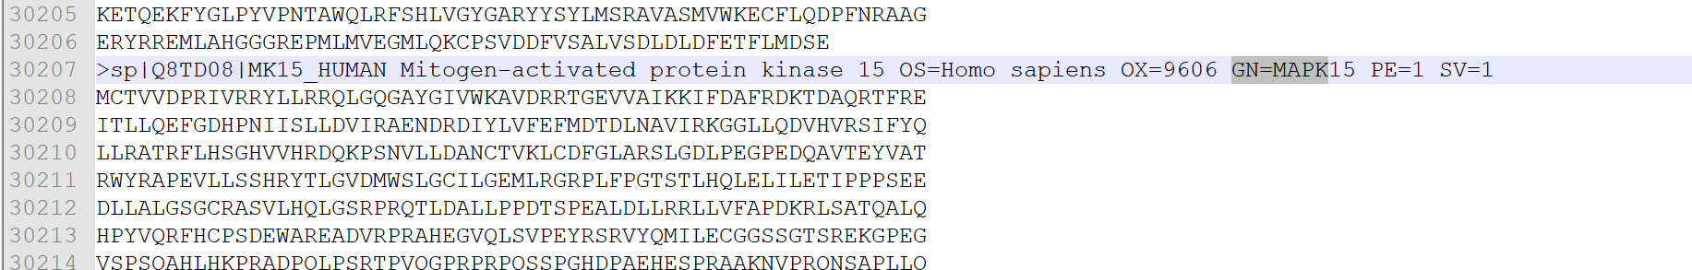
from Bio import SeqIO
import re
records = SeqIO.parse("UP000005640_9606.fasta", "fasta")
pattern = re.compile(r"GN=MAPK\d+ ", re.IGNORECASE)
mapk_count = 0
for record in records:
description = str(record.description)
m = pattern.search(description)
if(m):
print("id:",record.id, " description:",description)
mapk_count+=1
print('Count:',mapk_count)
Here we process a FASTA file for human proteins (download from Canvas)
to extract gene names,
See if you understand the regex I’m using.
Output
..
id: sp|Q13164|MK07_HUMAN description: sp|Q13164|MK07_HUMAN Mitogen-activated protein kinase 7 OS=Homo sapiens OX=9606 GN=MAPK7 PE=1 SV=2
id: sp|Q16539|MK14_HUMAN description: sp|Q16539|MK14_HUMAN Mitogen-activated protein kinase 14 OS=Homo sapiens OX=9606 GN=MAPK14 PE=1 SV=3
id: sp|P45983|MK08_HUMAN description: sp|P45983|MK08_HUMAN Mitogen-activated protein kinase 8 OS=Homo sapiens OX=9606 GN=MAPK8 PE=1 SV=2
id: sp|O15264|MK13_HUMAN description: sp|O15264|MK13_HUMAN Mitogen-activated protein kinase 13 OS=Homo sapiens OX=9606 GN=MAPK13 PE=1 SV=1
Count: 13

Slide 39
Summary
You should be able to run command-line blast
You should be able to read tab-separated BLAST results using some regular python
You can start using biopython for more complicated jobs, try out some examples in the tutorials

