Slide 1
04
03
02
01
USING
Assistive Feedback
AI
Building Formative Activities
Enhancing Lectures
Develop Teaching Resources
4
Automate feedback provided on coursework submissions via Canvas/ChatGPT.
Referencing criteria only!
Improving student experience.
Increasing consistency across large groups of markers.
Example: Assistive Feedback Tool
[Link to Video Overview]
Quickly develop a structured resource on ANY topic for students.
Swallow your pride.
Use ChatGPT to build a resource that’s twice as good in half the time.
Example: Active Learning Workshop.
Introduction to Visualisation using R and Ggplot2.
Quickly build formative quizzes for Canvas.
Support student comprehension.
Increase student engagement.
Prompt critical thinking.
Example: Paper Comprehension
[How to video]
Quickly develop in-class polls/quizzes using ChatGPT and Poll Everywhere/Kahoot.
Reinforce student understanding of lecture content.
Increase student engagement.
Example: LIFE748 Structural Bioinformatics Lecture
[How to Video (Poll Everywhere)]
[How to Video (Kahoot)]
3
2
IN YOUR TEACHING
1
R. Treharne & J. Foster

Slide 2
04
01
03
02
USING
Assistive Feedback
Enhancing Lectures
AI
Building Formative Activities
Develop Teaching Resources
4
Automate feedback provided on coursework submissions via Canvas/ChatGPT.
Referencing criteria only!
Improving student experience.
Increasing consistency across large groups of markers.
Example: Assistive Feedback Tool
[Link to Video Overview]
Quickly develop in-class polls/quizzes using ChatGPT and Poll Everywhere/Kahoot.
Reinforce student understanding of lecture content.
Increase student engagement.
Example: LIFE748 Structural Bioinformatics Lecture
[How to Video (Poll Everywhere)]
[How to Video (Kahoot)]
Quickly develop a structured resource on ANY topic for students.
Swallow your pride.
Use ChatGPT to build a resource that’s twice as good in half the time.
Example: Active Learning Workshop.
Introduction to Visualisation using R and Ggplot2.
Quickly build formative quizzes for Canvas.
Support student comprehension.
Increase student engagement.
Prompt critical thinking.
Example: Paper Comprehension
[How to video]
3
2
IN YOUR TEACHING
1
R. Treharne & J. Foster
https://tinyurl.com/teaching-with-ai

Slide 3
04
01
03
02
USING
Assistive Feedback
Enhancing Lectures
AI
Develop Teaching Resources
Building Formative Activities
4
Automate feedback provided on coursework submissions via Canvas/ChatGPT.
Referencing criteria only!
Improving student experience.
Increasing consistency across large groups of markers.
Example: Assistive Feedback Tool
[Link to Video Overview]
Quickly develop in-class polls/quizzes using ChatGPT and Poll Everywhere/Kahoot.
Reinforce student understanding of lecture content.
Increase student engagement.
Example: LIFE748 Structural Bioinformatics Lecture
[How to Video (Poll Everywhere)]
[How to Video (Kahoot)]
Quickly develop a structured resource on ANY topic for students.
Swallow your pride.
Use ChatGPT to build a resource that’s twice as good in half the time.
Example: Active Learning Workshop.
Introduction to Visualisation using R and Ggplot2.
Quickly build formative quizzes for Canvas.
Support student comprehension.
Increase student engagement.
Prompt critical thinking.
Example: Paper Comprehension
[How to video]
3
2
IN YOUR TEACHING
1
R. Treharne & J. Foster
https://tinyurl.com/teaching-with-ai

Slide 4
04
01
03
02
USING
Assistive Feedback
Enhancing Lectures
AI
Building Formative Activities
4
Develop Teaching Resources
Automate feedback provided on coursework submissions via Canvas/ChatGPT.
Referencing criteria only!
Improving student experience.
Increasing consistency across large groups of markers.
Example: Assistive Feedback Tool
[Link to Video Overview]
[Link to Tool]
Quickly develop in-class polls/quizzes using ChatGPT and Poll Everywhere/Kahoot.
Reinforce student understanding of lecture content.
Increase student engagement.
Example: LIFE748 Structural Bioinformatics Lecture
[How to Video (Poll Everywhere)]
[How to Video (Kahoot)]
Quickly develop a structured resource on ANY topic for students.
Swallow your pride.
Use ChatGPT to build a resource that’s twice as good in half the time.
Example: Active Learning Workshop.
Introduction to Visualisation using R and Ggplot2.
Quickly build formative quizzes for Canvas.
Support student comprehension.
Increase student engagement.
Prompt critical thinking.
Example: Paper Comprehension
[How to video]
3
2
IN YOUR TEACHING
1
R. Treharne & J. Foster
https://tinyurl.com/teaching-with-ai

Slide 5
04
01
03
02
USING
Enhancing Lectures
AI
Assistive Feedback
Building Formative Activities
Develop Teaching Resources
4
Automate feedback provided on coursework submissions via Canvas/ChatGPT.
Referencing criteria only!
Improving student experience.
Increasing consistency across large groups of markers.
Example: Assistive Feedback Tool
[Link to Video Overview]
Quickly develop in-class polls/quizzes using ChatGPT and Poll Everywhere/Kahoot.
Reinforce student understanding of lecture content.
Increase student engagement.
Example: LIFE748 Structural Bioinformatics Lecture
[How to Video (Poll Everywhere)]
[How to Video (Kahoot)]
Quickly develop a structured resource on ANY topic for students.
Swallow your pride.
Use ChatGPT to build a resource that’s twice as good in half the time.
Example: Active Learning Workshop.
Introduction to Visualisation using R and Ggplot2.
Quickly build formative quizzes for Canvas.
Support student comprehension.
Increase student engagement.
Prompt critical thinking.
Example: Paper Comprehension
[How to video]
3
2
IN YOUR TEACHING
1
R. Treharne & J. Foster
https://tinyurl.com/teaching-with-ai

Slide 6
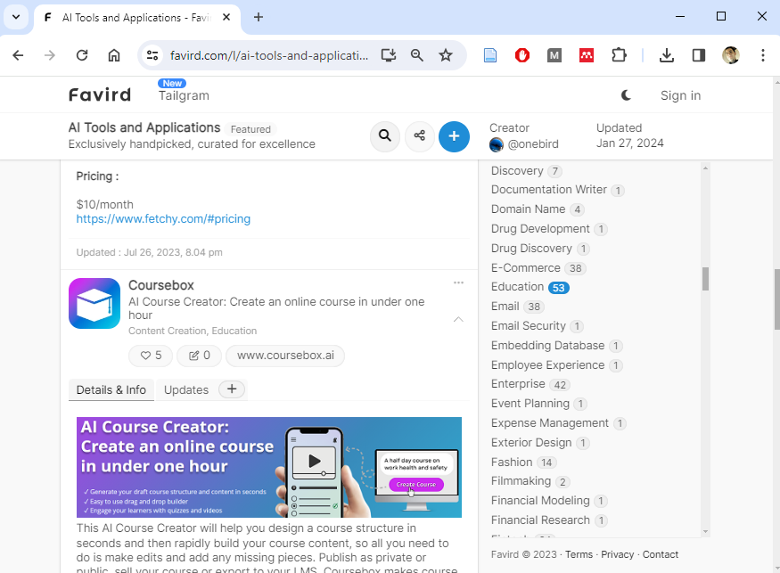
04
01
03
02
USING
Assistive Feedback
Enhancing Lectures
AI
Building Formative Activities
Develop Teaching Resources
4
Automate feedback provided on coursework submissions via Canvas/ChatGPT.
Referencing criteria only!
Improving student experience.
Increasing consistency across large groups of markers.
Example: Assistive Feedback Tool
[Link to Video Overview]
Quickly develop in-class polls/quizzes using ChatGPT and Poll Everywhere/Kahoot.
Reinforce student understanding of lecture content.
Increase student engagement.
Example: LIFE748 Structural Bioinformatics Lecture
[How to Video (Poll Everywhere)]
[How to Video (Kahoot)]
Quickly develop a structured resource on ANY topic for students.
Swallow your pride.
Use ChatGPT to build a resource that’s twice as good in half the time.
Example: Active Learning Workshop.
Introduction to Visualisation using R and Ggplot2.
Quickly build formative quizzes for Canvas.
Support student comprehension.
Increase student engagement.
Prompt critical thinking.
Example: Paper Comprehension
[How to video]
3
2
IN YOUR TEACHING
1
R. Treharne & J. Foster
https://tinyurl.com/teaching-with-ai

Slide 7


04
01
03
02
Mon 8 April. 10 AM.
2hr Online Workshop
For ALL staff.
tinyurl.com/leveraging-ai
USING
Assistive Feedback
Enhancing Lectures
AI
Building Formative Activities
Develop Teaching Resources
4
Automate feedback provided on coursework submissions via Canvas/ChatGPT.
Referencing criteria only!
Improving student experience.
Increasing consistency across large groups of markers.
Example: Assistive Feedback Tool
[Link to Video Overview]
Quickly develop in-class polls/quizzes using ChatGPT and Poll Everywhere/Kahoot.
Reinforce student understanding of lecture content.
Increase student engagement.
Example: LIFE748 Structural Bioinformatics Lecture
[How to Video (Poll Everywhere)]
[How to Video (Kahoot)]
Quickly develop a structured resource on ANY topic for students.
Swallow your pride.
Use ChatGPT to build a resource that’s twice as good in half the time.
Example: Active Learning Workshop.
Introduction to Visualisation using R and Ggplot2.
Quickly build formative quizzes for Canvas.
Support student comprehension.
Increase student engagement.
Prompt critical thinking.
Example: Paper Comprehension
[How to video]
3
2
IN YOUR TEACHING
1
R. Treharne & J. Foster
https://tinyurl.com/teaching-with-ai

Slide 8
01
Enhancing Lectures
Quickly develop in-class polls/quizzes using ChatGPT and Poll Everywhere/Kahoot.
Reinforce student understanding of lecture content.
Increase student engagement.
Example: LIFE748 Structural Bioinformatics Lecture
[How to Video (Poll Everywhere)]
[How to Video (Kahoot)]
1

Slide 9
02
Building Formative Activities
Quickly build formative quizzes for Canvas.
Support student comprehension.
Increase student engagement.
Prompt critical thinking.
Example: Paper Comprehension
[How to video]
2

Slide 10
03
Develop Teaching Resources
Quickly develop a structured resource on ANY topic for students.
Swallow your pride.
Use ChatGPT to build a resource that’s twice as good in half the time.
Example: Active Learning Workshop.
Introduction to Visualisation using R and Ggplot2.
3

Slide 11
04
Assistive Feedback
4
Automate feedback provided on coursework submissions via Canvas/ChatGPT.
Referencing criteria only!
Improving student experience.
Increasing consistency across large groups of markers.
Example: Assistive Feedback Tool
[Link to Video Overview]

