Slide 1
BLADE RUNNER 2050 : Story Board
R. Travis Rose

Slide 2
Long-term Goal
Creating a playable demo of a Role Playing Game set in the Blade Runner universe
BR 2050 : REP 'TEC
REPs=>'Resident Engineered Personnel'
Features to include a main action-driven board game, 3D exploration and combat, and mini-games
Overall game structure based on Bladerunner 1996 PC game + Bladerunner : REP DETECT board game

Slide 3
Open Source Libraries&Art
List of components
Licensing
Creative Commons art
Demo game in set Bladerunner(BR) universe
Demo story/game play => Fair Use

Slide 4
Customer Wishes
Describe customer needs and wishes
  Need to have a structured, yet randomly generated world
Explain the requirements
  An anti-shooter VR game set in the BR universe
  Positions on board translate into a new scene generated with 3D sky box, embedded (inset) game grids, 3D models, to include shading, lighting, 1st person and 3rd person camera views
  Turn-based strategy game
  Must out-run REPs (<= time or REP power)

Slide 5
Fulfilling
Customer Needs
Describe the main attributes of the product
  Turn-based strategy game
  Occasional “Grand Theft Auto” mixed with anti-“shooter” action
  REPs must be captured alive to win
  Player skills model: (I)nvestigation, (D)etection, (C)ombat
Link the product attributes to customer needs
  Cell-phone version => pre-rendered scenes
  Laptop version => more playable 3D scenes

Slide 6
Strengths and Advantages
Summarize the special features and advantages of the product being introduced
  Game logic to include randomly generated characters and plot
  Series of “chases” + combat to capture REPs
  Series of conflicts need to be resolved in order to unravel the REP's plot

Slide 7
Strengths and Advantages (II)
An anti-shooter game
Built-in card/s system
2D/3D animation&compositing

Slide 8
Next Steps of Action
Explain the steps that now need to be taken
  Proof-of-concept, light-weight, portable demo
  More features with 3D rendering in laptop version

Slide 9
Summary
BR 2050 // 20 Five-0 : Story Board
Long-term Goal
Customer Wishes
Fulfilling
Customer Needs
Strengths and Advantages

Slide 10
Story:
Card-driven
Gathering clues
// hands: standard deck + tarot
Poker dice
“Unlocking” ESPER functions
“Equalizer” style scenarios
e.g., “girlfriend”  ; lives in same building
- protect from REPs
- capturing REPs
- bring back to Tyrell
...

Slide 11
“Girlfriend”|Cat woman named “Karma”
 :
Syndrome=> REP sympathizer
REP conflicts ensue next door
Former police partner; semi-retired
Karma stops by sometimes
Karma is backlogged (LOL)
“Empathic sympath” (maybe)
Home AI monitoring
Ambiguous relationship status
…
Player point system =>+

Slide 12
Settings|Locations
Airport(s)
Gas Station
Grocery Store
Hotel
Night Club
Police HQ
Ranch house
Warehouse
Rain, fog
Tyrell/Wallace Corps
Animoid Row
Anneken's Manneq.
“Yukon” hotel
White Dragon
Chinatown
Eyeworks
Snakepit (club)
The Bradbury

Slide 13
Player Upgrades
Exp level
Items
Skills
...

Slide 14
=>

Slide 15
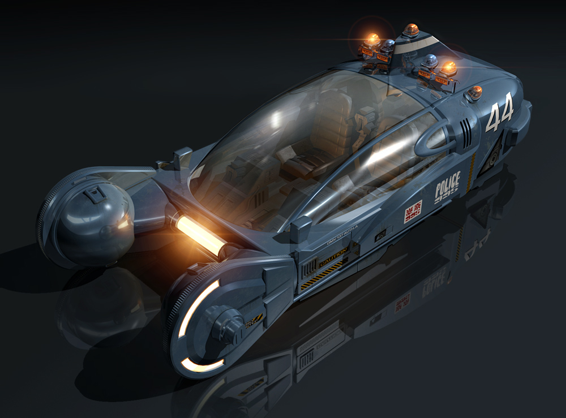
Vehicle Upgrades

Slide 16
Plots
Overcoming the Monster <=
Rags to Riches<= might be investigative
Quest
Voyage and Return <= relativistic effects
Comedy <= Parody
Tragedy
Rebirth
Mystery <= e.g., CERN|time travel|etc.
Rebellion against “The One” (Overlord)
    Who rules? ÿ

Slide 17
Example Sources of Conflicts:
 | $
Alcohol/Drugs
Attitude(e.g., face/emotion)
Biologic
  Bio functions
Chemical
Disrespect(verbal)
  Explosives
Electrostatic
Hoarding
  Trip-wire (traps)
Physical
  Stand-off/hostage situations
  Robbery in progress
  Combat
  Radiation
  Spiritual
Electronic
  E-mail / cell phones
Relational
  e.g., Human vs. REPs
  Kidnapping
Theft
  Physical objects
  Resource(Food/water/...)
Logistic
  Collision (traffic accidents)
  Missed connection
  Space travel
    Relativistic effects
    Quantum theory
    Teleportation
    Time travel

Slide 18
Simulating VK test
Voight-Kampff : empathy test
“Show thinking”/poker dice game
  “cellular” ping technology can read cellular biological response
  Losing hands in animated poker dice rolls => REP detection

Slide 19
(Maybe) Hawaii Five-0 plot tie-in
Los Angeles
Honolulu

Slide 20
Example Props
Apt.
BR gun
Player/Enemy/Sidekicks
Cat/Dog
ESPER computer system
Girl
Mug shots
Playing cards
Poker dice
Shot glass
Unicorn
Vehicles
Interior + exterior textures
Multi-story building model(s)
Email (<= clue)
Cell phone
  Communicate with enemy players/NPCs
  Satellite tracking

Slide 21
Organizational Data Structures
Game board with adjacency matrix
  List of pre-defined backgrounds/skyboxes
  Algorithm with list of randomized skybox images
Inventory
Item database
Character database
Interfaces (<= for player interaction)
Scenes (<= develop the story)
  Intro, flashbacks, etc.

Slide 22
=>

Slide 23
Interfaces
Cut scenes / Intro
Game Board
Player stats
Inventory
ESPER (similar to KIA in Westwood) : Clues
  People
  Places
  Things
On location scenes
Human vs. REP combat
“Karate chess” style tactical RPG

Slide 24
Interfaces (II)
Card decks
  Action cards
  Clue cards => object(s) added to inventory
  Standard deck
Poker dice game
  Stand-alone (side game)
  “Show thinking” animation
Selected Fan Art (fair use) for load screens...
Etc.

Slide 25
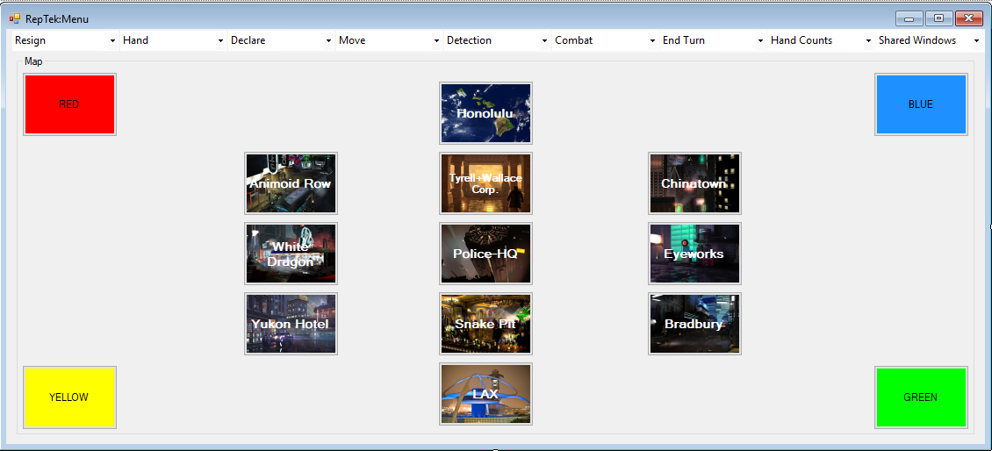
Compact Game Map / Push Button Interface & Drop-down Menus

Slide 26
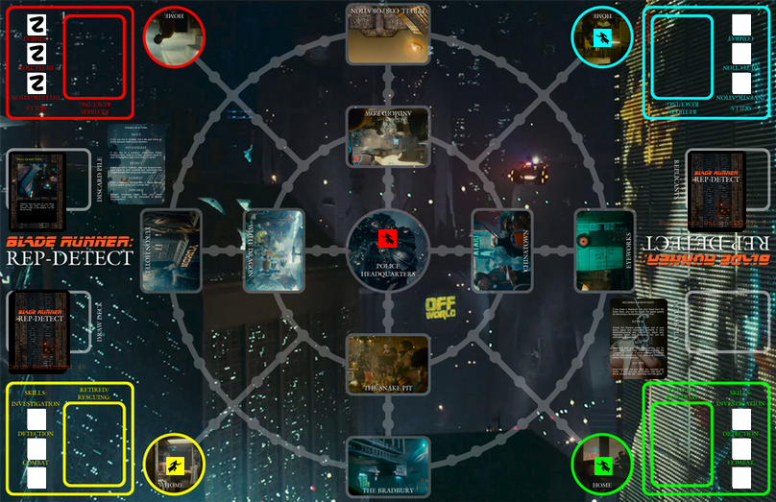
<=Inspired by “Blade Runner: REP-DETECT”

Slide 27
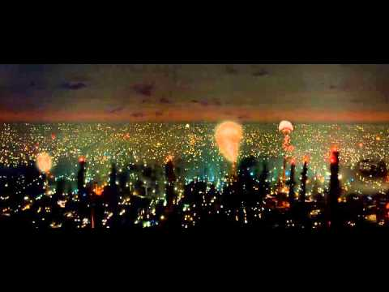
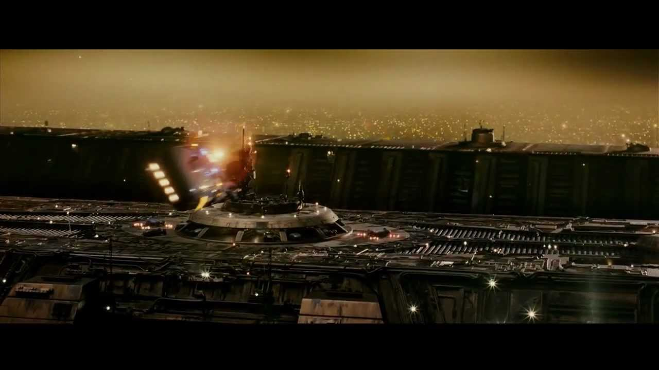
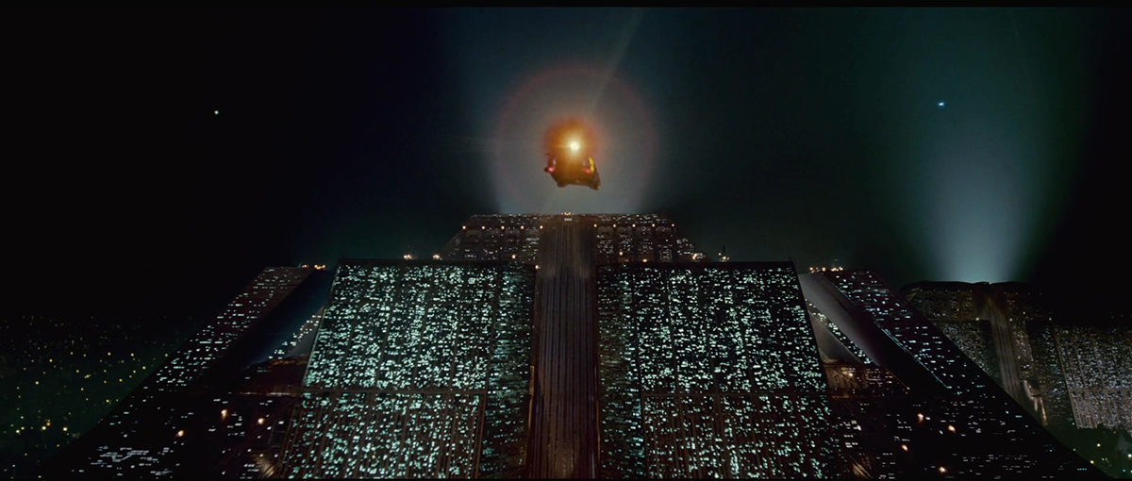
1. Opening Scene(s)(\C\)

Slide 28
Scenario(s)
Runciter's Animals – tutorial
Other pre-assigned scenario/conflicts
    Tyrell/Wallace corp scenes
Randomly distribute clues
Random competitors/NPCs
Cooperative/competitor AI
Randomly assign other conflicts
Goals:
    Unlock ESPER with clues
    Capture REPs
    Understanding “Karma” + 
    Player/party/vehicle upgrades
    Escape with REP(s)
    ...

Slide 29
Effects/Techniques
Particle systems:
  Rain, smoke, fire fog
Shaded polygons <= red/blue flashing lights
Pre-rendered Sky Box backgrounds
  Some pre-defined, some can be randomized
  Interior of BR apartment => pre-defined
Random city + building generation
  Similar to “Pixel City” (<= may re-use)

Slide 30
Techniques
Westwood Studios inspired:
    “Slice” model/approach
  2D/3D views
  Animated GIF
  Alpha blending

Slide 31
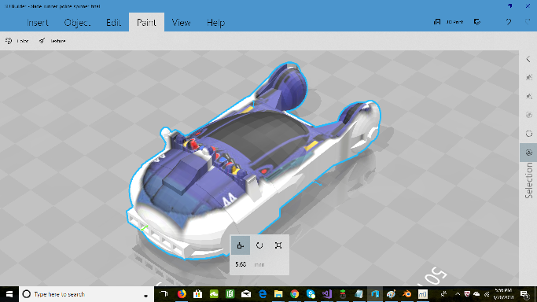
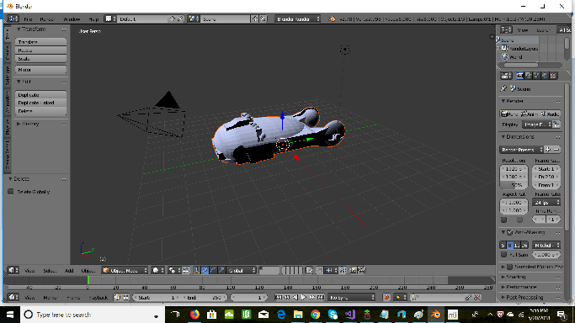
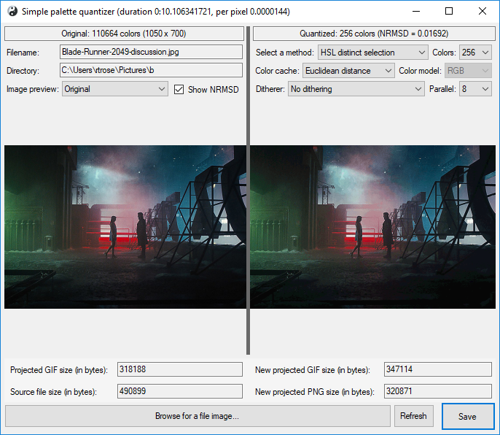

Sample Tool Chain&Workflow(s)

Slide 32
Sample Tool Chain&Workflow(s)
3D Builder =>
<= Blender
Palette Quantizer
  Images => Resources
=> VS2017+ => app

