Slide 1
BR REP TEK : Retro Game
'REP TEK'

Slide 2
Overview
Summarize the main plans
Explain the long-term course to follow

Slide 3
Long-term goal
State the desired goal
Define the goal in more detail

Slide 4
The Present Situation
Give a summary of the current situation

Slide 5
Development up to present
Development made up to the current situation
Important background information
Original forecasts which turned out to be wrong
Original forecasts which turned out to be true

Slide 6
Potential Alternatives
State the alternative strategies
List the pros and cons of each strategy
Give a forecast of costs

Slide 7
Recommendation
Recommend one or several strategies
Give a summary of the expected results
Name the next steps to be taken
Delegate the various tasks

Slide 8
BR REP TEK : Retro Game
Overview
Long-term goal
The Present Situation
Development up to present
Potential Alternatives
Recommendation

Slide 10
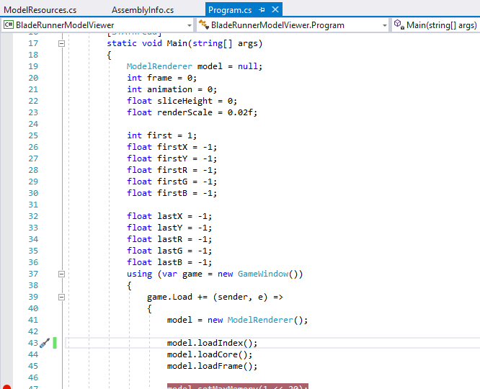
e.g.,

Slide 11
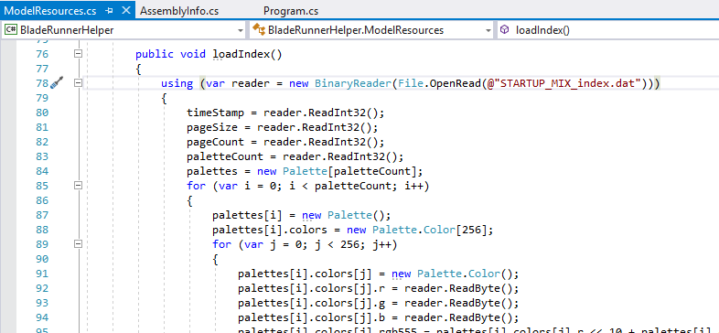
STARTUP_MIX_index.dat (X)

Slide 12
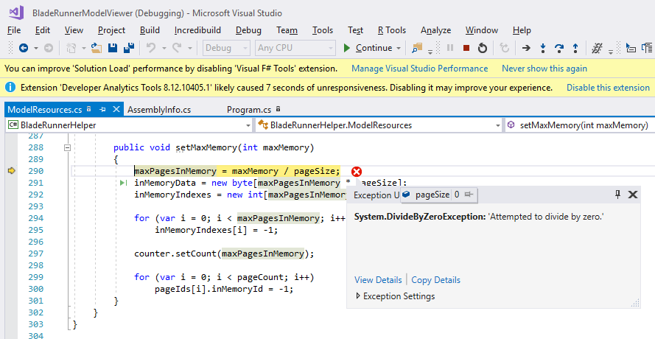
Skip loadIndex() ...? (X)

Slide 13
...
Loading:
COREANIM.DAT => OK
HDFRAMES.DAT => OK
“*MIX_index.dat” supposed to come from Dragon Unpacker 5 tool
Originally for Quake *.pak files

