Slide 1





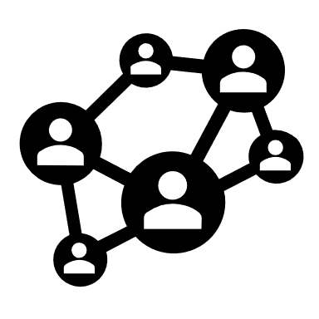

SYMBOL LEGEND
Flask Website (w/ optional cyborg)
A Nameserver
Bing Search APIs
Graph DB
Bc text is distracting.

Slide 2
Flask Website (w/ optional cyborg)
“google.com”
“172.217.14.206”
A Nameserver
1. User enters starting domain & nslookup gets ip addresses.

Slide 3
Flask Website (w/ optional cyborg)
“(domain:’google.com’) --[POINTS_TO]--> (addr: ‘172.217.14.206’)”
Graph DB
2. Flask saves the relationships into Neo4j & updates the visualization.

Slide 4
Flask Website (w/ optional cyborg)
{site1: https://foo.com, site2:…}
{‘q’: ‘ip:172.217.14.206’}
Bing Search APIs
3. Flask queries Bing to get other websites using the same IP address.

Slide 5
Flask Website (w/ optional cyborg)
“foo.com”
A Nameserver
4. Repeat.

