Slide 2
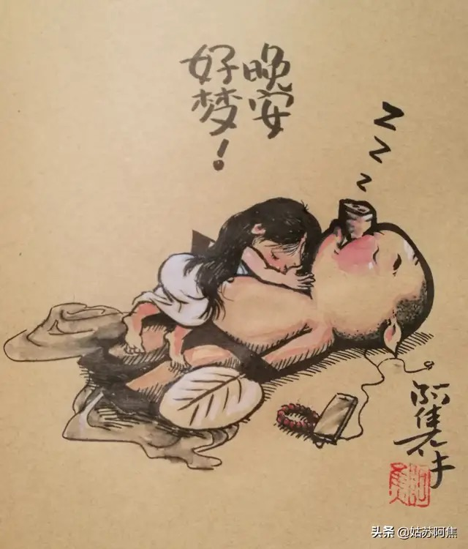
Hello
World!

Slide 3
Hello
World!

