Slide 1
Does exposure to happy-sounding music have an effect on mood?
Tom Ashkenazi, Tres Pimentel, Robert Turnage

Slide 2
Question
People’s music preferences vary widely - pop, metal, folk, etc.
Does happy-sounding music have the effect of making people feel happier / boosting mood?
Happy-sounding defined as “high valence” - Spotify metric

Slide 3
Why is this important?
If happy-sounding music does boost mood, some potential applications include:
Companies playing happy music in stores to make customers happier
Boost purchases in stores?
Comfort customers/patients in stressful environments?
Increase employee performance?
Listen to happy music every day as a form of self care

Slide 4
Hypothesis
In a sense we are testing two hypotheses:
Directly, we are testing the hypothesis that: if someone is exposed to happy-sounding music, it will have a positive effect on their mood
However, we are defining “happy-sounding” as a song with a high valence score from Spotify. In a sense then, we are indirectly testing the validity of this metric.

Slide 5
Past Research
Past studies have shown that listening to happy music can boost mood - when the participant listens to music they enjoy [1] or to happy-sounding music with the goal of boosting mood [2]
Music has been shown to reduce stress, anxiety, and nervousness [3]
Many music-related studies, weirdly, do not involve listening to music - just surveys / interviews
We wanted to test this hypothesis by having people listen to music, rather than just asking their opinions on it
^{[1]} Impact of Music on Mood: Empirical Investigationhttps://www.researchgate.net/publication/285055978_Impact_of_Music_on_Mood_Empirical_Investigation
^{[2]} Trying to be happier really can work: Two experimental studies (https://www.researchgate.net/publication/265086573_Trying_to_be_happier_really_can_work_Two_experimental_studies
^{[3]}Effects of music interventions on stress-related outcomes: a systematic review and two meta-analyses https://www.tandfonline.com/doi/full/10.1080/17437199.2019.1627897?src=recsys

Slide 6
Experiment Design
Valence: musical positivity conveyed by a track (per Spotify)
Treatment: Listening to a 30 second sample from 3 “high-valence” songs
ROXO
Control: Listening to 30 second sample from 3 “low-valence” songs (placebo)
RO-O
We asked a series of questions before and after listening
Main question: How do you feel right now?
Likert scale 1-5
We took the difference of the participant’s answers in the pre and post-listening surveys as the outcome variable

Slide 7
Individuals recruited via convenience sampling and posting to relevant interest forums. Assigned treatment/control upon entering survey
N = 120
Individuals in treatment who answered the first survey and listened to at least 1 song
N = 50
27 individuals did not complete the first survey or listen to at least 1 song
Individuals in control who answered the first survey and listened to at least 1 song
N = 43
Individuals in treatment who finished the survey and listened to all 3 songs
N = 48
4 individuals did not complete the full survey after answering the first (i.e. pre-listening) survey
Individuals in control who finished the survey and listened to all 3 songs
N = 41
Individuals in treatment who met duration requirements* to be considered “fully treated”
N = 33
29 individuals completed the survey in a time under which listening to every song in full is likely impossible
Individuals in treatment who met duration requirements* to be considered “fully treated”
N = 28

Slide 8
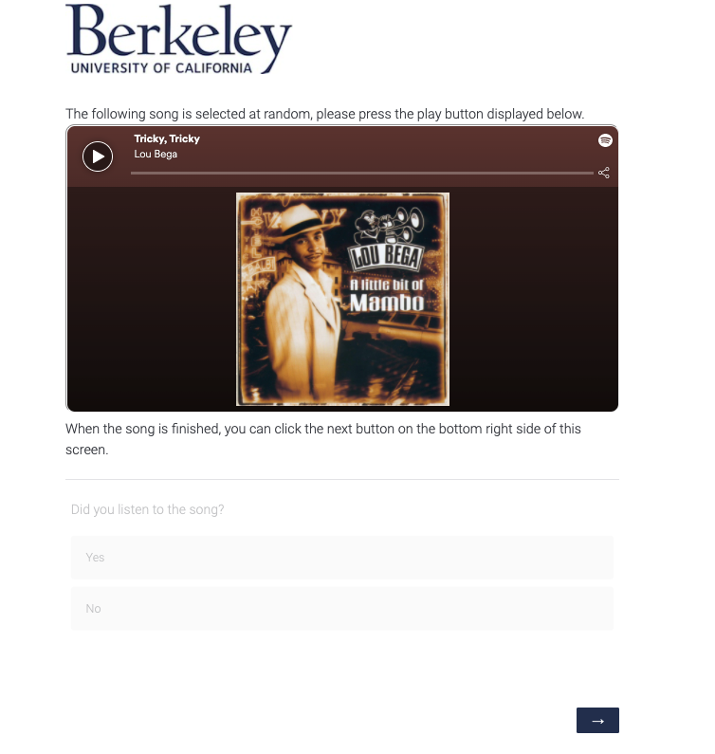

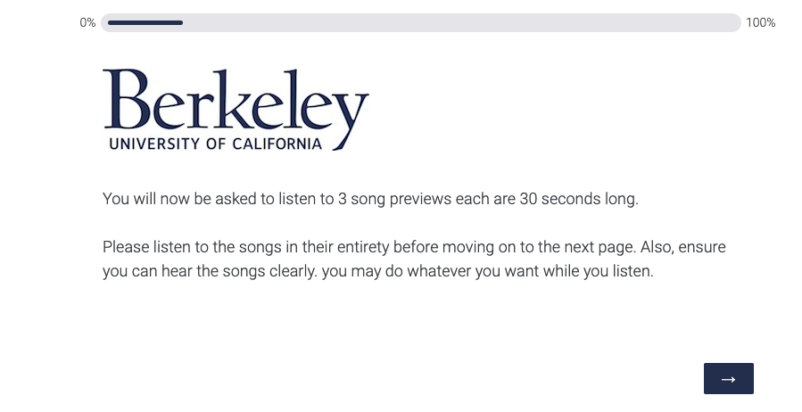
Treatment and Measurement
1
3
2
4

Slide 9
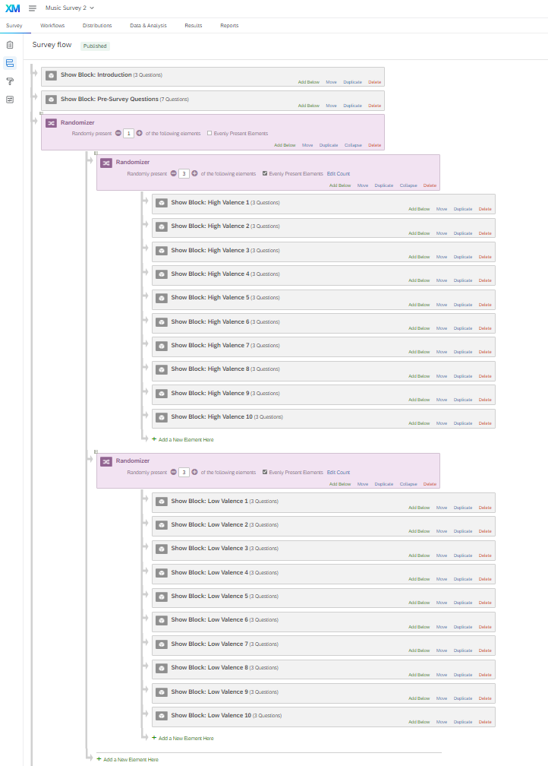
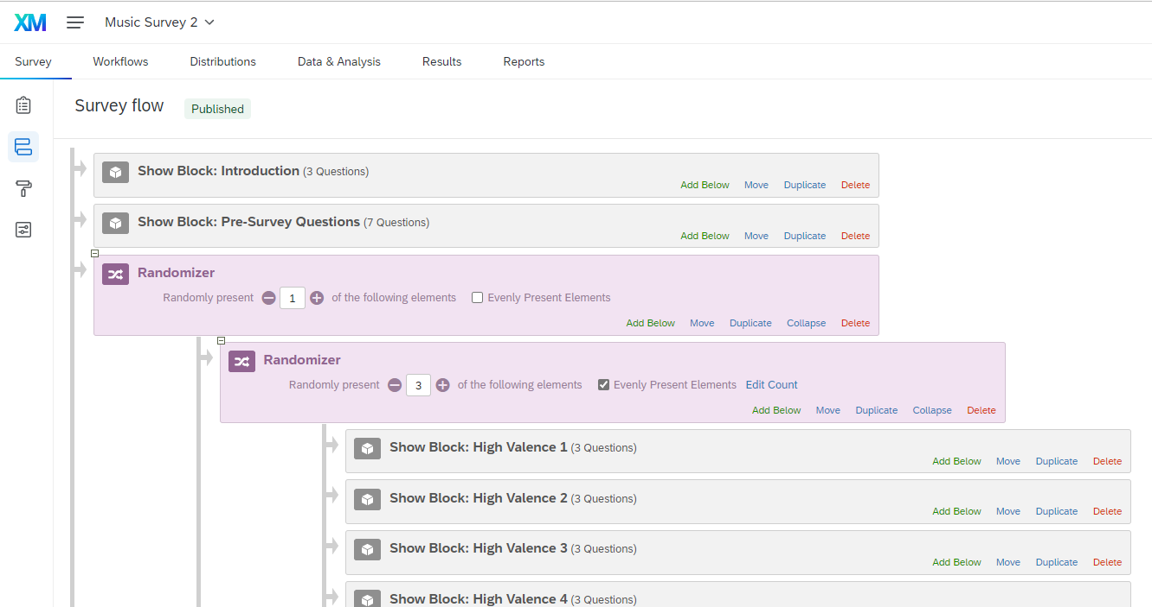
Operationalization
Qualtrics Design Flow

Slide 10
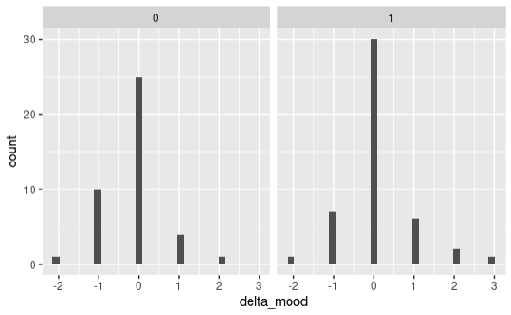
Initial Results
Control
Treatment

Slide 11
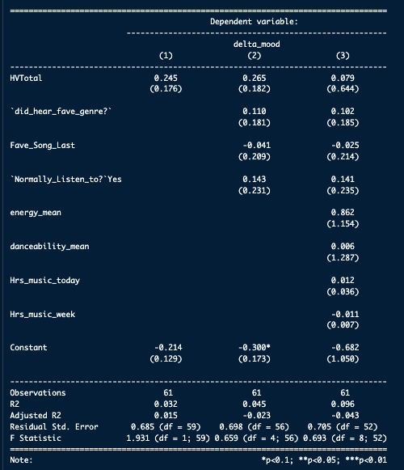
Results
No significant effect sizes / variables!
Effect sizes are very small, with relatively large standard errors
In particular, big standard error inflation of the treatment variable from model 2 -> 3 is primarily caused by inclusion of “energy_mean”
We ran many other models and are happy to share results or answer any questions

Slide 12
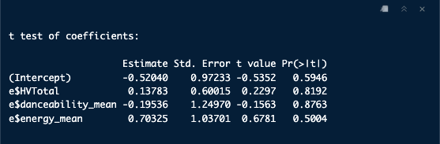
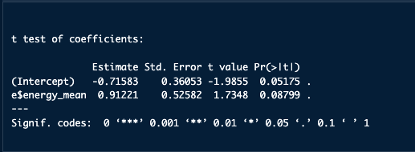
Analysis / Takeaways
Listening to happy-sounding music doesn’t seem to have an effect on mood
Effect essentially disappears with addition of multiple covariates
It seems like high-energy music may have more of an effect?
When regressing using only energy - effect size is pretty big (although insignificant) - ~.91 on a 5 point scale

Slide 13
Analysis / Takeaways
We tested many other covariates:
Did someone hear their favorite genre?
Did someone like the last song the best/least?
How many hours of music had they listened to today?
How many hours of music had they listened to this week?
How had they listened to the music (e.g. through headphones, computer, in car)?
Used as proxy for if they were paying more attention to the music
Would they classify this music as “similar to what they listened to”?
None of these covariates showed any promise in helping detect whether happy-sounding music boosted mood (nor did they show any indication of boosting mood themselves)

Slide 14
Issues
Lack of power
Had difficulty finding relevant research that could inform our power calculation
We estimated effect size would be larger than it actually was - therefore we had less power than we believed
Also, we may have gotten more power using a 10 point likert scale than a 5 point one (how do people think about mood?)
This, compounded with non-compliance issues, greatly decreased our ability to detect an effect (if one existed)

Slide 15
Issues
Recruitment / Non-compliance
We estimate the vast majority of people who took our survey came from convenience sampling - even still took a lot of effort to get people to participate
Ending total participation was 121 observations, reduced to 61 after throwing out participants who did not complete the survey, listen to every song, etc.
5 second / question assumption
As previously mentioned, issues with Qualtrics prevented us from placing many controls that 1. prevented people from skipping songs and 2. reliably detecting if they had done so
We were able to reliably capture:
Did participants answer every question and visit every page?
How long did they spend in the survey in total?

Slide 16
Final Thoughts
Although we didn’t find any significant results - we still think this was worth doing
Hard to find research similar to this
Would like to try this experiment again using lessons learned from this one

