Slide 1
Sobel Filter
IN
OUT
Sobel Kernel :
X direction
 | 0 | 1 | 2 | 3 | 4 | 5 | 6 | 7 | 8 | 9
0
1
2
3
4
5
6
7
8
9
 | 0 | 1 | 2 | 3 | 4 | 5 | 6 | 7 | 8 | 9
0 | 0 | 0 | 0 | 0 | 0 | 0 | 0 | 0 | 0 | 0
1 | 0 |  |  |  |  |  |  |  |  | 0
2 | 0 |  |  |  |  |  |  |  |  | 0
3 | 0 |  |  |  |  |  |  |  |  | 0
4 | 0 |  |  |  |  |  |  |  |  | 0
5 | 0 |  |  |  |  |  |  |  |  | 0
6 | 0 |  |  |  |  |  |  |  |  | 0
7 | 0 |  |  |  |  |  |  |  |  | 0
8 | 0 |  |  |  |  |  |  |  |  | 0
9 | 0 | 0 | 0 | 0 | 0 | 0 | 0 | 0 | 0 | 0
-1 | 0 | 1
-2 | 0 | 2
-1 | 0 | 1
Sobel Kernel :
Y direction
-1 | -2 | -1
0 | 0 | 0
1 | 2 | 1
Each pixel (besides border case) applies stencil pattern to neighbors
Sobel Filter Radius = 1 (1 cell away in each direction), nine (9) neighbors
Border pixels – (don’t have all neighbors) : fill with zero

Slide 2


Sobel Operation
Mathematically, the operator uses two 3×3 kernels which are convolved with the original image to calculate approximations of the derivatives - one for horizontal changes, and one for vertical.
Define A as the source image, and Gx and Gy are two images at each point contain the horizontal and vertical derivative approximations, the computations are as follows:

Slide 3
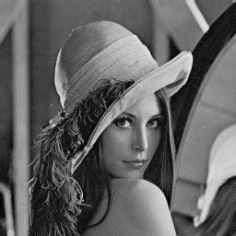
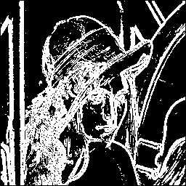
Sobel (Filter Radius =1)
lena.bmp - standard test image is a digital image file used across
different institutions to test image processing and algorithms.

Slide 4
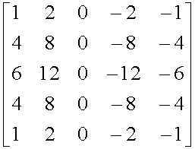
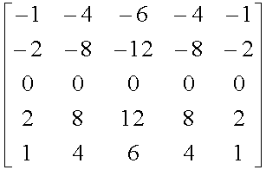
There are numerous filter kernels, for example (Filter Radius = 1):
There are numerous filter kernels, for example (Filter Radius = 3):

Slide 5
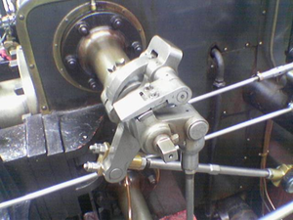
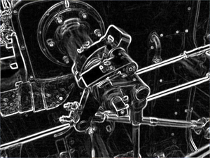
Example Sobel Operation

Slide 6
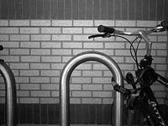
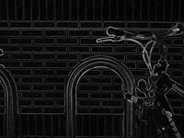
Example Sobel Operation

Slide 7
CPU Implementation
void CPU_Sobel(unsigned char* imageIn, unsigned char* imageOut, int width, int height)
{
int i, j, rows, cols, startCol, endCol, startRow, endRow;
const float SobelMatrix[9] = {-1,0,1,-2,0,2,-1,0,1};
rows = height; cols = width; startCol = 1; endCol = cols -1; startRow = 1; endRow = rows - 1;
// Go through all inner pizel positions
for(i=startRow; i<endRow; i++) {
for(j=startCol; j<endCol; j++) {
// sum up the 9 values to calculate both the direction x and direction y
float sumX = 0, sumY=0;
for(int dy = -FILTER_RADIUS; dy <= FILTER_RADIUS; dy++) {
for(int dx = -FILTER_RADIUS; dx <= FILTER_RADIUS; dx++) {
float Pixel = (float)(imageIn[i*width + j + (dy * width + dx)]);
sumX += Pixel * SobelMatrix[(dy + FILTER_RADIUS) * FILTER_DIAMETER + (dx+FILTER_RADIUS)];
sumY += Pixel * SobelMatrix[(dx + FILTER_RADIUS) * FILTER_DIAMETER + (dy+FILTER_RADIUS)];
}
}
imageOut[i*width + j] = (abs(sumX) + abs(sumY)) > EDGE_VALUE_THRESHOLD ? 255 : 0;
}
}
}
#define FILTER_RADIUS 1
#define FILTER_DIAMETER 3
How
Does
This
Work?
Alternative to sqrt: set output to max(255) or min(0)

Slide 8
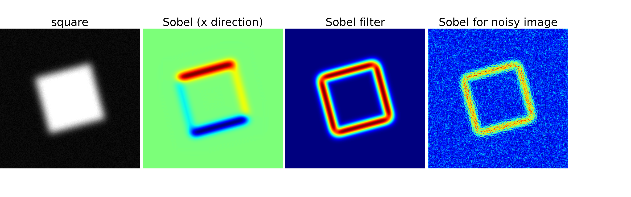
Sobel

Slide 9
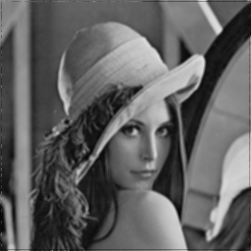
Average

Slide 10
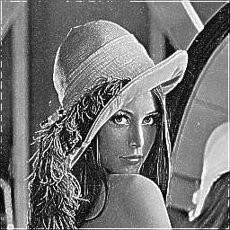
Boost – “Boost” pixels with dull neighbors

Slide 11
CUDA Kernel <<<(3,3),(4,4)>>>
 | 0 | 1 | 2 | 3 | 4 | 5 | 6 | 7 | 8 | 9
0
1
2
3
4
5
6
7
8
9
Array : 10x10
BlockSize : 4x4
Threads : No work
How many blocks? How many total threads?
How many full-working and part-working blocks?
How many total working and not-working threads?

Slide 12
Issues
 | 0 | 1 | 2 | 3 | 4 | 5 | 6 | 7 | 8 | 9
0
1
2
3
4
5
6
7
8
9
Array : 10x10
BlockSize : 4x4
B (1,0)
Each block would have border threads that need neighboring pixel values from other blocks. Ex: Block (1,0) Thread (0,3) needs input from neighbors
Borders of original image as well as excess have to be turned off

Slide 13
Defining Block to Load Shared Memory
 | 0 | 1 | 2 | 3 | 4 | 5 | 6 | 7 | 8 | 9
0
1
2
3
4
5
6
7
8
9
Array : 10x10
Calculate Grid based
on Tile : 4x4
Block : 6x6
Width +2*Filter_Radius
Height +2*Filter_Radius

Slide 14
Defining Block to Load Shared Memory
 | 0 | 1 | 2 | 3 | 4 | 5 | 6 | 7 | 8 | 9
0
1
2
3
4
5
6
7
8
9
Array : 10x10
Calculate Grid based
on Tile : 4x4
Block : 6x6
Width +2*Filter_Radius
Height +2*Filter_Radius

Slide 15
Defining Block to Load Shared Memory
 | 0 | 1 | 2 | 3 | 4 | 5 | 6 | 7 | 8 | 9
0
1
2
3
4
5
6
7
8
9
Array : 10x10
Calculate Grid based
on Tile : 4x4
Block : 6x6
Width +2*Filter_Radius
Height +2*Filter_Radius

Slide 16
Defining Block to Load Shared Memory
 | 0 | 1 | 2 | 3 | 4 | 5 | 6 | 7 | 8 | 9
0
1
2
3
4
5
6
7
8
9
Array : 10x10
Calculate Grid based
on Tile : 4x4
Block : 6x6
Width +2*Filter_Radius
Height +2*Filter_Radius

Slide 17
Defining Block to Load Shared Memory
 | 0 | 1 | 2 | 3 | 4 | 5 | 6 | 7 | 8 | 9
0
1
2
3
4
5
6
7
8
9
BLUE shaded regions
Are only threads
To update output image

Slide 18
Writing kernel
 | 0 | 1 | 2 | 3 | 4 | 5 | 6 | 7 | 8 | 9
0
1
2
3
4
5
6
7
8
9
Eliminate threads from doing any work to output image

