Slide 1
Active Learning for Active Learning
Robbie Weber
PoCSci 2022
Seattle, WA

Slide 2
Active Learning: Some Definitions
Active Learning: Actively select data points to learn a function using as little data as possible.
Active Learning: Actively engage students in their lessons rather than passively presenting content.

Slide 3
Our Question
How do we utilize active learning techniques so that students can learn active learning better?

Slide 4
The Case for Active Learning
Active learning is a proven technique in ML when you have less data.
But it’s hard to understand
Lots of math.
Also for some reason, bandits everywhere. Not sure why they haven’t been captured yet.
Students struggle to learn active learning

Slide 5
Solution: Active Learning
Active learning is a ubiquitous pedagogical tool.
New instructors are often afraid of active learning.
Putting no thought into active learning activities is still enough to do active learning!
And the research says it always works.

Slide 6
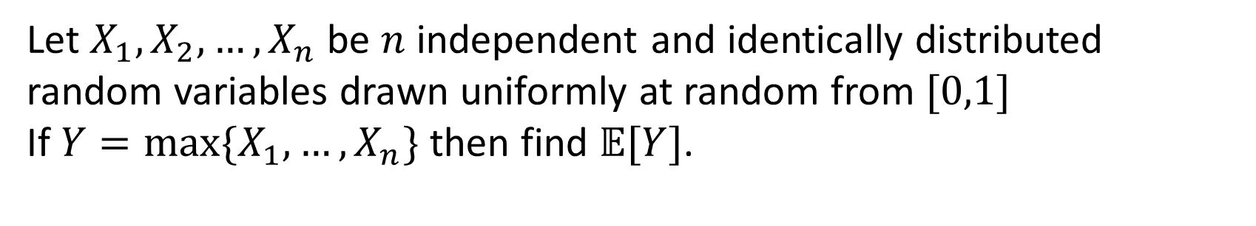
Case Study
Take a homework problem and turn it into a multiple choice poll.
Let $X_{1},X_{2},…,X_{n}$ be $n$ independent and identically distributed random variables drawn uniformly at random from $[0,1]$
If $Y=\max{\{X_{1},…,X_{n}\}}$ then find $𝔼[Y]$.

Slide 7
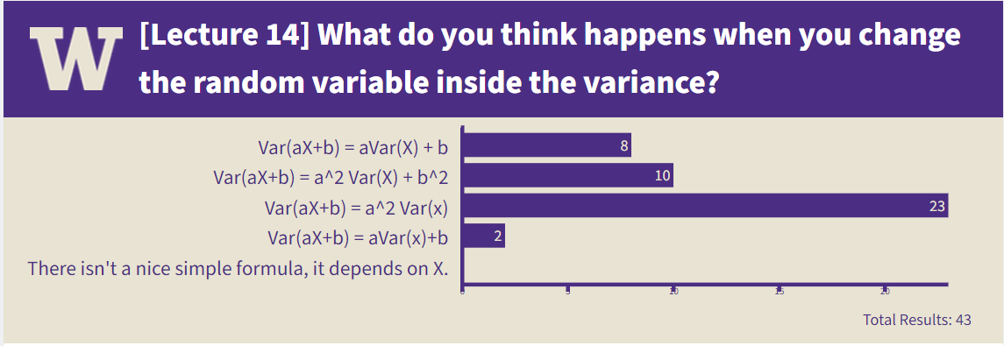




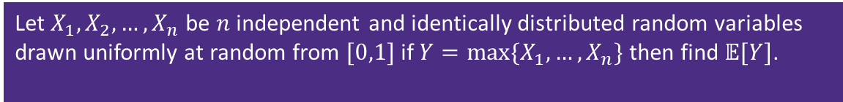
Case Study
Take a homework problem and turn it into a multiple choice poll.
As long as more than 25% get it right, learning has happened!
And if less than 25% get it right, call it a trick question.
Let $X_{1},X_{2},…,X_{n}$ be $n$ independent and identically distributed random variables drawn uniformly at random from $[0,1]$ if $Y=\max{\{X_{1},…,X_{n}\}}$ then find $𝔼[Y]$.
$n/(n+1)$
26
$1/n$
25
$(n−1)/n^{2}$
$1/2$
27
101

Slide 8
More Ideas
Have students execute algorithms themselves.
Wearing masks will let them feel like bandits.
Also make them tie one hand behind their back.
Think-Pair-Share for commentary on research proposals.
Two minutes of skimming and thought should bring more insightful comments than current NeurIPS process.

Slide 9
Figure 1
Effect of Active Learning on Effectiveness of Learning
good
Learner Outcome
bad
less
more
Amount of Active Learning

