Slide 1
A New Branch of Graph Theory
Robbie Weber
Joint work with John Thickstun

Slide 2
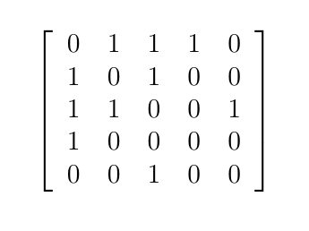
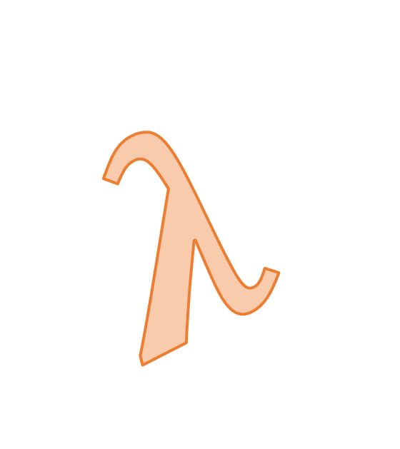
Classical Graph Theory
Spectral Graph Theory
$$λ$$

Slide 3
DEEP
GRAPH THEORY

Slide 4

What is Deep Graph Theory?
Takes graph theory statements out of context, and examines their philosophical implications.

Slide 5
Example: Trees and Forests
Forest: an undirected, acyclic graph.
Tree: an undirected, acyclic, connected graph.

Slide 6

Is It a Tree?

Slide 7
Is It a Forest?

Slide 8
Example: Trees and Forests
Forest: an undirected, acyclic graph.
Tree: an undirected, acyclic, connected graph.

Slide 9
Every tree
is a forest!

Slide 10
Example: Trees and Forests
Forest: an undirected, acyclic graph.
Tree: an undirected, acyclic, connected graph.
We usually think of forests as a bunch of trees
That’s wrong! A single tree, on its own, is a forest.

Slide 11

EVERY TREE IS A FOREST.

Slide 12
Future work
Converting caterpillar graphs into butterfly graphs.
Using the Petersen graph to predict Coach Petersen’s success leading Washington football.
Think of more graph theory jokes non-theorists can understand.

Slide 13
EVERY TREE IS A FOREST.

