Slide 1

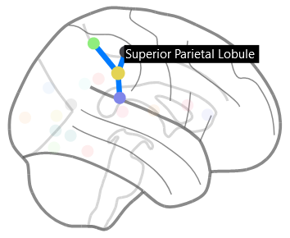
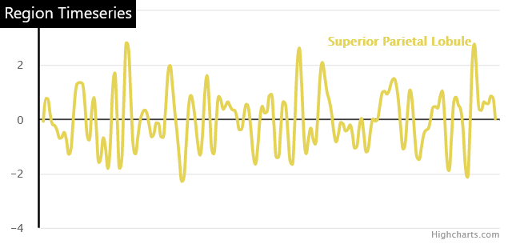
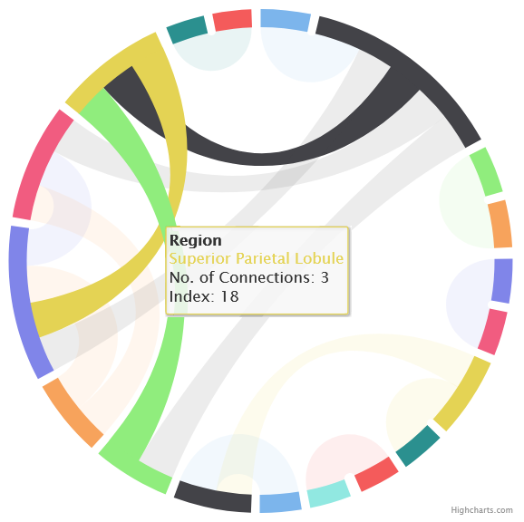
BrainBoard
Mutually Interactive Brain Connectivity Visualisations
Introduction
Implementation
Information Visualisation
BrainBoard is a collection of simple, 2D brain visualisations which afford the viewer a deeper understanding of the complex information contained in the functional MRI scan. Functional MRI is a neuroimaging technique capable of capturing blood flow within the brain over time (BOLD signal). By combining this with structural information, we can compare the synchronicity of signals created by blood flow in particular brain regions, known as BOLD functional connectivity^{[1]}. Visualisations of this nature are of particular interest to neuroscientists as an explorative analysis and validation tool for brain connectivity. Real world region coordinates and connection strengths can be computed and exported from Nilearn^{[2]} into a simple JSON format and uploaded to BrainBoard for visualisation. The plots generated are interactive to encourage exploration of the subject data.
BrainBoard is implemented as a web app using Vue.js for reactivity and a Vue HighCharts wrapper for the dependency wheel and timeseries plots. The orthographical projection plots are a custom implementation using SVG. The background images for each of the plot axes are blank Nilearn assets for their orthographical brain projection plots. All plots are implemented as Vue components for maximum maintainability. For speed and efficiency, JavaScript web workers are utilised to process the imported JSON files.
Design Cont.
…mental workload required to generate quality insights^{[3]}. Individual views are designed to contain as little parallel information as possible so that determining which of the plots contain the desired information and discerning that information is as simple as possible. By separating the data out, users are able to compartmentalise the information much more efficiently, leading to lower time-to-insight.
Interactivity is a vital aspect of BrainBoard because multiple plots build a single cohesive representation of the data. In this system, interactivity is built to be prompt, cohesive and clear and is achieved through careful colour coordination and suppression of unrelated datapoints (Fig. 1, 2). To facilitate region location via their scientific names, tables accompany the plots containing tabulated versions of the region and connection data. These tables also interact with the rest of the system when hovered.
Finally, BrainBoard was built, not only be a functional and insightful visualisation of the human brain, but also to be visually appealing. Visual appeal is an important and often overlooked aspect of information visualisation, particularly in scientific circles^{[4]}. The plots in BrainBoard possess a simple beauty which we believe will improve user engagement and lead to a greater chance of meaningful insight.
Fig. 1
Mutual Interactivity
BrainBoard is designed such that interaction with any of the three visualisations results in a simulated reciprocal interaction in the other two. This has the effect of displaying all three complementary views of some aspect of the data at the same time, strengthening the depth of prospective insights. Colours are synchronised across all three plots to retain visual consistency and accuracy of insights. Fig. 1, 2, 3 are mutually highlighting the Superior Parietal Lobule.
Fig. 3
The Visualisations
Design
c
The most important design decision in BrainBoard was to separate the presented information out into three separate plots which then synchronise during interaction as though they are all one plot. The data is separated out into three logical sections:
Region spatial coordinate data
Connection strength data
BOLD timeseries data
Other visualisations, such as those available in Nilearn, attempt to combine the spatial and connection strength data into a single plot using transparency as an indicator of strength, we argue that this increases the …
BrainBoard employs three simple plots; each providing a complementary view of the imported brain data. The first is an orthographical projection of the brain (Fig. 1), providing vital spatial context for connected regions. The second (Fig. 2) are the connections plotted in a dependency wheel diagram, providing the relative connection strengths between regions. Regions are arcs on the circumference of the plot and connections are chords cutting across the wheel area. The relative strength of the connection is conveyed by the width of its chord. Finally, Fig. 3 is a timeseries plot showing the BOLD (fMRI) signal extracted from the selected region.
Rory Pinkney
References
[1] Ogawa et al. NAS. 1990, 9868-9872
[2] Abraham et al. Frontiers. 2014, 14
[3] Wyeld. IEEE. 2005, 593-598
[4] Moere & Purchase. IV. 2011, 356-371
Fig. 2

