Slide 1

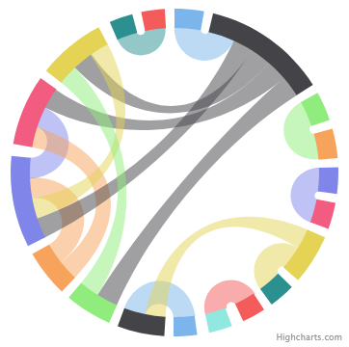
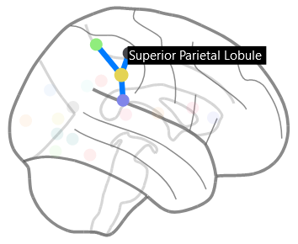

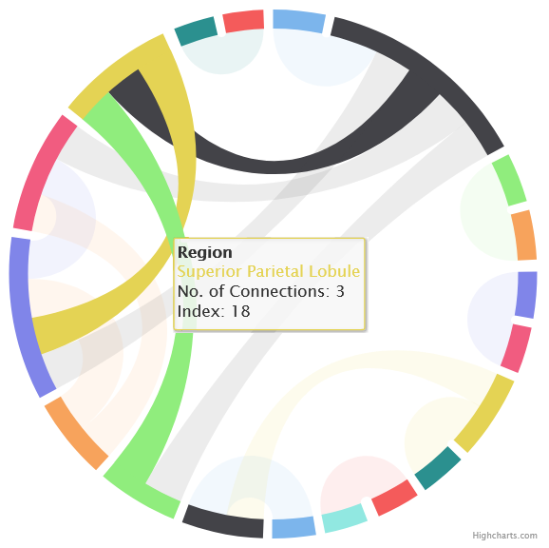
BrainBoard
Mutually Interactive Brain Connectivity Visualisations
Background
Information Visualisation
dsf
Mutual Interactivity
Rory Pinkney
References
[1] Maaten & Hinton. JMLR. 2008, 2579-2605
[2] Baccianella et al. ISDA. 2009, 283-287
[3] Bouckaert & Frank. KDDM. 2004, 3-12
[4] Ballard & Wang. WCICA. 2016, 1021-1026

