Slide 1
Mahout
Introduction to Machine Learning at Scale
by Ryan Tyer
Notes:
Work at Jive Software by way of Filtrbox. What we deal with: Crawling/Parsing/Matching/Searching/Analyzing large sets of data from the web. 200m items a day. Starting to move towards more data mining aspects, such as topic categorization and classification, recommending content that isn’t a strict match, etc

Slide 2
Mahout = ?
A library for Machine Learning at Scale
Notes:
So what is Mahout? <READ SLIDE> But that really doesn’t tell us much. So let’s look a little deeper. It’s an apache project which provides a library to assist with Machine Learning and Data Mining at Scale. NEXT SLIDE

Slide 3
Mahout = ?
A library for Machine Learning at Scale
Notes:
But what does *that* mean. Well, let’s decompose it. Machine Learning and Data Mining. At Scale.

Slide 4
Mahout
http://mahout.apache.org/
In a lot of ways, it’s a big bag of algorithms, plus glue
Alternatives
Mallet (http://mallet.cs.umass.edu/)
Weka (http://www.cs.waikato.ac.nz/~ml/weka/index.html)
OpenNLP (http://incubator.apache.org/opennlp/)
Plain ol’ statistics
Notes:
Required info for any mahout talk ☺ The name Mahout (rhymes with trout) means elephant driver. One of Mahout’s way’s of scaling that we’ll get to is to make use of a hadoop cluster, hence the name. In fact, if you have used mahout before, the variants on algorithms that run on hadoop are often called drivers.
Describing it as such also undersells the work done to structure algorithms under common interfaces and make many of the algos scale to hadoop easily.

Slide 5
Machine Learning
A class of algorithms which allows computers to recognize patterns, make decisions and evolve behavior from data.
(http://en.wikipedia.org/wiki/Machine_learning)
Notes:
Understanding ML algorithms, at least at a high level, is important to using Mahout.

Slide 6
Machine Learning
Recommendations
Clustering
Classification
Pattern Detection
Notes:
So what kind of things can you do with Machine Learning? This is *not* all of what ML covers, but it is a lot of what Mahout deals with.

Slide 7
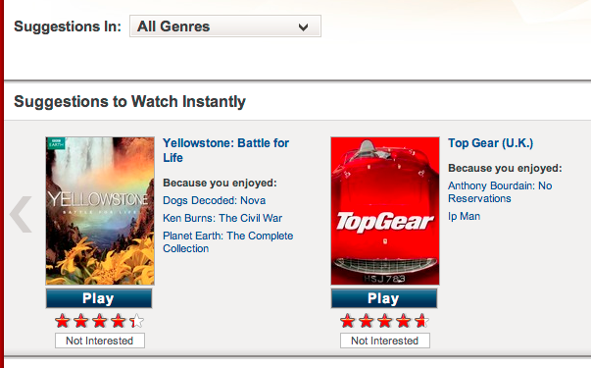
Recommendations

Slide 8
Recommendations
Suggesting something to someone based on similarity.
Collaborative filtering:
Given User A likes [X,Y,Z]
And User B likes [Z,Y]
Then User B may like X
Content based recommendations
You liked an action movie starring Brad Pitt. Here are other Brad Pitt action movies you haven’t seen.
Notes:
CF uses similarity between users or similarity between items but without taking the underlying content into play. If you only need ids of items, it’s likely CF.
Content based reco DOES make use of the underlying content (author, director, genre, etc)
Item based often better for performance due to decreased volatility. User set size vs Item set size also a factor.

Slide 9
Clustering
Unsupervised Learning
Grouping things together, based on similarity, until there are distinct groups.
Examples:
Find similar users on a social networking site, regardless of affiliation
Identify dominant topics/terms from a set of documents

Slide 10
Clustering – How?
Convert data to series of N dimensional vectors
Populate them based on features of the data
Identify clusters of vectors
Flat/exclusive clustering (K-Means)
Hierarchical
Overlapping (Fuzzy K/C-Means)
Generative Algos (Dirichlet/LDA)

Slide 11
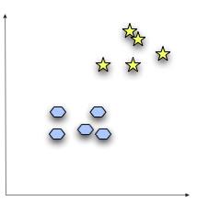
Clustering

Slide 12
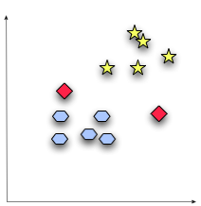
Clustering – Centroids

Slide 13
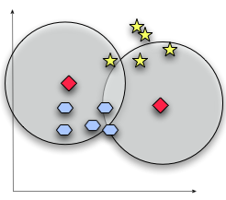
Clustering – Mid-iterations

Slide 14
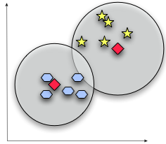
Clustering - Final

Slide 15
Classification
Learning algorithms that make a decision on a set of data
Commonly, a model is created by training it against a set of known data
Naïve bayes
Decision Trees
SGD
Examples:
Spam detection
Language identification
Fraud detection
Sentiment identification

Slide 16
Classification – How?
Prepare/acquire training data; Data with known answer to question.
Ex: Large set of emails correctly identified as spam
Define predictors (spam words, known senders, etc)
Train appropriate algorithm to produce a model
Evaluate model with test data, repeat until happy with result
Profit!

Slide 17
Mahout: Scale
They mean Hadoop, right?
Yes. Well, no. Kind of?

Slide 18
What Mahout Provides
Highly optimized data structures (for memory and performance of very specific tasks)
Vector:
DenseVector
RandomAccessSparseVector
SequentialAccessSparseVector
GenericPreference and PreferenceArray
FastByIDSet and FastByIDMap
FastByIDMap uses 28 byes/entry vs 84 bytes/entry for HashMap
Notes:
All their data structures and algorithms are highly tuned for the specific approach they’re going for. Multiple implementations of classes are offered, such as RandomAccessSparseVector, for specific conditions.
Reduced memory/increased performance based on assumptions of usage for where they’re used

Slide 19
What Mahout Provides (cont)
Scalable Algorithms
Batch (offline) Collaborative Filtering, Clustering, Classification algorithms are all M/R based
Other algorithms can be run pseudo-distributed to distribute compute cost
Easy to start on single node and move right on to running on a cluster
RecommenderJob/Drivers
Notes:
All their data structures and algorithms are highly tuned for the specific approach they’re going for. Multiple implementations of classes are offered, such as RandomAccessSparseVector, for specific conditions.

Slide 20
What Mahout Provides (cont)
Helper classes to integrate Hadoop and Mahout
VectorWritable
MahoutDriver
SequenceFilesFromDirectory
SparseVectorsFromSequenceFiles
Most of the common actions are wrapped by the bin/mahout script

Slide 21
What Mahout Provides (cont)
Common interfaces for algorithms
Allows modular composition
Easy to replace algorithm implementations
Ex – Drop in replacement for DistanceMeasure
EuclidianDistanceMeasure
ManhattanDistanceMeasure
CosineDistanceMeasure

Slide 22
What Mahout Provides (cont)
Easy ability to assess performance of algorithms
Recommenders:
RecommenderEvaluator
RecommenderIRStatsEvaluator
Clustering: ClusterDumper
Classification: Classifier Evaluation API
Auc
OnlineAuc
OnlineSummarizer
More…

Slide 23
Demo A
Intro to Recommendations on GroupLens Data
Inspired by Mahout in Action, Mahout example apps, etc

Slide 24
Demo B
BooleanPreference Twitter User Recommender
Going from idea to impl

Slide 25
Thanks
Ryan Tyer
<firstname>.<lastname>@[gmail|jivesoftware].com
@rtyer

