Slide 1
Socket programing with OpenSSL
TA: 李鴻鈞
2016/12/8

Slide 2
Overview
Introduction to OpenSSL
Installation of OpenSSL
Generate Key Pairs and Certificates
SSLSocket Programming Assignment
Reference
Appendix

Slide 3
Overview
Introduction to OpenSSL
Installation of OpenSSL
Generate Key Pairs and Certificates
SSLSocket Programming Assignment
Reference
Appendix

Slide 4
Introduction to OpenSSL
OpenSSL is open source project implements the main cryptographic operations
Also implement SSL/TLS protocols.
OpenSSL is a C library, available on many platforms
Windows/Linux/BSD/MacOS
OpenSSL has powerful command line tool^{【1】}
openssl command [command_opts][command_args]
【1】OpenSSL office documents https://www.openssl.org/docs/apps/openssl.html

Slide 5
Overview
Introduction to OpenSSL
Installation of OpenSSL
Generate Key Pairs and Certificates
SSLSocket Programming Assignment
Reference
Appendix

Slide 6
Installation of openSSL
For Windows^{【2】}
choose Win32 OpenSSL v1.0.1j (suggested)
http://slproweb.com/products/Win32OpenSSL.html
For Linux(ex:ubuntu)
apt-get install openssl & apt-get install libssl-dev
Or ,you can download source from https://www.openssl.org/source/
For MacOS
Install and update version of OpenSSL on Mac OS X
http://itouchs.blogspot.tw/2012/04/installing-updated-version-of-openssl.html
【2】 See Appendix 1. Install OpenSSL on windows

Slide 7
Overview
Introduction to OpenSSL
Installation of OpenSSL
Generate Key Pairs and Certificates
SSLSocket Programming Assignment
Reference
Appendix

Slide 8
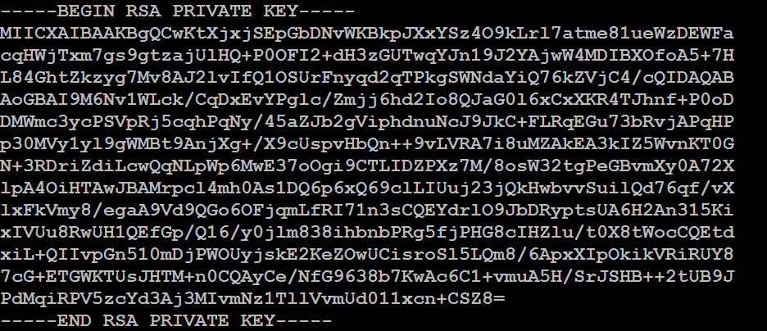
Generate Key Pairs
Steps to generate a pair of public/private key.
Create a pair of RSA key of 1024 bits.
openssl genrsa -out private.pem 1024

Slide 9
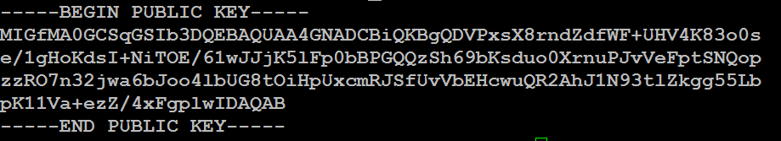
Generate Key Pairs
2. Use private key to export the public key
openssl rsa -in private.pem -out public.pem -outform PEM -pubout
Now, you have a pair of private key (private.pem) and public key (public.pem) . You can use them to encrypt/decrypt a file^{【3】}
【3】 See Appendix 2. Encryption / Decryption a file

Slide 10
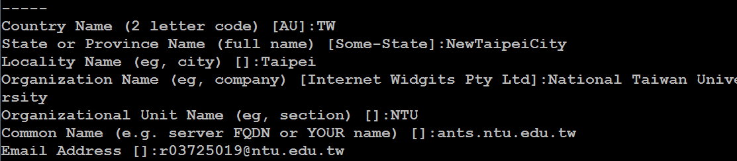
Generate Self-signed Certificate ( )
We need to generate a self-signed certificate
Because we don't plan on having our certificate signed by CA (cost $$)
We only wish to test our SSL implementation
openssl req -x509 -nodes -days 365 -newkey rsa:1024 -keyout mykey.pem -out mycert.pem

Slide 11
Overview
Introduction to OpenSSL
Installation of OpenSSL
Generate Key Pairs and Certificates
SSL Socket Programming
Reference
Appendix

Slide 12
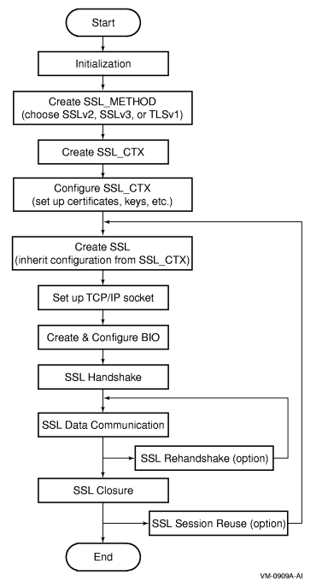
Overview of SSL Application with OpenSSL APIs
Set up socket in the ssl structure

Slide 13
Initialization
Before you can call any other OpenSSL APIs in the SSL application programs, you must perform initialization using the following SSL APIs.
SSL_library_init()
/*用來載入SSL的加密及解密演算法*/
SSL_load_error_strings()
/*載入相關的error message string*/

Slide 14
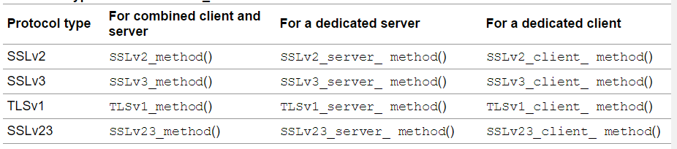
Creating and Setting Up the SSL Context Structure (SSL_CTX)
Example:
const SSL_METHOD *meth;
SSL_CTX *ctx;
meth = SSLv3_method();
ctx = SSL_CTX_new(meth);

Slide 15
Setting up the Certificate and key
Loading a Certificate
SSL_CTX_use_certificate_file()
/*將certificate 載入前面步驟生成的SSL_CTX structure中*/
Load a Private key
SSL_CTX_use_PrivateKey_ASN1()
SSL_CTX_use_PrivateKey_file()
/*以上的APIs將生成的private key 載入SSL_CTX structure中*/

Slide 16
Example
if ( SSL_CTX_use_certificate_file(ctx, CertFile, SSL_FILETYPE_PEM) <= 0 ) //set the local certificate from CertFile
{
ERR_print_errors_fp(stderr);
abort();
}
if ( SSL_CTX_use_PrivateKey_file(ctx, KeyFile, SSL_FILETYPE_PEM) <= 0 ) //set the private key from KeyFile
{
ERR_print_errors_fp(stderr);
abort();
}
if ( !SSL_CTX_check_private_key(ctx) ) //verify private key
{
fprintf(stderr, "Private key does not match the public certificate\n");
abort();
}

Slide 17
Creating and Setting Up the SSL Structure
Call SSL_new() to create an SSL structure. Information for an SSL connection is stored in the SSL structure. The protocol for the SSL_new() API is as follow:
SSL *ssl;
ssl = SSL_new(ctx); //將ssl context structure (ctx)作為參數

Slide 18
Creating and setting up the Socket -On the Server
listen_sock = socket(PF_INET, SOCK_STREAM, IPPROTO_TCP);
CHK_ERR(listen_sock, "socket");
memset(&sa_serv, 0, sizeof(sa_serv));
sa_serv.sin_family = AF_INET;
sa_serv.sin_addr.s_addr = INADDR_ANY;
sa_serv.sin_port = htons(s_port); /* Server Port number */
err = bind(listen_sock, (struct sockaddr*)&sa_serv,sizeof(sa_serv));
CHK_ERR(err, "bind");
/* Receive a TCP connection. */
err = listen(listen_sock, 5);
CHK_ERR(err, "listen");

Slide 19
Creating and setting up the Socket -On the Client
sock = socket(AF_INET, SOCK_STREAM, IPPROTO_TCP); CHK_ERR(sock, "socket");
memset (&server_addr, '\0', sizeof(server_addr)); server_addr.sin_family = AF_INET; server_addr.sin_port = htons(s_port); /* Server Port number */ server_addr.sin_addr.s_addr = inet_addr(s_ipaddr); /* Server IP */ err = connect(sock, (struct sockaddr*) &server_addr, sizeof(server_addr)); CHK_ERR(err, "connect");

Slide 20
Setting Up the Socket in the SSL Structure
After you create the SSL structure and the TCP/IP socket (sock), you must configure them so that SSL data communication with the SSL structure can be performed automatically through the socket.
Using SSL_set_fd() APIs to assign socket to ssl
SSL_set_fd(ssl, sock)

Slide 21
SSL handshake
The SSL handshake is a complicated process that involves significant cryptographic key exchanges. However, the handshake can be completed by calling SSL_accept() on the SSL server and SSL_connect() on the SSL client.
SSL_connect(ssl) //Client side
SSL_accept(ssl) //Server side

Slide 22
Data Communication
To send data over the SSL connection, call SSL_write(). The data to be sent is stored in the buffer specified as a second argument. For example:
To read data sent from the peer over the SSL connection, call SSL_read(). The received data is stored in the buffer specified as a second argument. For example:
SSL_write(ssl, wbuf, strlen(wbuf));
SSL_read(ssl, rbuf, sizeof(rbuf)-1)

Slide 23
SSL Closure
When you finish an SSL application program, the major task is to free (deallocate) the data structures that were created and used in the application program.
SSL_free(ssl); // release connection state
After free the ssl structure,close the socket and free SSL context structure(ctx)
close(sock); // close socket
SSL_CTX_free(ctx); // release context

Slide 24
References
SSL Programing Tutorial
https://www.openssl.org/docs/apps/openssl.html
OpenSSL Office site
https://www.openssl.org/docs/apps/openssl.html
Terry : Use OpenSSL to generate key pairs
http://goo.gl/oS4N15
OpenSSL - 金鑰與憑證的管理
http://ijecorp.blogspot.tw/2014/03/openssl.html
Stack overflow
http://stackoverflow.com/questions/11705815/client-and-server-communication-using-ssl-c-c-ssl-protocol-dont-works
Secure Server Client using OpenSSL in C
http://simplestcodings.blogspot.tw/2010/08/secure-server-client-using-openssl-in-c.html
University of Utah – Network Programming
http://www.cs.utah.edu/~swalton/listings/sockets/programs/

Slide 25
THANK YOU

Slide 26
Appendix 1 Install OpenSSL on windows
Preparation work
On Windows, you have first installed Microsoft Visual C++ 2008 Redistributable Package (x86)
Download source http://www.microsoft.com/en-us/download/details.aspx?id=29
Double click vcredist_x86.exe, and 【Next】->【Next】->【Finish】
Then install openssl

Slide 27
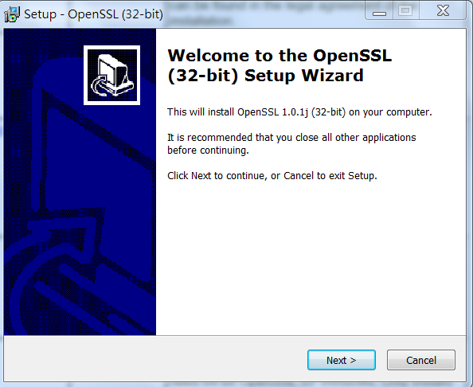
Install openSSL on Windows

Slide 28
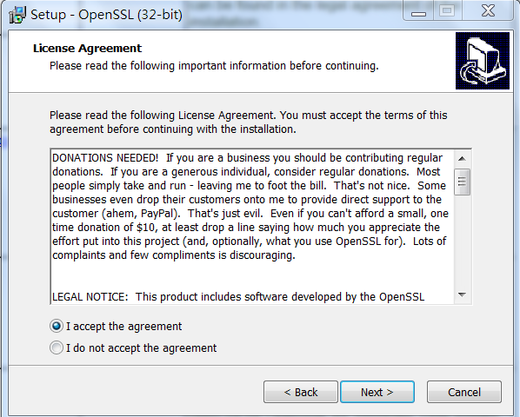
Install openSSL on Windows

Slide 29
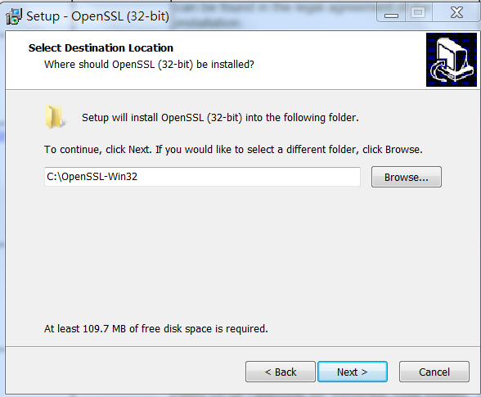
Install openSSL on Windows

Slide 30
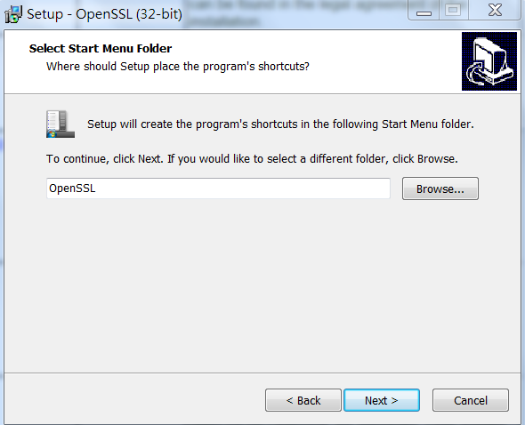
Install openSSL on Windows

Slide 31
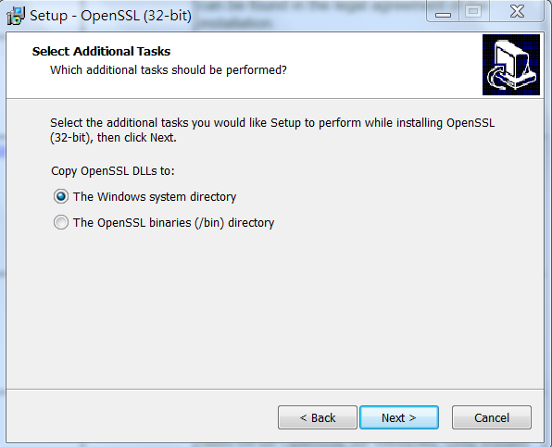
Install openSSL on Windows
Choose 【The Windows system directory】

Slide 32
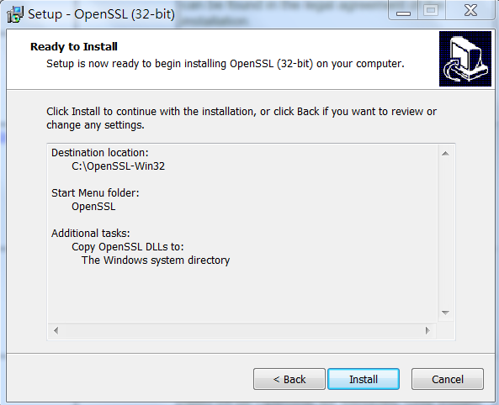
Install openSSL on Windows

Slide 33
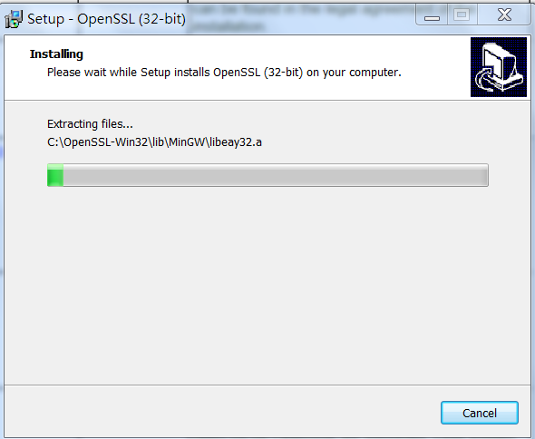
Install openSSL on Windows

Slide 34
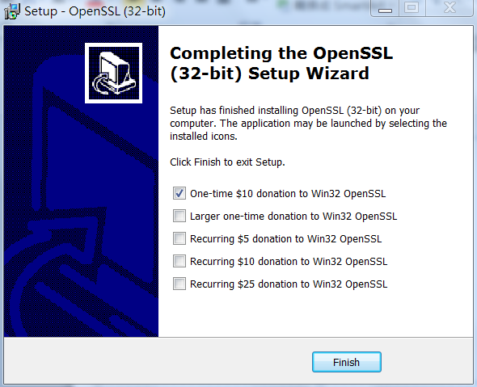
Install openSSL on Windows
Just click【Finish】, ignore the donation to OpenSSL !

Slide 35
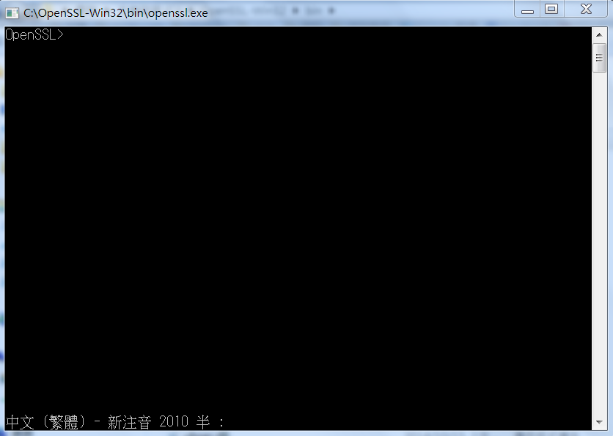
Install openSSL on Windows
If you don’t change the default installation path
The openssl terminal will reside in
C:\OpenSSL-Win32\bin\openssl.exe
Then you can use it to start generate key pairs

Slide 36
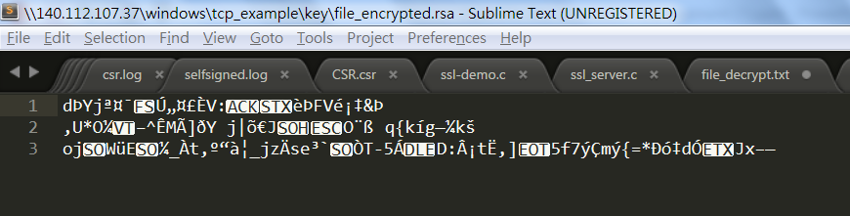
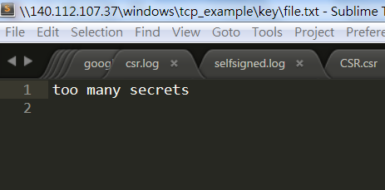
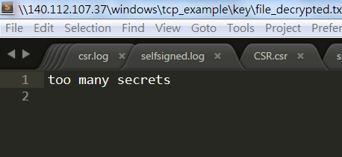
Appendix 2 Encryption / Decryption a file
If you want to encrypt & decrypt a file (file.txt).You can follow steps below.
Use your public key to encrypt file (encrypted file : file_encrypted.rsa)
Use your private key to decrypt it and get the original contents
openssl rsautl -encrypt -inkey public.pem -pubin -in file.txt -out file_encrypted.rsa
openssl rsautl -decrypt -inkey private.pem -in file_encrypted.rsa -out file_decrypted.txt

