Slide 1
Modeling E. huxleyi 379 and Sulfitobacter D7
Jackson Page-Roth

Slide 2
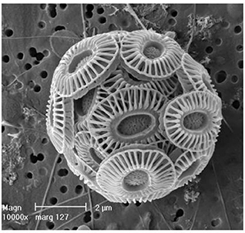
Emiliania huxleyi
(now Gephyrocapsa huxleyi)
Most abundant coccolithophore in the ocean
Massive annual blooms
Important in global carbon and sulfur cycling
Produces DMSP intracellularly
Neukermans and Fournier (2018)

Slide 3
Sulfitobacter D7
Part of the Roseobacter clade
Some Sulfitobacters are commensal or even reciprocal with E. huxleyi
D7 is pathogenic in certain conditions

Slide 4
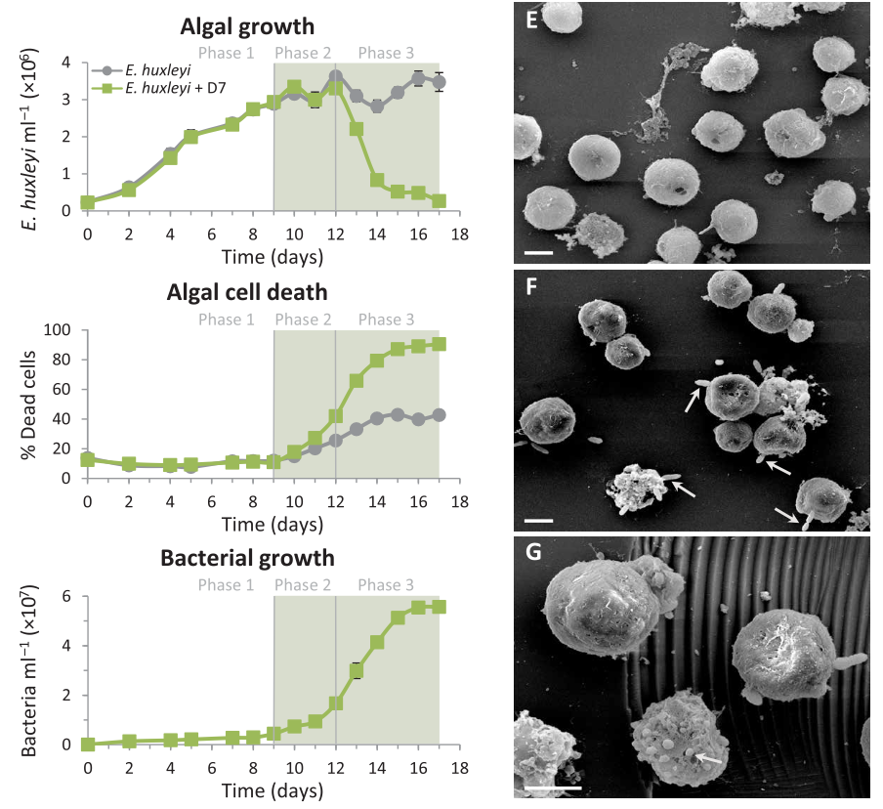
D7 pathogenicity to
E. huxleyi
Barak-Gavish, et al. (2018)

Slide 5
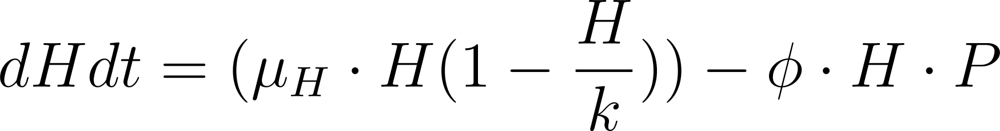
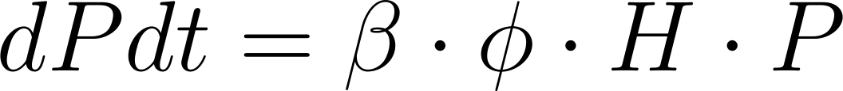

Modeling equations
H: host conc. (E. huxelyi) P: pathogen conc. (D7) B: bacteria conc. (all other bacteria)
mu: growth rate k: carrying capacity phi: interaction coefficient beta: “burst” size
Notes:
H = Malthusian + carrying capacity - host predator interactions

Slide 6
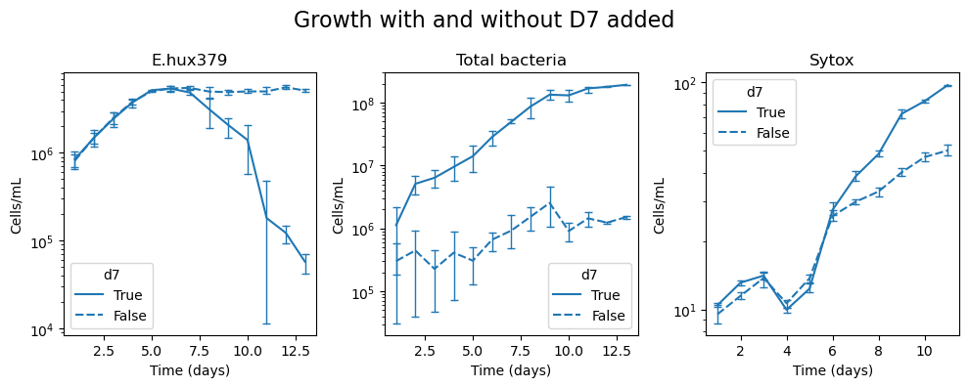
E. huxelyi 379 growth
Total bacteria = P+D (from previous slide)

Slide 7
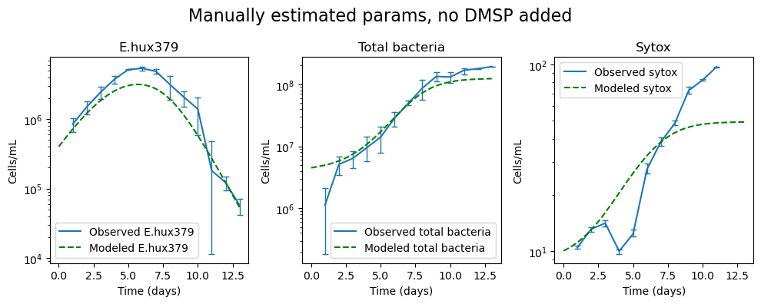
Estimating params

Slide 8
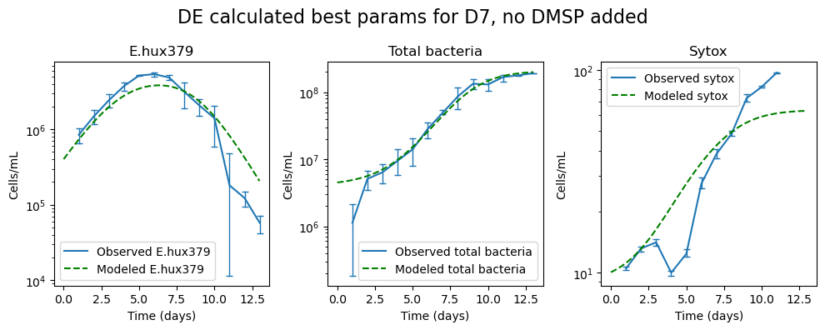
Refining the model with DE
Best parameters: phi: 7.10e-09, beta: 20.82
Normalized mean squared errors (MSE): 0.031

Slide 9
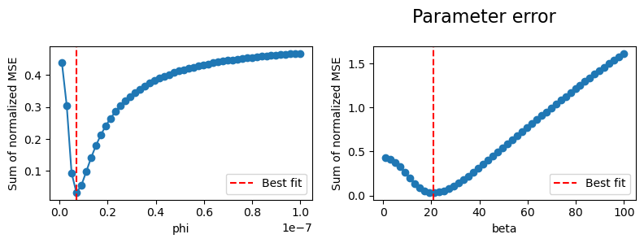
Parameter error

Slide 10
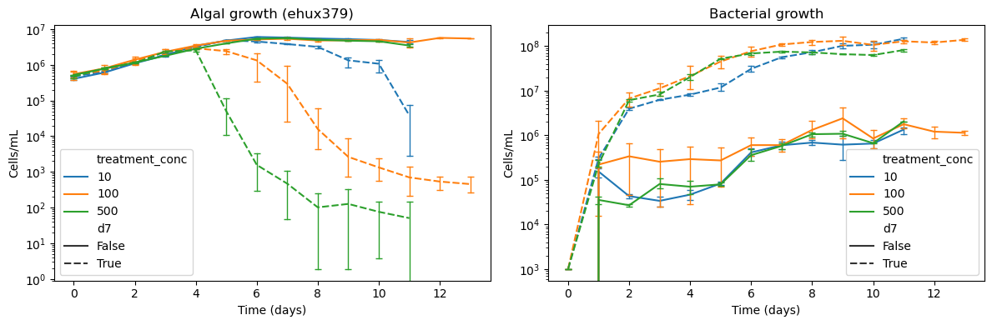
Interaction rate changes based on DMSP released at death?

Slide 11
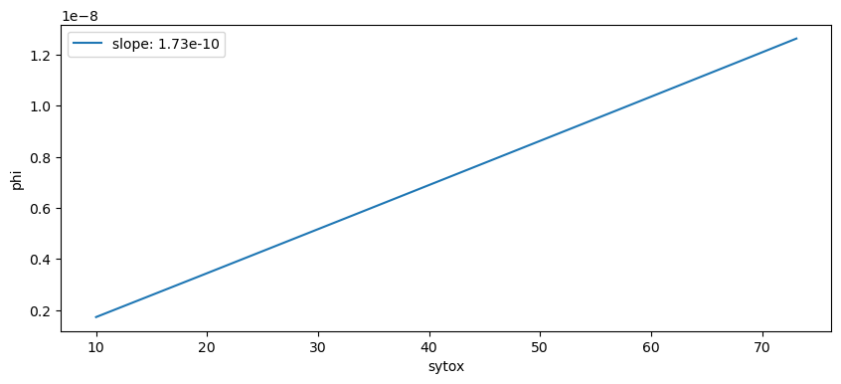
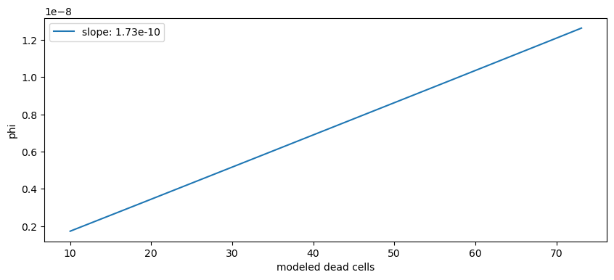
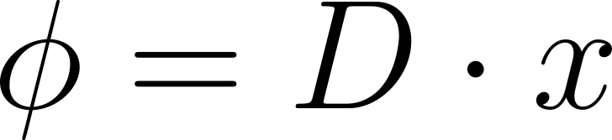
Linear phi function

Slide 12
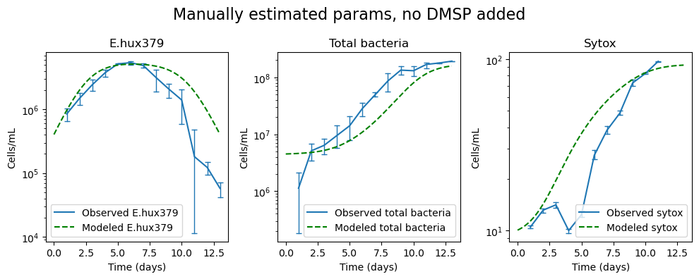
Estimating params

Slide 13
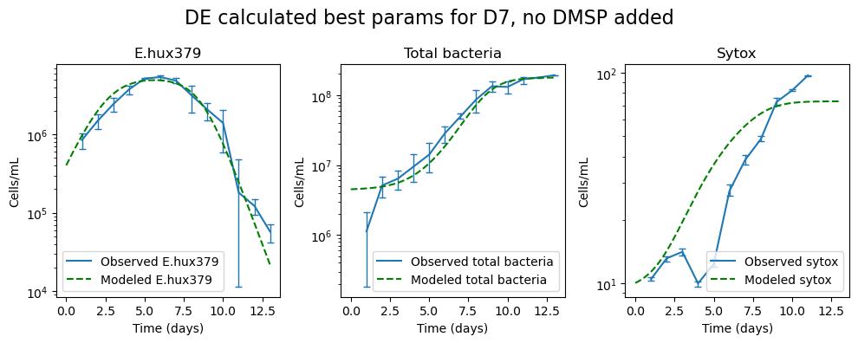
Refining the model with DE
Best parameters: x: 1.72e-10), beta: 16.76
Normalized mean squared errors (MSE): 0.017

Slide 14
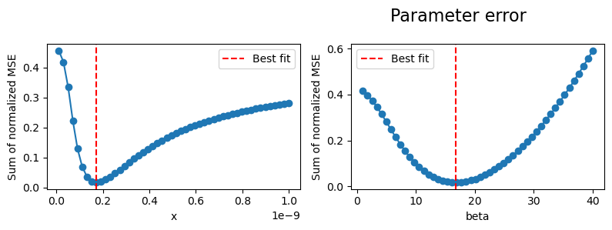
Parameter error

Slide 15
DMSP cell quotas
0.8 pg DMSP/cell * 1ug/10^6pg = 8*10-7 ug DMSP/cell
DMSP molar mass: 134.1967g/mol
10 umol/L(uM) DMSP * 134.1967ug/umol = 1.34*10^3 ug/L
100 umol/L(uM) DMSP * 134.1967ug/umol = 1.34*10^4 ug/L
500 umol/L(uM) DMSP * 134.1967ug/umol = 6.7*10^4 ug/L
1.8*10^6 cells/mL * 8*10-7 ug DMSP/cell
10^8 cells/L * 8*10-7 ug DMSP/cell = 80 ug DMSP/L

Slide 16
Questions
Added DMSP compared to dead cells released DMSP
Adding phages and E. hux 2090
Background bacterial community

Slide 17
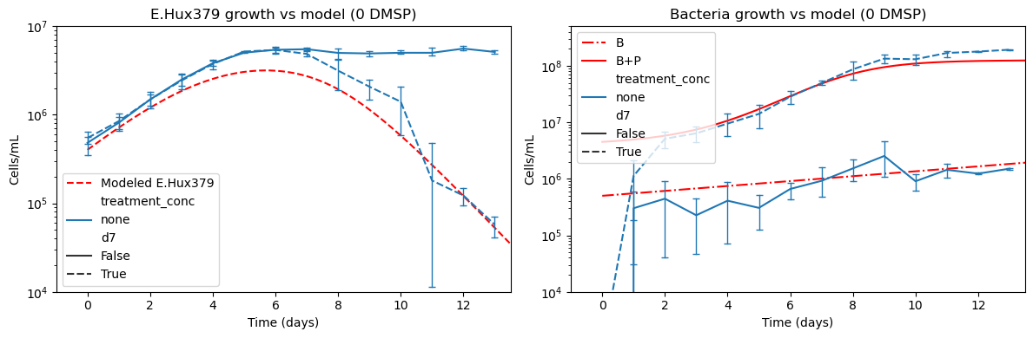

Slide 18
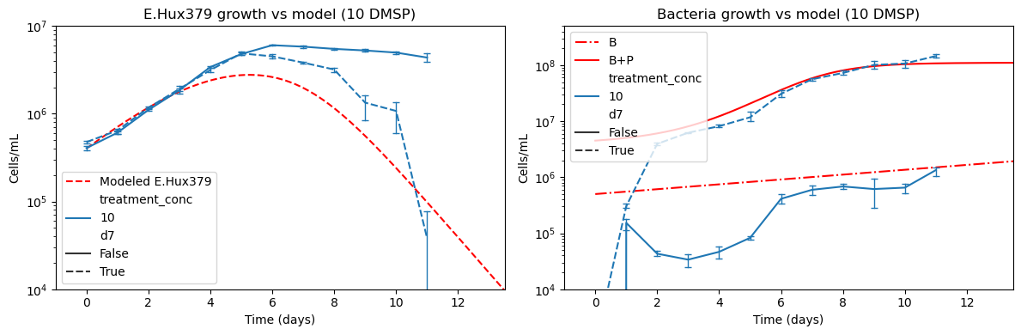

Slide 19
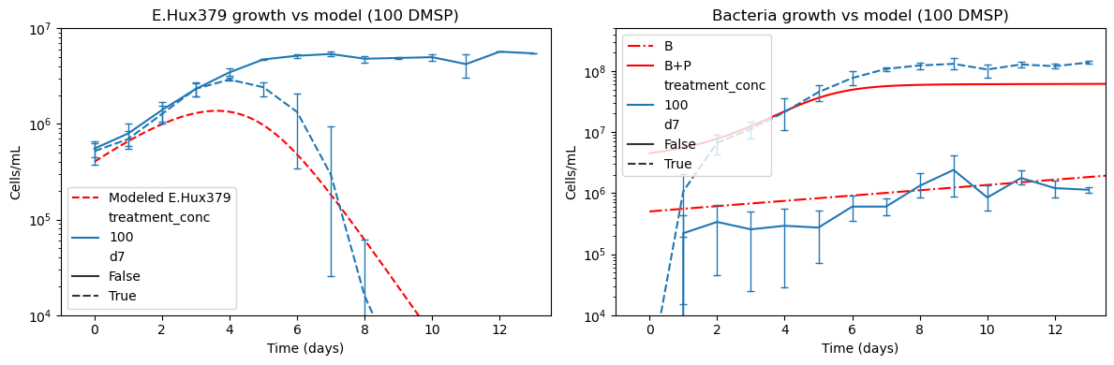

Slide 20
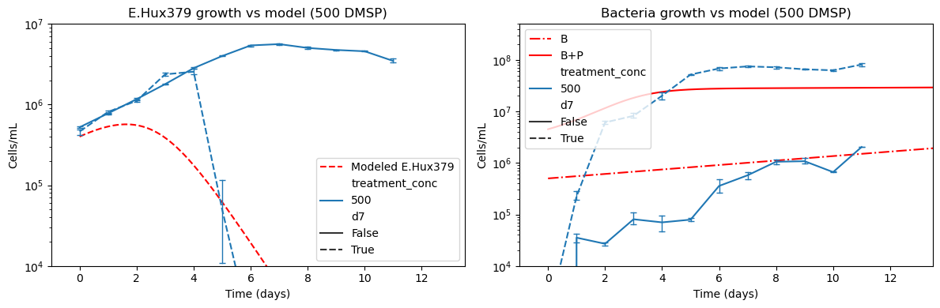

Slide 21
