Slide 1
VIVOUCH / W5
Release candidate ready for W6
10.0
internal readiness
Acceptance, security, evidence and release decision · 21 July 2026

Slide 2
The candidate clears every technical gate
TECHNICAL GO
179/179
20/20
Proceed to W6 development. Keep the release tag on hold until all four owners sign the same frozen candidate.
backend tests
frontend tests
10
0
database migrations
runtime dependency vulnerabilities
P0 = 0 · P1 = 0 · Known limitations retained · No tag before sign-off
ViVouch · W5 Acceptance & Security
02

Slide 3
All 20 W5 tasks now have a verifiable disposition
20 / 20
D1
D2
D3
D4
D5
Scope + rubric
Security + RBAC
Core flows
Regression
Decision
Complete with code, test evidence, documentation, or an explicit non-release limitation. No silent waiver remains.
Closed scope gaps
two-step redeem · branch CRUD · CMS · filters · review eligibility · auth recovery · audit context
ViVouch · W5 Acceptance & Security
03

Slide 4
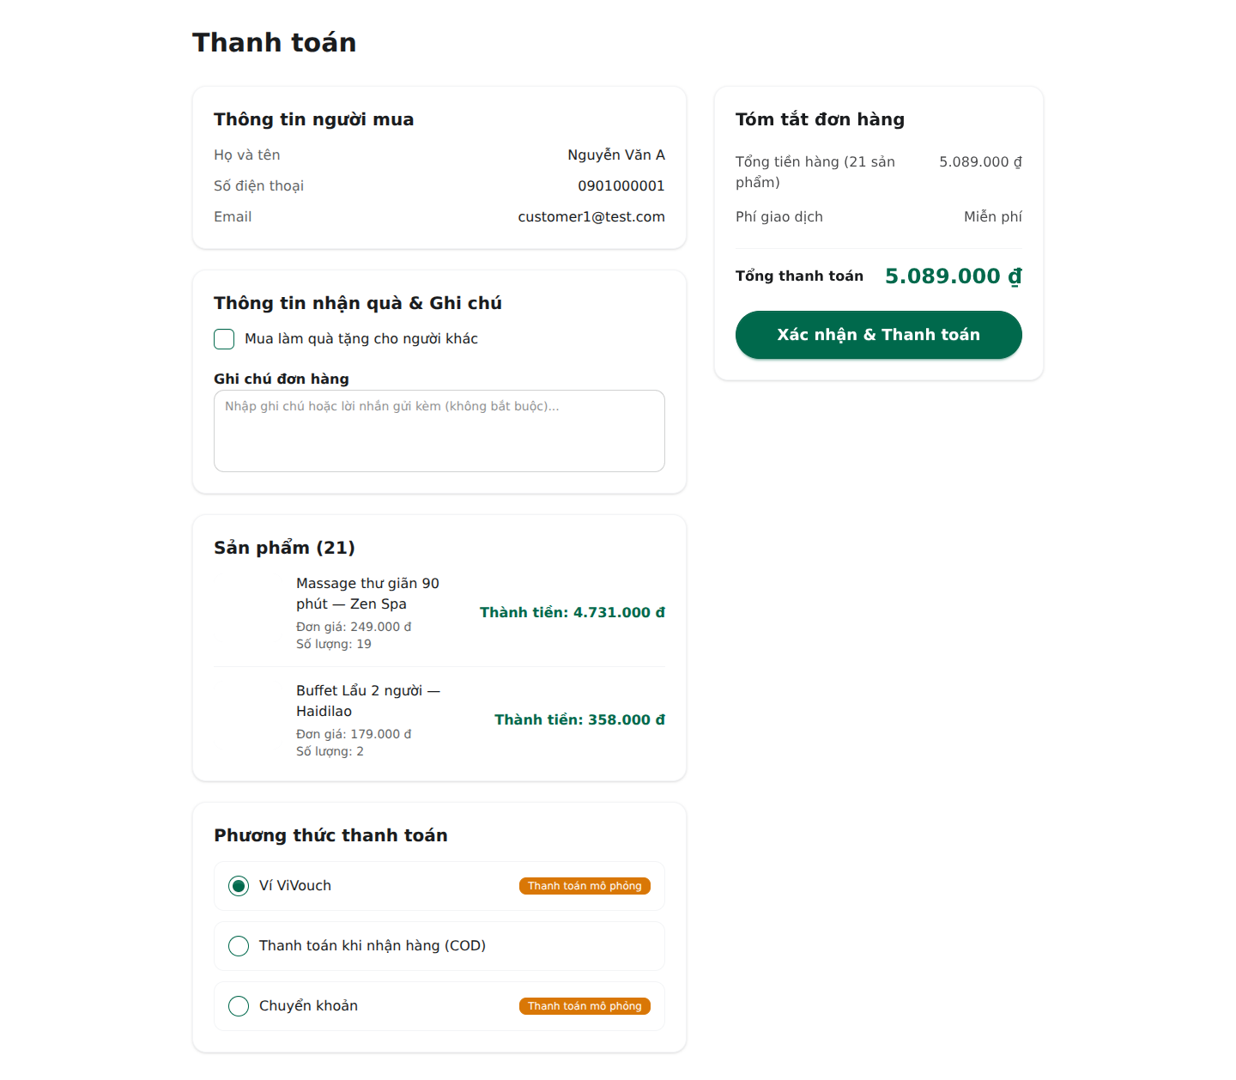
Core transactions now preserve the business invariants
01
Checkout
Row locks, stock validation, idempotency key, payment and codes commit together.
02
Redeem
Check is non-mutating; confirm re-locks the code and enforces partner + branch scope.
03
Review
Eligibility is decided server-side from ownership and purchase/use state.
ViVouch · W5 Acceptance & Security
04

Slide 5
Security controls are enforced at API boundaries
01
Rotating sessions
Refresh-token rotation, replay rejection, logout revocation and automatic client refresh.
02
Abuse resistance
Stable 429 responses on authentication, checkout and redeem paths, with tests.
03
Authorization
Role checks plus partner ownership, branch scope, customer ownership and suspension state.
04
Forensics
Audit records include old/new values, actor, IP, user agent, request context and date filters.
ViVouch · W5 Acceptance & Security
05

Slide 6
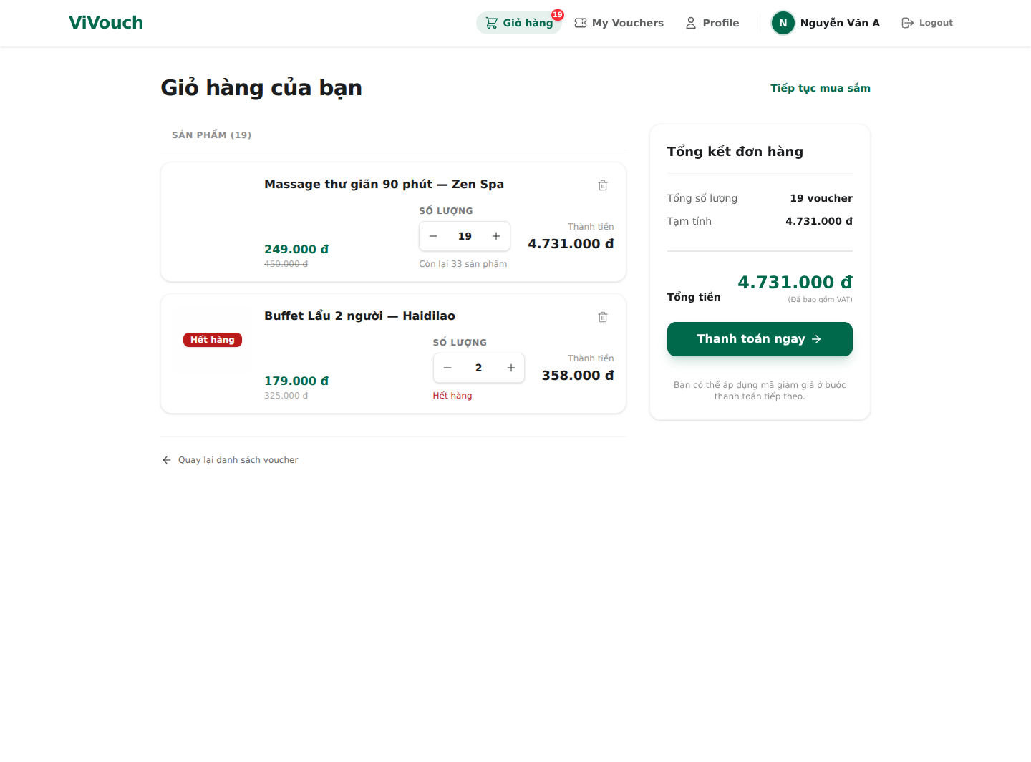
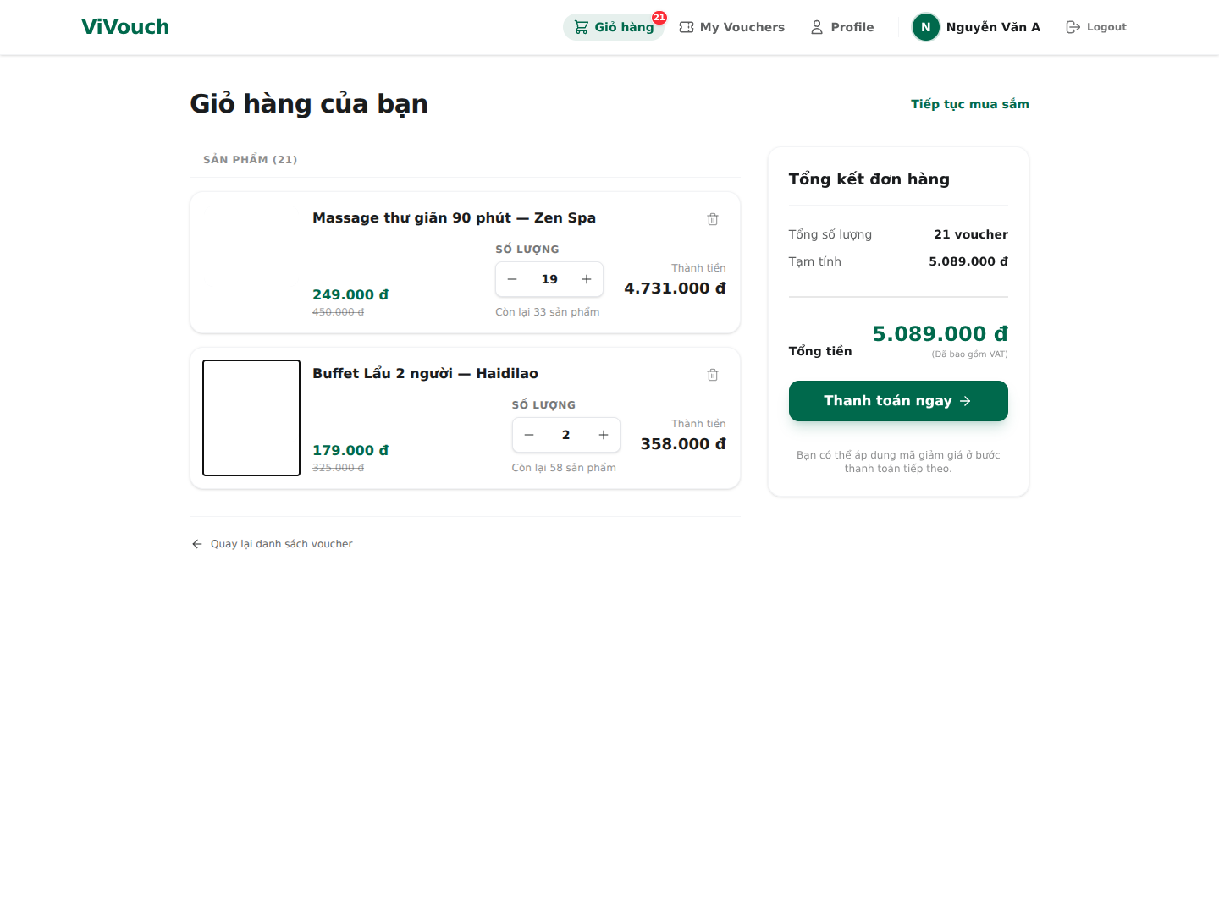
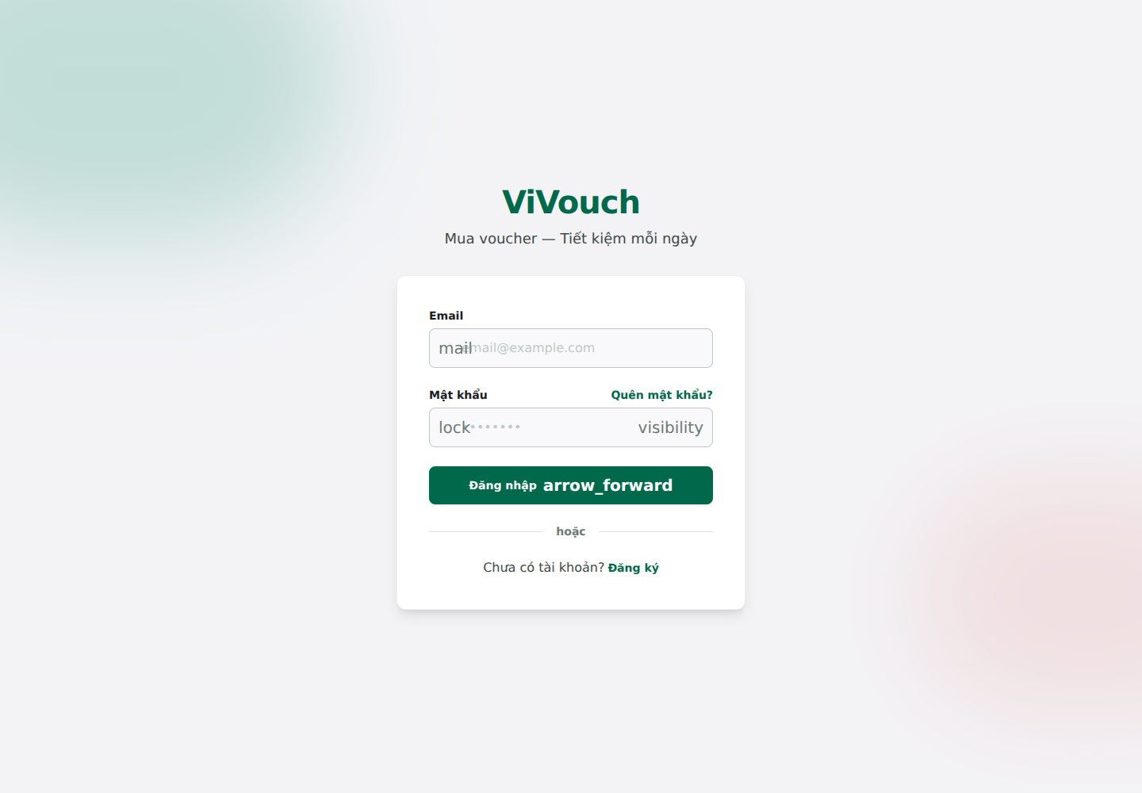
Negative cases are visible, stable and recoverable
Out of stock
Quantity cap
Unauthenticated
Captured against seeded data on the same candidate—not mock artwork.
ViVouch · W5 Acceptance & Security
06

Slide 7
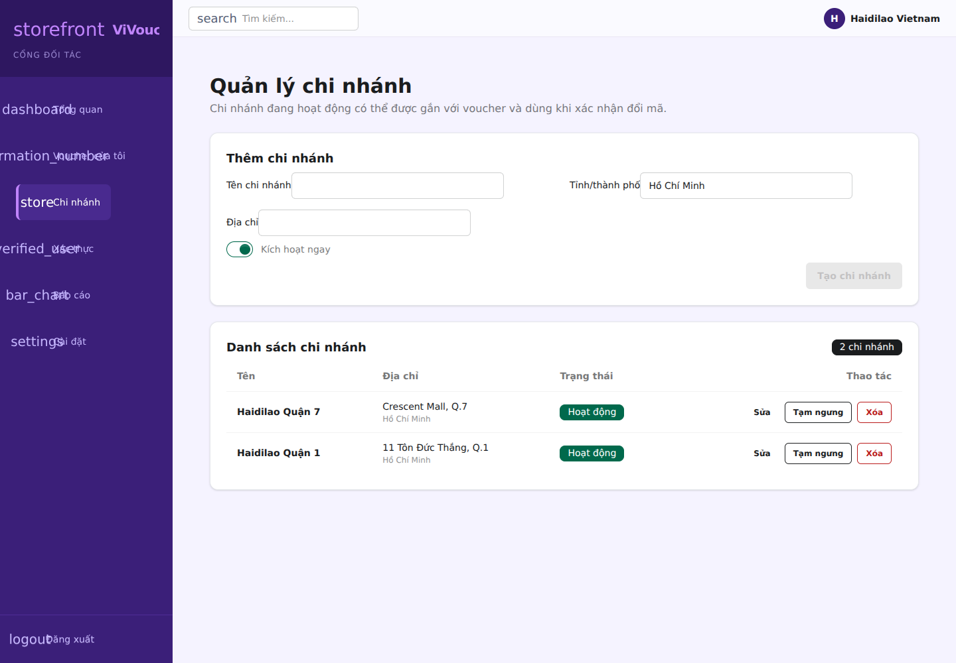
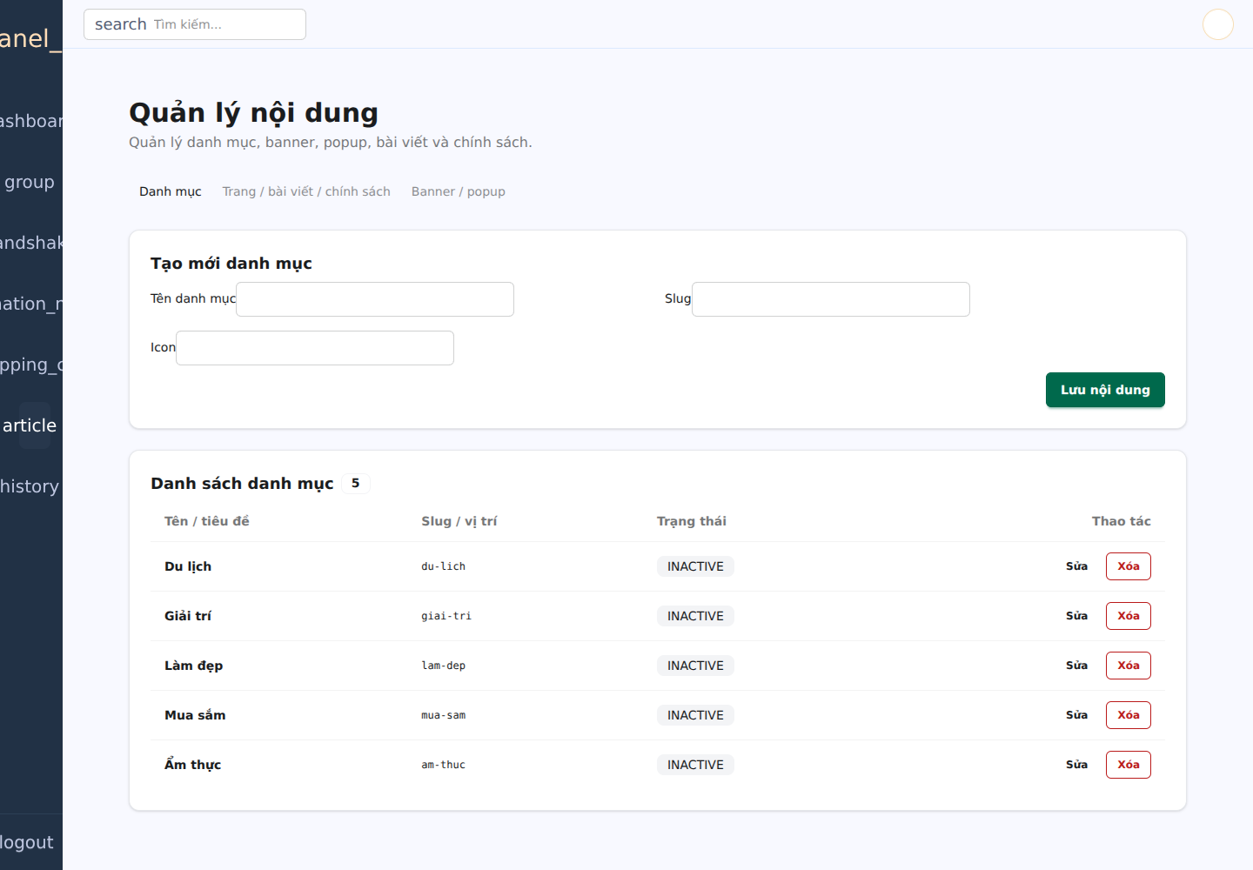
Partner and Admin close the remaining W5 scope gaps
Partner
• branch create/update/activate • voucher draft + submission • check → confirm redeem • branch-scoped reports
Admin
• role assignment + user lock • partner suspend/reactivate • order cancel/refund • CMS + searchable audit trail
ViVouch · W5 Acceptance & Security
07

Slide 8
The acceptance evidence is repeatable
Migrate
Seed
Test
Build
Audit
10/10
PASS
199/199
PASS
0
canonical-backend-20260721.log · canonical-frontend-20260721.log
Frozen against base SHA 523390ae… plus this patch manifest
ViVouch · W5 Acceptance & Security
08

Slide 9
The 10.0 score is a transparent internal readiness score
Business scope & flows
Checkout, redeem, review, three portals
2.0 / 2.0
Security & integrity
RBAC, ownership, locks, replay, rate limits
2.0 / 2.0
Quality & verification
199 tests, build, migrations, audit
2.0 / 2.0
Documentation & traceability
BRD → API → code → evidence
2.0 / 2.0
Release governance
P0/P1 zero, limitations and no-tag rule
2.0 / 2.0
Official course grading remains the assessor’s decision.
10.0 / 10.0
ViVouch · W5 Acceptance & Security
09

Slide 10
Proceed to W6; release only after owner approval
TECHNICAL GO
TAG HOLD
Candidate may advance to W6 engineering and demo preparation.
Duy · Huy · Vinh · Tùng must each sign the same frozen candidate.
W6 · P2
production email provider · shared rate-limit store · browser E2E in CI
W7 · P3
payment gateway · object storage · observability and operational dashboards
ViVouch · W5 Acceptance & Security
10

