Slide 1
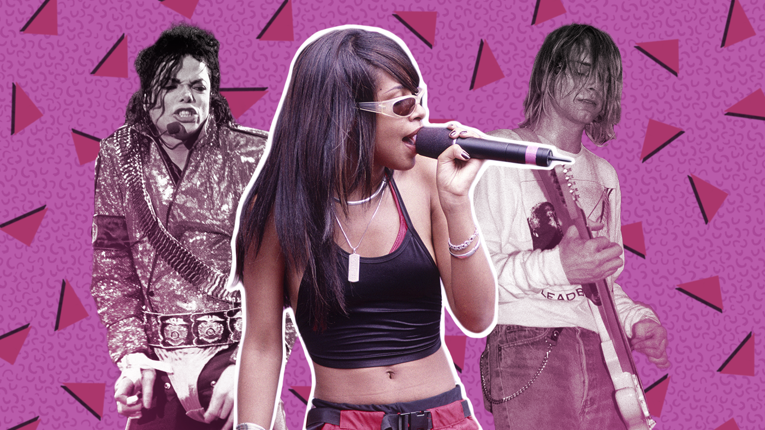
Breaking Down the 90s Hit Formula
Kailyn, Ruhama, Lewis, Derrick, Jacob

Slide 2
Introducing the Dataset
The dataset we analyzed features over 900 classic 1990s songs and their detailed audio features pulled from Spotify– factors like tempo, danceability, loudness, valence, and more. With over 500 artists represented, this dataset gave us the chance to explore not only what made music in the 90s sound the way it did, but to also ask:
What made certain songs hits?
How did musical features vary between artists?
Do technical features like speed, volume, or instrumentalness actually affect popularity?
Source:
This dataset, titled “1990s Classic Hits (with Spotify Data),” was uploaded to Kaggle by retired computer programmer and music fanatic, The Bumpkin, in August 2024.
https://www.kaggle.com/datasets/thebumpkin/1990s-classic-hits-with-spotify-data

Slide 3
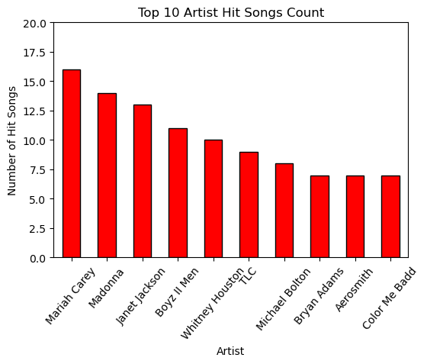
Lewis
This bar chart shows the top 10 artists with the highest number of hit songs in the dataset. Each bar represents the number of hit songs associated with an artist. An observation I noticed is that there's a sharp drop in hit count from the top 3 artists to the others in the top 10. This suggests that there is a steep popularity curve in the artists, where only a few of the most popular dominated the charts in the 1990s and defined the decade.

Slide 4
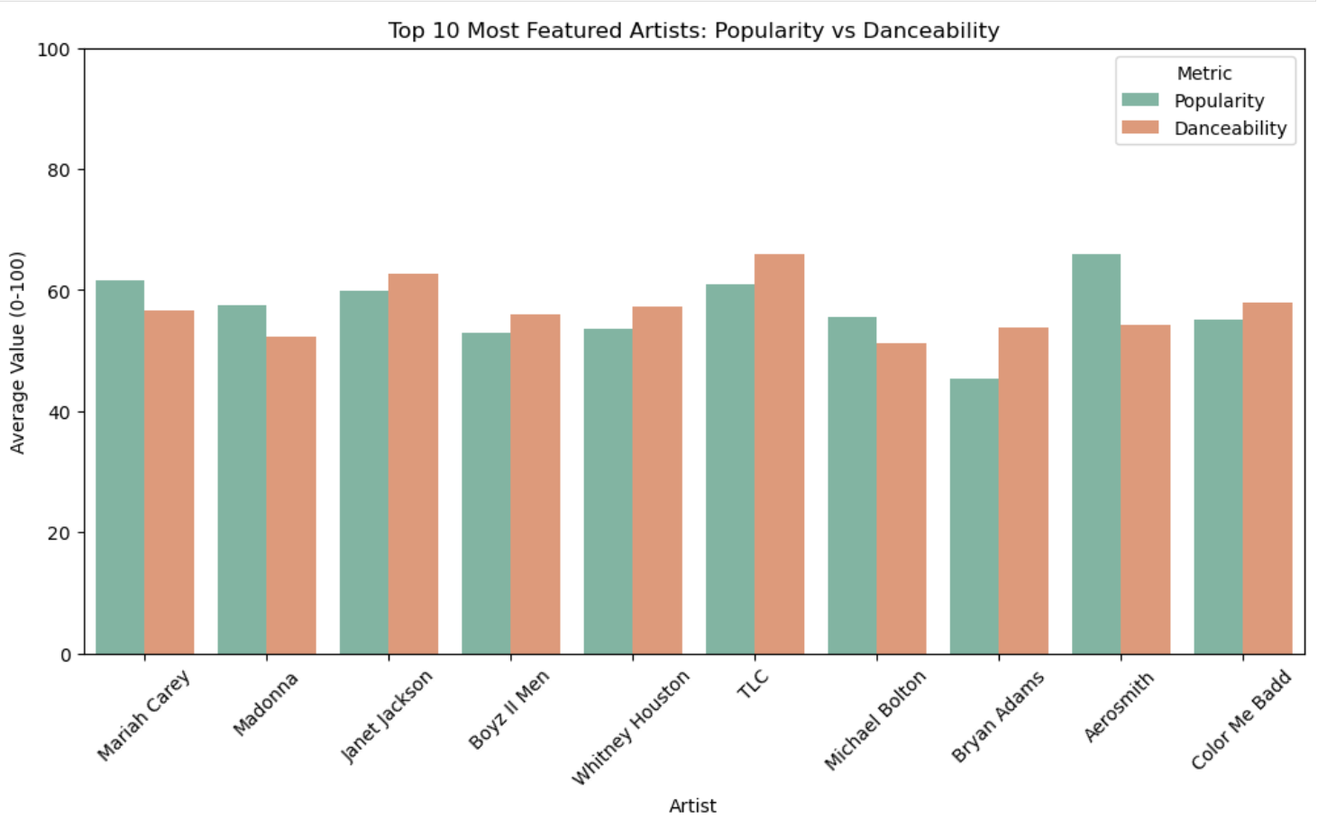
How does average popularity compare with danceability across the most prominent artists?
This grouped bar chart compares the average popularity and danceability of the 10 most frequently featured artists in the dataset.

Slide 5
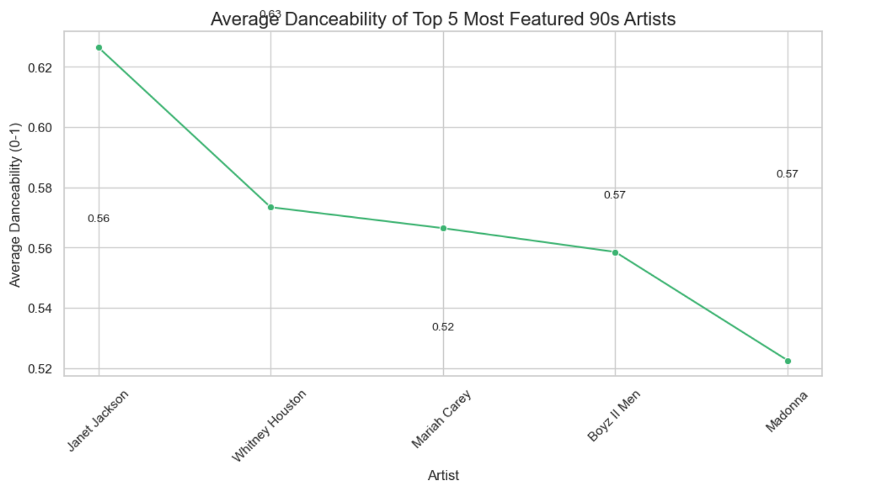
Visualization
Line plot ranking top 5 most featured artists by Danceability. Labeled each data point for clarity.
Key Insight:
This line plot confirms that danceability was not a defining trait for artists. The result highlights clear stylistic divisions in 90s hit music, where danceability did not shape audience but the individuals artist’s sound.

Slide 6
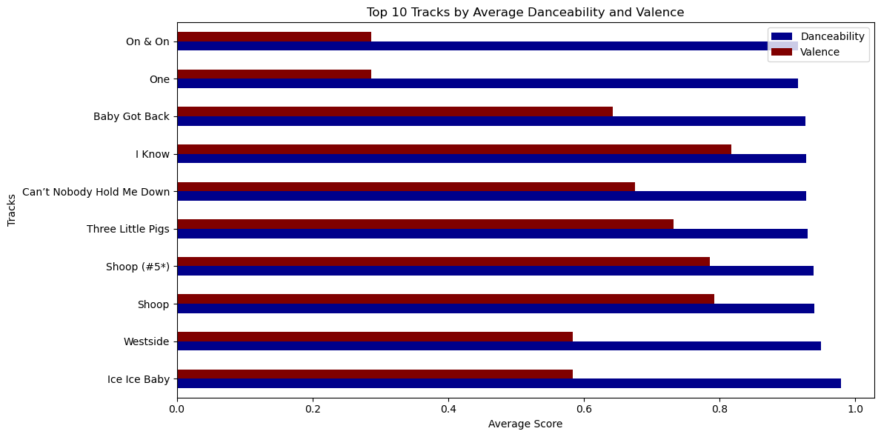
Lewis
Tracks with high Danceability often also show high Valence, implying that upbeat danceable songs also tend to sound happier.
Some tracks with slightly lower Valence in this top 10 may be highly danceable but carry a more neutral or even melancholic tone.

Slide 7
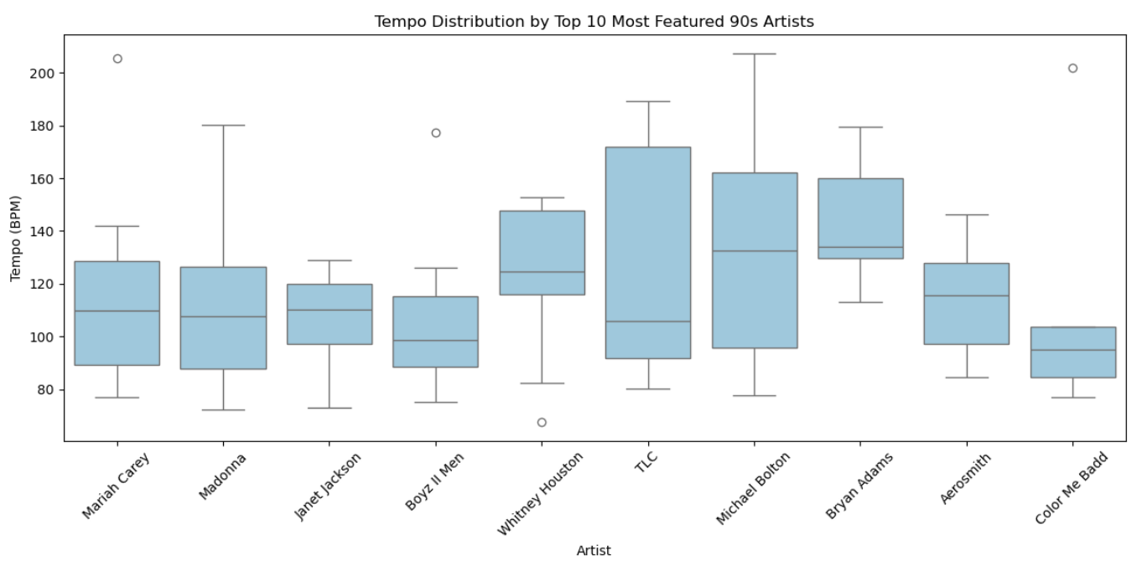
How does tempo differ across the most prominent artists of the 90s?
This boxplot shows the distribution of tempo (in BPM) for the 10 most frequently featured artists in the dataset.
Highest spreads: TLC and Michael Bolton
Lowest spreads: Color Me Badd and Janet Jackson
Even among the most prominent artists of the decade, there was significant variation in how tempo was used

Slide 8
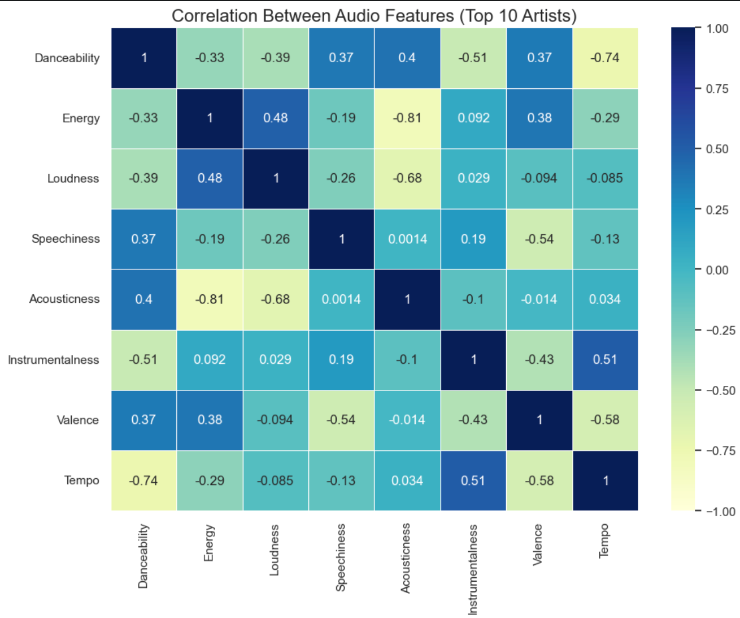
Visualization:
Heatmap showing how the audio features from top 10 correlate.Strong positive and moderate relationships highlighted in color.
Key Insight:
The heatmap reveals strong, predictable relationships between core audio features, with Energy and Loudness moving together across all artists. It also confirms that danceable, upbeat songs tended to be faster and more positive in tone. Importantly, the weak correlation between these traits and popularity suggests that while technical sound design shaped a track’s character, other forces like artist visibility, radio trends, and cultural influence were stronger drivers of chart success.

Slide 9
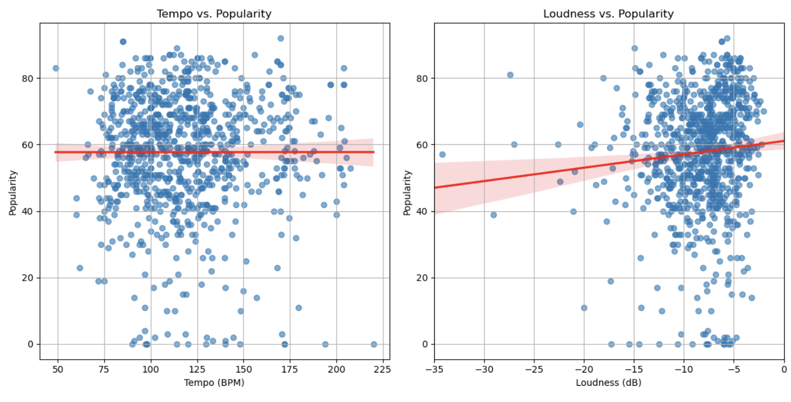
Does the speed and volume of a song affect its popularity?
These two scatterplots examine whether a track’s tempo (BPM) or loudness (dB) are meaningfully related to its popularity.
Tempo: no relationship (r=0.0003)
Loudness: slight positive relationship (r=0.089)

Slide 10
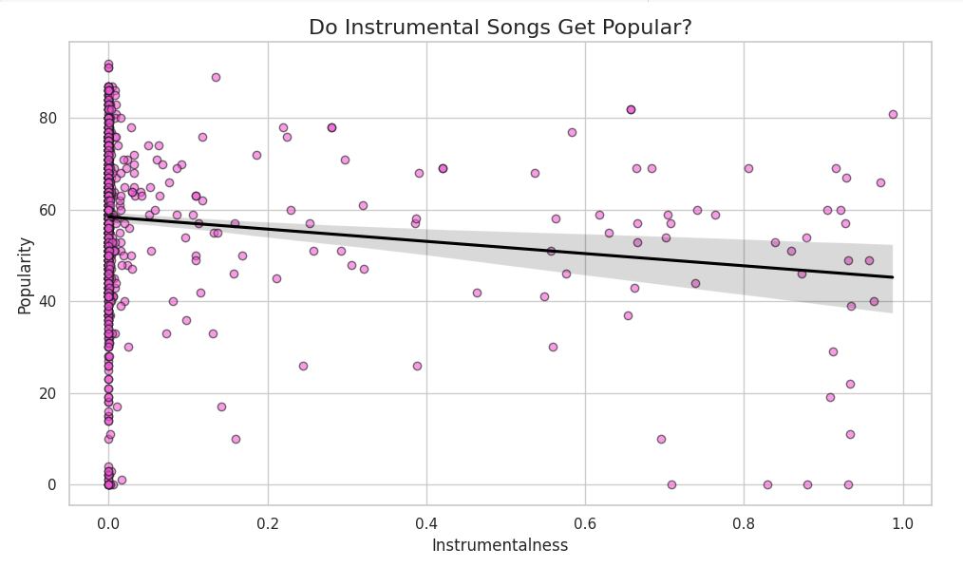
Key Insights:
Most songs had low instrumentality (i.e., vocals present)
Highest popularity scores were tied to vocal-driven tracks
Few instrumental songs made it into the top hits
Trend line suggests: More instrumental → Less popular
Notes:
This graph compares instrumentalness (x-axis) and popularity (y-axis) for top 90s classic hits.
Instrumentalness ranges from 0 (full vocals) to 1 (completely instrumental).
Popularity is Spotify’s score from 0 to 100, measuring how popular a track is.
Most data points are clustered near 0 on the x-axis — meaning most songs included vocals.
The most popular songs had low instrumentalness, showing that listeners preferred vocal-heavy tracks.
The trend line slopes downward, suggesting a negative relationship — as instrumentalness increases, popularity tends to decrease.
This reflects the musical landscape of the 90s — dominated by pop, R&B, and hip-hop, where vocals were central.
Very few songs were highly instrumental, and even fewer were hits.
Overall takeaway: Vocals were key to a song’s popularity in the 1990s.

Slide 11
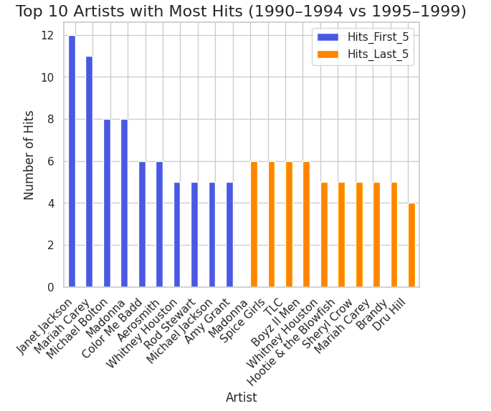
Key Insights
Early 90s: Dominated by Pop and R&B (e.g., Whitney Houston, Mariah Carey, Janet Jackson).
Late 90s: Rise of Hip-Hop, R&B, and Pop-Rock (e.g., TLC, Boyz II Men, Hootie & the Blowfish).
Genre Blending: Artists fused Pop, R&B, and Hip-Hop to appeal to wider audiences (e.g., Mariah Carey).
Cultural Shift: Late 90s marked the youth-driven pop culture with boy bands and R&B icons.
Notes:
Introduction:
"This graph compares the top 10 artists of the 90s, showing their number of hits in the first 5 years (1990–1994) and the last 5 years (1995–1999)."
Graph Breakdown:
"The x-axis represents the artists, while the y-axis shows the number of hits each artist had in their respective period."
"Each artist has two bars: one for their hits in the first 5 years (blue) and one for the last 5 years (orange)."
Key Insights:
"Mariah Carey, Whitney Houston, and Madonna were consistent across both periods, maintaining popularityand dominating the charts throughout the decade."
"TLC" and "Boyz II Men" show a notable rise in the latter half of the decade, reflecting the growing influence of R&B and hip-hop.
"The late 90s saw a shift towards more youth-driven pop culture, with groups like Hootie & the Blowfish and Sheryl Crow bringing pop-rock and alternative sounds into the mainstream."
"This graph highlights a transition in the music scene, moving from a pop/R&B-focused early 90s to a more diverse musical landscape, incorporating hip-hop, R&B, and alternative rock."
Conclusion:
"The comparison emphasizes how the music scene evolved during the 90s, showing how genres blended and transformed, ultimately shaping the future of pop music."

Slide 12
Conclusion
This Dataset reveals that 90s hits were dominated by a few top artists like Mariah Carey, Madonna, and Janet Jackson, who defined the decade with their chart-topping success.
Danceability and valence were closely linked, with upbeat tracks often sounding happier, while instrumental songs tended to be less popular.
Tempo and loudness showed minimal direct impact on popularity, suggesting that cultural trends and artist influence played larger roles.
The shift from early 90s pop/R&B to late 90s hip-hop and genre-blending highlights the evolving musical landscape.
Ultimately, technical features shaped a song’s character, but broader cultural forces drove its success.

