Slide 1


















dmft1:
,
,
,
,
Impurity solver:
CTQMC,OCA,NCA
dmft0:
,
,
,
,
,
lapw1:
dmft2:
,
,
,
,
,
lapw0:
,
core:
,
,
start:
mixer:

Slide 2
start:
lapw0:
mixer:
,
DFT loop
core:
lapw1:
,
,
,
,
dmft2:
,
,
,
dmft0:
,
,
,
DMFT loop
dmft1:
Impurity solver:
CTQMC,OCA,NCA
,
,
,
,
,
,

Slide 3
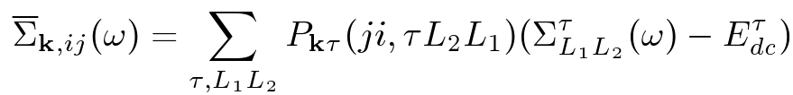
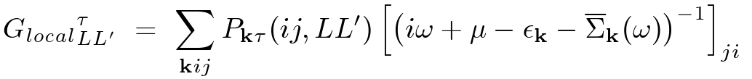
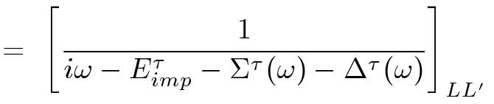
dmft1
,
,
,
,
projector:
self-energy
in KS base:
DMFT self-consistency condition:

Slide 4
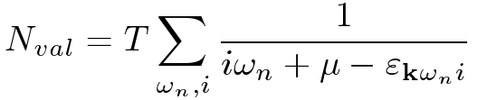
dmft2
,
,
,
projector:
self-energy
in KS base:
DMFT eigenvalues:
The chemical potential:
Valence charge density:
total energy contribution:

