Slide 1
The right tool for the job
Which aspects to consider when choosing a documentation framework
Ruth Fuchss
technical writer at Autronica Fire and Security AS
Ruth.Fuchss@autronicagroup.com, https://www.linkedin.com/in/rfuchss/
Notes:
Say you can build up a documentation setup from scratch – how to choose?
My background – both SW and HW docs, started with DITA CMS, then home-grown DITA docs-as-code, Doxygen & Sphinx docs-as-code
Now Autronica, HW, with old-fashioned docs – Word and InDesign files stored in SharePoint – want to modernize
Free reign to select the right tool

Slide 2
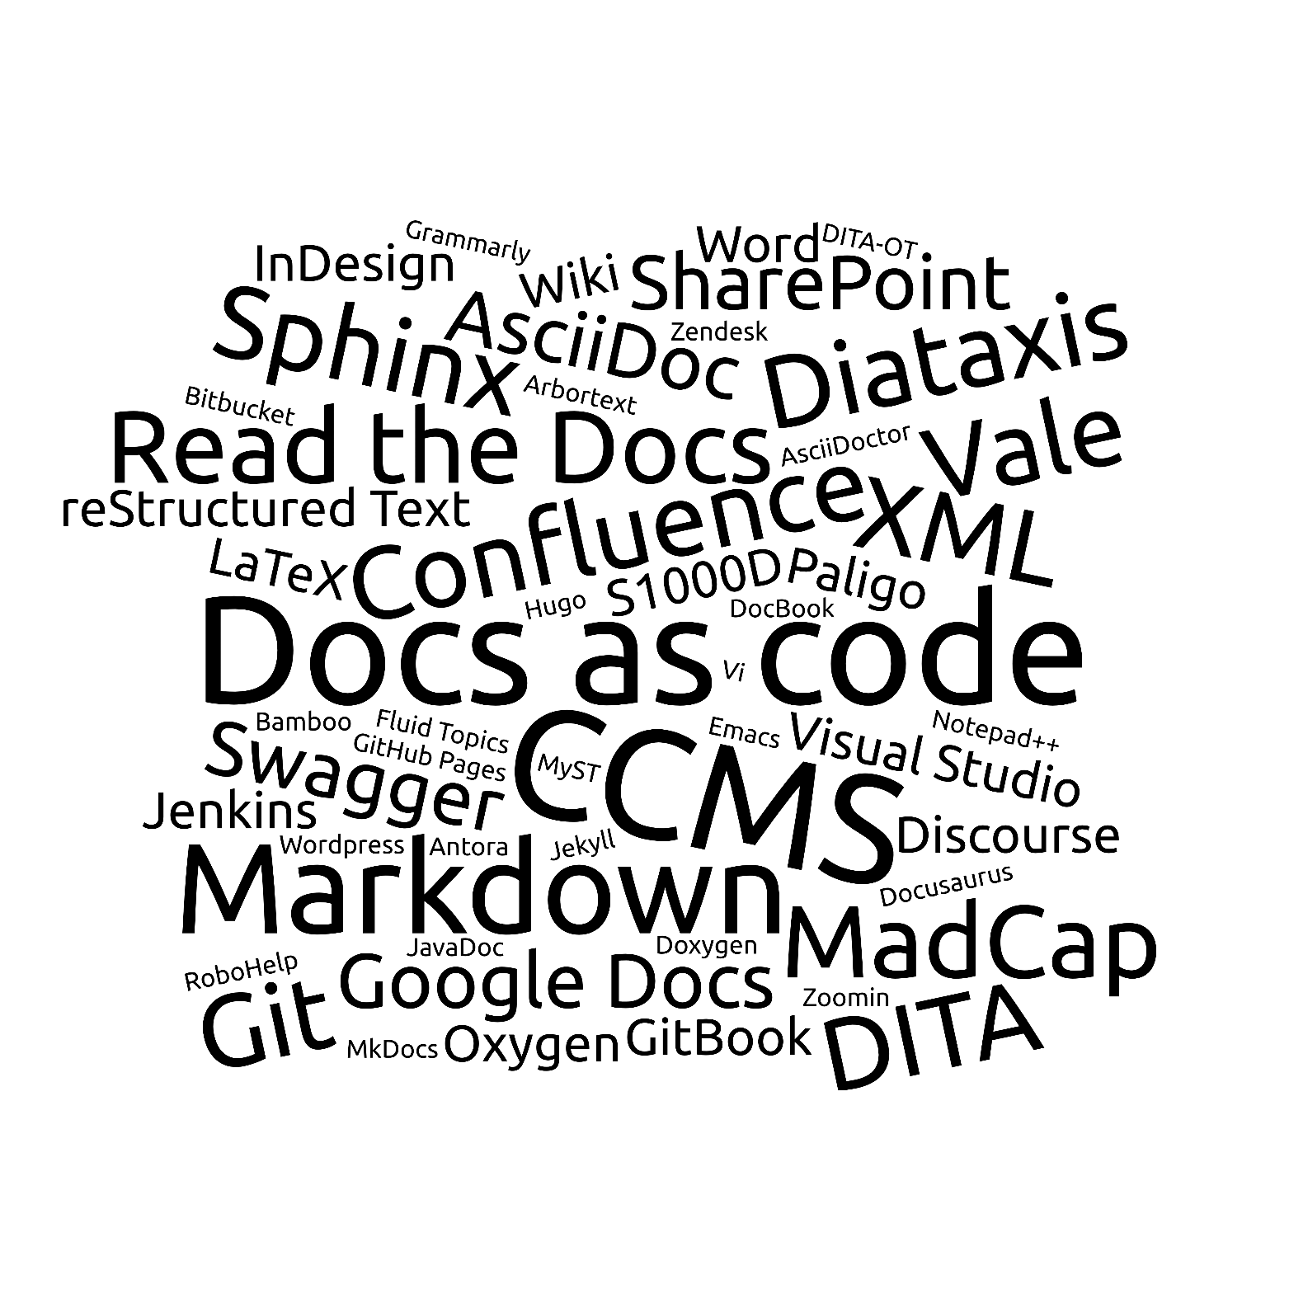
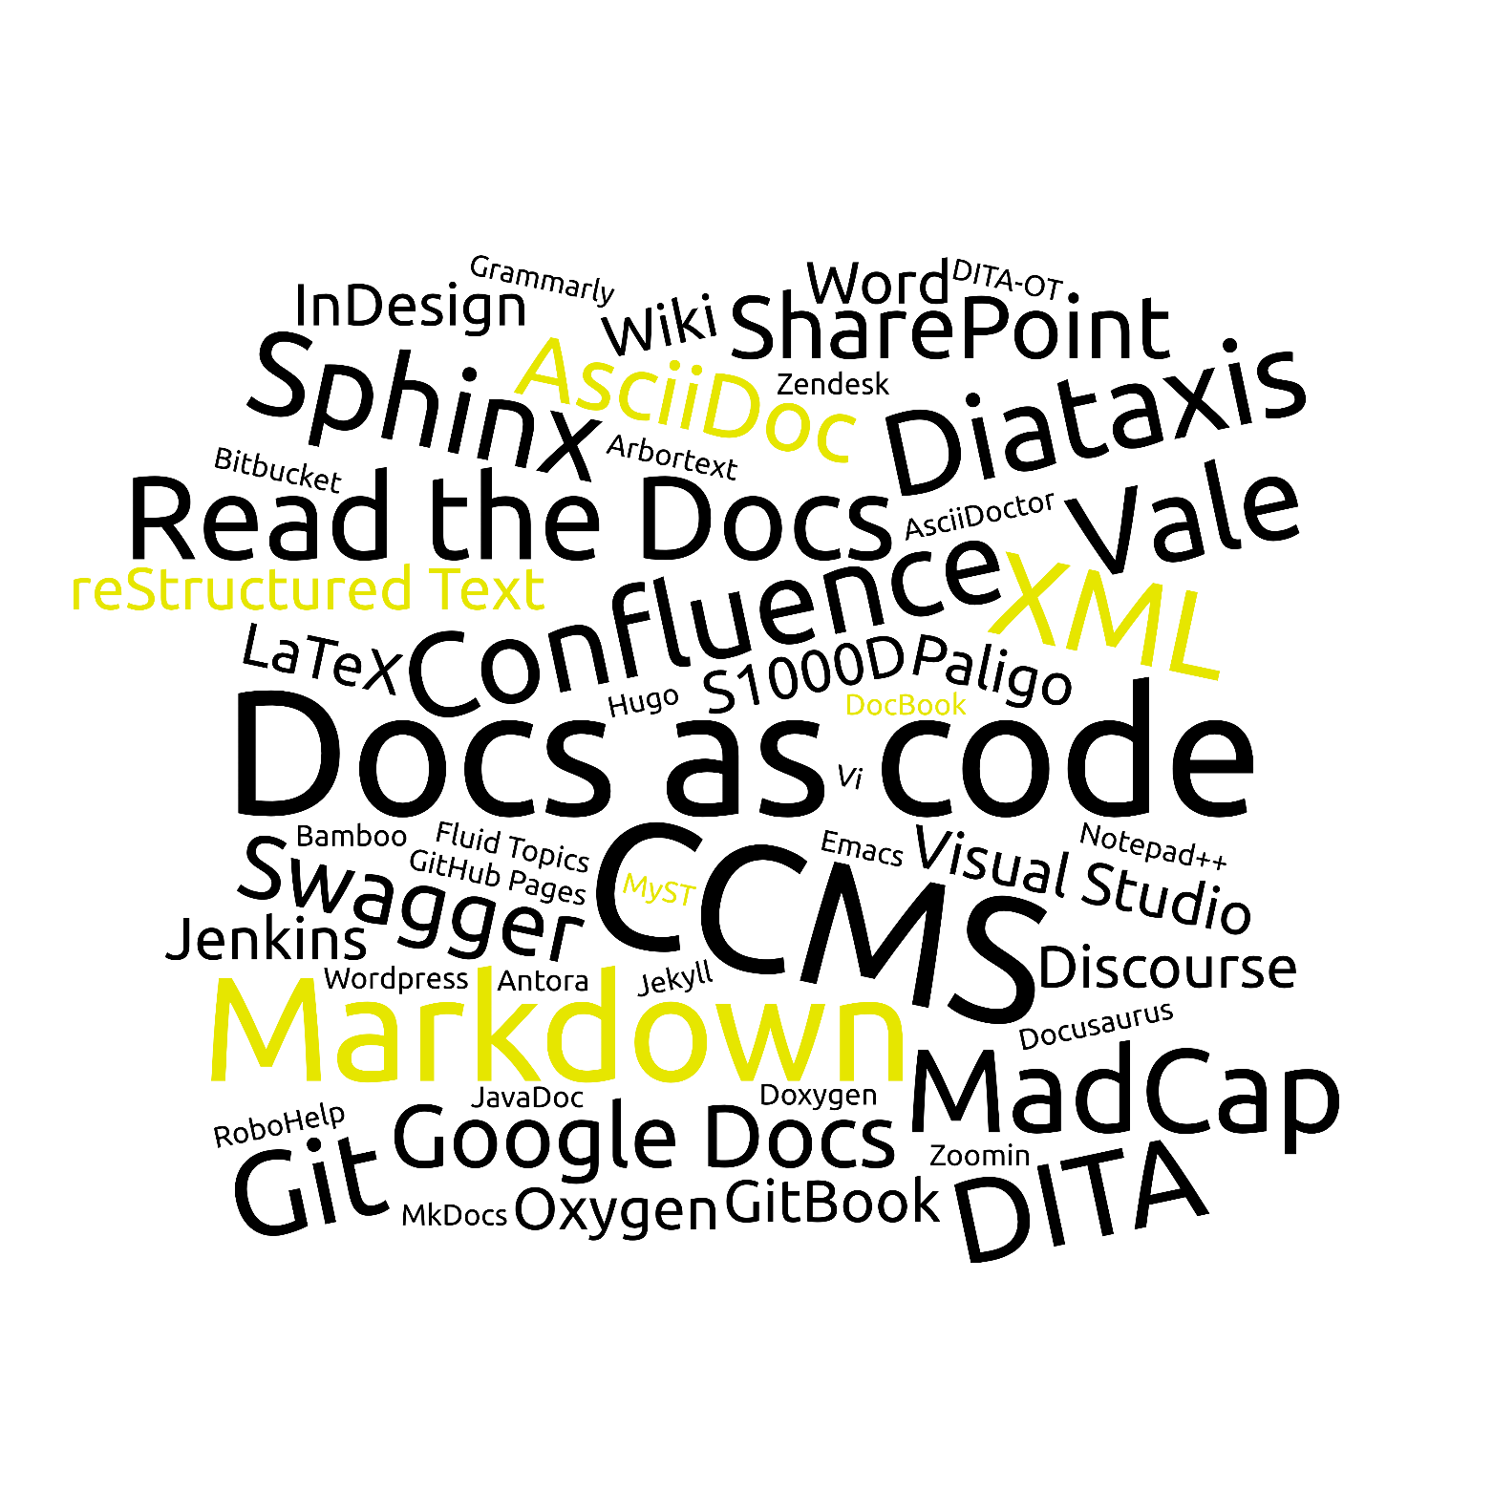
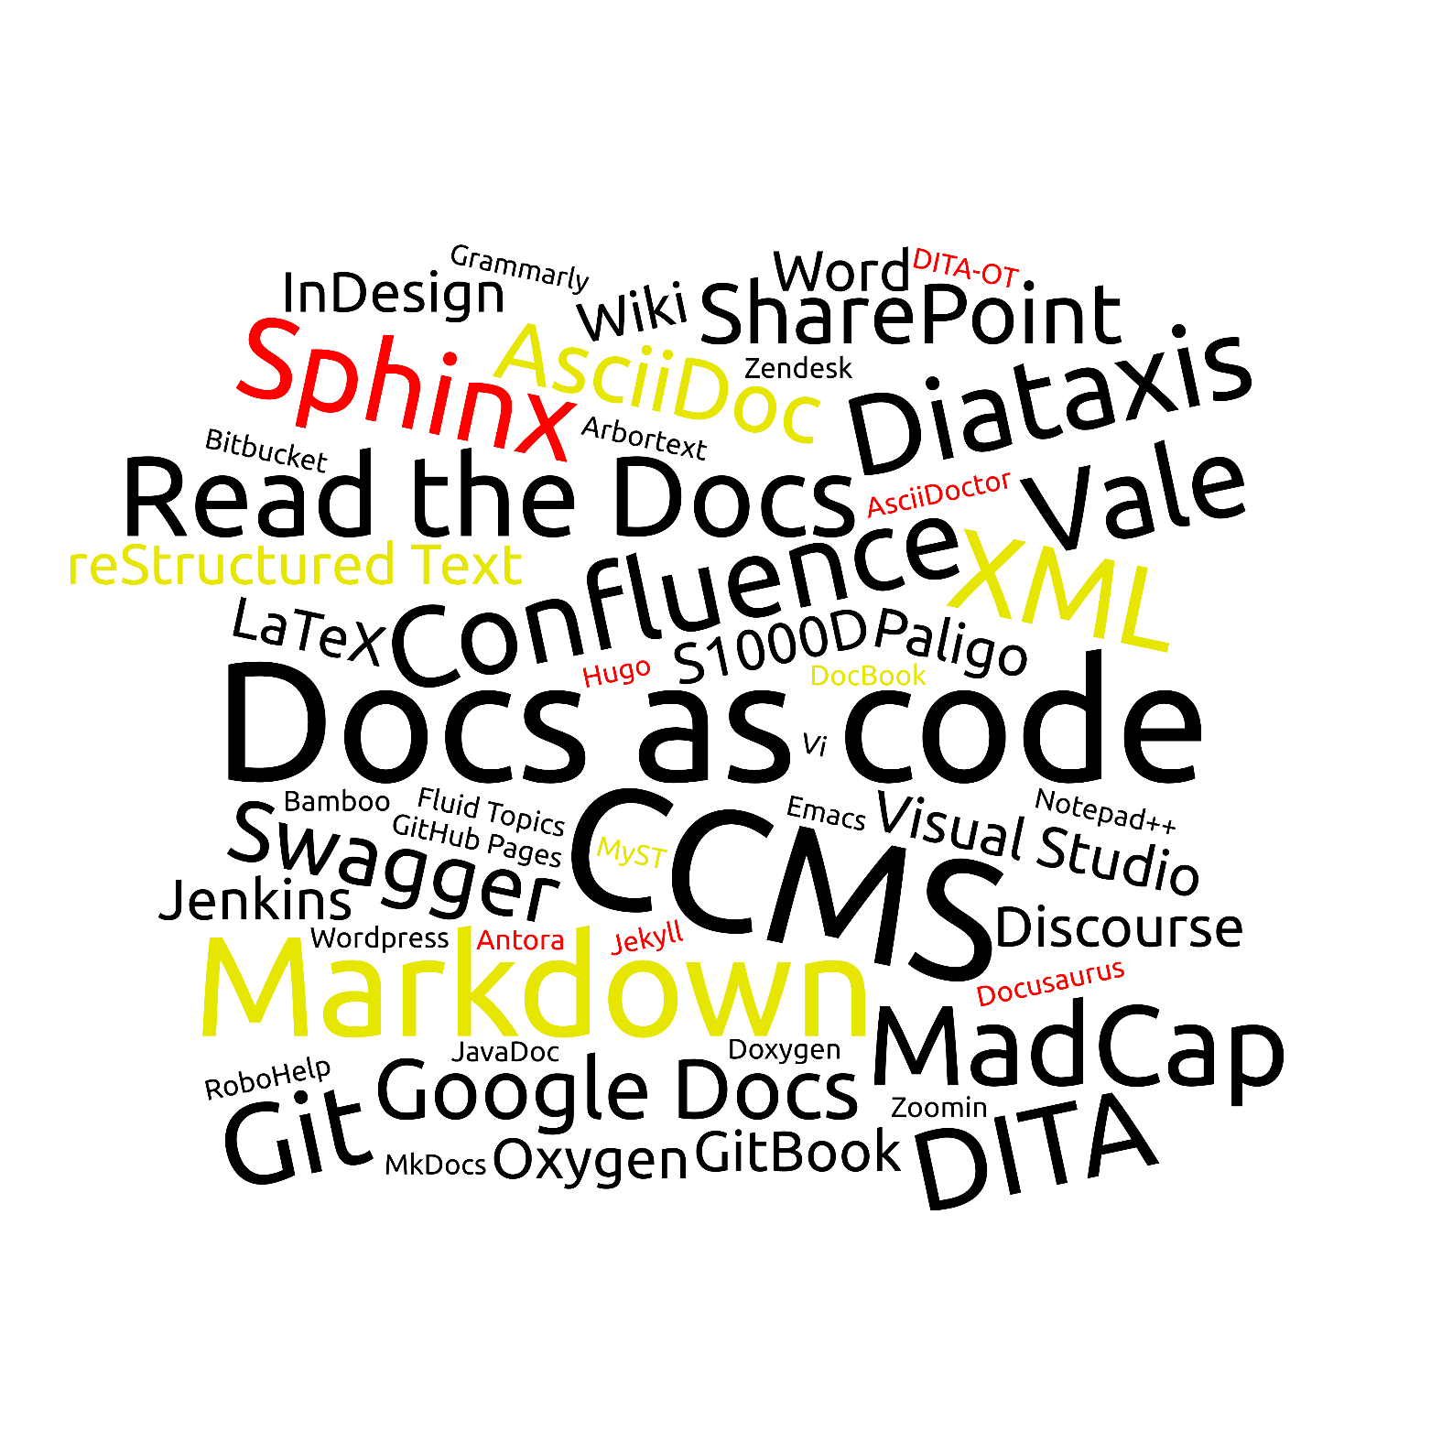
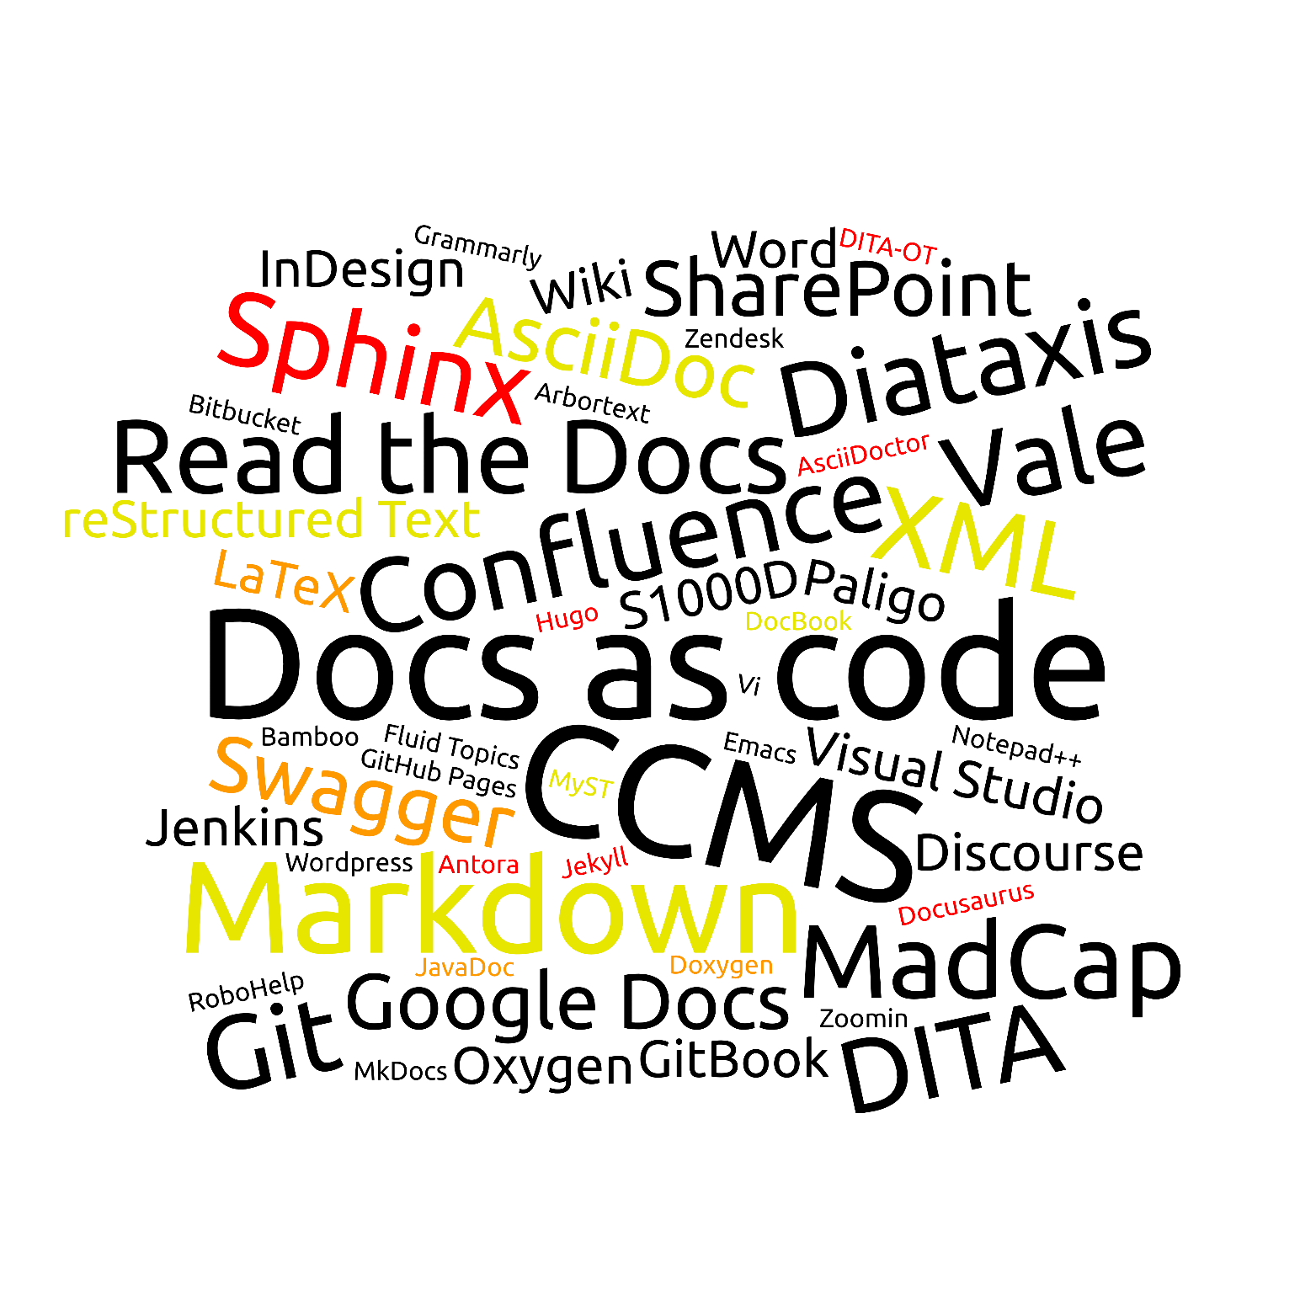
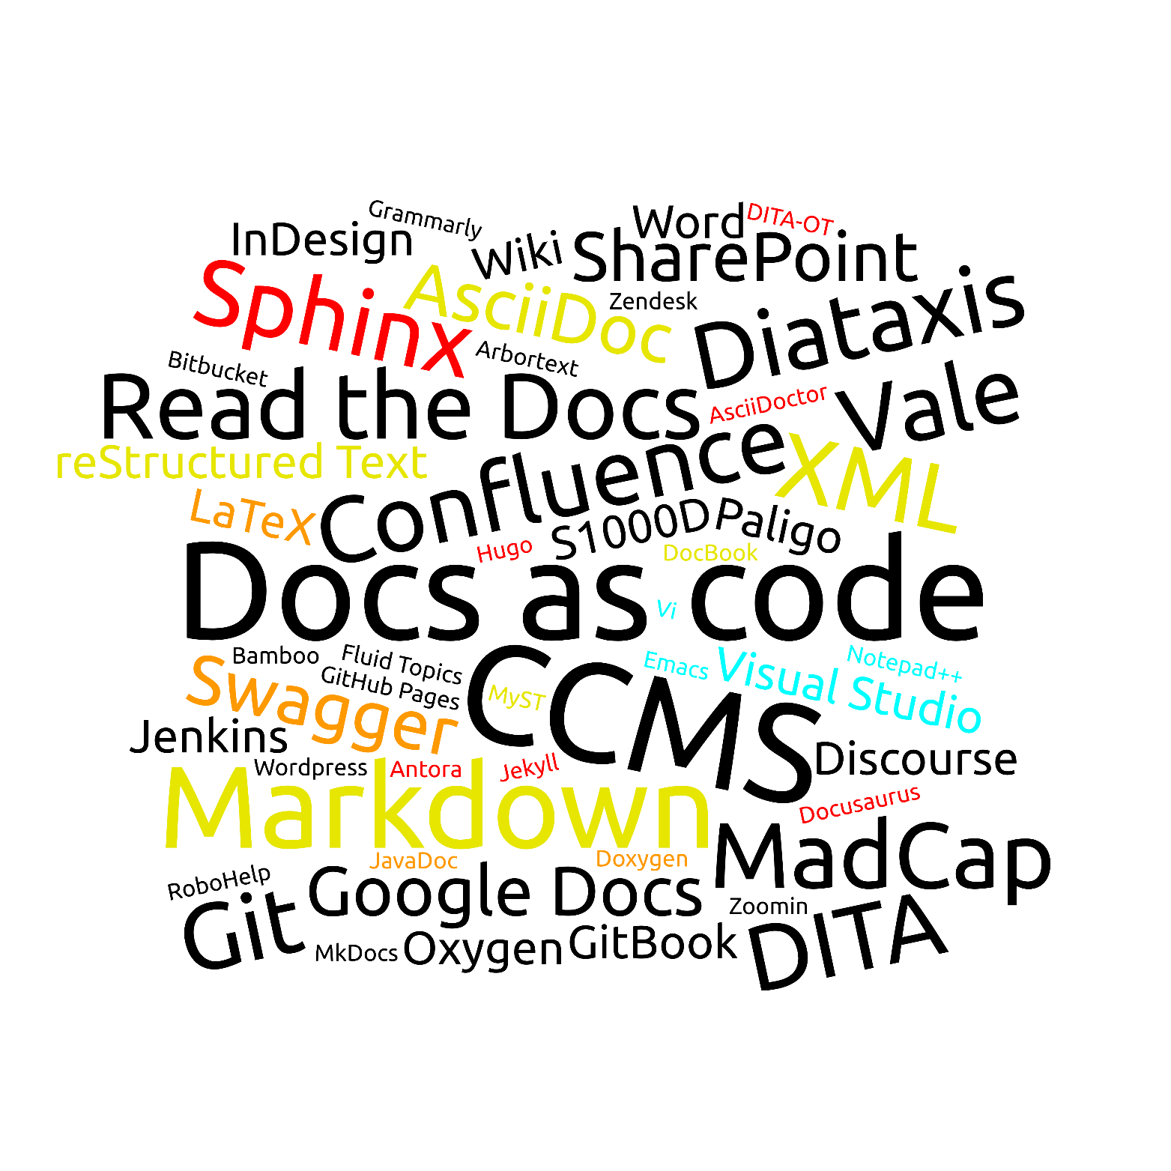
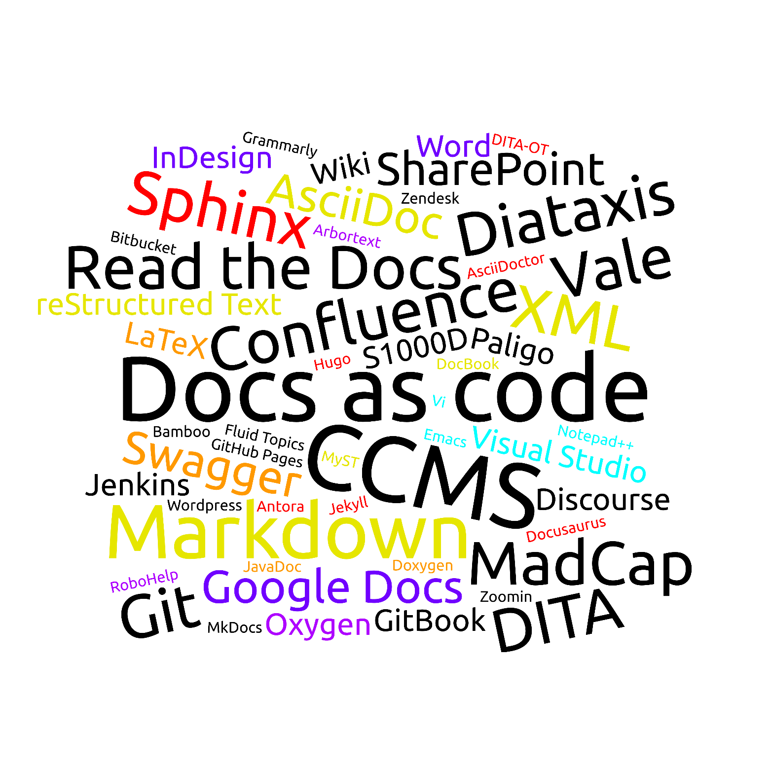
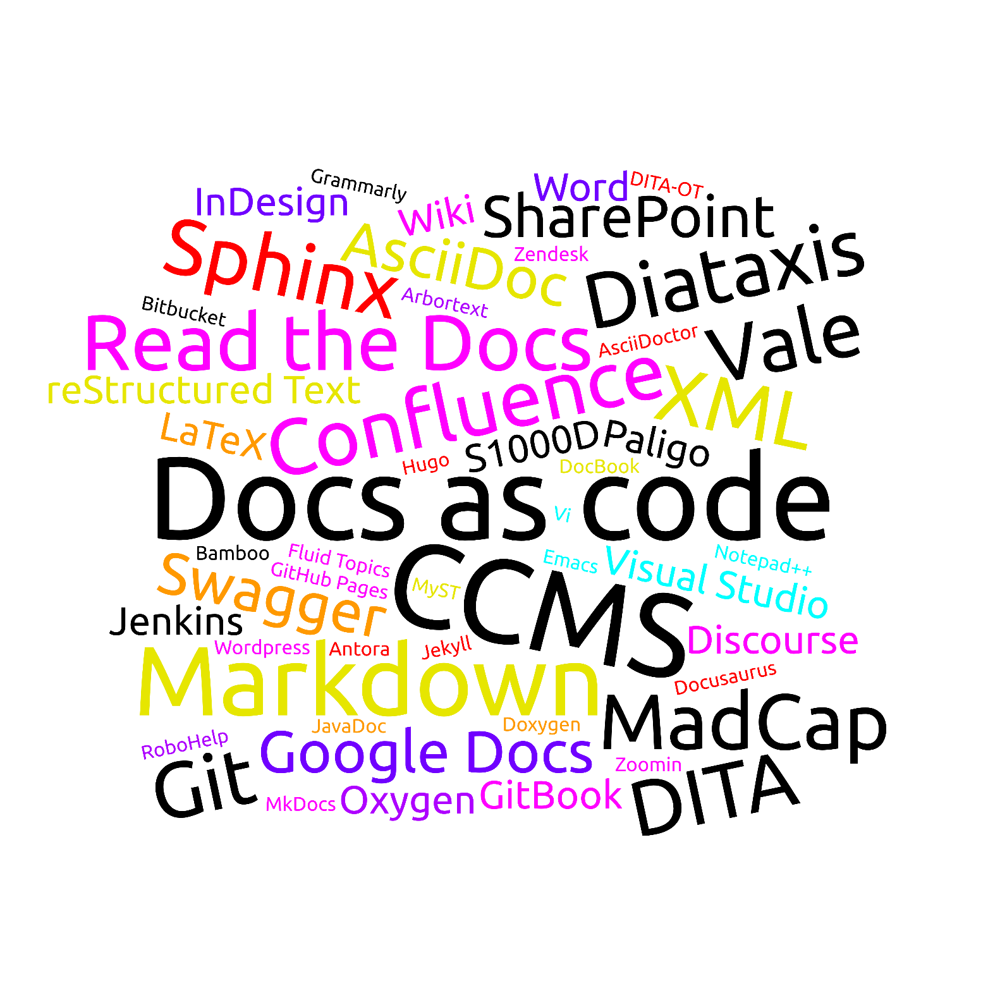
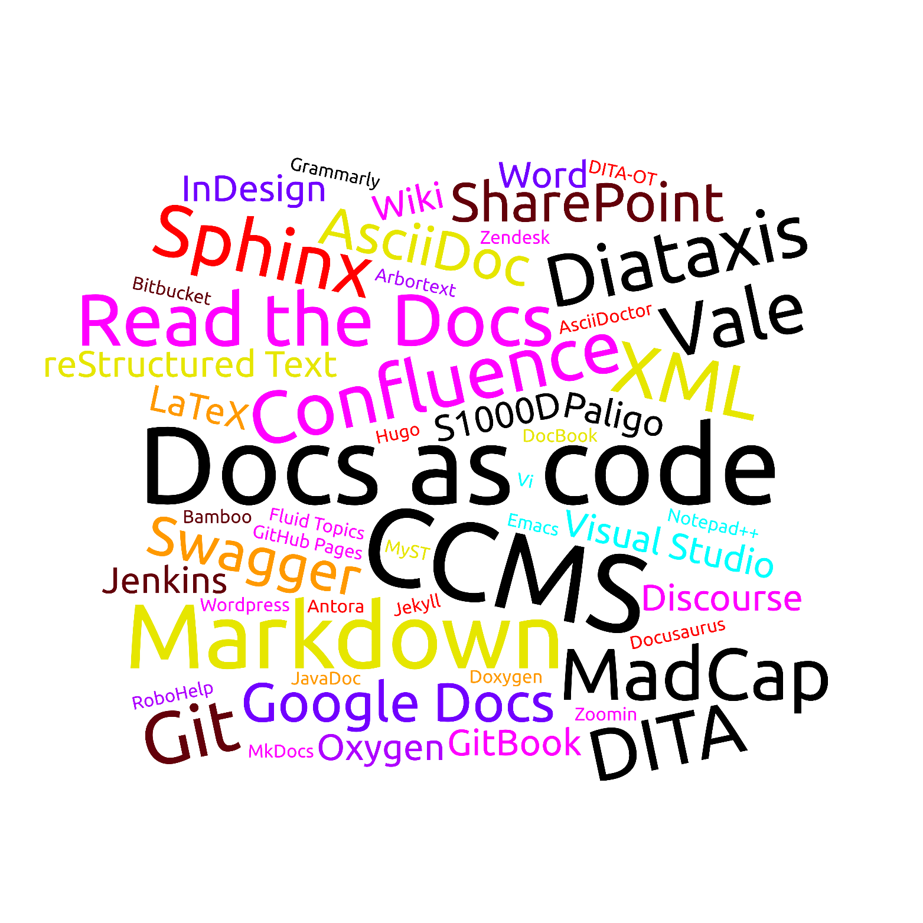
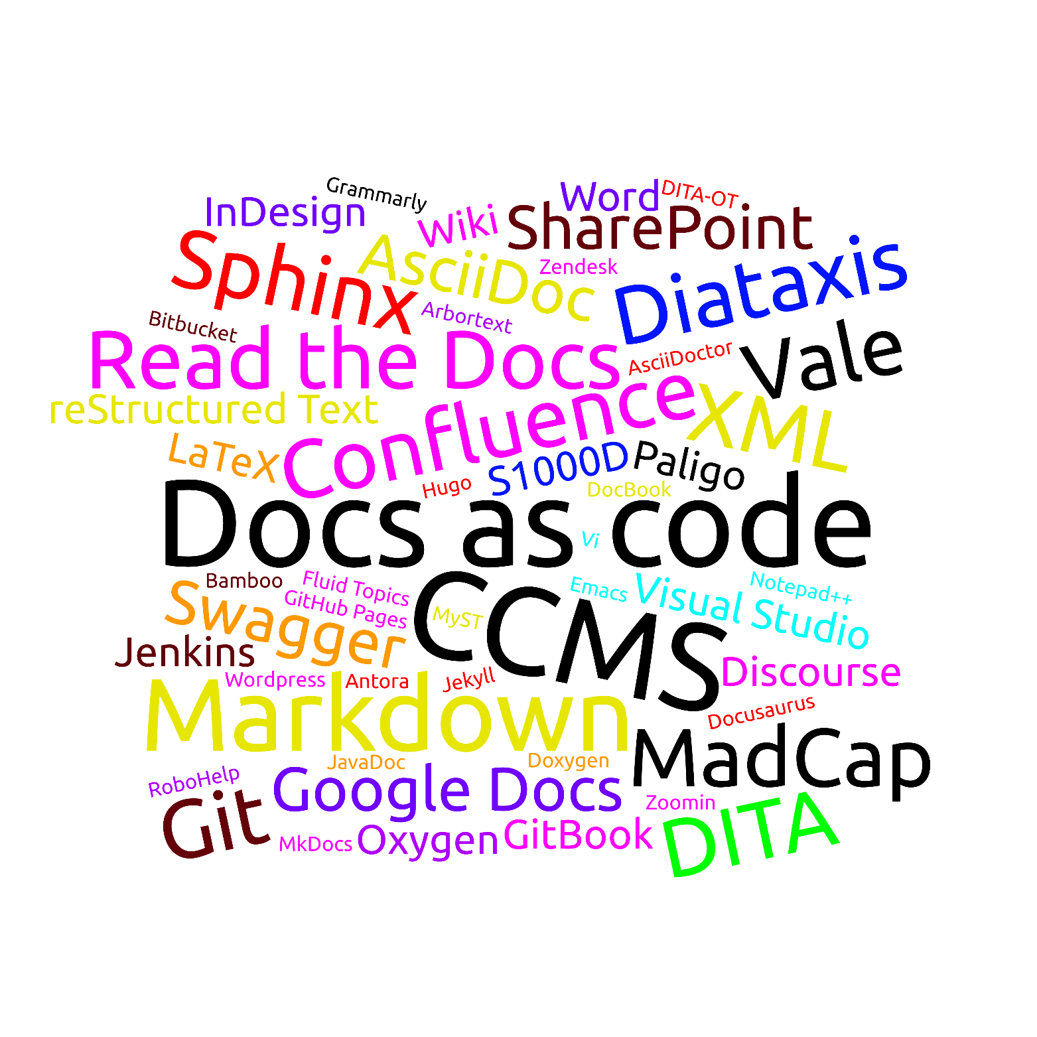
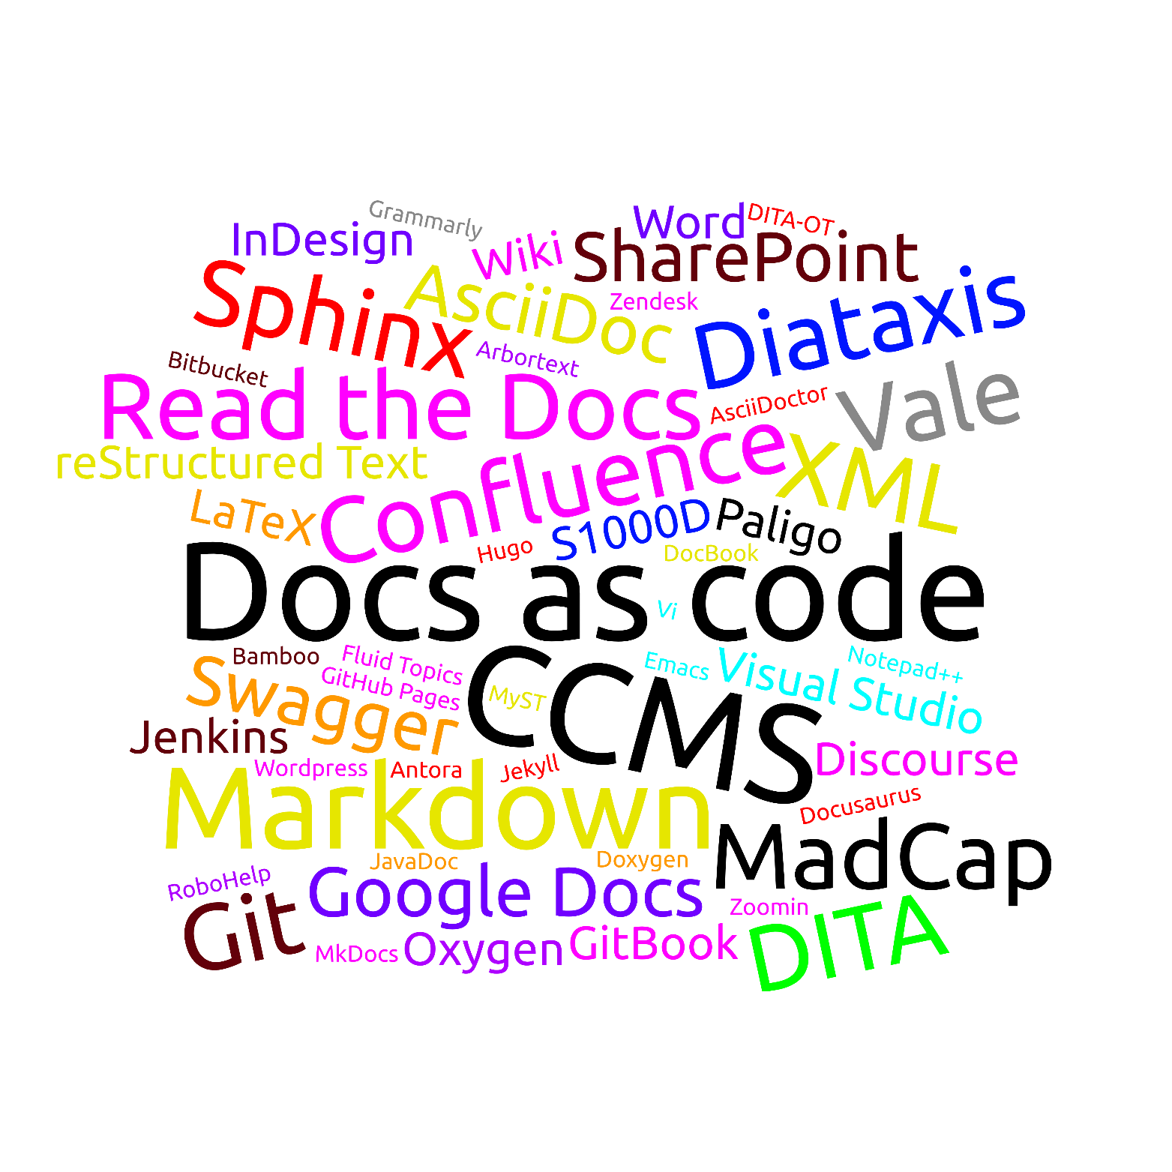
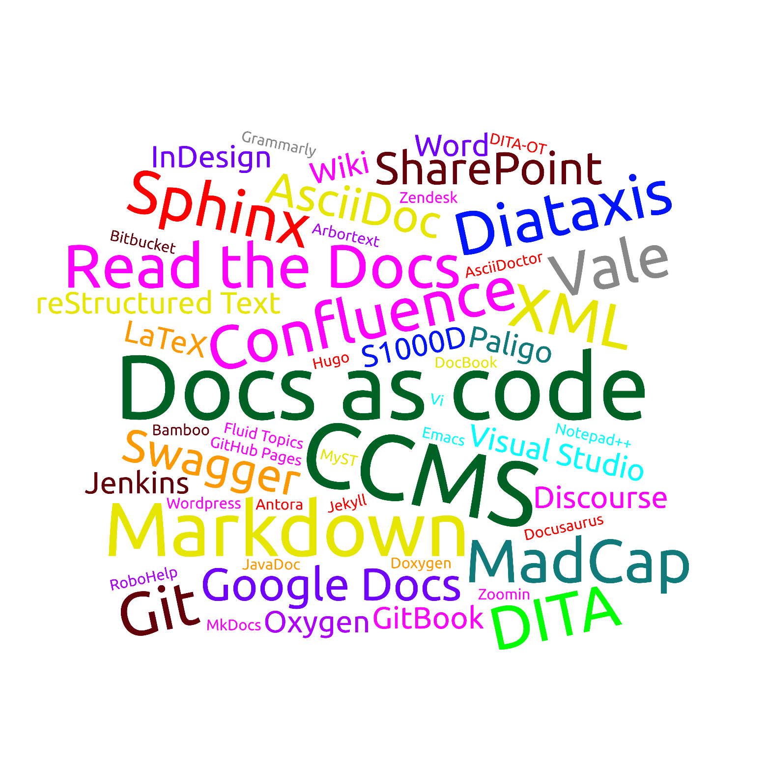
What is a “tool”?
Notes:
First question - what do I mean with “tool”?
Amount of tools can be overwhelming, but more manageable when classified:
Syntax/formats/markup languages (how to write)
Engines (transform to output)
Editors (for plain text files)
Editors with integrated engine/rendering (Oxygen/Arbortext for XML, or WYSIWG)
Delivery platforms (build/host like Read the Docs, input/output like Wiki/Forum, ingest and present like Zoomin/FluidTopics)
Storage/version control & build framework
Content framework for structuring content(DITA: both content framework and syntax)
Doc checkers for validation
Doc methodologies
You can mix and match – some work (Sphinx+Markdown or Word+Git) others don’t (InDesign+Emacs, CCMS+RTD)
Difficult to determine which to compare - apples and oranges
Methodologies: very central, on a different level than other tools (DITA or docs-as-code are not altenatives)

Slide 3
Documentation methodologies
Docs as code
CCMS
Use the same tools and workflows for documentation as for code
Write documentation in text files
Store files in version control
Define documents by grouping files
Manually or automatically build documentation output
Use established processes for review and approval
Pros and cons:
Full control over doc files/structure/processes
Everyone can choose their preferred editor
Flexibility for customization – but high complexity
Encourages developer contribution (or writing)
Use a specialized tool for all your documentation needs
Write documentation in the tool (usually WYSIWYG editor)
Save your content in semantic chunks (topics, snippets)
Define documents by grouping chunks
View automatically built documentation output
Use workflows defined in the tool for review and approval
Pros and cons:
The full process is controlled by the CCMS
Everyone involved must use the CCMS
Intuitive interface, focus on content without distractions
Gatekeeps control over documentation
Notes:
Docs as code: full control, flexibility, complexity
CCMS: black box, streamlined, focus on content, control of docs
Mindset, depends on you, your docs, company culture

Slide 4

How to decide?
Determine your requirements
  Questions in the following slides should help
  Relevance (and thus order) varies depending on your needs
Figure out what is non-negotiable
Do NOT compromise on any non-negotiables
Don’t go blindly for your favorite tool
Notes:
Questions are not in any order – depends on what is most important for YOU
Decide which points you do not want to compromise on (for example, PDF)
Stay strict on those non-negotiables – don’t plan with workarounds (on factors that are important for you)
Logical choice for me would have been Sphinx, but ended up with choice between DITA and AsciiDoc, and CCMS and docs-as-code
Will not go through all in detail, but more in the speaker notes

Slide 5

The team
Who writes the docs?
How big is the team?
  Will it grow?
Do others contribute?
  If so, who and how?
How is content reviewed?
Will new tools be accepted?
What skills does the team have?
How difficult is it to learn the new tool?
Can you hire people with the required skills?
Who maintains the tool?
  What skills are needed for that?
Contributors
Expertise
Notes:
Who: TW, devs were not allowed to contribute => up to me to decide
Team: 1, won’t grow => will NEED devs to contribute, make it easy to contribute
Skills: command line, Git => not everyone in a HW company, BUT: web interface (more usable for AsciiDoc)
Maintenance: TW vs dev vs contractor, Sphinx/Python, AsciiDoc/Ruby, DITA-OT/XSLT
-----
Who writes the docs: only TWs, TWs and devs, only devs, external contributors
Who will be affected by your choice, who should have a say, whose needs have priority (devs in a CMS vs. TWs in the dev team’s Git repo?)
How big is the team: single writer vs. team
Many people: more professional/off-the-shelf solution - easier to use, more constraints (CCMS)
Few people: home-grown solution might work - less coordination required, more flexibility (docs-as-code)
Will you get in trouble with your home-grown solution in the future? (established docs-as-code like RTD)
Contribution: external/casual contributors
Make it as quick and easy as possible to contribute
Consider the background of the contributors (Wiki vs. GitHub)
Do external contributors have access to the sources (probably not in a CCMS)
Review: Live changes (Wiki/Forum)? Iterations with comments (Word/Google docs)? Tracked sign-offs (GitHub)?
Flexibility for typo fixes? (strict process vs. flexibility)
Acceptance: new workflows, new skills; dividing up content and styling
Small changes if needed (Word -> Wiki)
Skills: Command line/Git? (Dare to) figure out a GUI?
Difficulty: Do you need instructions? Checklists? Or is it intuitive/given by workflow?
Hire: DITA, Docs-as-code, AsciiDoc, …
depends on region and industry
Maintenance: both setup and maintenance; what programming language/framework (Sphinx/Python, AsciiDoc/Ruby, DITA-OT/XSLT)
You? (your skills) With support of …
Others in the company? (their skills)
A contractor? (no niche skills)

Slide 6

The docs
How consistent are your documents?
  How consistent do you want them to be?
Do you reuse content?
Is the documentation part of the product development?
Do you have API docs?
Does your tooling choice affect others?
  Do you have translations?
Are there industry conventions or legal requirements?
  Do you need versioning?
In what format are the docs published?
  Are those the formats you want?
Where are the docs hosted?
How many documents do you have?
How important is the look & feel? (consistency, esthetics)
Should the output be consumable for AI?
  Or even optimized for AI?
Content
Delivery
Notes:
Consistency: consistent => rigid to enforce, not consistent => flexibility – we have HW & SW
Reuse: simple on topic level, harder for conditional text and variables => no Markdown
Format: PDF – want HTML (=> not Word)
Look & feel: split between content and presentation for consistency, but this means compromise on esthetics
-----
Consistency: many similar documents (enforce consistency) or wide range (flexibility)?
Consistent: rigid structure, templates to enforce consistency across different writers (DITA)
Flexible: don’t overcomplicate (Markdown)
Reuse: of paragraphs/fragments or topics
Include files (most tools, even Word) – how to keep track of documents that use a file?
More complicated: need for variables or conditional text, for example, for similar products (not plain Markdown)
Others: outside the company
Include/build on docs for other tools (must be compatible, automatic migration?)
Rebrand other docs (migrate them, maintain different tools)
Might also be the other way around
Can a translation agency work with the tool? Or can you use AI to translate?
Product dev: same timeline (usually: SW yes, HW no)
Yes: use same workflows (docs-as-code)
No: more flexibility (can also use docs-as-code, but not as integrated)
API docs: Combine API and conceptual docs or keep separate?
How much flexibility do you lose for conceptual docs (tools and workflows), and is that worth it?
Can you use one tool for API and conceptual docs? (Doxygen can do both)
Industry: HW – versioning/sign-off, SW – continuous delivery
Versioning at what level (document level, topic level, highlighted changes)
Touches on next point, delivery
Formats: HTML, PDF (epub, help, xml), which is the main focus
PDF: most can create some kind of PDF, but not necessarily pretty (not Markdown, Wiki, Forum)
HTML: most tools can do this, but think about hosting as well (not Word/Indesign/LaTeX, but CMS or sth supported by a publishing platform like RTD)
Hosting: mainly for HTML (but PDFs must be managed as well)
Company website vs. hosting platform (with custom URL?)
How many: one big doc center vs. many individual documents (that might be interlinked? Must be kept in sync?)
Related to the hosting part
Needs consideration if there is a mismatch for formats (one HTML doc but many PDFs)
Maybe consider a content delivery platform
Look & feel: two different aspects
Docs might be from different sources – can that be visible? (content delivery platform)
Control the layout or separate content and layout? (InDesign vs. DITA/AsciiDoc)
AI: touches on aspects already mentioned – consistency, format (semantic markup), hosting (retrievability), content vs. layout

Slide 7

The implementation
What tools do others in your company use?
  DevOps for product development?
  Do developers already have (internal) doc builds?
  Overall IT infrastructure and OS?
What is the budget?
Can you expect support?
  From whom?
What is the desired/required time to market?
How much customization is required?
Are you willing to compromise on functionality?
Do you already have documentation that should be migrated?
  Can this be automized?
Infrastructure
Getting started
Notes:
Infrastructure: piggy-back on existing solutions, don’t force tools on people
Budget: open-source docs as code vs. off-the-shelf, additional editor, contractor cost – also a time factor
Migration: in our case yes, but pandoc can do Word->AsciiDoc well, script to split files, some cleanup required because of badly formatted Word files
-----
Others’ tools: don’t reinvent the wheel
DevOps for docs-as-code (build servers, GitHub/GitLab/Bitbucket, hosting)
Piggy-back on internal doc builds
Don’t pick a Windows-only tool if everybody uses Linux (or the other way around – which is not as much of an issue)
Budget: free/affordable open-source vs. paid commercial
Generally: docs-as-code can be cheap/free, CCMS will cost
Might need specific editors in addition
Support: find someone to brainstorm and sanity-check with
In the company, a contractor, or a community
TtM: how quickly do you want this?
Depends on size of documentation and degree of learning required
But also company culture: quicker to set up a home-grown system or buy a full framework?
Customization: how much is needed?
related to TtM and “who does the work”
Can you use an off-the-shelf solution? Or do you need custom integrations (with a PIM, doc database, …)?
How hard is it to extend the tool, and who can do it?
Compromise: off-the-shelf vs. fully customized
Can you live with “non-perfect” docs for a while? Or should everything be in place before you switch?
Iterative approach of improving
Migration: not needed if you start from scratch
Migrate existing docs (before switch or with next update?) or keep old docs as they are?
How difficult is the migration? (pandoc, custom scripting might help, CCMS often has import functionality)

Slide 8

The outlook
Who can support contributors?
Who can do changes/fixes if needed?
Can you get support for the selected tool?
How difficult is it to onboard all contributors?
  How difficult is it to do a one-off change?
Will you still be happy with your tool in five years?
  How much work would it be to switch tools later?
Will the selected tool still exist and be supported?
If you and/or the main maintainer are no longer there, will the tool still work for others?
Short term
Long term
Notes:
Onboard: CCMS users (external? Licenses?) vs. install all tools / you’re on vacation – is the web interface usable?
5 years: not sure about docs-as-code vs CCMS! BUT: AsciiDoc->DocBook->CCMS will work
-----
Contributors: writer team, other internal contributors, external contributors
Who will respond to “this doesn’t work” or “I have trouble setting it up”?
Changes/fixes: something breaks (website is down, file is corrupt, merge went wrong) or there are new requirements (new document type, PDF footer change)
External contractor? Can you do it, or someone from your dev department?
What are the costs and the timeframe?
Support: professional paid support, community support (forum), read/edit the code
Onboarding: similar to learning curve for writing team, but based on different skills
SW devs might find a docs-as-code workflow simple, HW maybe not
A good, intuitive UI might be easy for everyone – but who does the user management?
How much setup is required for a one-off change – say the CTO spots a typo and wants to change it? (docs-as-code through Git web interface vs. CCMS with single-sign on), or you’re on vacation and so needs to back up
Long term: your team might grow or shrink, requirements might change (output format, go open-source)
Totally possible to start with docs-as-code and move to CCMS (consider migration costs)
Or move from CCMS to docs-as-code (consider export functionality and team skills)
Exist: consider trends, some tools are rather niche
Maintainer: avoid bus factor and highly home-grown tools

Slide 9
Thank you!
Answers?
Notes:
Out of time, out of questions ;)

