Slide 1
Paper Review:
Wind-Driven Accretion in PPDs
Ⅰ. Suppression of the MRI and Launching of the Magnetocentrifugal Wind
(Bai and Stone, 2013: ApJ, 769, 76)
ProtoPlanetary Disks
東北大学
天体理論グループ 修士1年 熊田 遼太

Slide 2
Outline
Outline
Introduction
Simulation Setup
Simulation Result
Summary
(Slide3-Slide9)

Slide 3
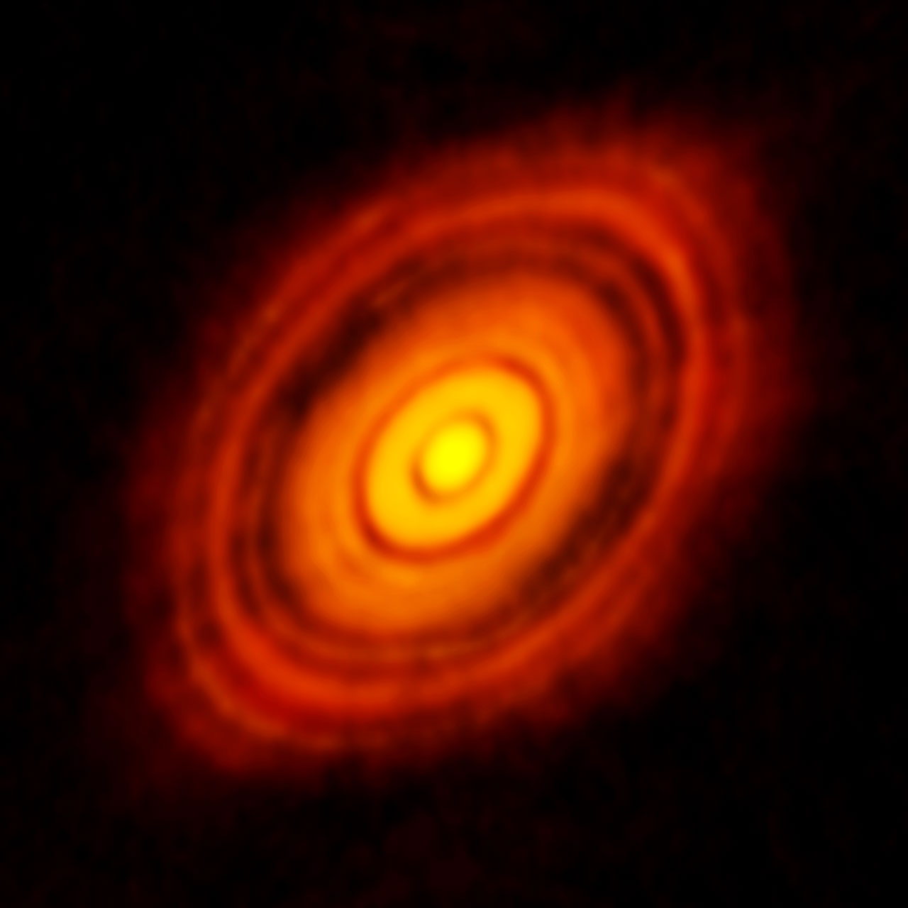
Protoplanetary disk (PPD)
Accretion disk around protostar : planet formation
Accretion rate : one of the most important quantities
If is too large
Disk disappear
before planets form
Accretion rate given by observation: (Gullbring et al. 1997)
ALMA image of the protoplanetary disc
around HL Tau
(ALMA Partnership et al. 2015)
Accretion is driven by transport of angular momentum
What is mechanism of transport of angular momentum ?

Slide 4
α disk model : Theoretical approach
(Shakura & Sunyaev 1973)
In this model
Transport mechanism = Turbulent viscosity parameterized by α
cs : sound speed
Σ : surface density
Derivation of
Stress tensor TRφ
(Stress tensor)
α-parameter
In PPD
Maxwell stress is described in MHD
Accretion rate

Slide 5
Magneto-Hydro dynamics (MHD)
Fluid mechanics for plasma
Plasma moves with magnetic field lines (frozen-in flux theorem)
Magnetic Pressure
Magnetic Tension
B
B
Tension
Pressure
Gradient
Plasma
Plasma
Important role in MRI (next slide)

Slide 6
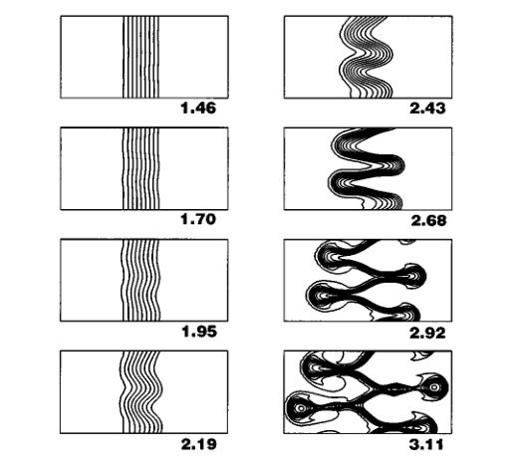
Magneto-Rotational Instability (MRI)
Instability caused by
differential rotation velocity in MHD
z
B
z
R
(Balbus & Hawley, 1998)
R
angular momentum
It is believed MRI plays a big role of mechanism of AM transport.

Slide 7
Magnetic diffusion
Induction equation
B
electron
neutral
B
J∥
J
Ohmic
Resistivity
J×B
J⊥
Ambipolar Diffusion
(detail:next slide)
Hall Effect
(not included in Bai&Stone 2013)
In PPD,
gas is weakly ionized.

Slide 8
Ambipolar diffusion
Induction equation
@ neutrals-rest frame
(= fluid-rest frame)
B
J∥
J
B
charge
(with B)
neutral fluid
J×B
J⊥
B

Slide 9
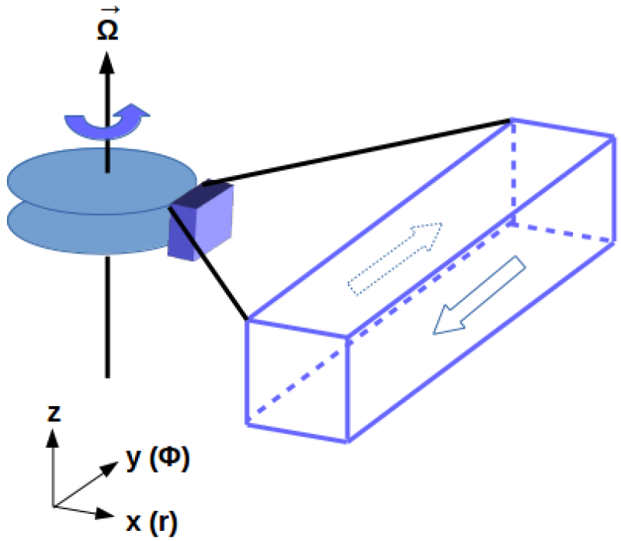
This Work : Bai & Stone 2013
Previous Research
Magnetic diffusion makes MRI weaker in general
Detail behavior is less well understood (except Ohm)
Bai & Stone 2013
What is the role of ambipolar in MRI ?
Is MRI really mechanism of transport ?
They did vertically stratified shearing-box
MHD simulations + (Ohm and ambipolar)
figure credit: https://www.astr.tohoku.ac.jp/~tomida/athena/modules.html

Slide 10
Outline
Outline
Introduction
Simulation Setup
Simulation Result
Summary
(Slide11-Slide12)

Slide 11
Basic Equation
Mass Conservation
Equation of Motion
z(height)
Coriolis
Centrifugal
Gravity
(radial)
Induction Equation
x
y
(azimuthal)
diffusion term
⬇
1 AU
protostar(1M⨀)

Slide 12
Initial & Boundary condition
Boundary Condition
x :shearing
y :periodic
z :outflow
z(height)
Note:
Modify mass at each time steps
to maintain steady state
y
x
(azimuthal)
(radial)
Initial Condition: Minimum-Mass Solar Nebular disk model
Sound speed cs = 1 km/s (at 1 AU)
Keplerian frequency Ω ∼ 10⁻⁷ s⁻¹ ∼ 1 yr⁻¹
Thermal scale height H ≡ cs /Ω ∼ 10¹² cm ∼ 0.1AU
Density profile ρ = (13.1×10⁻⁸ g cm⁻³) exp(-(z/H)²)
Magnetic field Bz Bz = 4.1 ×10³ G (1+sin(2πx/Lx))
Diffusivity using table
⬇
1 AU
Lx =4H
protostar(1M⨀)
Box Size
(0.4AU, 0.8AU, 1.6AU)

Slide 13
Outline
Outline
Introduction
Simulation Setup
Simulation Result
Summary
(Slide14-Slide17)
(Slide18)

Slide 14
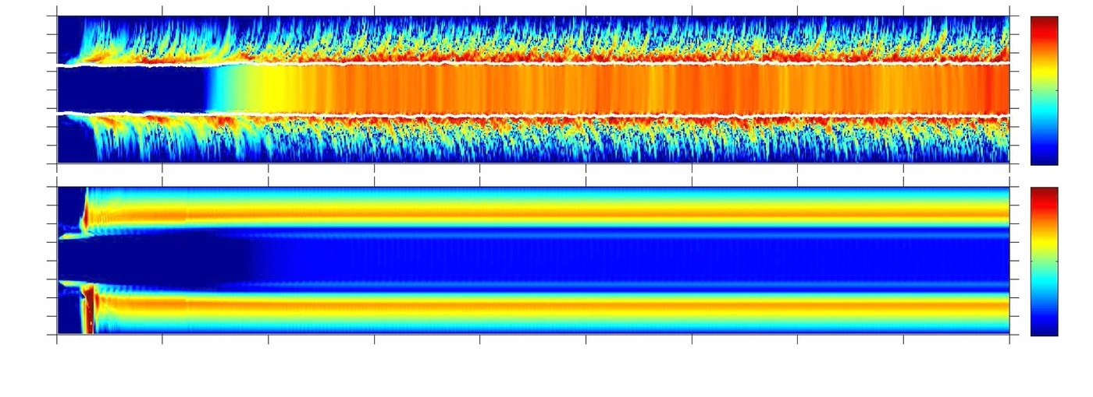
Result : Suppressing MRI
-2
Ohm
-8 -4 0 4 8
-3
z/H
-4
Ohm+
Ambipolar
-3.5
-8 -4 0 4 8
-4
-4.5
0
200
400
600
800
Time (Ω ⁻¹)
(Bai & Stone 2013)
Including only Ohm
Including Ohm + ambipolar
Strong Maxwell stress in upper region
weaker Maxwell stress
Ambipolar diffusion suppressed MRI

Slide 15
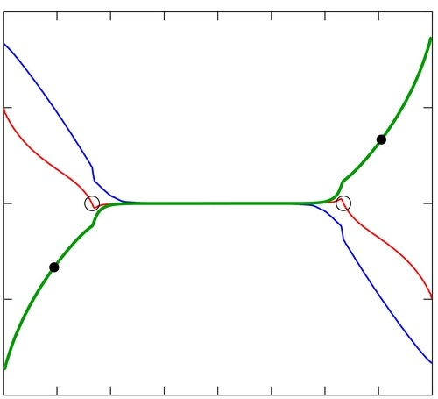
Result : Accretion rate considering only MRI
4
vz
2
0
Velocity (cs )
-2
vz
-4
-8
-6
-4
-2
0
2
4
6
8
z/H
note: H = 0.1 AU
Is there another main player of transport ?

Slide 16
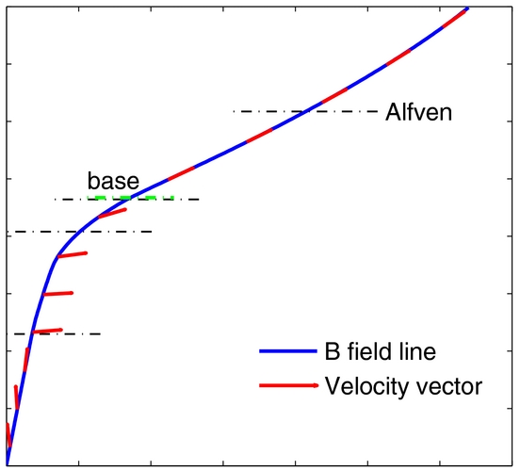
Result : Magneto-centrifugal Wind
Magneto-centrifugal wind
blows in this region
What is magneto-centrifugal wind?
4
B
7
vz
Ω
6
2
5
z/H
plasma
4
Velocity (cs )
0
3
⭐
disk region
2
1
-2
protostar
0
vz
0
1
2
3
4
5
6
7
-4
Plasma tied B-line is blown off.
x/H
-8
-6
-4
-2
0
2
4
6
8
z/H

Slide 17
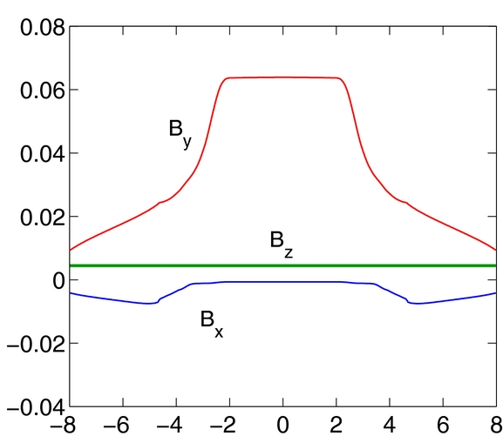
Result : Calculation of Accretion rate
B
z/H
considering magneto-centrifugal wind
has consistent with .

Slide 18
Summary
Question
What is the role of ambipolar diffusion in MRI ?
Is MRI really mechanism of transport ?
vertically stratified
shearing-box MHD simulations
with Ohm & Ambipolar
Conclusion
Ambipolar diffusion makes MRI extremely weaker
Magneto-centrifugal wind is
transport mechanism of angular momentum
Paper : Bai & Stone 2013; ApJ, 769, 76

Slide 19
Accretion rate given by observation
(Gullbring et al. 1998)
Gullbring et al. obtained accretion rate from luminosity of accretion disk.
:stellar radius
:stellar mass
:inner radius of accretion disk

Slide 20
Hall Effect
3 kinds of magnetic diffusion:
B
J∥
J
B
ion fluid
J×B
J⊥
electron(with B)
Hall Effect
(not included in Bai&Stone 2013)

Slide 21
Derivation of Magnetic diffusion
Equation of Motion of j with respect to neutrals
Lorentz force
collision term

Slide 22
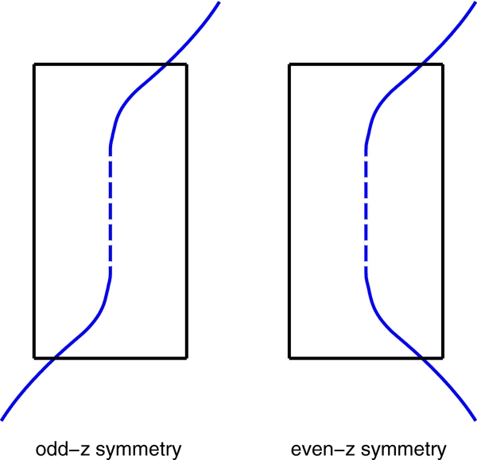
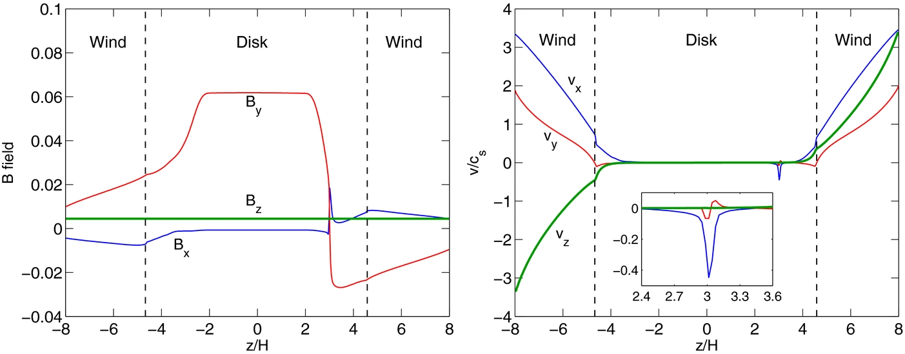
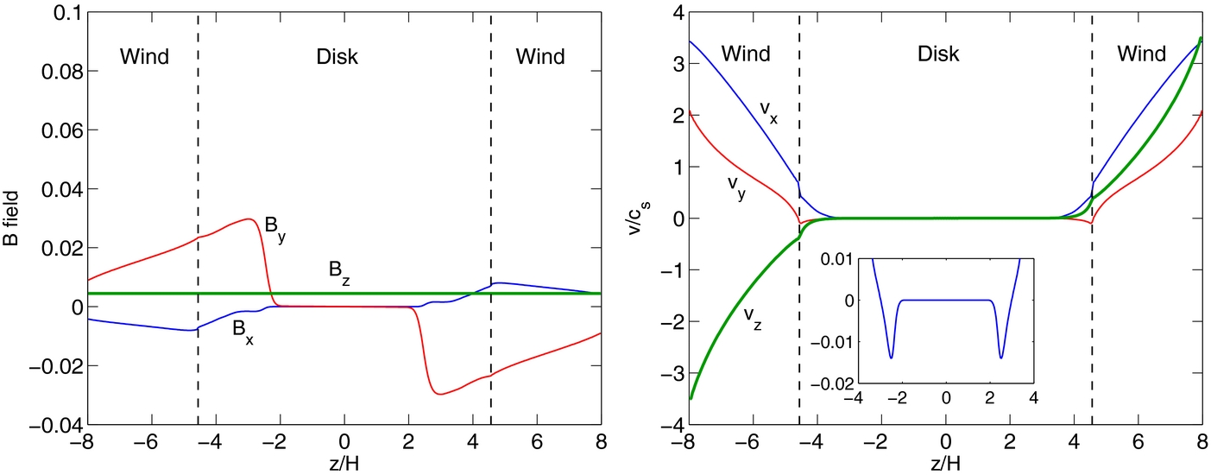
Comparison between Odd-z & Even-z
B field
Velocity field(v/cs)
Odd-z
Current layer
Even-z
Same configuration
in the wind region
regardless of symmetry

Slide 23
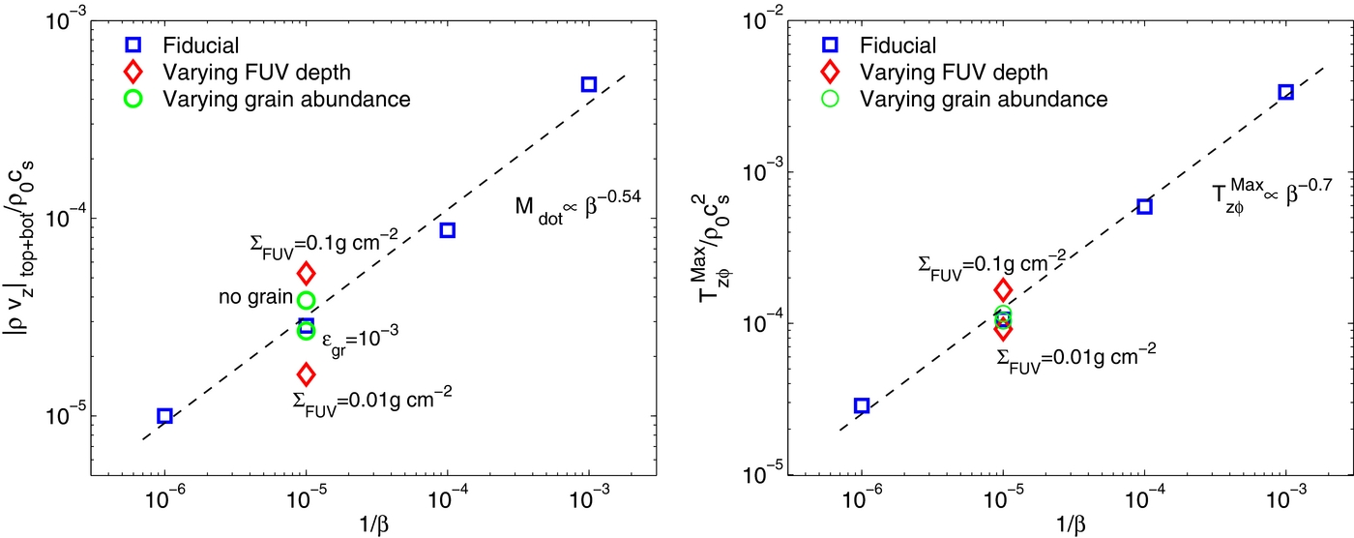
Parameter study
Comparing with ρvz and Tzϕ
under changing B0, FUV(Far Ultra Violet) penetration, Grain abundance
Wind efficiency mainly depends on B0 and FUV penetration

Slide 24
Initial & Boundary condition (detail)
Boundary Condition
x:shearing
y:periodic
z:outflow boundary
Hawley et al. 1995

Slide 25
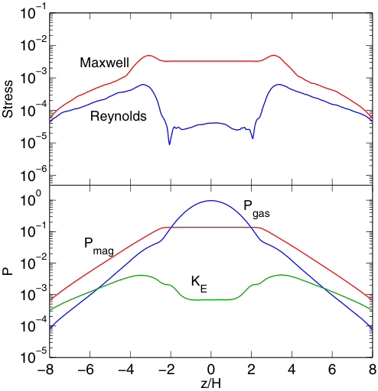
Profiles in Simulation 1
BS13

Slide 26
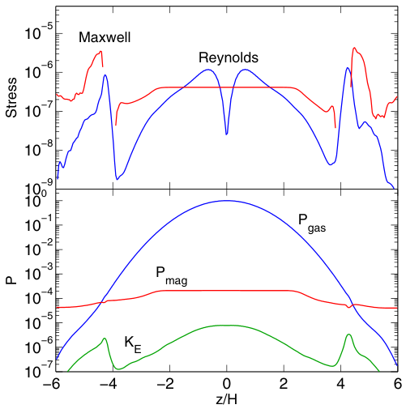
Profiles in Simulation 2
Constant
Bai & Stone (2013)

Slide 27
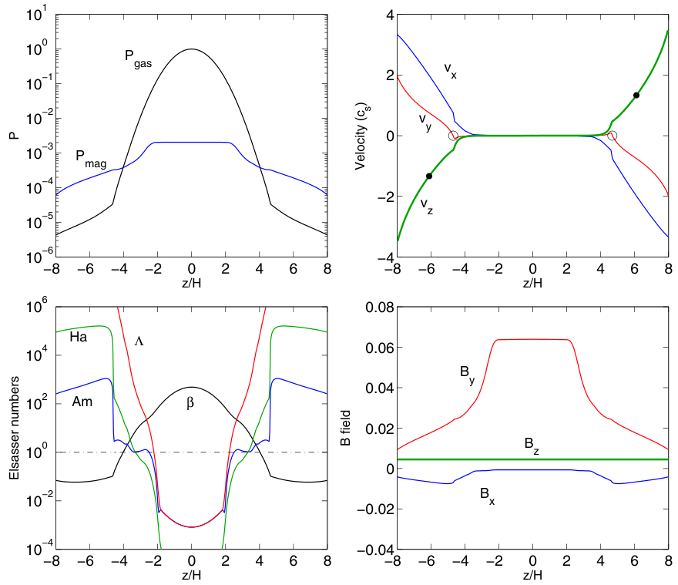
Profiles in Simulation 3

Slide 28
Profiles in Simulation 3

Slide 29
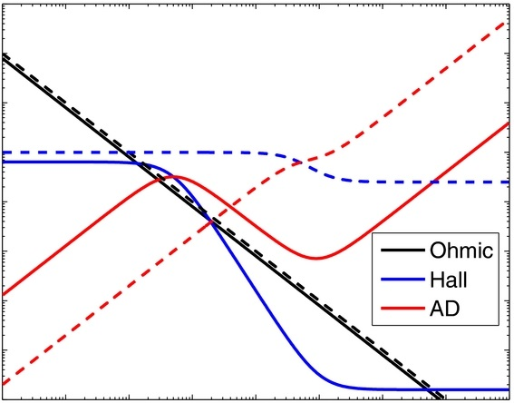
Magnetic Diffusivities
(detail:Bai 2011b)
3
Diffusivity of ambipolar η_{A} in BS13
B
η_{A}
∝η
QA1B ²
QA2Bi²
QA2B ²
QA1, QA2 : proportional coefficient
Bi : B when ion Hall parameter = 1
-5
-2
6
log βe
(Hall parameter of electron)

Slide 30
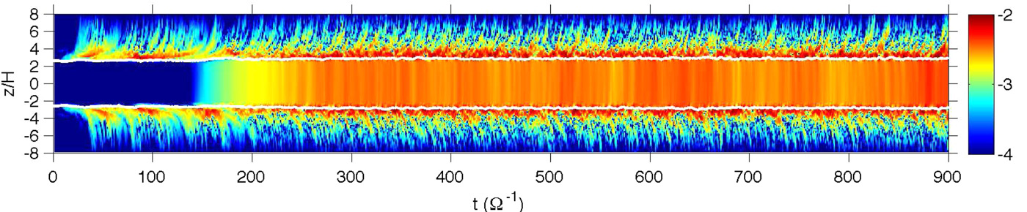
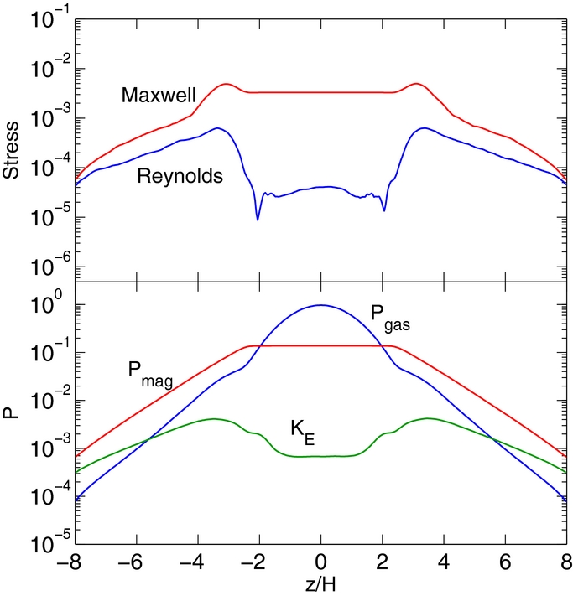
Detail of Ohm + B0
Bai & Stone (2013)
Accretion rate:
Ohmic resistivity causes
Maxwell stress stronger in midplane.

Slide 31
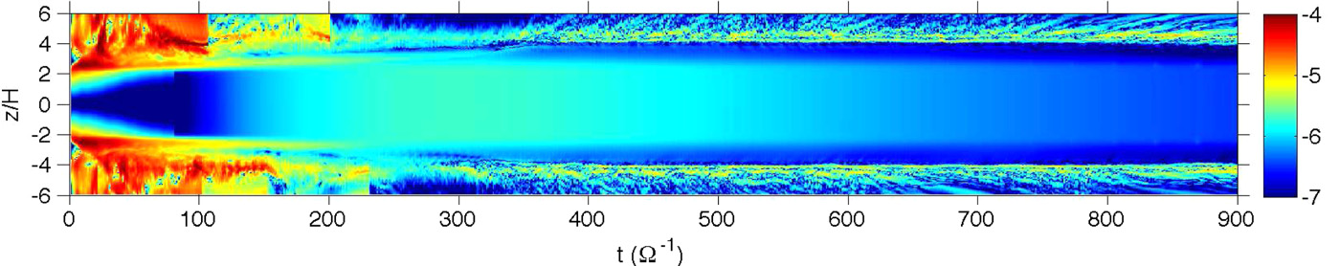
Ohm + AD + zero-B0
Bai & Stone (2013)
discontinuous
Calculated accretion rate:
Too small
MRI is extremely suppressed by Ambipolar Diffusion

Slide 32
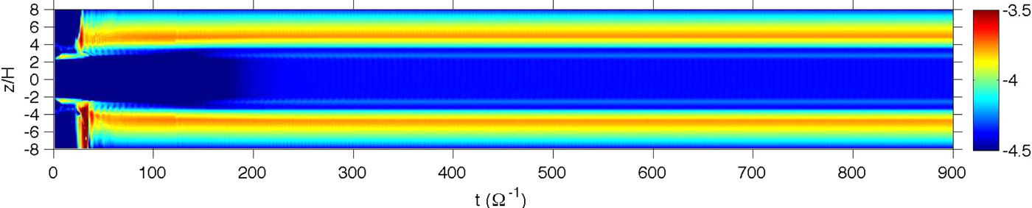
Detail of Ohm + Ambipolar + B0
(Bai & Stone, 2013)

Slide 33
Accretion rate
NS eq.

Slide 34
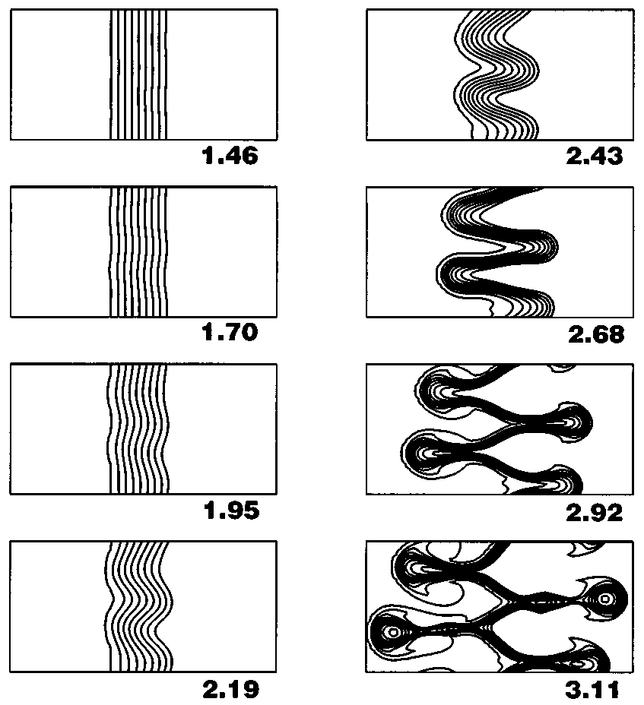
Instability caused by
differential rotation velocity in MHD
R
Plasma & B
z
Rotation Velocity
Magnetic
Tension
R
Torque
Balbus & Hawley (1998)

