Slide 1


Chapter 9
(Layered drawings of digraphs)
u
v
By: Waldo & Ludo

Slide 2
Chapter 9 (Graphically)
The hierarchical approach:
Handled by :
DiGraph G
Cyclic
(9.4)
Waldo
Cycle Removal
aCyclic
(9.1)
Ludo
Layer assignment
(9.2)
Waldo
Crossing reduction
(9.3)
Layered drawing of G
X coordinate assignment

Slide 3
Important requirements of layering:
The layered digraph should be compact.
The layering should be proper.
The number of dummy vertices should be small

Slide 4
The layering algorithm:
No labels are set
Assign labels (integer),
such that s < v < t
Assign vertices to a layer,
such that layer of t <= v <= s

Slide 5
selecting vertices to label
When choosing a vertex v all preceding vertices u (u,v) should be labeled and minimized.
Minimization is accomplished by looking at the most significant labels.
Example {6} < {3,7}; {1,2,9} < {2,3,9}; etc.
For more on this definition see page 274 of the book

Slide 6
Phase one (assign labels)
1
2
7
4
3
6
9
10
8
5
12
11
13

Slide 7
selecting vertices to add to a layer
When choosing a vertex u all vertices v (u,v) should be placed in a layer lower than u.

Slide 8
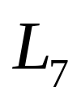
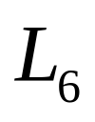
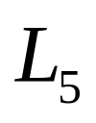
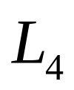
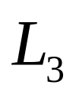
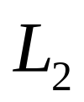

Phase two (assign layers)
1
1
2
3
2
7
4
3
6
5
4
9
10
8
5
8
7
6
12
11
10
9
13
12
11
13

Slide 9
Algorithm (Coffman-Graham layering)
Input: Reduced digraph G=(V,E) and a positive integer W
Output: Layering of G of width at most W
Initially, all vertices are unlabeled (trivial, as we’ve seen)
For (i = 1 to |V|) perform
a. Choose an unlabeled vertex v, such that {lbl(u) : (u,v) element of E } is minimized
b. Lbl(v) = i
K=1; L1=null; U=null.
While U != V loop
a. Choose u element of (V-U), such that every vertex in {v : (u,v) element of E} is in U, and lbl(u) is maximized
b. If not |Lk| < W and for every edge (u,w), w is element of preceding levels
then k++;
add u to Lk
c. Add u to U.

Slide 10
Phase two (adjusted)
1
2
1
7
4
3
6
4
3
9
10
8
5
8
7
12
11
10
9
5
13
12
11
13
6
2

Slide 11
Algorithm (Coffman-Graham layering) adjusted
Exercise.. (only for phase two – previous slide)
A. Describe the adjusted algorithm
B. Draw the iterational steps of the adjusted algorithm one by one.

Slide 12
Crossing Reduction
Input: proper layered digraph
Layer-by-Layer Sweep
Two-Layer Crossing Problem

Slide 13





Two-Layer Crossing Problem
Each vertex in the two layers gets a unique x-coordinate, purely for ordering purposes:

Slide 14

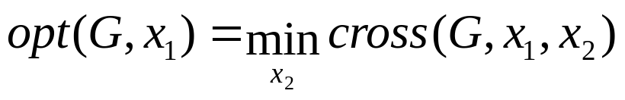
Two-Layer Crossing Problem
Two-Layer Crossing Problem

Slide 15
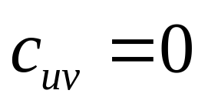
Crossing Numbers
u
v

Slide 16
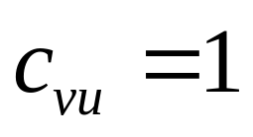
Crossing Numbers
v
u

Slide 17
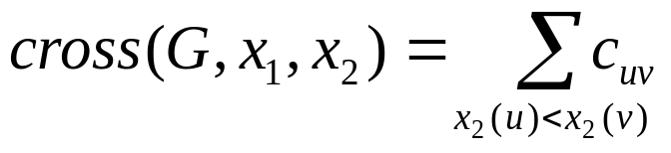
Crossing Numbers
p
q
u
r
 | p | q | u | r
p | 0 | 2 | 1 | 1
q | 5 | 0 | 6 | 3
u | 6 | 9 | 0 | 6
r | 2 | 3 | 2 | 0

Slide 18
Crossing Numbers
p
q
u
r
 | p | q | u | r
p | 0 | 2 | 1 | 1
q | 5 | 0 | 6 | 3
u | 6 | 9 | 0 | 6
r | 2 | 3 | 2 | 0

Slide 19
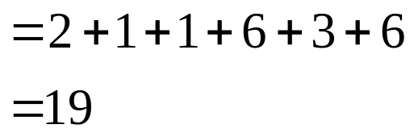
Crossing Numbers
p
q
u
r
 | p | q | u | r
p | 0 | 2 | 1 | 1
q | 5 | 0 | 6 | 3
u | 6 | 9 | 0 | 6
r | 2 | 3 | 2 | 0

Slide 20
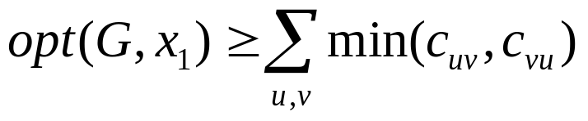
Crossing Numbers
p
q
u
r
 | p | q | u | r
p | 0 | 2 | 1 | 1
q | 5 | 0 | 6 | 3
u | 6 | 9 | 0 | 6
r | 2 | 3 | 2 | 0

Slide 21
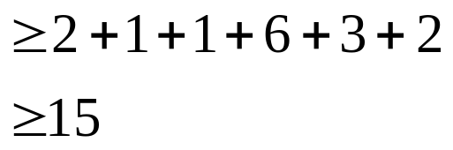
Crossing Numbers
p
q
u
r
 | p | q | u | r
p | 0 | 2 | 1 | 1
q | 5 | 0 | 6 | 3
u | 6 | 9 | 0 | 6
r | 2 | 3 | 2 | 0

Slide 22
Algorithms for minimizing
Adjacent Exchange
  Similar to Bubble-sort
Split
  Similar to Quick-sort
Barycenter Method
Median Method
Quadratic time
Linear time

Slide 23
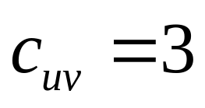
Adjacent-Exchange
u
v

Slide 24

Adjacent-Exchange
v
u

Slide 25
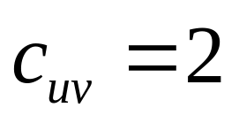
Adjacent-Exchange
u
v

Slide 26
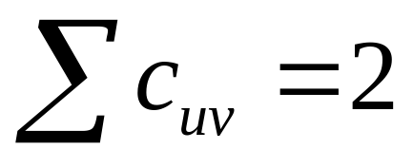
Adjacent-Exchange
v
u

Slide 27
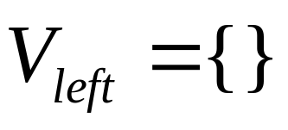
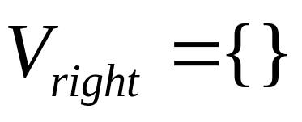
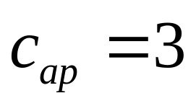
Split
a
p

Slide 28
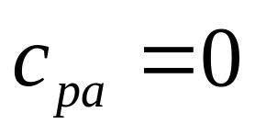
Split
p
a

Slide 29
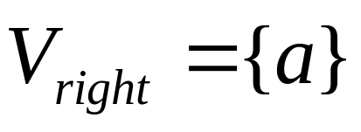
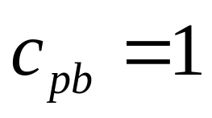
Split
p
b

Slide 30
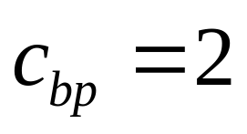
Split
b
p

Slide 31
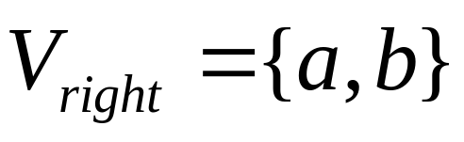
Split
p

Slide 32
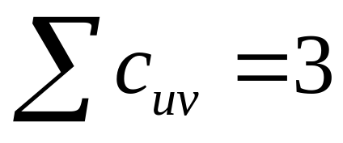
Split
p
a
b

Slide 33
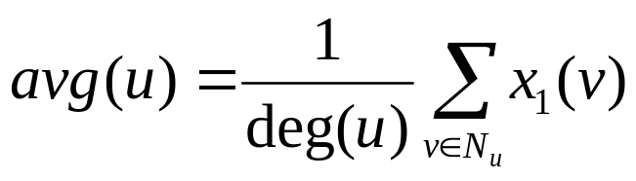
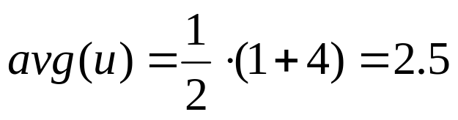
Barycenter Method
u
1
2
3
4
5
6
7
If same barycenter: seperate arbitrarily by small amount

Slide 34
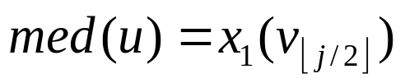

Median Method
u
1
2
3
4
5
6
7
Median
???
X-coordinate of u is the median of its neighbours
If no neighbours, then med(u) = 0
Special case, if med(u) = med(v)...odd degree left, even right

Slide 35
Not always optimal
Barycenter
1
2
3
4
5
6
7
Median
1
2
3
4
5
6
7
8
9
10

Slide 36
Horizontal Coordinate Assignment
Bends occur at dummy vertices
Objective is to:
  Reduce angles of bends (minimal width)
  Keep ordering of crossing reduction step

Slide 37
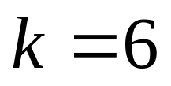
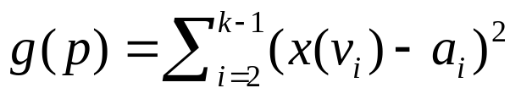

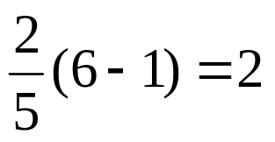
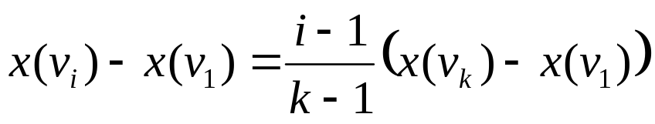

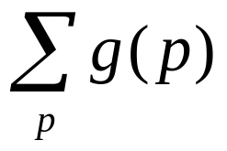

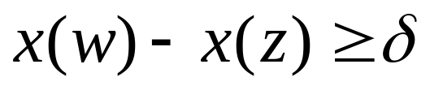
Horizontal Coordinate Assignment
X
0
1
2
3
4
5
6
1
2
2
3
3
4
5
6

Slide 38
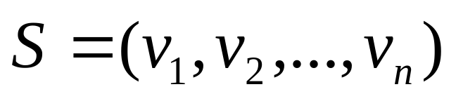
Cycle Removal
Vertex sequence for G:
1
2
3
4
5
6
Dashed edges are the leftward edges
Leftward edges form feedback set R
Reversing R makes G acyclic
7
8
9
1
2
3
4
5
6
7
8
9

Slide 39
Cycle Removal
Problem:
  Minimizing leftward edges / feedback set R
How?
  Greedy Cycle Removal Algorithm

Slide 40
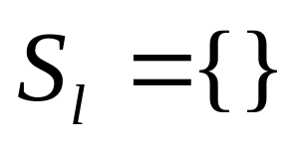
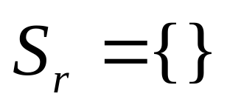
Cycle Removal
1
2
3
Iterate: prepend sinks to Sr and remove them from G
4
5
6
7
8
9

Slide 41
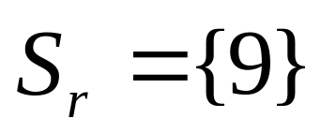
Cycle Removal
1
2
3
Iterate: prepend sinks to Sr and remove them from G
4
5
6
7
8

Slide 42
Cycle Removal
1
2
3
Iterate: prepend sinks to Sr and remove them from G
4
5
6
Iterate: append sources to Sl and remove them from G
7
8

Slide 43
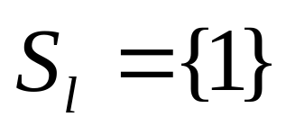
Cycle Removal
2
3
Iterate: prepend sinks to Sr and remove them from G
4
5
6
Iterate: append sources to Sl and remove them from G
7
8

Slide 44
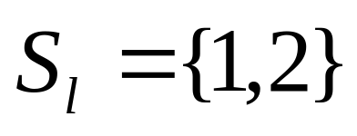
Cycle Removal
3
Iterate: prepend sinks to Sr and remove them from G
4
5
6
Iterate: append sources to Sl and remove them from G
7
8

Slide 45
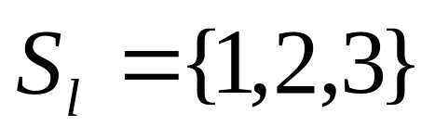
Cycle Removal
Iterate: prepend sinks to Sr and remove them from G
4
5
6
Iterate: append sources to Sl and remove them from G
7
8

Slide 46
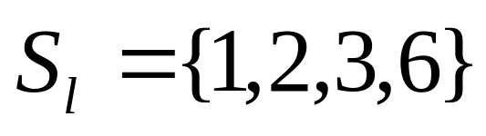
Cycle Removal
Iterate: prepend sinks to Sr and remove them from G
4
5
Iterate: append sources to Sl and remove them from G
7
8

Slide 47
Cycle Removal
Iterate: prepend sinks to Sr and remove them from G
4
5
Iterate: append sources to Sl and remove them from G
7
8
Choose vertex u such the outdegree(u) – indegree(u) is max, append to Sl and remove from G

Slide 48
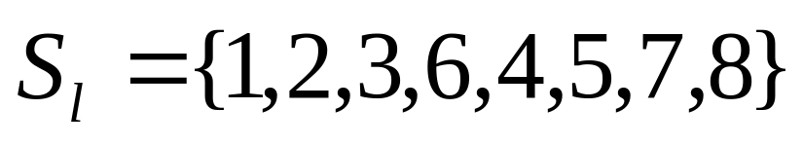
Cycle Removal
Iterate: prepend sinks to Sr and remove them from G
Iterate: append sources to Sl and remove them from G
Choose vertex u such the outdegree(u) – indegree(u) is max, append to Sl and remove from G
Concatenate Sl and Sr to obtain S

Slide 49
Cycle Removal
1
2
3
4
5
6
7
8
9
1
2
3
6
4
5
7
8
9

Slide 50
Cycle Removal
1
2
3
4
5
6
7
8
9
1
2
3
6
4
5
7
8
9

Slide 51
Chapter 9 (in a nutshell)
The hierarchical approach:
Layer assignment
Crossing reduction
Horizontal coordinate assignment

Slide 52
Exercise
Prove Theorem 9.1 (Exercise 3 in book)

