Slide 1
Layered Graph Drawing
(Sugiyama Method)

Slide 2
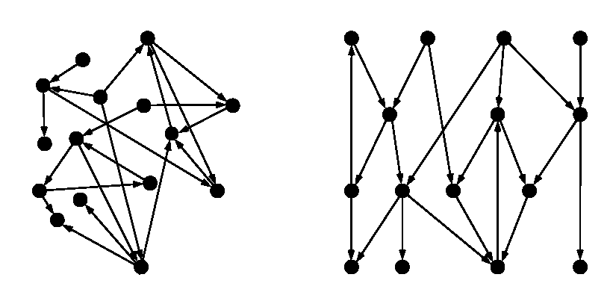
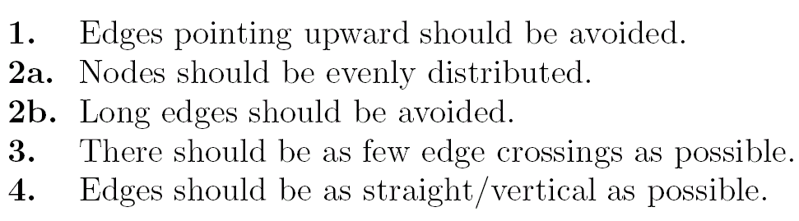
Drawing Conventions and Aesthetics
a digraph
A possible layered drawing

Slide 3
The Sugiyama method
Layered networks are often used to represent dependency relations.
Sugiyama et al. developed a simple method for drawing layered networks in 1979.
Sugiyama’s aims included:
  few edge crossings
  edges as straight as possible
  nodes spread evenly over the page
The Sugiyama method is useful for
  dependency diagrams
  flow diagrams
  conceptual lattices
  other directed graphs: acyclic or nearly acyclic.

Slide 4
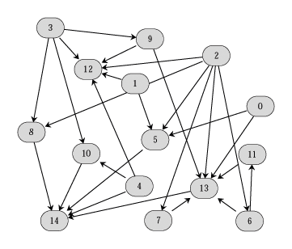
The Sugiyama method

Slide 5
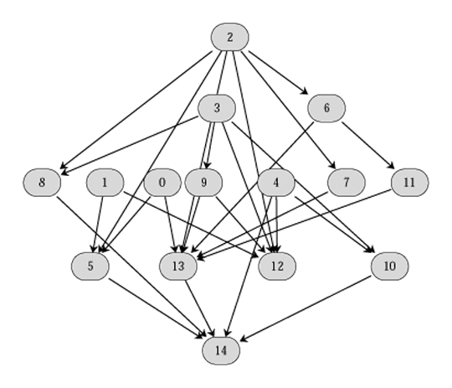
The Sugiyama method
Step 1
Cycle Removal
Step 2
Layering

Slide 6
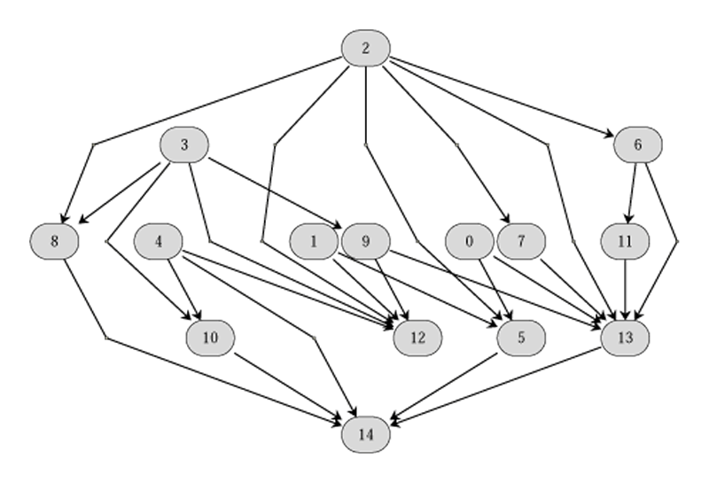
The Sugiyama method
Step 1
Cycle Removal
Step 2
Layering
Step 3
Node ordering

Slide 7
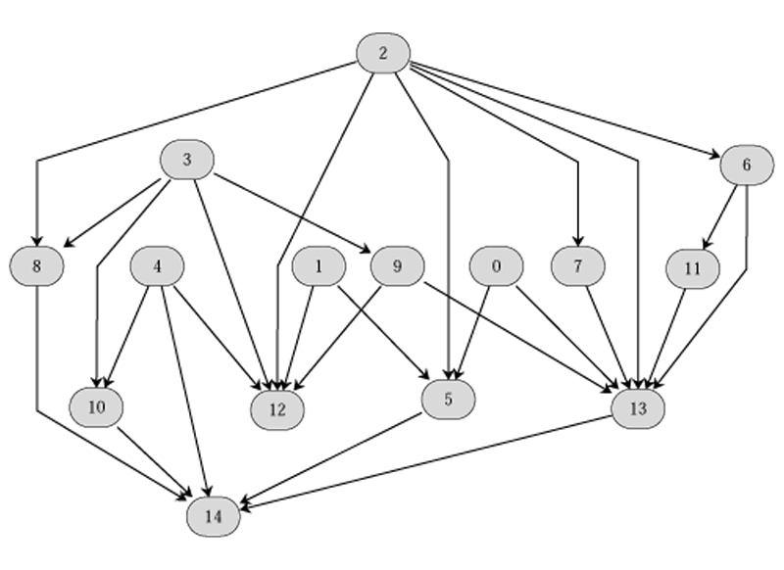
The Sugiyama method
Step 1
Cycle Removal
Step 2
Layering
Step 3
Node ordering
Step 4
Coordinate
assignment

Slide 8
Layered Drawing of Digraphs
Polyline drawings of digraphs with vertices arranged in horizontal layers
Sugiyama, Tagawa and Toda ‘81
Eades and Sugiyama ‘91
Evolutionary algorithm approach of Branke et al.
Magnetic field approach of Sugiyama and Misue.
Attractive in practice: most graph drawing systemsinclude the Sugiyama method.

Slide 9
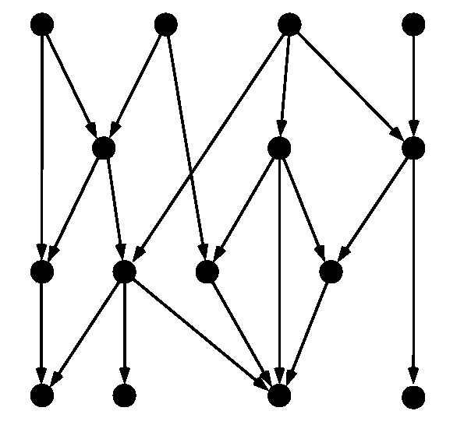
Step 1. Cycle Removal
Input graph may contain cycles
  1. make an acyclic digraph by reversing some edges
  2. draw the acyclic graphs
  3. render the drawing with the original edge directions
Acyclic graph by
reversing two edges

Slide 10
Step 1. Cycle Removal
Each cycle must have at least one edge against the flow
  We need to keep the number of edges against the flow small
Main problem: how to choose the set of edges R so that it is small
Feedback arc set:
  set of edges R whose reversing makes the digraph acyclic
Feedback edge set:
  set of edges whose removal makes the digraph acyclic
Maximum acyclic subgraph problem
  find a maximum set Ea such that the graph(V, Ea) contains no cycles : NP-hard
Feedback arc set problem
  find a minimum set Ef such that the graph(V, E \ Ef) contains no cycles : NP-hard

Slide 11
Step 1. Cycle Removal
Edges in E \ Ea will be reversed
Assume no two-cycles (or delete both two edges)
Heuristics
  Fast heuristic
  Enhanced Greedy heuristic
  Randomized algorithm:[BS90]: O(mn) time
Exact algorithm: [Grotschel et al 85, Reinelt 85]

Slide 12
1. Fast heuristic
Maximum acyclic subgraph problem
  equivalent to unweighted linear ordering problem: find an ordering of the vertices, a mapping o such that the # of edges (u,v), o(u) > o(v) is minimized.
Easiest heuristic
  take an arbitrary ordering
  then delete the edges (u,v) with o(u) > o(v)
  May use given ordering: BFS or DFS
  No performance guarantee: reverse |E|-|V|-1 edges (DFS)
Heuristic that guarantees acyclic set of size at least ½|E| [BS90]
  Delete for every vertex either incoming or outgoing edges
  Linear time

Slide 13
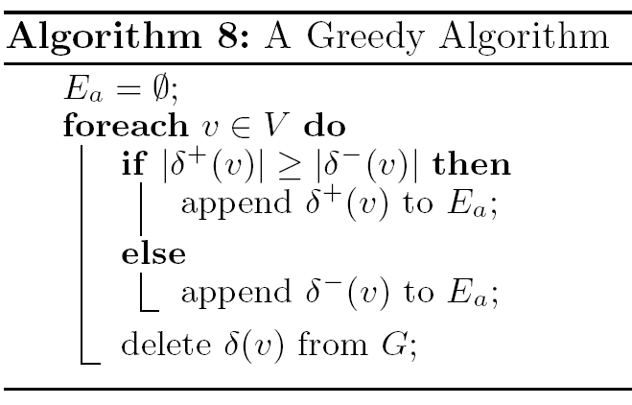
1. Fast heuristic [BS90]

Slide 14
2. Enhanced greedy heuristic
Feedback set problem: equivalent to finding a vertex sequence with as few leftward edges as possible
  S=(v1, v2, …, vn): vertex sequence of a digraph G
  Leftward edge: (vi, vj) with i > j
  set of leftward edges for a vertex sequence forms a feedback set

Slide 15
Greedy Cycle Removal
Greedy cycle removal heuristic [Eades et al 93]
  Source & sink play a special role: edges incident to source & sink cannot be part of a cycle
  Successively remove vertices from G
  Add each in turn, to one of two lists Sl & Sr, either the end of Sl or the beginning of Sr
  Greedy: choice of vertices to be removed and the choice of the list to be added

Slide 16
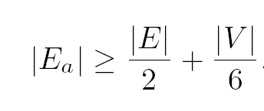
Greedy Cycle Removal
Greedy Cycle Removal [Eades et al 93]
  All sinks (sources) should be added to Sr (Sl)
  Choose a vertex u whose outdeg(u)-indeg(u) is maximized and add to Sl
  performance
  Can be implemented in linear time and space
  Sparse graph: Ea with at least 2/3|E|

Slide 17
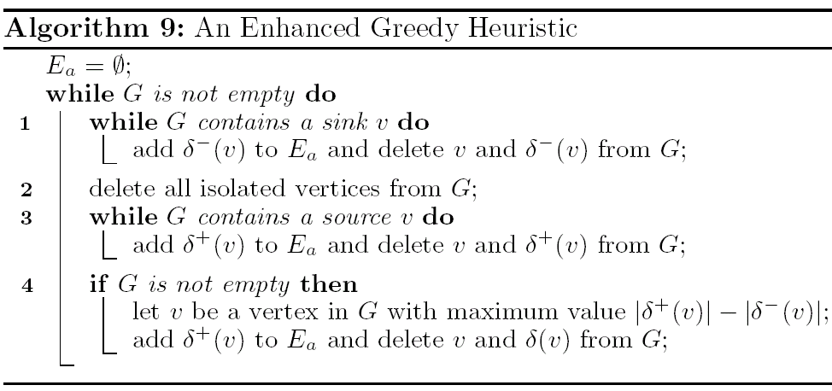
Greedy Cycle Removal

Slide 18
Analysis
Delete all two cycles before applying Greedy-cycle-removal
  Two-cycle: a directed cycle with two edges
[Theorem] G: connected digraph with n vertices & m edges without two cycles. Greedy-Cycle-Removal computes a vertex sequence S of G with at most m/2 – n/6 leftward edges
[Theorem] Greedy-Cycle-Removal can be implemented in linear time & space
Simple & speedy
Sparse graph [EL95]
[Theorem] G: connected digraph with n vertices & m edges without two cycles. Each vertex of G has total degree at most 3. Greedy-Cycle-Removal computes a vertex sequence S of G with at most m/3 leftward edges

Slide 19
Step 2. Layer Assignment
Layering: partition V into L1, L2, …, Lh
Layered (di)graph: digraph with layers
Height h: # of layers
H-layered graph: digraph with height h
Width w: # of vertices with largest layer
Span of an edge
Proper digraph: no edge has a span > 1
Some application, vertices are preassigned to layers
However, in most applications, we need to transform an cyclic digraph into a layered digraph

Slide 20
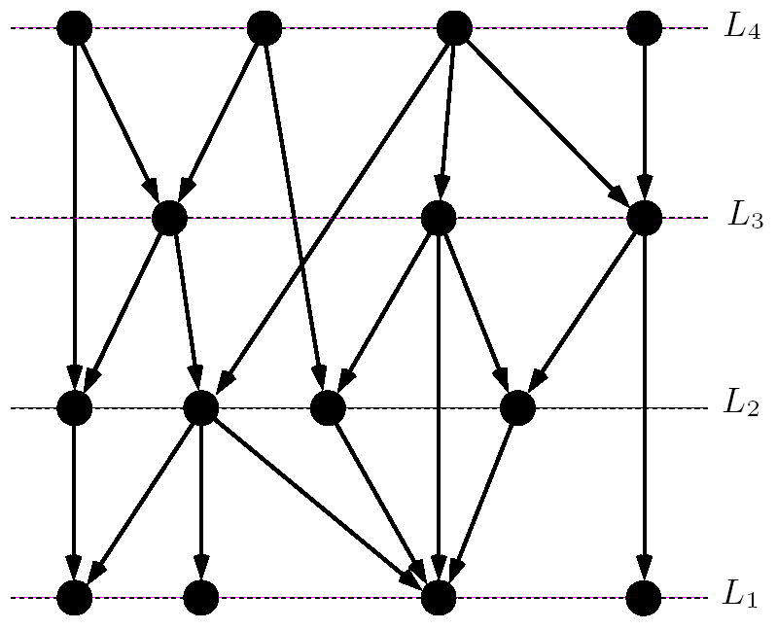
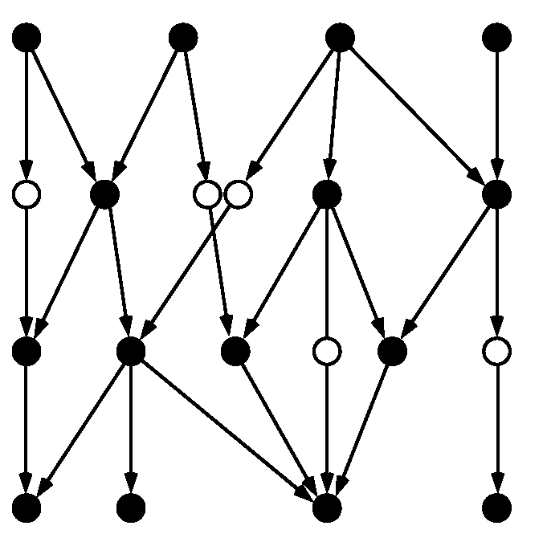
Y=4
Y=3
Y=2
Y=1
Layering
Introducing dummy vertices

Slide 21
Step 2. Layer Assignment
Requirements
  1. Layered digraph should be compact: height & width
  2. The layering should be proper: add dummy vertices
  3. The number of dummy vertices should be small
    A. time depends on the total number of vertices
    B. bends in the final drawing occur only at dummy vertices
    C. the number of dummy vertices on an edge measures the y extent of the edge: avoid long edge.
Methods
  1. Longest path layering: minimize height
  2. Layering to minimize width
  3. Minimize the number of dummy vertices

Slide 22
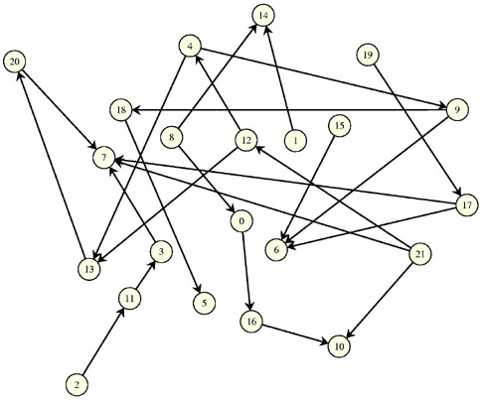
Three Layering Algorithms
Grafo1012 (Di Battista et al., Computational Geometry: Theory and Applications, (7), 1997)
Longest Path
Coffman-Graham
Network Simplex

Slide 23
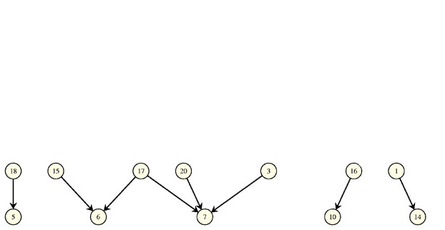
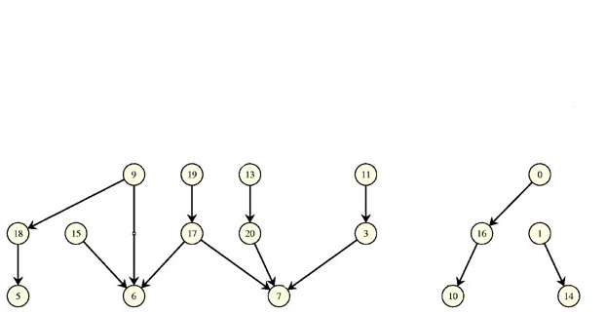
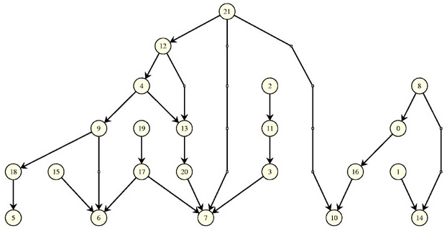
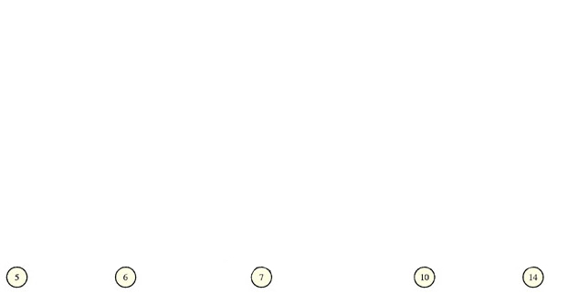
Longest Path Layering

Slide 24
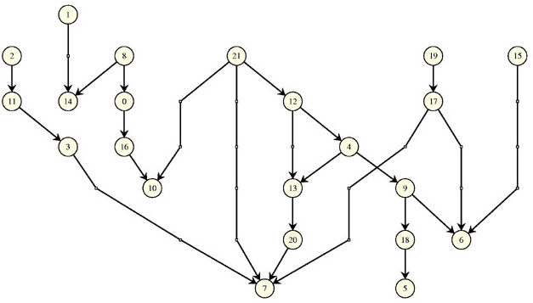
Coffman-Graham Layering (1972)
h ≤ (2-2/W)h_{opt}

Slide 25
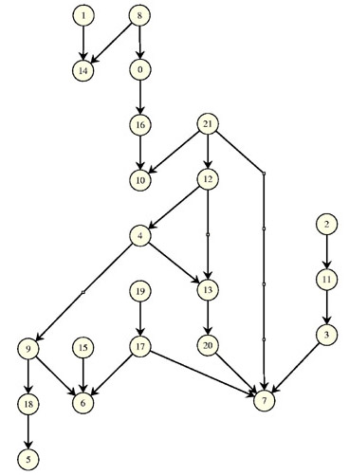
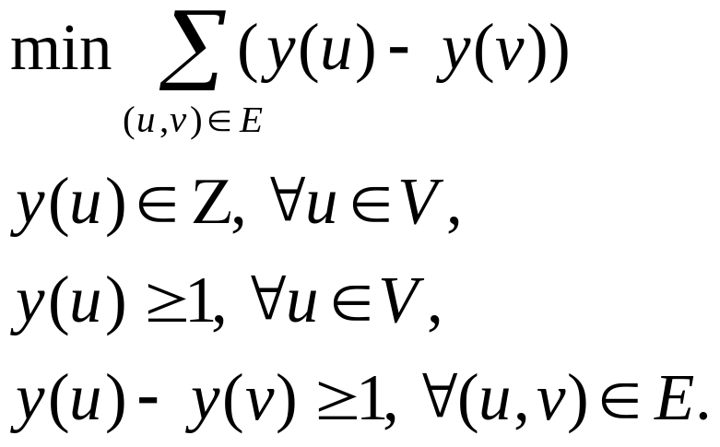
Network Simplex Layering (AT&T, 1993)
ILP formulation

Slide 26


1. Longest path layering
Minimizing the height
Place all sinks in layer L₁
Each remaining vertex v is placed in layer L_{p+1},
where the longest path from v to a sink has length p
Can be computed in linear time
Main drawback: too wide

Slide 27
2. Layering to minimize width
Finding a layering with minimum height subject to a maximum width constraint: Precedence-constrained multiprocessor scheduling problem -> NP-complete [GJ79]
Coffman-Graham Layering
  Input: reduced graph G (no transitive edges) and W
  Output: layering of G with width at most W
  Aim: ensure the height of the layering is kept small [LS77]
  Two phases
  1. Order the vertices
  2. Assign layers
Width: does not count dummy vertices

Slide 28
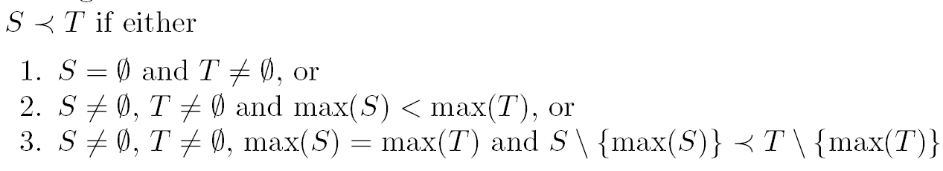
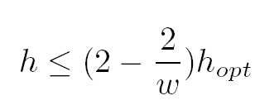
Coffman-Graham Layering
Simple lexicographic order:
First phase: lexicographical ordering
Second phase: ensure that no layer receive more than W vertices
[LS77] height is not too large

Slide 29
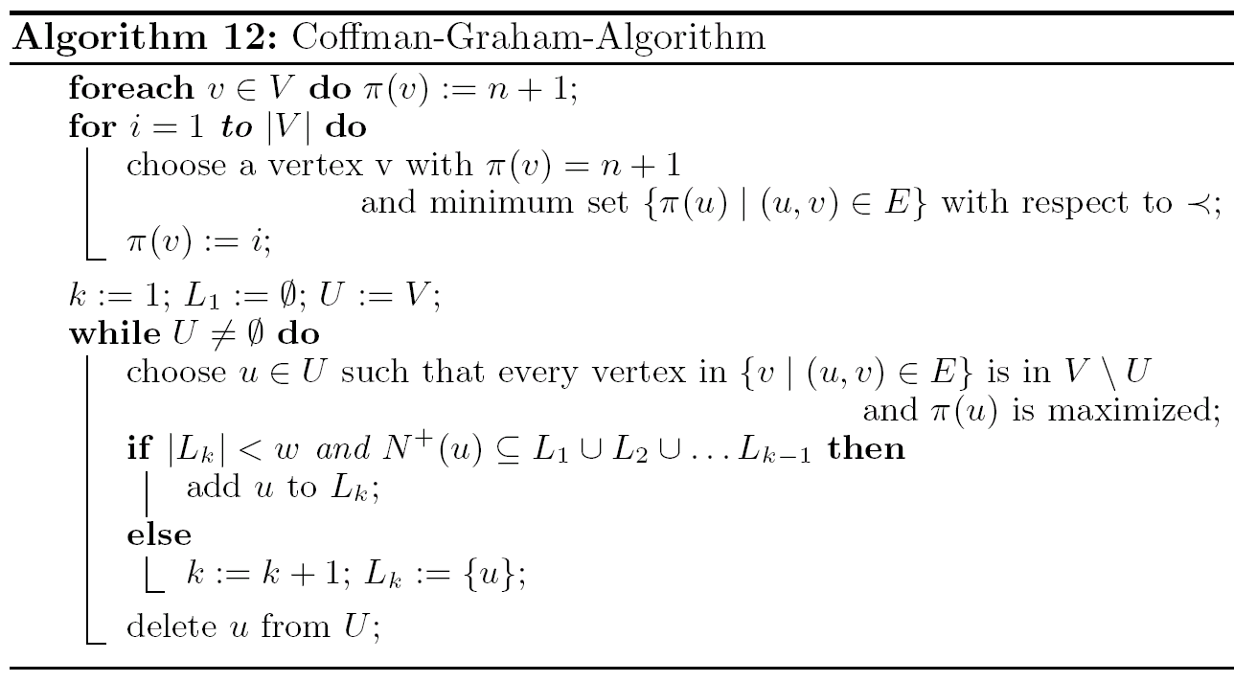
Coffman-Graham Layering

Slide 30
3. Minimizing # of dummy vertices
one can compute a layering in polynomial time that minimizes the number of dummy vertices [GKNV93]
f = Σ _{(u,v)∈V} ( y(u) - y(v) - 1)
f: sum of vertical spans of the edges in the layering
- # of edges : (# of dummy vertices)
Layer assignment problem is reduced to choosing y-coordinates to minimize f
Integer linear programming problem

Slide 31
Remark
Methods
  1. Layering for general graphs [Sander 96]
  2. Minimizing the height: Longest path layering
  3. Layering with given width: Coffman-Graham algorithm: width is more important than height
  4. Minimizing the total edge span (# of dummy vertices) : relatively compact drawing
[Sander 96]
1. Calculate y by DFS or BFS
2. Calculate minimum cost spanning trees
3. Apply spring embedder

Slide 32
Step 3. Crossing Reduction
Input: proper layered graph
# of edge crossings does not depend on the precise position of the vertices, but only the ordering of the vertices within each layer (combinatorial, rather than geometric)
NP-complete, even for only two layers [GJ83]
Many heuristics
  Layer-by-layer sweep: two layer crossing problem
  1. Sorting
  2. Barycenter method
  3. Median method
  4. Integer programming method: exact algorithm

Slide 33
Crossing Reduction: ordering
1
2
2
1
3
4
5
4
5
3
6
7
6
7
step 3
8
9
9
8
10
11
12
11
10
12
13
14
13
14
21 edge crossings
5 edge crossings

Slide 34
Layer-by-layer sweep
A vertex ordering of layer L₁ is chosen
For i = 2, 3, …, h
  The vertex ordering of L_{i-1} is fixed
  Reordering the vertices in layer Li to reduce edges crossings between L_{i-1} and L_{i}
Two layer crossing problem:
given a fixed ordering of L_{i-1}, choose a vertex ordering of Layer L_{i} to minimize # of crossings
Several variations: layer-by-layer sweep

Slide 35
Layer-by-layer sweep
1
2
L₆
Step 3 uses a
“layer-by-layer sweep”,
from bottom to top.
At each stage of the sweep, we:
  hold one layer fixed, and
  Re-arrange the nodes in the layer above to avoid edge crossings.
3
4
5
L₅
free
6
7
L₄
fixed
free
8
9
L₃
fixed
free
10
11
12
L₂
fixed
13
14
L₁
Notes:
8

Slide 36
Two layer crossing problem
The difficult part is to
re-arrange the free layer
1
2
3
4
5
8
9
L₃
free
6
7
fixed
10
11
L₂
12
free
8
9
L₃
?
fixed
10
11
12
L₂
9
8
L₃
13
14
10
11
12
L₂

Slide 37
Two layer crossing problem
The problem of finding an optimal solution is NP-hard.
free
6
1
2
L_{i+1}
fixed
8
5
9
4
7
3
L_{i}
Heuristics
  Barycenter method: place each free node at the barycenter of its neighbours.
  Median method: place each free node at the median of its neighbours.
Notes:
13

Slide 38
Two layer crossing problem
given a two-layered digraph G=(L1,L2,E) and an ordering x1 of L1, find an ordering x2 of L2, such that cross(G,x1,x2) = opt(G,x1)
  two-layered digraph G=(L1, L2, E): a bipartite digraph
  cross(G, x1, x2): # of crossings in a drawing of G
  opt(G,x1): min _{x2} cross(G, x1, x2)
NP-complete: [EW94]
Simple observation: u and v are in L2
the # of crossings between edges incident with u and edges incident with v depends only on the relative positions of u and v and not on the other vertices

Slide 39
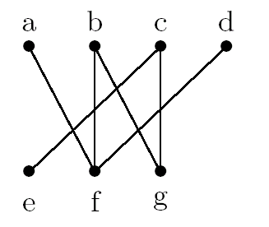
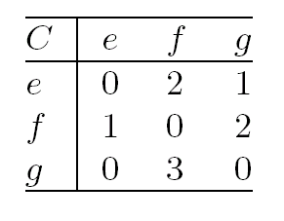
Crossing number
Crossing number c_{uv}
  # of crossings that edges incident to u make with edges incident v, when x2(u) < x2(v)
  # of pairs (u,w), (v,z) of edges with x1(z) < x1(w)

Slide 40
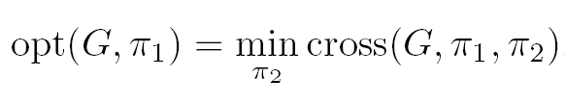
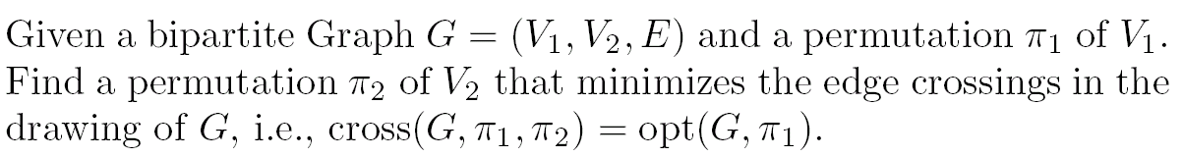
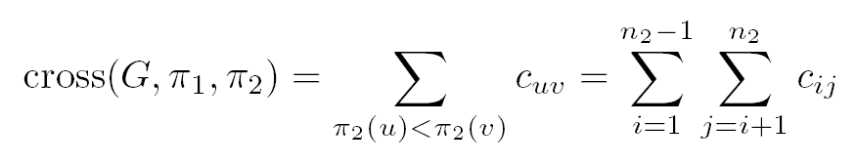
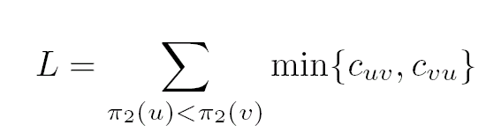
One-sided crossing minimization

Slide 41
1. Sorting Method
Aim: to sort the vertices in L2 into an order that minimizes # of crossings
Naive algorithm: O(|E|)², can be reduced
Adjacent-Exchange
  exchange adjacent pair of vertices using the crossing numbers, in a way similar to bubble sort
  Scan the vertices of L2 from left to right, exchanging an adjacent pair u, v whenever c_{uv} > c_{vu}
  O(|L2|²) time
Split
  quick sort: choose a pivot vertex p in L2, and place each vertex u to the left of p if c_{up} < c_{pu}, and to the right of p otherwise
  Apply recursively to the left & right of p
  O(|L2|²) time in worst case; O((|L2|log (|L2|) in practice

Slide 42
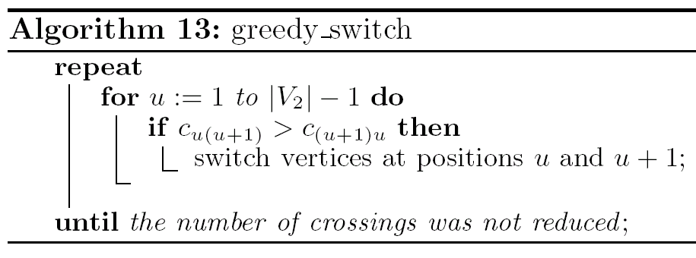
Adjacent-Exchange

Slide 43
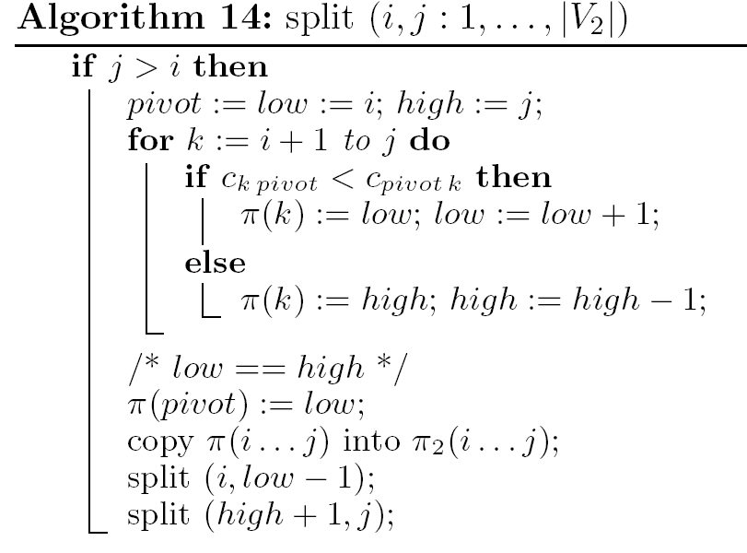
Split

Slide 44
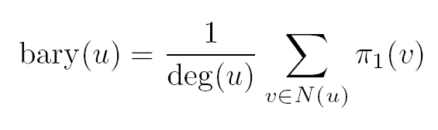
2. The Barycenter Method
The most common method
x-coordinate of each vertex u in L2 is chosen as the barycenter(average) of the x-coordinates of its neighbors
x2(u) = bary(u) = 1/deg(u) Σ x1(v), v is a neighbor
If two vertices have the same barycenter, then order them arbitrarily
Can be implemented in linear time

Slide 45
3. The Median Method
Similar to the barycenter method
x-coordinate of each vertex u in L2 is chosen as the median of the x-coordinates of its neighbors
v1, v1, …, vj: neighbors of u with x1(v1) < x1(v2) < … < x1(vj)
  med(u) = x1(vj/2)
  if u has no neighbor, then med(u) = 0
How to use med(u) to order the vertices in L2: sort L2 on med(u)
If med(u) = med(v)
  Place the odd degree vertex on the left of the even degree vertex
  If they have the same parity, choose the order of u & v arbitrarily
Can be computed using a linear-time median finding algorithm [AHU83]

Slide 46
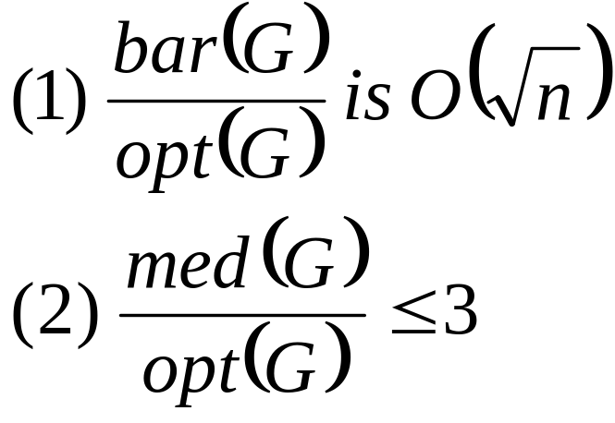
Analysis
[Theorem]
if opt(G,x1)= 0, then bar(G,x1)=med(G,x1)=0
Performance guarantees
  Theorem 1:
  The barycenter method is at worst O(sqrt(n)) times optimal.
  Theorem 2:
  The median method is at worst 3 times optimal.

Slide 47
3. Median Method
Some intuition behind Theorem 2
(median method is at worst 3 times optimal).
free
v
fixed
x nodes
x nodes
median

Slide 48
3. Median Method
Some intuition behind Theorem 2
(median method is at worst 3 times optimal).
free
v
u
fixed
y nodes
x nodes
y nodes
x nodes
median

Slide 49
3. Median Method
Median placement:
free
v
u
Median:
3xy crossings
xy crossings
xy crossings
xy crossings
fixed
y nodes
x nodes
y nodes
x nodes

Slide 50
3. Median Method
Optimal placement:
free
u
v
Optimal:
xy+1 crossings
xy+1 crossings
fixed
y nodes
x nodes
y nodes
x nodes

Slide 51
3. Median Method
Median: at most 3xy crossings
Optimal: at least xy+1 crossings
Theorem 2: The median method is at worst 3 times optimal.
In practice, there are many good methods, and the median is just one of them.

Slide 52
4. Integer Programming methods
Integer programming approach may be used for two-layer crossing problem
Solving integer programs require sophisticated technique: branch and cut approach can be used to obtain an optimal solution for digraphs of limited size [JM97]
Advantage: find the optimal solution
Disadvantage: no guarantee to terminate in polynomial time
Successful for small to medium sized digraphs

Slide 53
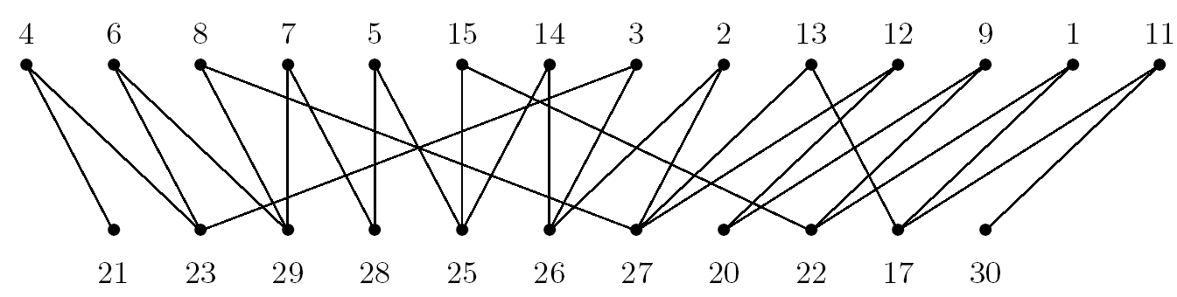
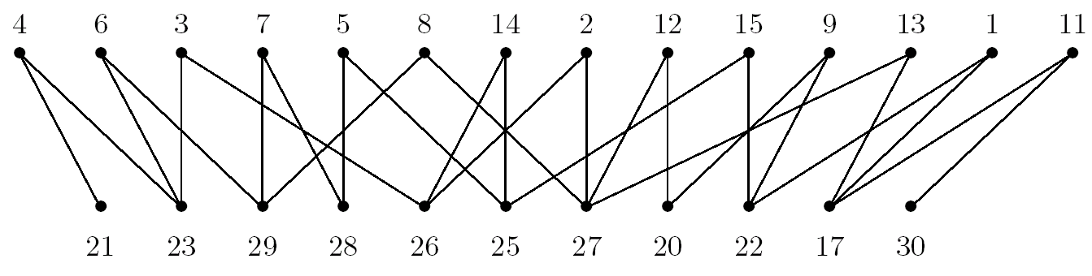
5. Planarization method [Mutzel97]
Use maximal planar subgraph approach

Slide 54
Remark
Median method seems very attractive
Comparative tests
  pseudo-random graphs [EK86, JM97]
  real-world digraphs [GKNV93]
  No single winner
Use a hybrid approach
  1. Use the median method to determine the initial ordering
  2. Use an adjacent exchange method to refine

Slide 55
Step 4. Horizontal Coordinate Assignment
Bends occur at the dummy vertices in the layering step.
We want to reduce the angle of such bends by choosing an x-coordinate for each vertex, without changing the ordering in the crossing reduction step
Optimization problem with constraints
  draw each directed path as straight as possible
  ensure the ordering in each layer (enforce minimal distance)
It may affect the width of the drawing
Some layered drawing requires exponential area with straight lines
Quadratic programming problems can be solved by standard methods, but it requires considerable computational resource

Slide 56
Priority Barycenter Method
Position vertices at the Barycenter of their neighbours
  Can reuse “positions” from the ordering step
Assign each vertex a priority
  Priority = degree
  Dummy vertices have the highest priority
Enforce minimal distance between adjacent vertices
  If two vertices are too close then move ONE of them to a safe distance
  Move the vertex with the lower priority

