Slide 1
Software Testing and Quality Assurance
Theory and Practice
Chapter 2
Theory of Program Testing
Notes:
------------------------------------------------------------------
------------------------------------------------------------------
-------------------------------------------------------------------
--------------------------------------------------------------------

Slide 2
Outline of the Chapter
Basic Concepts in Testing Theory
Theory of Goodenough and Gerhart
Theory of Weyuker and Ostrand
Theory of Gourlay
Adequacy of Testing
Limitations of Testing
Summary

Slide 3
Basic Concepts in Testing Theory
Testing theory puts emphasis on
  Detecting defects through program execution
  Designing test cases from different sources: requirement specification, source code, and input and output domains of programs
  Selecting a subset of tests cases from the entire input domain
  Effectiveness of test selection strategies
  Test oracles used during testing
  Prioritizing the execution of test cases
  Adequacy analysis of test cases

Slide 4
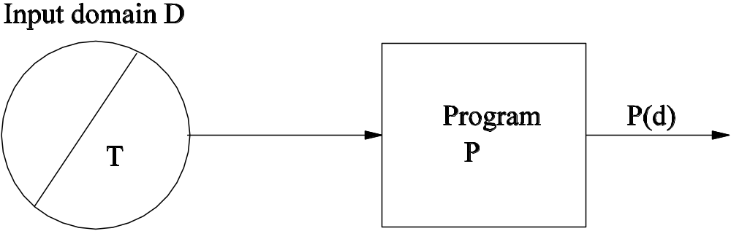
Theory of Goodenough and Gerhart
Fundamental Concepts
  Let P be a program, and D be its input domain. Let T ⊆ D. P(d) is the result of executing P with input d.
  Figure 2.1: Executing a program with a subset of the input domain.
  OK(d): Represents the acceptability of P(d). OK(d) = true iff P(d) is acceptable.
  SUCCESSFUL(T): T is a successful test iff ∀t ∈ T, OK(t).
  Ideal Test: T is an ideal test if OK(t), ∀t ∈ T => OK(d), ∀d ∈ D.

Slide 5
Theory of Goodenough and Gerhart
Fundamental Concepts (Contd.)
  Reliable Criterion: A test selection criterion C is reliable iff either every test selected by C is successful, or no test selected is successful.
  Valid Criterion: A test selection criterion C is valid iff whenever P is incorrect, C selects at least one test set T which is not successful for P.
  Let C denote a set of test predicates. If d ∈ D satisfies test predicate c ∈ C, then c(d) is said to be true.
  COMPLETE(T, C) ≡ (∀c ∈ C)(∃t ∈ T) c(t) ∧ (∀t ∈ T)(∃c ∈ C) c(t)
Fundamental Theorem
  (∃T ⊆ D) (COMPLETE(T,C) ∧ RELIABLE(C) ∧ VALID(C) ∧ SUCCESSFUL(T))
  => (∀d ∈ D) OK(d)

Slide 6
Theory of Goodenough and Gerhart
Program faults occur due to our
  inadequate understanding of all conditions that a program must deal with.
  failure to realize that certain combinations of conditions require special care.
Kinds of program faults
  Logic fault
    Requirement fault
    Design fault
    Construction fault
  Performance fault
  Missing control-flow paths
  Inappropriate path selection
  Inappropriate or missing action
Test predicate: It is a description of conditions and combinations of conditions relevant to correct operation of the program.

Slide 7
Theory of Goodenough and Gerhart
Conditions for Reliability of a set of test predicates C
  Every branching condition must be represented by a condition in C.
  Every potential termination condition must be represented in C.
  Every condition relevant to the correct operation of the program must be represented in C.
Drawbacks of the Theory
  Difficulty in assessing the reliability and validity of a criterion.
  The concepts of reliability and validity are defined w.r.t. to a program. The goodness of a test should be independent of individual programs.
  Neither reliability nor validity is preserved throughout the debugging process.

Slide 8
Theory of Weyuker and Ostrand
d ∈ D, the input domain of program P and T ⊆ D.
OK(P, d) = true iff P(d) is acceptable.
SUCC(P, T): T is a successful test for P iff forall ∀t ∈ T, OK(P, t).
Uniformly valid criterion: Criterion C is uniformly valid iff
  (∀P) [ (∃d ∈ D)(¬OK(P,d)) => (∃T ⊆ D) (C(T) ∧ ¬SUCC(P, T)) ].
Uniformly reliable criterion: Criterion C is uniformly reliable iff
  (∀P) (∀T1, ∀T2 ⊆ D) [ (C(T₁) ∧ C(T₂)) => (SUCC(P, T₁) <==> SUCC(P,T₂)) ].
Uniformly Ideal Test Selection
  A uniformly ideal test selection criterion for a given specification is both uniformly valid and uniformly reliable.
A subdomain S is a subset of D.
  Criterion C is revealing for a subdomain S if whenever S contains an input which is processed incorrectly, then every test set which satisfies C is unsuccessful.
    REVEALING(C, S) iff
    (∃d ∈ S) (¬OK(d)) => (∀T ⊆ S)(C(T) => ¬SUCC(T)) .

Slide 9
Theory of Gourlay
The theory establishes a relationship between three sets of entities
  specifications, programs and tests.
Notation
      P: The set of all programs (p ∈ P ⊆ P)
      S: The set of all specifications (s ∈ S ⊆ S)
      T: The set of all tests (t ∈ T ⊆ T)
      “p ok(t) s” means the result of testing p with t is judged to be acceptable by s.
      “p ok(T) s” means “p ok(t) s,” ∀t ∈ T.
      “p corr s” means p is correct w.r.t. s.
A testing system is a collection < P, S, T, corr, ok>, where corr ⊆ P x S and ok ⊆ T x P x S, and ∀p∀s∀t(p corr s => p ok(t) s).
A test method is a function M: P x S →T
  Program dependent: T = M(P)
  Specification dependent: T = M(S)
  Expectation dependent

Slide 10
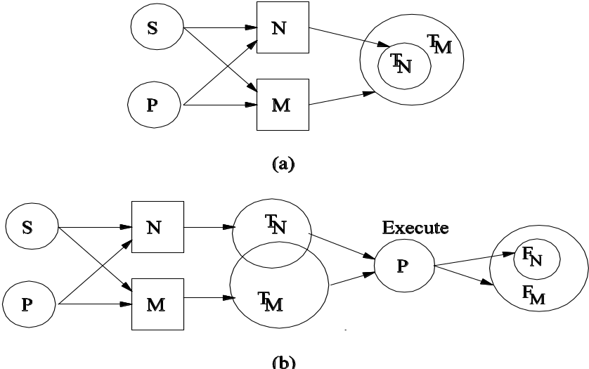
Theory of Gourlay
Power of test methods: Let M and N be two test methods.
  For M to be at least as good as N, we want the following to occur:
    Whenever N finds an error, so does M.
    (F_{M} and F_{N} are sets of faults discovered by test sets produced by test methods M and N, respectively.)
    (T_{M} and T_{N} are test sets produced by test methods M and N, respectively.)
  Two cases: (a) T_{N} ⊆ T_{M} and (b) T_{M} and T_{N} overlap
  Figure 2.3: Different ways of comparing the power of test methods.

Slide 11
Adequacy of Testing
Reality: New test cases, in addition to the planned test cases, are designed while performing testing. Let the test set be T.
If a test set T does not reveal any more faults, we face a dilemma:
  P is fault-free. OR
  T is not good enough to reveal (more) faults.
➔ Need for evaluating the adequacy (i.e. goodness) of T.
Some ad hoc stopping criteria
  Allocated time for testing is over.
  It is time to release the product.
  Test cases no more reveal faults.

Slide 12
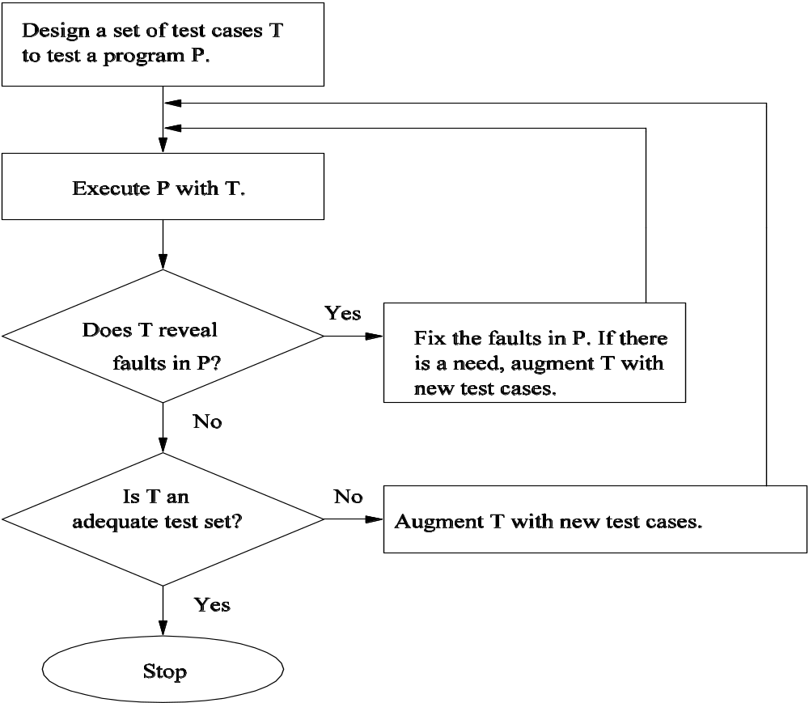
Adequacy of Testing
Figure 2.4: Context of applying test adequacy.

Slide 13
Adequacy of Testing
Two practical methods for evaluating test adequacy
  Fault seeding
  Program mutation
Fault seeding
  Implant a certain number (say, X) of known faults in P, and test P with T.
  If k% of the X faults are revealed, T has revealed k% of the unknown faults.
  (More in Chapter 13)
Program mutation
  A mutation of P is obtained by making a small change to P.
  Some mutations are faulty, whereas the others are equivalent to P.
  T is said to be adequate if it causes every faulty mutations to produce unexpected results.
  (More in Chapter 3)

Slide 14
Limitations of Testing
Dijkstra’s famous observation
  Testing can reveal the presence of faults, but not their absence.
Faults are detected by running P with a small test set T, where |T| << |D|, where |.| denotes the “size-of” function and “<<“ denoted “much smaller.”
  Testing with a small test set raises the concern of testing efficacy.
  Testing with a small test set is less expensive.
The result of each test must be verified with a test oracle.
  Verifying a program output is not a trivial task.
  There are non-testable programs. A program is non-testable if
    There is no test oracle for the program.
    It is too difficult to determine the correct output.

Slide 15
Summary
Theory of Goodenough and Gerhart
    Ideal test, Test selection criteria, Program faults, Test predicates
Theory of Weyuker and Ostrand
    Uniformly ideal test selection
    Revealing subdomain
Theory of Gourlay
    Testing system
    Power of test methods (“at least as good as” relation)
Adequacy of Testing
    Need for evaluating adequacy
    Methods for evaluating adequacy: fault seeding and program mutation
Limitations of Testing
    Testing is performed with a test set T, s.t. |T| << |D|.
    Dijkstra’s observation
    Test oracle problem

