Slide 1
Data scientist salary analysis
Goals is to evaluate salary data for hiring decisions of future data scientist team
By Wanida Ruangsiriluk
November 26, 2023
Analysis includes:
Evaluation of salary data of all job titles and across different sizes of companies located worldwide
Comparison of salary of full-time employees residing in the US and outside of US locations
Evaluation of data scientist-related roles of full-time employees residing in the US and outside of US locations, including new adjusted salaries to the inflation rate and forecast for 2023 range
Suggestion of salary range for Data Scientists specifically before and after salary adjustment

Slide 2
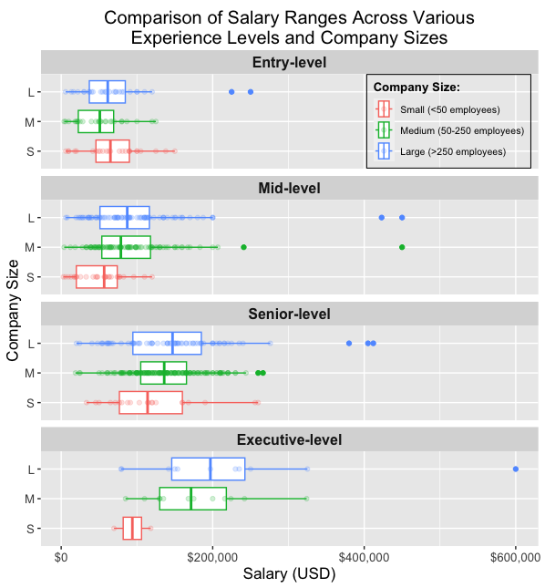
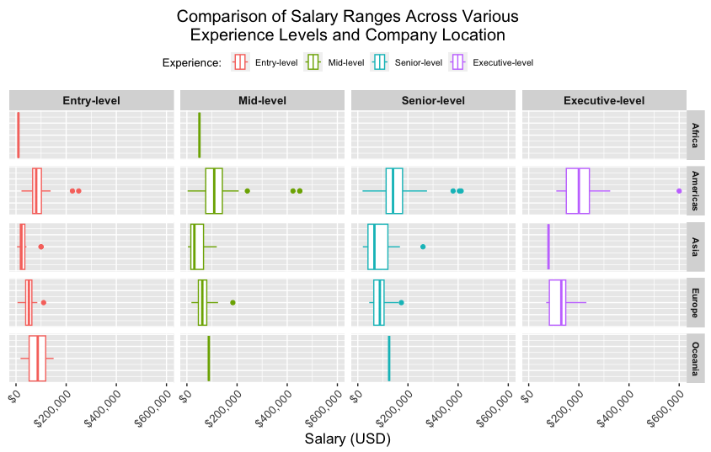
Salary range of all job titles across different sizes of company and experience levels
Interestingly, high median salary came from companies located in Americas continent for all levels except entry-level which is comparable to Oceania, provided that there is less data point obtained from Oceania than Americas
Salary range of all roles is comparable across levels except the executive level which is clearly higher in medium and large companies

Slide 3
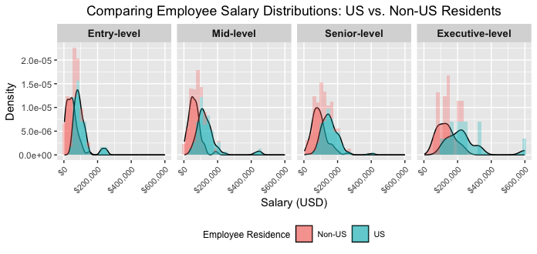
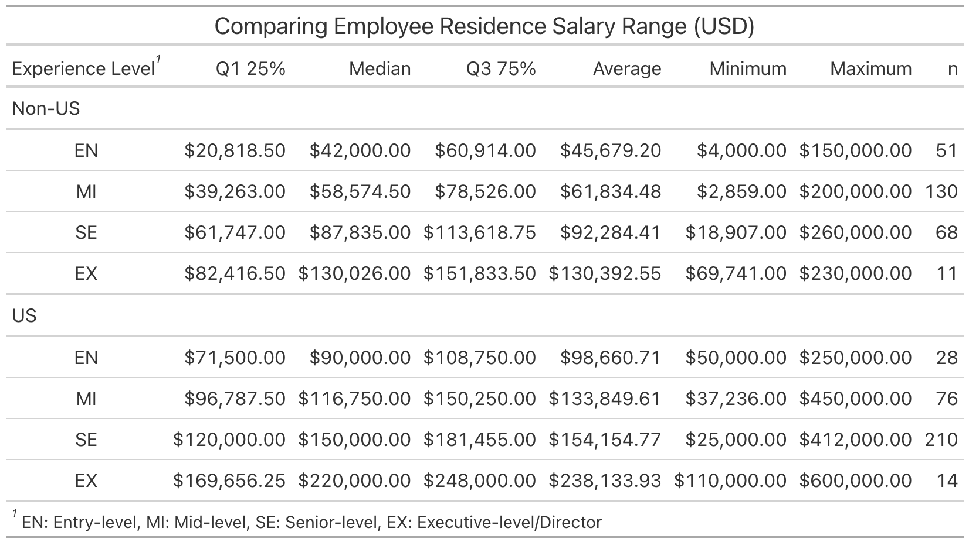
Comparison of salary range of employees residing in US and outside of US
Employees residing in US showed a higher median salary and wider spread of the range than non-US
The salary range distribution shifted more to the higher salary and spread wider with a higher experienced level, especially the executive level
Table on the right shows the IQR, average minimum, and maximum, demonstrating employees residing in the US earned more than the ones residing outside of the US
The median and average of US resident employees is approximately 2x higher than non-US resident employees at the entry and mid level

Slide 4
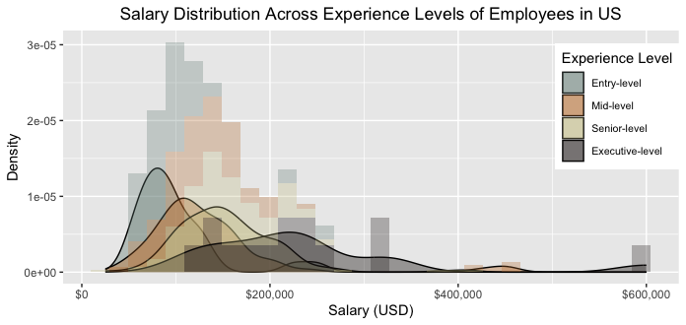
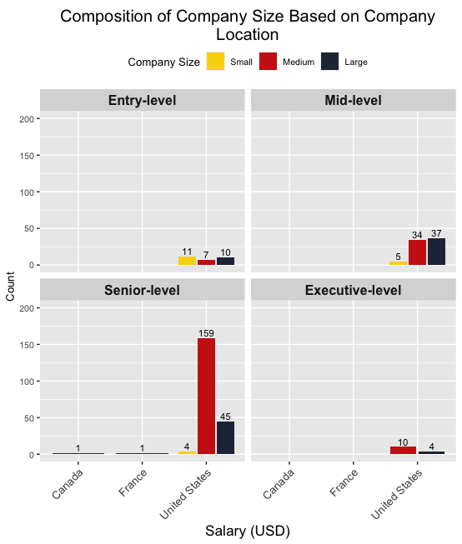
Salary range of all roles for employees residing in US only
For employees residing in the US, there is clearly a wider spread of the range at the executive level (from $110k - $600k)
The salary range distribution shifted more to the higher salary and spread to a wider range when moving toward higher experienced levels
More than 99% of US resident employees are employed by companies located in the United States, and most of them are at the senior level in mid-size companies.

Slide 5
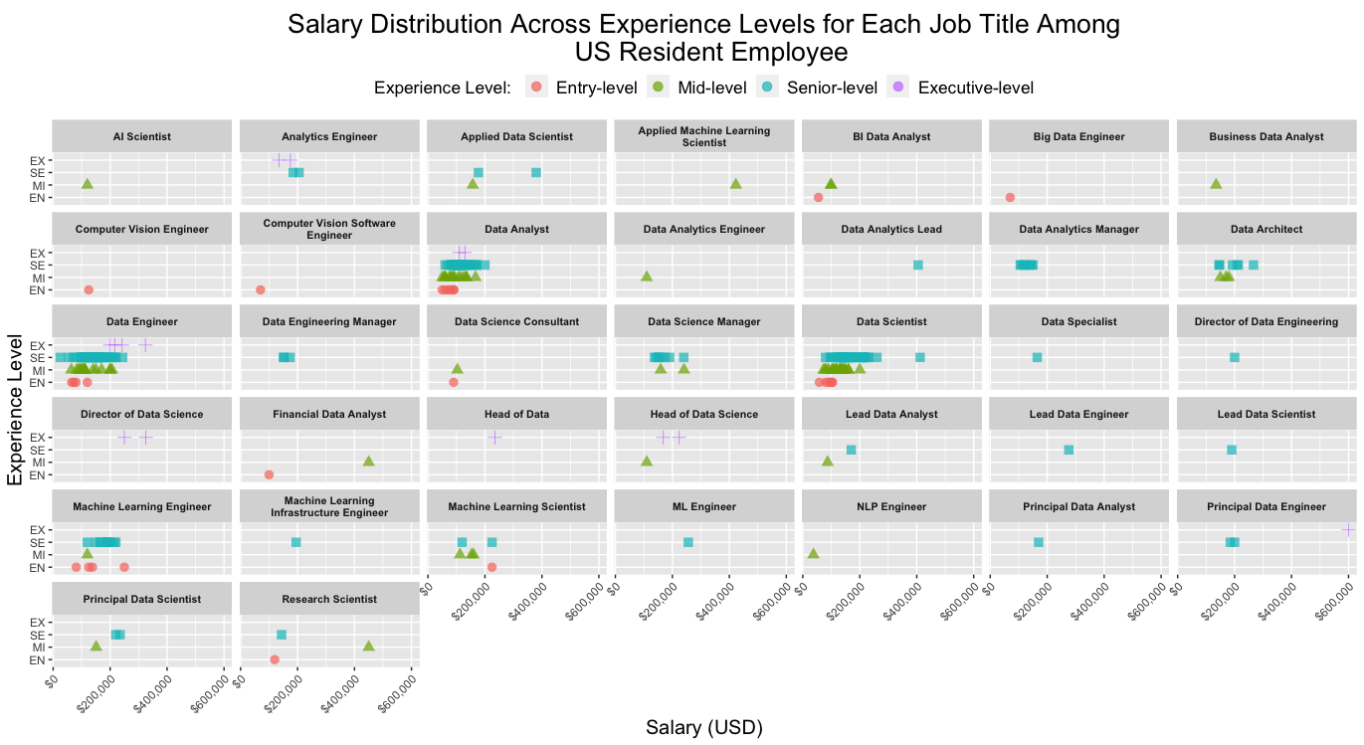
Salary plot based on job title showed the majority of salaries falling in the range below $300,000 with employees at mid- and senior-level
Most data came from Data Scientist, Data Analyst and Data Engineer job title

Slide 6
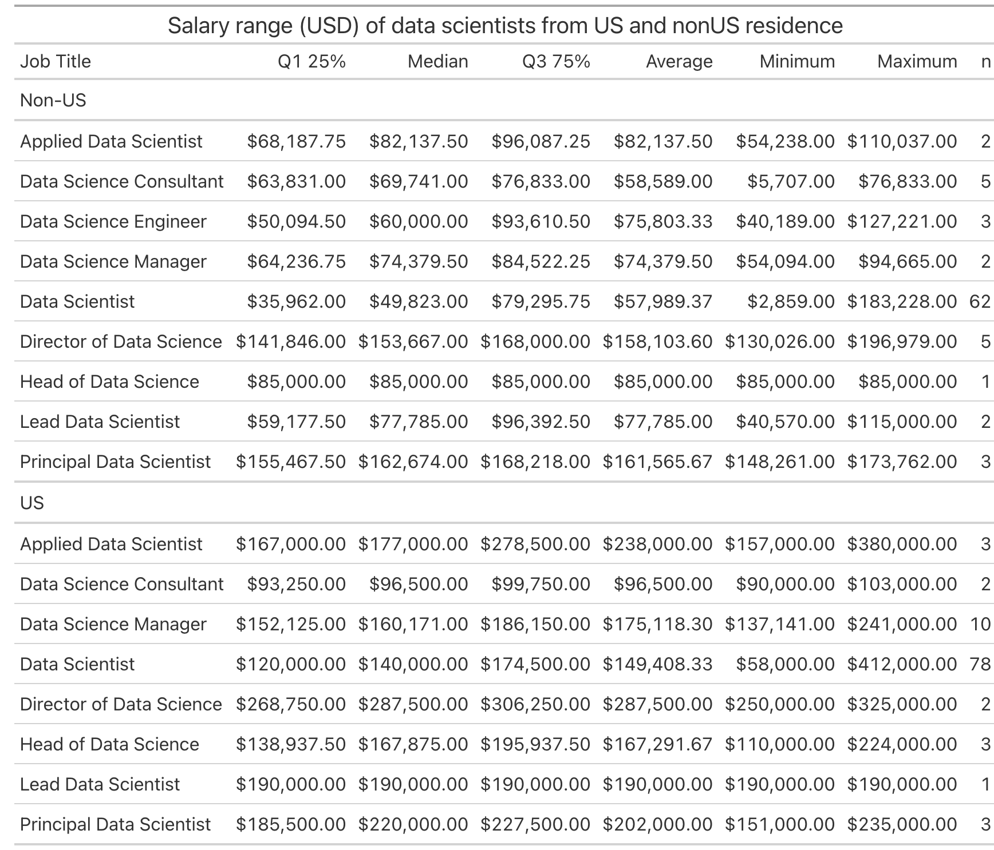
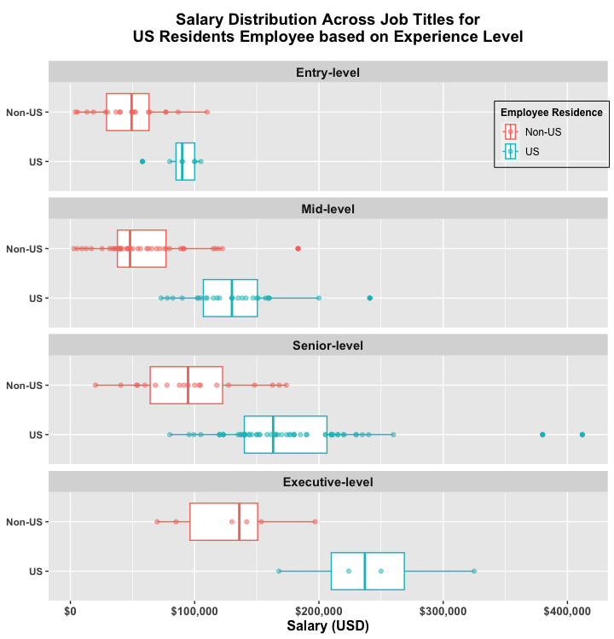
Salary range of each data scientist-related roles comparing employees residing in US vs Non-US
For purpose of evaluating the salary of Data Scientist roles, only select salary from data scientist-related titles to do analysis:
Employees residing in the US showed a higher median salary and wider spread of the range than those outside of the US
Salary range is listed on the right table for each data scientist-related title

Slide 7
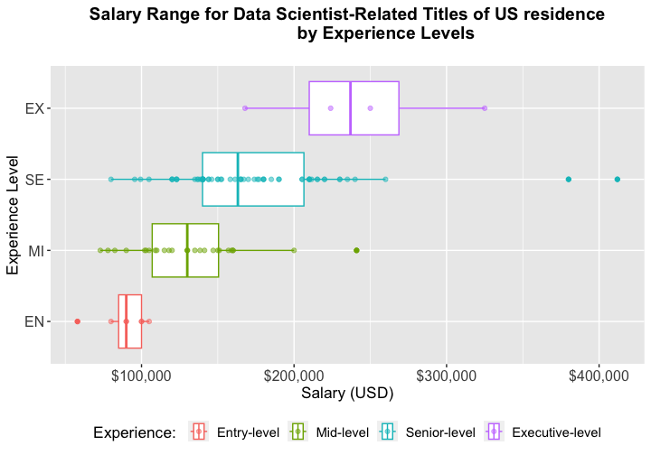
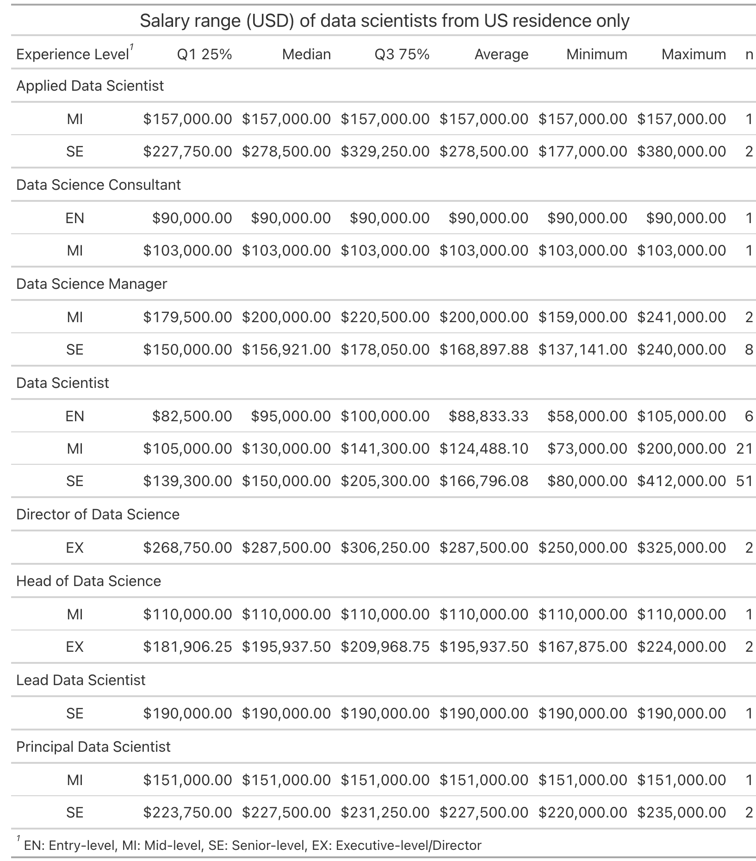
Salary range of data scientist-related roles comparing different experience levels
For employees residing in the US, the salary range of each data scientist-related title is listed on the right table sorted by experienced level
Data Scientist specific title will only have the highest work experience at the senior level
The box plot above shows the IQR and some outliers of each experienced level

Slide 8
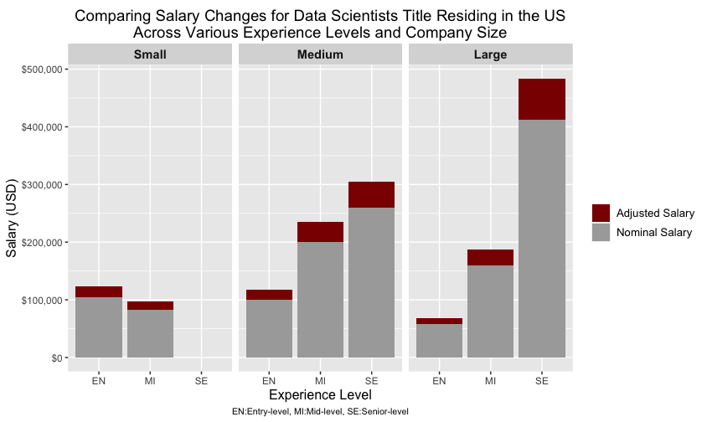
Adjusting salary of data scientist title to inflation rate for the year 2023
Salary can be adjusted to the inflation rate following the inflation adjustment calculations as found in Principles of Macroeconomics by Gregory Mankiw et al (2014^{)a,b} . Average method was used to extrapolate the current 2023 adjusted salary from historical inflation rate since 2020 (when this salary data was obtained).
Focusing on Data Scientist title specifically, a comparison of nominal and adjusted salary based on experience level from different company sizes shows that the large company with a higher nominal salary would have to adjust a higher range than the smaller company sizes.
Also, majority of senior-level Data Scientists are from either medium or large companies only
https://rdrr.io/cran/priceR/
https://rdrr.io/cran/priceR/src/R/adjust_for_inflation.R

Slide 9
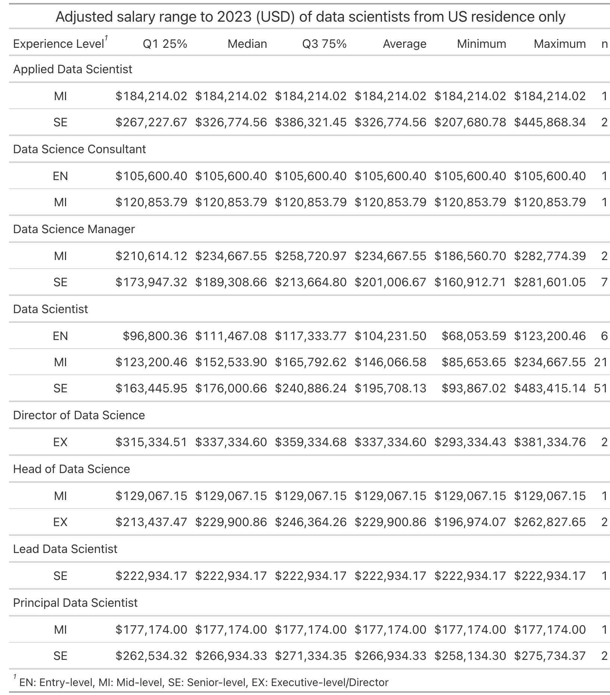
Comparison salary range of data scientist related roles after adjusting to inflation rate to 2023
New Salary Range

Slide 10
Summary
Salary range of all roles is comparable across levels except the executive level which has a higher median, especially in medium and large companies
Comparing across the world, companies located in the Americas showed higher salaries than other continentals
Salaries of employees residing outside of the US are at a lower range than the ones from US residents and could be up to 2x lower, depending on the experience level
Employees residing in the US are from companies located in the US and mostly are from medium and large size companies
Salaries of all Data Scientist roles residing in the US reflect a higher range than the ones residing outside of the US also, and the majority of the companies are located in the US
Tables showing nominal and adjusted salary range of each data scientist-related title and ranked by experienced level are presented here
Depending on desired experience level, to obtain higher experienced Data Scientist and be competitive to get the top talent, salary range of employees residing in the US and work with medium and large company size, locating in the US should be considered
Also, a new adjusted range should be proposed, since the salary is going up due the inflation

