Slide 1
FSDS scenarios / 场景
Bilingual deck · v2

Slide 2
Assumptions 假设参数
margin_usd=48.0 · treat_cost=6.5
SoT save ~33.6% · debate ~39.3% (demos)
Edit: config/fsds_economics_assumptions.json → re-run run_fsds_business_impact_pack.py
OPEX vs CAPEX: RELEARN tickets excluded from OPEX net in uplift rollup

Slide 3
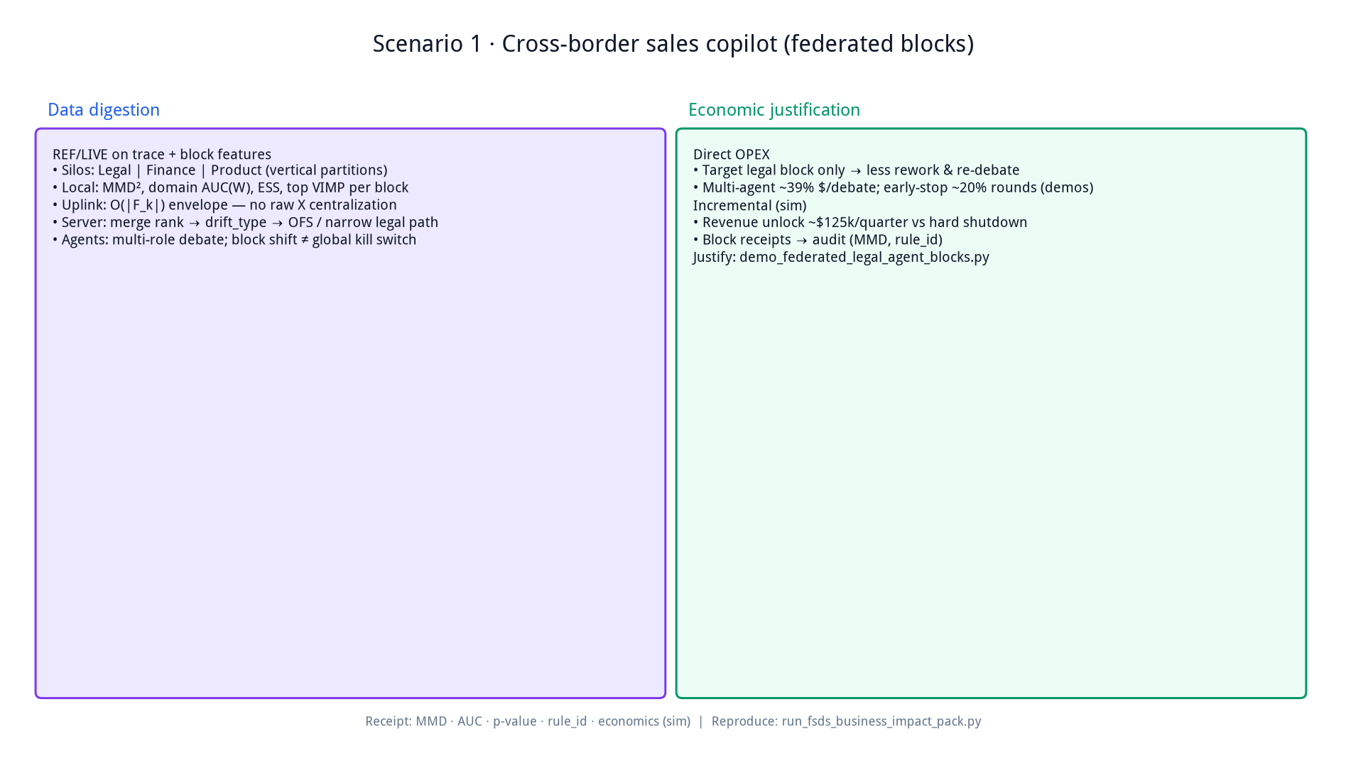

Slide 4
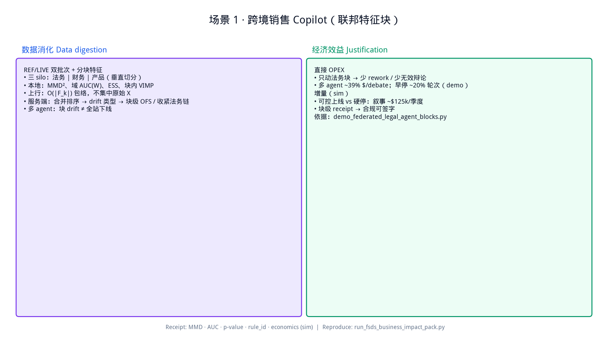

Slide 5
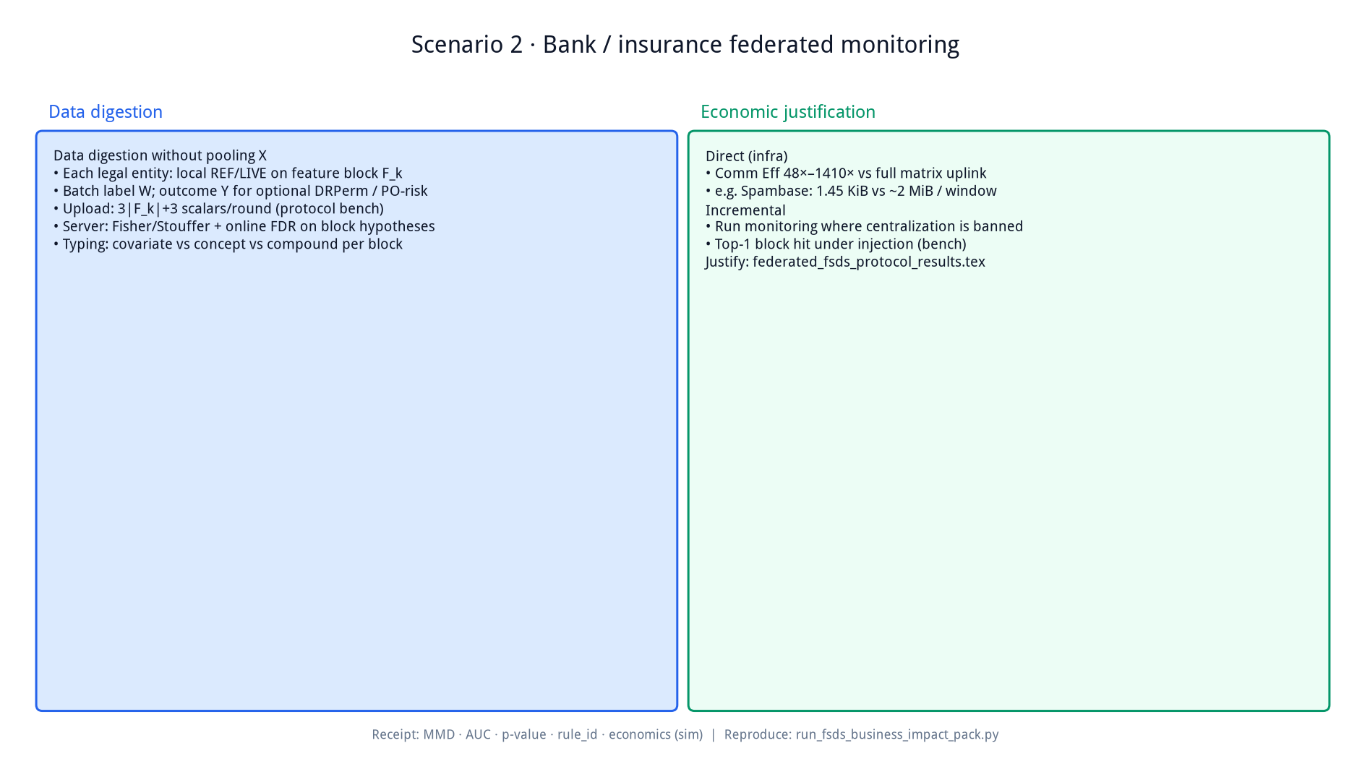

Slide 6
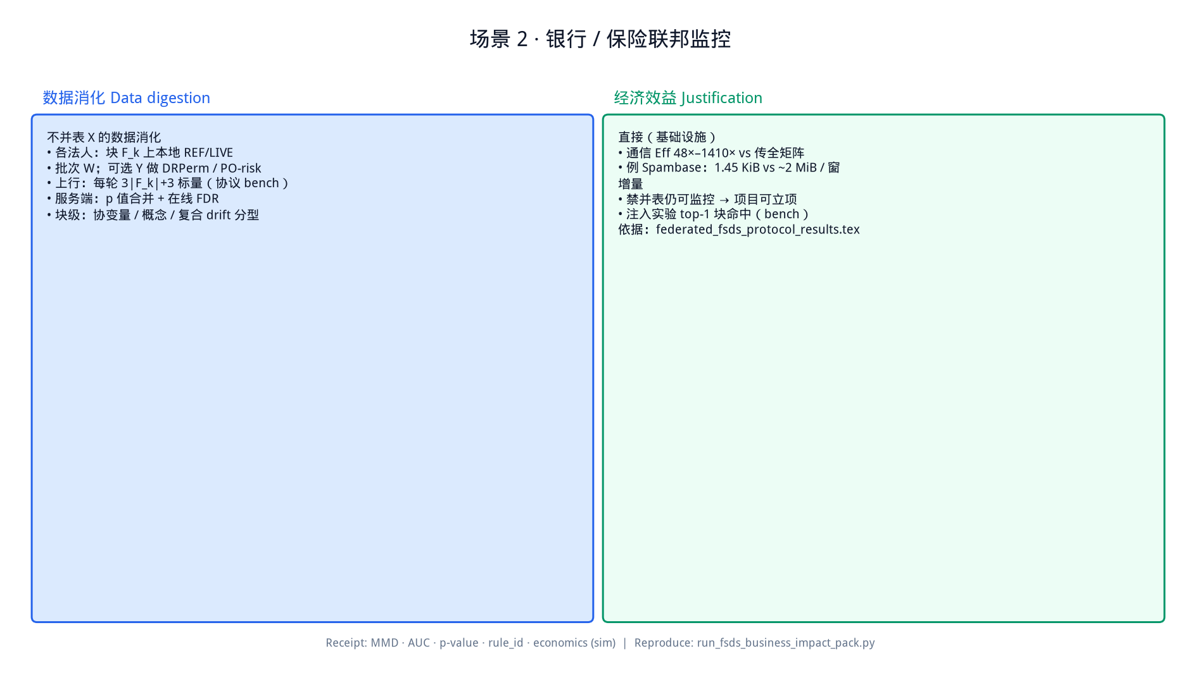

Slide 7
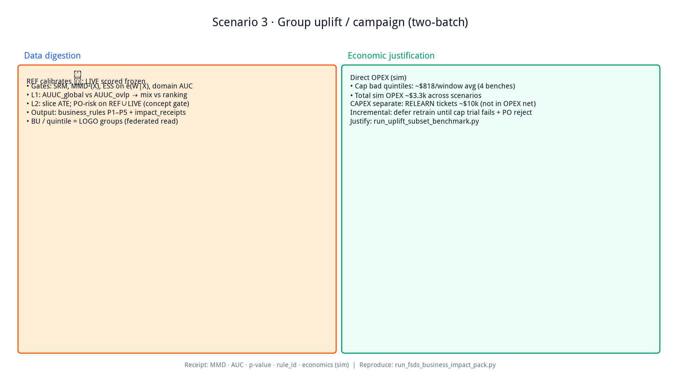

Slide 8
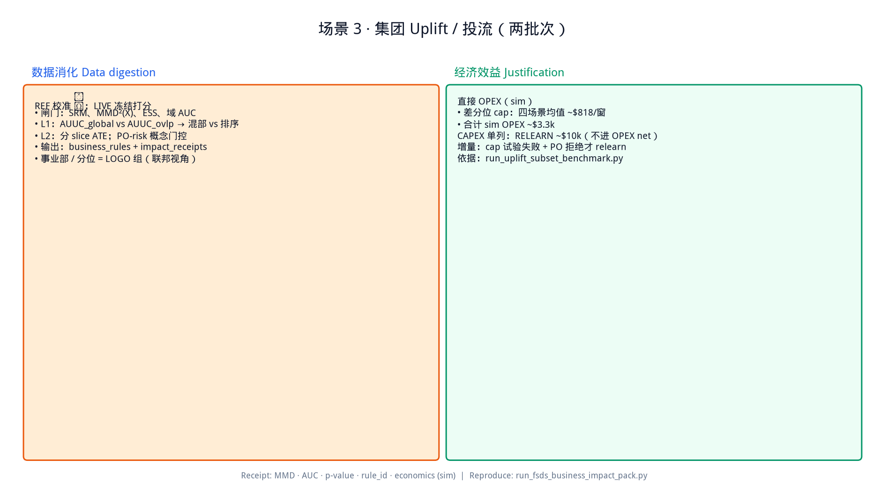

Slide 9
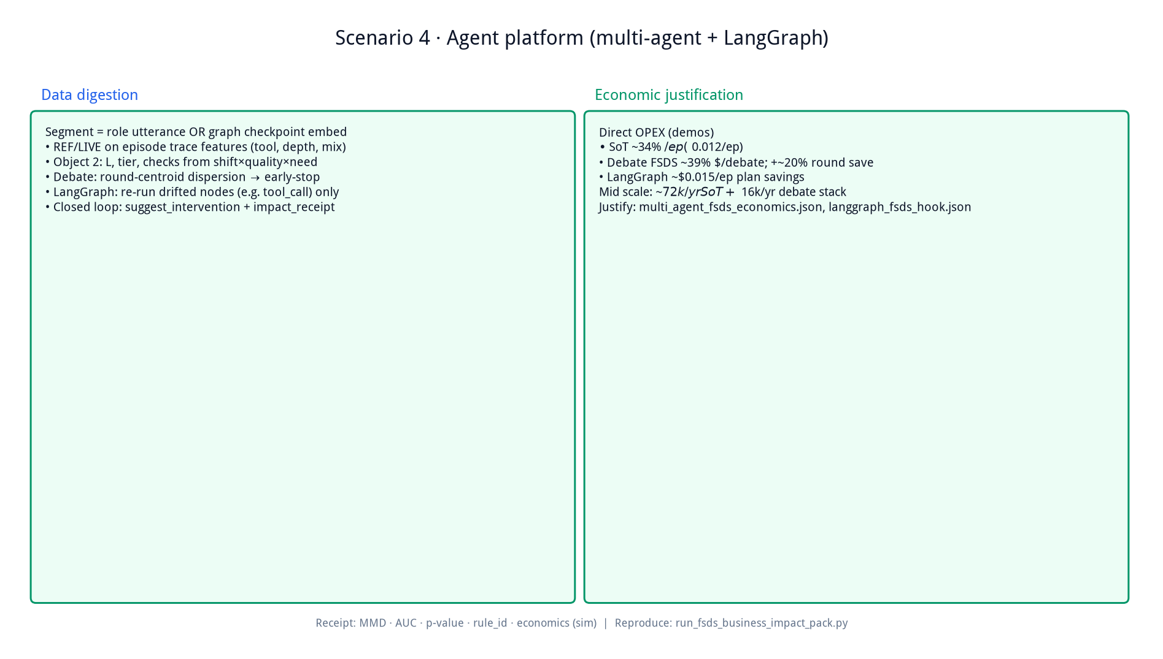

Slide 10
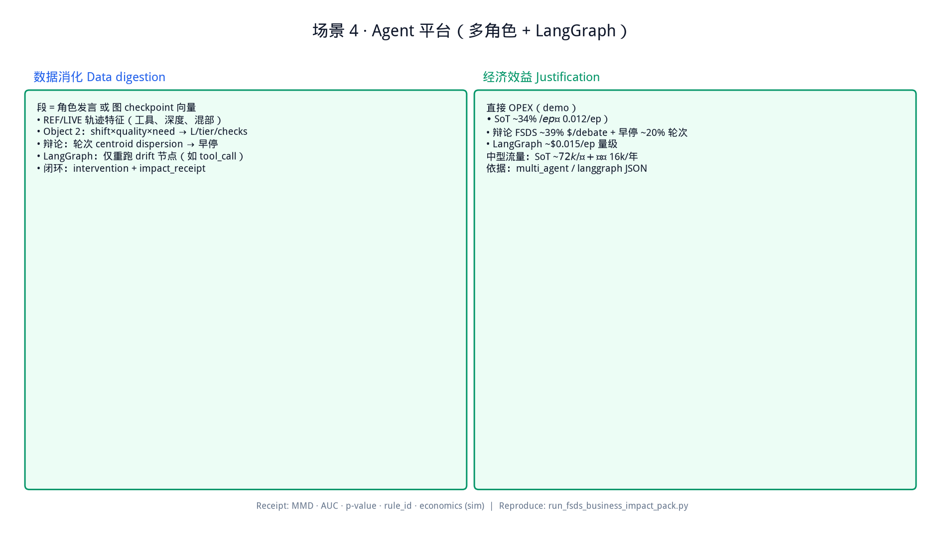

Slide 11


Slide 12


Slide 13


Slide 14
