Slide 1


YOU CAN WRITE ANYTHING
MORIMOTO

Slide 2

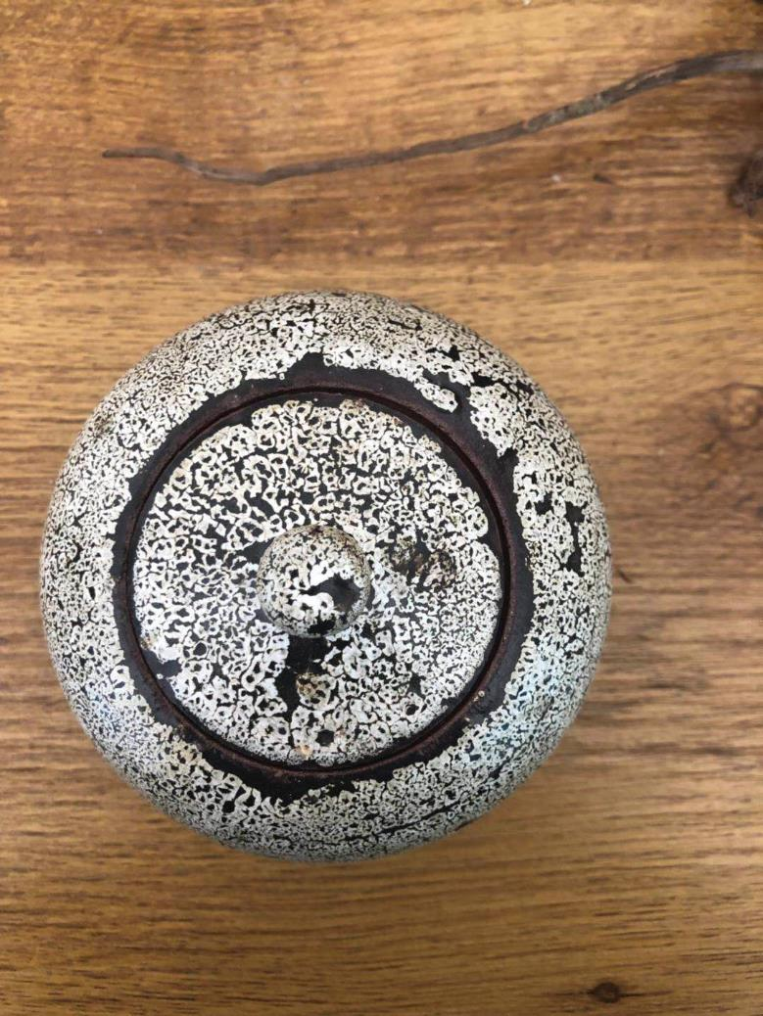

Report template of fashionable European and American style speech
I walked through many mountains, walked through many waters, and knew many people. The only thing that really makes me tempted is that you see me at the moment. But there is not too much extravagant hope, but I hope to have your heart, not to leave.
I walked through many mountains, walked through many waters, and knew many people. The only thing that really makes me tempted is that you see me at the moment. But there is not too much extravagant hope, but I hope to have your heart, not to leave.
DESIGND BY MUYUESHOP

Slide 3

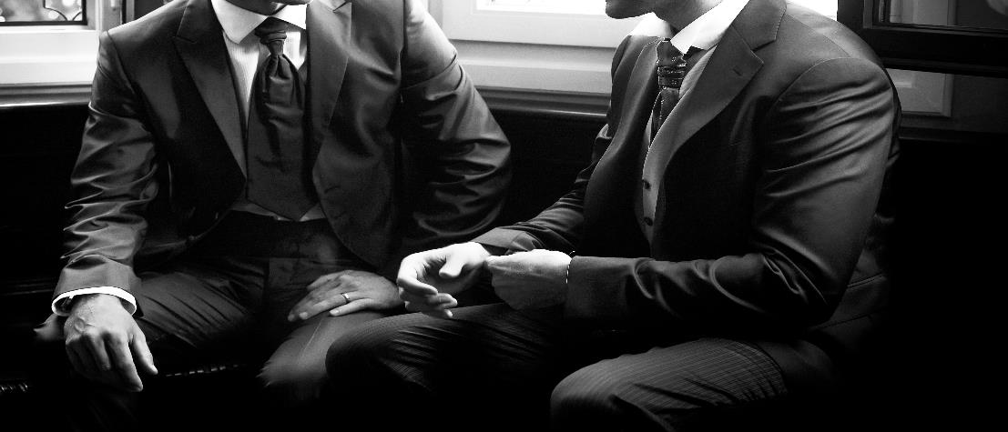

Your Best Titile Here
Report template of fashionable European and American style speech
I walked through many mountains, walked through many waters, and knew many people. The only thing that really makes me tempted is that you see me at the moment.
Your Best Titile Here
I walked through many mountains, walked through many waters, and knew many people. The only thing that really makes me tempted is that you see me at the moment. But there is not too much extravagant hope, but I hope to have your heart, not to leave.
I walked through many mountains, walked through many waters, and knew many people. The only thing that really makes me tempted is that you see me at the moment. But there is not too much extravagant hope, but I hope to have your heart, not to leave.
I walked through many mountains, walked through many waters, and knew many people. The only thing that really makes me tempted is that you see me at the moment.
简短的绪论
I walked through many mountains, walked through many waters, and knew many people. The only thing that really makes me tempted is that you see me at the moment.

Slide 4



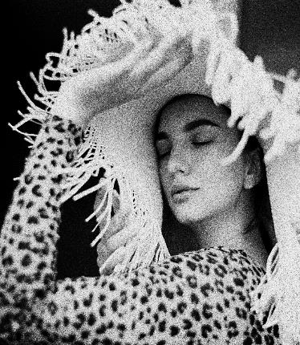
Report template of fashionable European and American style speech
I walked through many mountains, walked through many waters, and knew many people. The only thing that really makes me tempted is that you see me at the moment. But there is not too much extravagant hope, but I hope to have your heart, not to leave.

Slide 5



添加此处原有标题
添加此处原有标题
I walked through many mountains, walked through many waters, and knew many people. The only thing that really makes me tempted is that you see me at the moment.
I walked through many mountains, walked through many waters, and knew many people. The only thing that really makes me tempted is that you see me at the moment.

Slide 6

Report template of fashionable European and American style speech
简短的绪论
I walked through many mountains, walked through many waters, and knew many people. The only thing that really makes me tempted is that you see me at the moment.
I walked through many mountains, walked through many waters, and knew many people. The only thing that really makes me tempted is that you see me at the moment. But there is not too much extravagant hope, but I hope to have your heart, not to leave.
I walked through many mountains, walked through many waters, and knew many people. The only thing that really makes me tempted is that you see me at the moment. But there is not too much extravagant hope, but I hope to have your heart, not to leave.
职业/姓名
I walked through many mountains, walked through many waters, and knew many people.
DESIGND BY MUYUESHOP

Slide 7
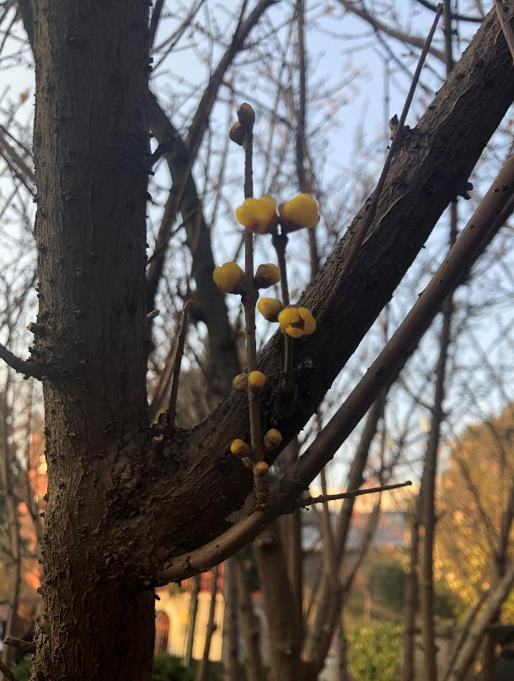

Report template of fashionable European and American style speech
I walked through many mountains, walked through many waters, and knew many people. The only thing that really makes me tempted is that you see me at the moment. But there is not too much extravagant hope, but I hope to have your heart, not to leave.
I walked through many mountains, walked through many waters, and knew many people. The only thing that really makes me tempted is that you see me at the moment. But there is not too much extravagant hope, but I hope to have your heart, not to leave.
简短的绪论
I walked through many mountains, walked through many waters, and knew many people. The only thing that really makes me tempted is that you see me at the moment.
职业/姓名
I walked through many mountains, walked through many waters, and knew many people.

Slide 8
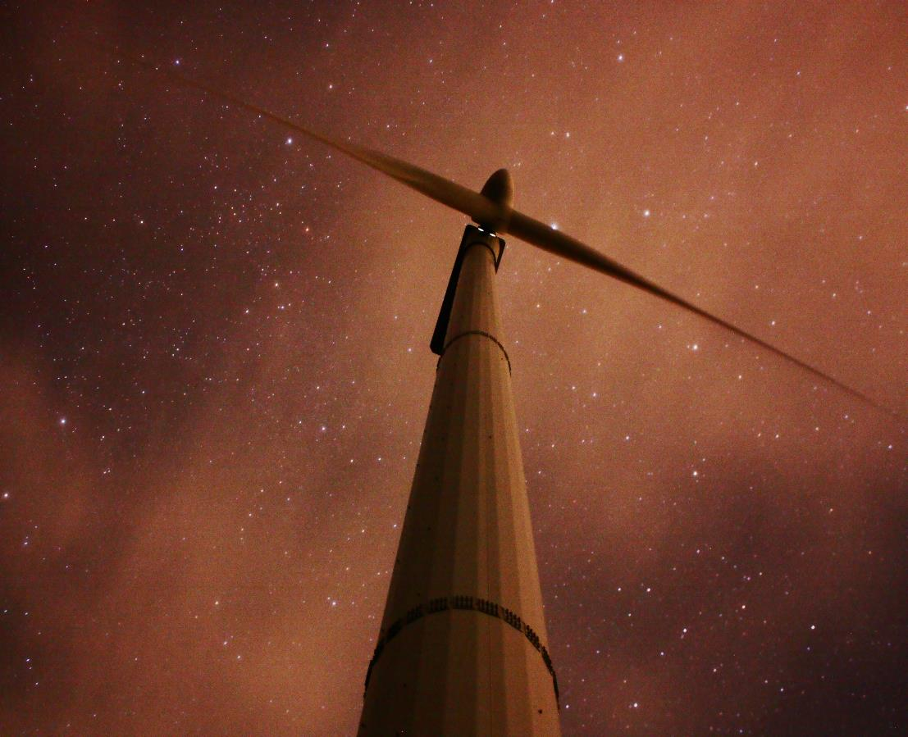

I walked through many mountains, walked through many waters, and knew many people. The only thing that really makes me tempted is that you see me at the moment. But there is not too much extravagant hope, but I hope to have your heart, not to leave.
I walked through many mountains, walked through many waters, and knew many people. The only thing that really makes me tempted is that you see me at the moment. But there is not too much extravagant hope, but I hope to have your heart, not to leave.
简短的绪论
I walked through many mountains, walked through many waters, and knew many people. The only thing that really makes me tempted is that you see me at the moment.

Slide 9
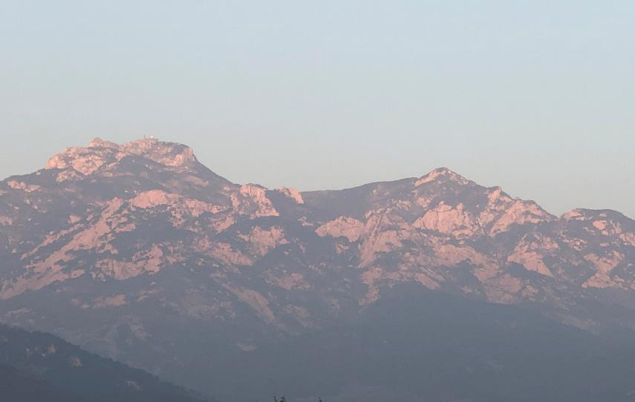
American style speech
I walked through many mountains, walked through many waters, and knew many people. The only thing that really makes me tempted is that you see me at the moment. But there is not too much extravagant hope, but I hope to have your heart, not to leave.
I walked through many mountains, walked through many waters, and knew many people. The only thing that really makes me tempted is that you see me at the moment. But there is not too much extravagant hope, but I hope to have your heart, not to leave.
I walked through many mountains, walked through many waters, and knew many people. The only thing that really makes me tempted is that you see me at the moment. But there is not too much extravagant hope, but I hope to have your heart, not to leave.
I walked through many mountains, walked through many waters, and knew many people. The only thing that really makes me tempted is that you see me at the moment. But there is not too much extravagant hope, but I hope to have your heart, not to leave. walked through many mountains, walked through many waters, and knew many people. The only thing that really makes me tempted is that you see me at the moment. But there is not too much extravagant hope, but I hope to have your heart, not to leave.
me tempted is that you see me at the moment. But there is not too much extravagant hope, but I hope to have your heart, not to leave.
I walked through many mountains, walked through many waters, and knew many people. The only thing that really makes me tempted is that you see me at the moment. But there is not too much extravagant hope, but I hope to have your heart, not to leave.
I walked through many mountains, walked through many waters, and knew many people. The only thing that really makes me tempted is that you see me at the moment. But there is not too much extravagant hope, but I hope to have your heart, not to leave.
I walked through many mountains, walked through many waters, and knew many people. The only thing that really makes me tempted is that you see me at the moment. But there is not too much extravagant hope, but I hope to have your heart, not to leave.

Slide 10

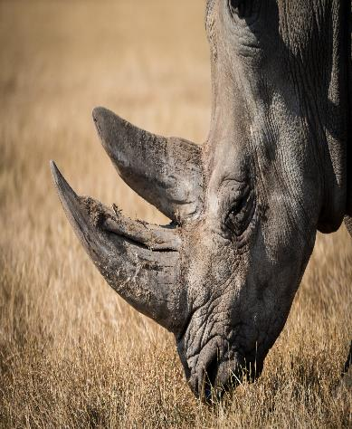
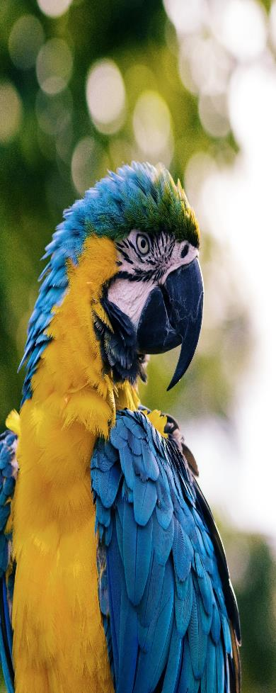




Slide 11


Report template of fashionable European and American style speech
I walked through many mountains, walked through many waters, and knew many people. The only thing that really makes me tempted is that you see me at the moment. But there is not too much extravagant hope, but I hope to have your heart, not to leave.
I walked through many mountains, walked through many waters, and knew many people. The only thing that really makes me tempted is that you see me at the moment. But there is not too much extravagant hope, but I hope to have your heart, not to leave.
DESIGND BY MUYUESHOP

Slide 12


Report template of fashionable European and American style speech
I walked through many mountains, walked through many waters, and knew many people. The only thing that really makes me tempted is that you see me at the moment. But there is not too much extravagant hope, but I hope to have your heart, not to leave.
I walked through many mountains, walked through many waters, and knew many people. The only thing that really makes me tempted is that you see me at the moment. But there is not too much extravagant hope, but I hope to have your heart, not to leave.
DESIGND BY MUYUESHOP

Slide 13


I walked through many mountains, walked through many waters, and knew many people. The only thing that really makes me tempted is that you see me at the moment. But there is not too much extravagant hope, but I hope to have your heart, not to leave.
I walked through many mountains, walked through many waters, and knew many people. The only thing that really makes me tempted is that you see me at the moment. But there is not too much extravagant hope, but I hope to have your heart, not to leave.

Slide 14
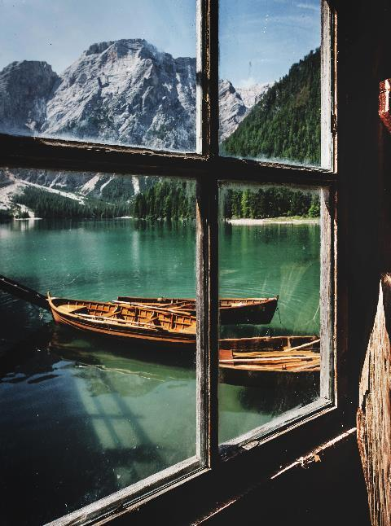
Rneddoleys
Report template of fashionable European and American style speech
I walked through many mountains, walked through many waters, and knew many people. The only thing that really makes me tempted is that you see me at the moment. But there is not too much extravagant hope, but I hope to have your heart, not to leave.
I walked through many mountains, walked through many waters, and knew many people. The only thing that really makes me tempted is that you see me at the moment. But there is not too much extravagant hope, but I hope to have your heart, not to leave.

Slide 15


Report template of fashionable European and American style speech
I walked through many mountains, walked through many waters, and knew many people. The only thing that really makes me tempted is that you see me at the moment. But there is not too much extravagant hope, but I hope to have your heart, not to leave.
I walked through many mountains, walked through many waters, and knew many people. The only thing that really makes me tempted is that you see me at the moment. But there is not too much extravagant hope, but I hope to have your heart, not to leave.

Slide 16
THANKS

