Slide 1

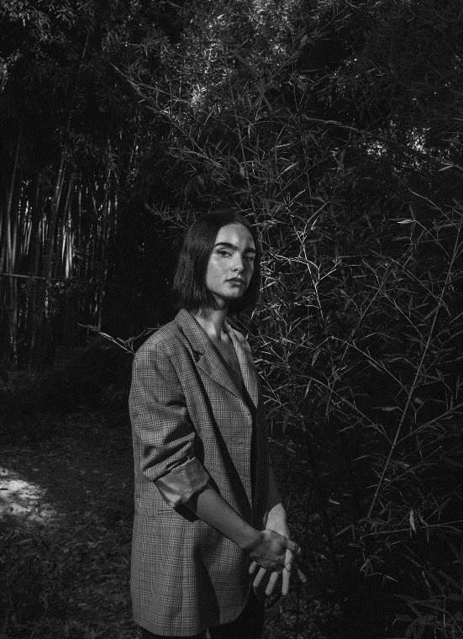


DESIGNED BY MORIMOTO
WHO WE ARE
MORIMOTO
欧美风时尚行业艺人相册画册
I walked through many mountains, walked through many waters, and knew many people. The only thing that really makes me tempted is that you see me at the moment. But there is not too much extravagant hope, but I hope to have your heart, not to leave.
I walked through many mountains, walked through many waters, and knew many people. The only thing that really makes me

Slide 2



Table of Content
1.0 当代女性应当如何定位
2.0 如何定义成功女性
3.0 女孩们应当怎么做
4.0 无惧挑战 做自己

Slide 3
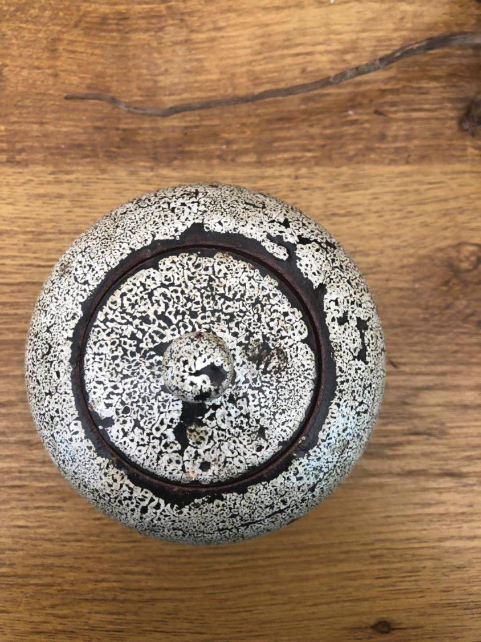
DESIGNED BY MUYUESHOP
从今天起
开始优雅的生活
I walked through many mountains, walked through many waters, and knew many people. The only thing that really makes me tempted is that you see me at the moment. But there is not too much extravagant hope, but I hope to have your heart, not to leave.
I walked through many mountains, walked through many waters, and knew many people. The only thing that really makes me tempted is that you see me at the moment. But there is not too much extravagant hope, but I hope to have your heart, not to leave.

Slide 4


I walked through many mountains, walked through many waters, and knew many people. The only thing that really makes me tempted is that you see me at the moment.
I walked through many mountains, walked through many waters, and knew many people. The only thing that really makes me tempted is that you see me at the moment. But there is not too much extravagant hope, but I hope to have your heart, not to leave.
I walked through many mountains, walked through many waters, and knew many people. The only thing that really makes me tempted is that you see me at the moment. But there is not too much extravagant hope, but I hope to have your heart, not to leave.

Slide 5


从今天起
开始优雅的生活
I walked through many mountains, walked through many waters, and knew many people. The only thing that really makes me tempted is that you see me at the moment. But there is not too much extravagant hope, but I hope to have your heart, not to leave.
I walked through many mountains, walked through many waters, and

Slide 6


I walked through many mountains, walked through many waters, and knew many people. The only thing that really makes me tempted is that you see me at the moment.
从今天起
开始优雅的生活
添加此处原有标题
I walked through many mountains, walked through many waters, and knew many people. The only thing that really makes me tempted is that you see me at the moment.

Slide 7

DESIGNED BY MUYUESHOP
添加此处原有标题
I walked through many mountains, walked through many waters, and knew many people. The only thing that really makes me tempted is that you see me at the moment. But there is not too much extravagant hope, but I hope to have your heart, not to leave.
添加此处原有标题
I walked through many mountains, walked through many waters, and knew many people. The only thing that really makes me tempted is that you see me at the moment. But there is not too much extravagant hope, but I hope to have your heart, not to leave.
添加此处原有标题
I walked through many mountains, walked through many waters, and knew many people. The only thing that really makes me tempted is that you see me at the moment. But there is not too much extravagant hope, but I hope to have your heart, not to leave.

Slide 8
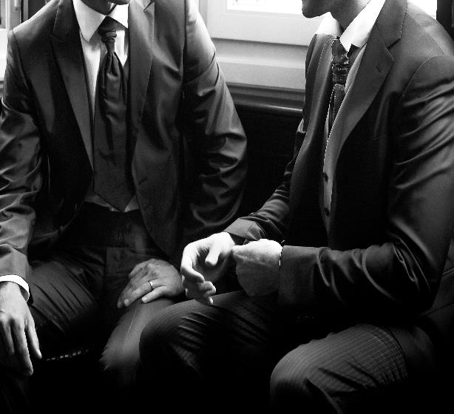
添加此处原有标题
I walked through many mountains, walked through many waters, and knew many people. The only thing that really makes me tempted is that you see me at the moment.
从今天起
开始优雅的生活
添加此处原有标题
I walked through many mountains, walked through many waters, and knew many people. The only thing that really makes me tempted is that you see me at the moment.

Slide 9

DESIGNED BY MUYUESHOP
从今天起
开始优雅的生活
A.
I walked through many mountains, walked through many waters, and knew many people. The only thing that really makes me tempted is that you see me at the moment. But there is not too much extravagant hope, but I hope to have your heart, not to leave.
I walked through many mountains, walked through many waters, and knew many people. The only thing that really makes me tempted is that you see me at the moment. But there is not too much extravagant hope, but I hope to have your heart, not to leave.
添加此处原有标题
I walked through many mountains, walked through many waters, and knew many people. The only thing that really makes me tempted is that you see me at the moment.

Slide 10
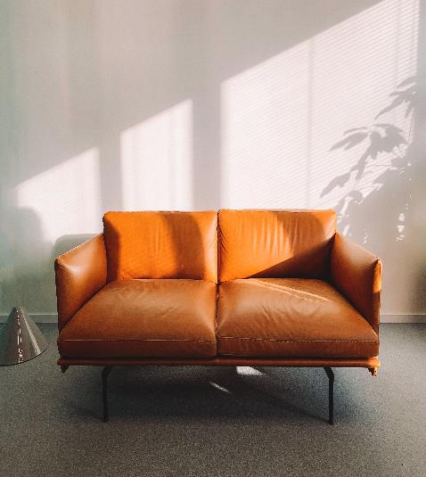
DESIGNED BY MUYUESHOP
从今天起
开始优雅的生活
I walked through many mountains, walked through many waters, and knew many people. The only thing that really makes me tempted is that you see me at the moment. I walked through many mountains, walked through many waters, and knew many people.
添加此处原有标题
I walked through many mountains, walked through many waters, and knew many people. The only thing that really makes me tempted is that you see me at the moment.

Slide 11

DESIGNED BY MUYUESHOP
从今天起
开始优雅的生活
I walked through many mountains, walked through many waters, and knew many people. The only thing that really makes me tempted is that you see me at the moment. I walked through many mountains, walked through many waters, and knew many people.

Slide 12

DESIGNED BY MUYUESHOP
WHO WE ARE
谢谢观看
欧美风时尚行业艺人相册画册
I walked through many mountains, walked through many waters, and knew many people. The only thing that really makes me tempted is that you see me at the moment. But there is not too much extravagant hope, but I hope to have your heart, not to leave.
I walked through many mountains, walked through many waters, and knew many people. The only thing that really makes me

