Slide 1


THE POWER POINT COME FROM WPS
MORIMOTO.

Slide 2

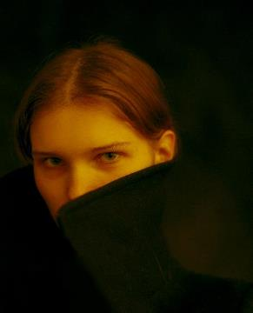

THE POWER POINT COME FROM WPS
MORIMOTO.
I walked through many mountains, walked through many waters, and knew many people. The only thing that really makes me tempted is that you see me at the moment. But there is not too much extravagant hope, but I hope to have your heart, not to leave.
I walked through many mountains, walked through many waters, and knew many people. The only thing that really makes me tempted is that you see me at the moment. But there is not too much extravagant hope, but I hope to have your heart, not to leave.

Slide 3

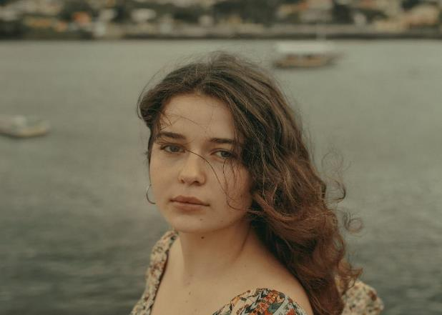
THE POWER POINT COME FROM WPS
MORIMOTO.
I walked through many mountains, walked through many waters, and knew many people. The only thing that really makes me tempted is that you see me at the moment. But there is not too much extravagant hope, but I hope to have your heart, not to leave.
I walked through many mountains, walked through many waters, and knew many people. The only thing that really makes me tempted is that you see me at the moment. But there is not too much extravagant hope, but I hope to have your heart, not to leave.

Slide 4
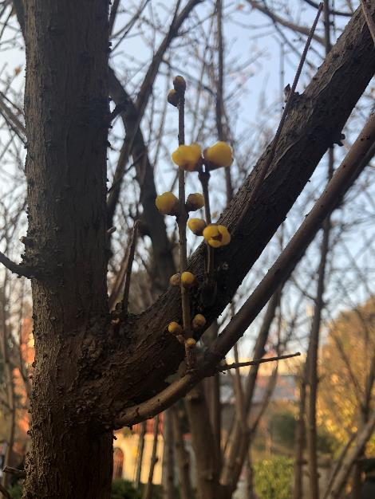
MORIMOTO.
I walked through many mountains, walked through many waters, and knew many people. The only thing that really makes me tempted is that you see me at the moment. But there is not too much extravagant hope, but I hope to have your heart, not to leave.
I walked through many mountains, walked through many waters, and knew many people. The only thing that really makes me tempted is that you see me at the moment. But there is not too much extravagant hope, but I hope to have your heart, not to leave.
$568
I walked through many mountains, walked through many waters and knew many people. The only thing that really makes me tempted is that you see me at the moment. But there is not too much extravagant hope, but I hope to have your heart,

Slide 5

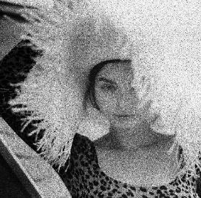

TEXT HERE
添加此处原有标题
简短的绪论
简短的绪论
简短的绪论
I walked through many mountains, walked through many waters, and knew many people. The only thing that really makes me tempted is that you see me at the moment.
I walked through many mountains, walked through many waters, and knew many people. The only thing that really makes me tempted is that you see me at the moment.
I walked through many mountains, walked through many waters, and knew many people. The only thing that really makes me tempted is that you see me at the moment.

Slide 6


添加此处原有标题
添加此处原有标题
I walked through many mountains, walked through many waters, and knew many people. The only thing that really makes me tempted is that you see me at the moment.
I walked through many mountains, walked through many waters, and knew many people. The only thing that really makes me tempted is that you see me at the moment.
MORIMOTO.
I walked through many mountains, walked through many waters, and knew many people. The only thing that really makes me tempted is that you see me at the moment. But there is not too much extravagant hope, but I hope to have your heart, not to leave.
I walked through many mountains, walked through many waters, and knew many people. The only thing that really makes me tempted is that you see me at the moment. But there is not too much extravagant hope, but I hope to have your heart, not to leave.

Slide 7


I walked through many mountains, walked through many waters, and knew many people. The only thing that really makes me tempted is that you see me at the moment. But there is not too much extravagant hope, but I hope to have your heart, not to leave.
I walked through many mountains, walked through many waters, and knew many people. The only thing that really makes me tempted is that you see me at the moment. But there is not too much extravagant hope, but I hope to have your heart, not to leave.
添加此处原有标题
I walked through many mountains, walked through many waters, and knew many people. The only thing that really makes me tempted is that you see me at the moment.
添加此处原有标题
I walked through many mountains, walked through many waters, and knew many people. The only thing that really makes me tempted is that you see me at the moment.
添加此处原有标题
I walked through many mountains, walked through many waters, and knew many people. The only thing that really makes me tempted is that you see me at the moment.

Slide 8


添加此处原有标题
添加此处原有标题
I walked through many mountains, walked through many waters, and knew many people. The only thing that really makes me tempted is that you see me at the moment. But there is not too much extravagant hope, but I hope to have your heart, not to leave.
I walked through many mountains, walked through many waters, and knew many people. The only thing that really makes me tempted is that you see me at the moment.
VIEW MORE

Slide 9

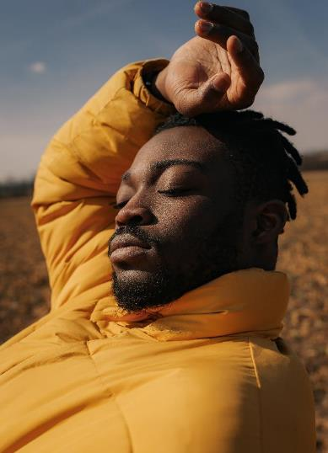
THE POWER POINT COME FROM WPS
MORIMOTO.
I walked through many mountains, walked through many waters, and knew many people. The only thing that really makes me tempted is that you see me at the moment. But there is not too much extravagant hope, but I hope to have your heart, not to leave.
I walked through many mountains, walked through many waters, and knew many people. The only thing that really makes me tempted is that you see me at the moment. But there is not too much extravagant hope, but I hope to have your heart, not to leave.
添加此处原有标题
I walked through many mountains, walked through many waters, and knew many people. The only thing that really makes me tempted is that you see me at the moment.

Slide 10

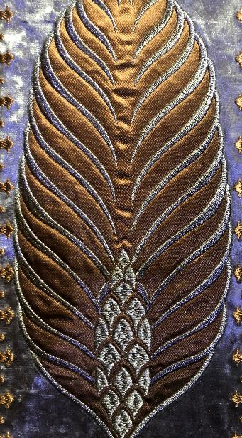
添加此处原有标题
MORIMOTO.
I walked through many mountains, walked through many waters, and knew many people. The only thing that really makes me tempted is that you see me at the moment.
添加此处原有标题
I walked through many mountains, walked through many waters, and knew many people. The only thing that really makes me tempted is that you see me at the moment. But there is not too much extravagant hope, but I hope to have your heart, not to leave.
I walked through many mountains, walked through many waters, and knew many people. The only thing that really makes me tempted is that you see me at the moment. But there is not too much extravagant hope, but I hope to have your heart, not to leave.
I walked through many mountains, walked through many waters, and knew many people. The only thing that really makes me tempted is that you see me at the moment.
THE POWER POINT COME FROM WPS
添加此处原有标题
I walked through many mountains, walked through many waters, and knew many people. The only thing that really makes me tempted is that you see me at the moment.

Slide 11


THE POWER POINT COME FROM WPS
I walked through many mountains, walked through many waters, and knew many people. The only thing that really makes me tempted is that you see me at the moment. But there is not too much extravagant hope, but I hope to have your heart, not to leave.
I walked through many mountains, walked through many waters, and knew many people. The only thing that really makes me tempted is that you see me at the moment. But there is not too much extravagant hope, but I hope to have your heart, not to leave.
I walked through many mountains, walked through many waters, and knew many people. The only thing that really makes me tempted is that you see me at the moment. But there is not too much extravagant hope, but I hope to have your heart, not to leave.
I walked through many mountains, walked

Slide 12
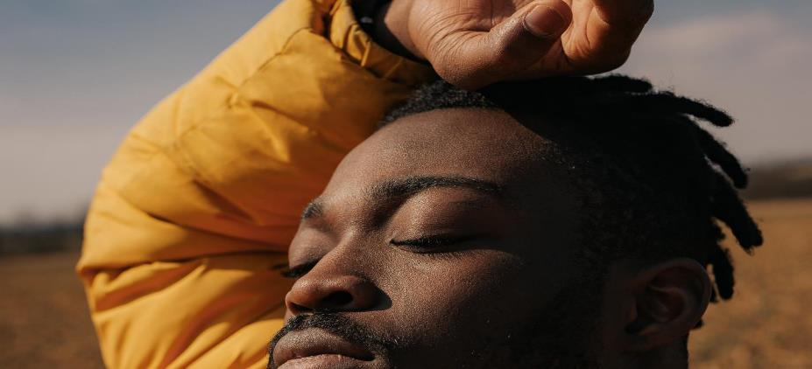
THANKS

