Slide 1
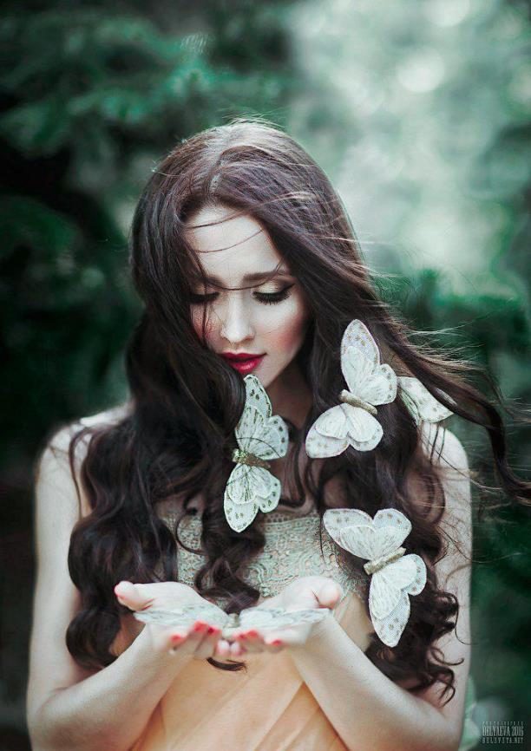

GLORIA
复古胶片感画册风PPT模板
A designer can use default text to simulate what text would look like. If it is not real text. A designer can use default text to simulate what text would look like.

Slide 2

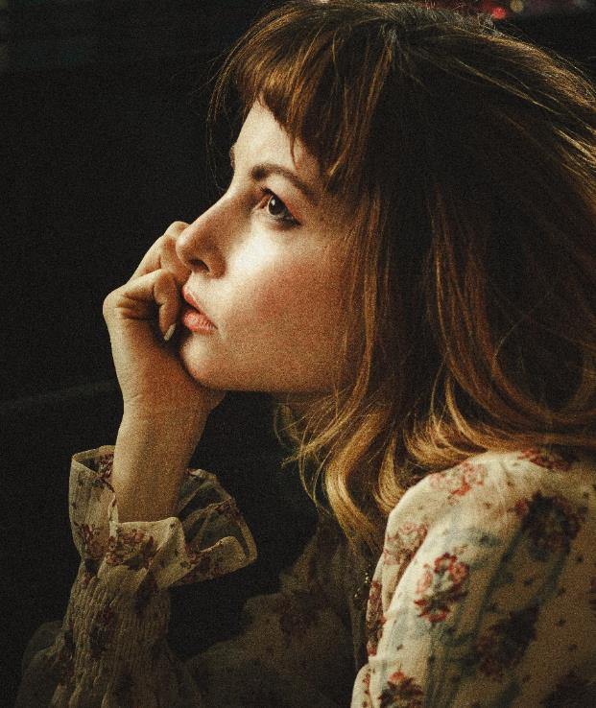

GLORIA
A designer can use default text to simulate what text would look like. If it is not real text. A designer can use default text to simulate what text would look like. A designer can use default text to simulate what text would look like. If it is not real text.

Slide 3


GLORIA
A designer can use default text to simulate what text would look like. If it is not real text. A designer can use default text to simulate what text would look like. A designer can use default text to simulate what text would look like. If it is not real text. A designer can use default text to simulate what text would look like.

Slide 4

GLORIA
GLORIA
A designer can use default text to simulate what text would look like. If it is not real text. A designer can use default text to simulate what text would look like. A designer can use default text to simulate what text would look like. If it is not real text. A designer can use default text to simulate what text would look like.

Slide 5

A designer can use default text to simulate what text would look like. If it is not real text. A designer can use default text to simulate what text would look like. A designer can use default text to simulate what text would look like. If it is not real text. A designer can use default text to simulate what text would look like.
GLORIA
01
A designer can use default text to simulate what text would look like. If it is not real text.
02
A designer can use default text to simulate what text would look like. If it is not real text.

Slide 6

A designer can use default text to simulate what text would look like. If it is not real text. A designer can use default text to simulate what text would look like. A designer can use default text to simulate what text would look like. If it is not real text. A designer can use default text to simulate what text would look like.
01
A designer can use default text to simulate what text would look like. If it is not real text.
GLORIA
02
A designer can use default text to simulate what text would look like. If it is not real text.

Slide 7
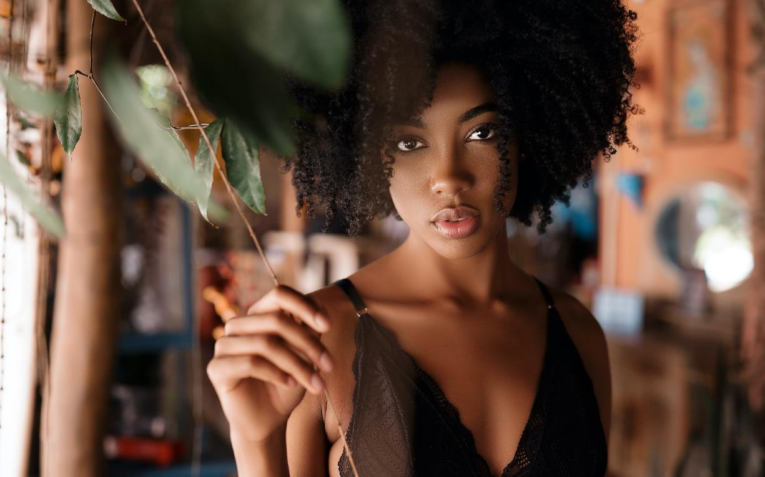
GLORIA
A designer can use default text to simulate what text would look like. If it is not real text. A designer can use default text to simulate what text would look like. A designer can use default text to simulate what text would look like.

Slide 8

A designer can use default text to simulate what text would look like. If it is not real text.
A designer can use default text to simulate what text would look like. If it is not real text. A designer can use default text to simulate what text would look like. A designer can use default text to simulate what text would look like.
GLORIA

Slide 9

GLORIA
A designer can use default text to simulate what text would look like. If it is not real text. A designer can use default text to simulate what text would look like. A designer can use default text to simulate what text would look like. If it is not real text.

Slide 10

GLORIA
A designer can use default text to simulate what text would look like. If it is not real text. A designer can use default text to simulate what text would look like.

Slide 11


GLORIA
A designer can use default text to simulate what text would look like. If it is not real text. A designer can use default text to simulate what text would look like. A designer can use default text to simulate what text would look like.

Slide 12

GLORIA
A designer can use default text to simulate what text would look like. If it is not real text. A designer can use default text to simulate what text would look like. A designer can use default text to simulate what text would look like. If it is not real text.

Slide 13


A designer can use default text to simulate what text would look like. If it is not real text. A designer can use default text to simulate what text would look like.
GLORIA

Slide 14

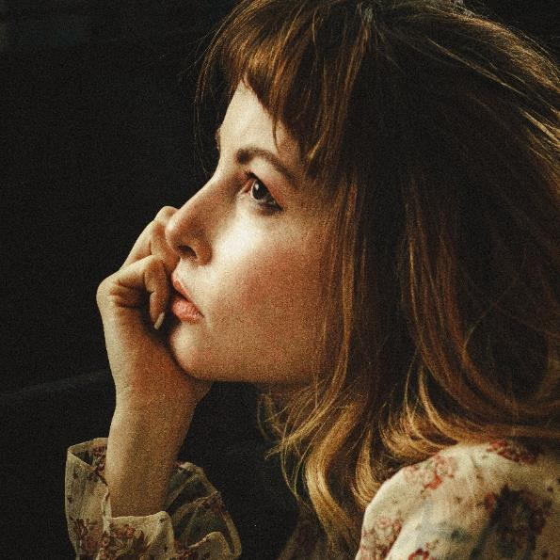
GLORIA
A designer can use default text to simulate what text would look like. If it is not real text. A designer can use default text to simulate what text would look like. A designer can use default text to simulate what text would look like. If it is not real text. A designer can use default text to simulate what text would look like.

Slide 15

A designer can use default text to simulate what text would look like. If it is not real text. A designer can use default text to simulate what text would look like.
A designer can use default text to simulate what text would look like. If it is not real text. A designer can use default text to simulate what text would look like.
GLORIA

Slide 16

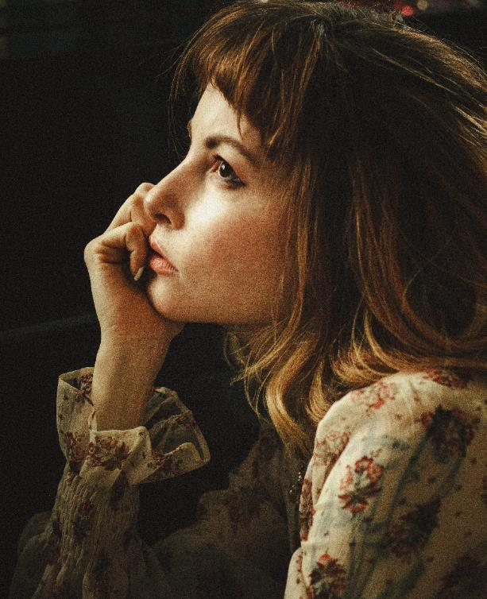

THANKS
复古胶片感画册风PPT模板
A designer can use default text to simulate what text would look like. If it is not real text. A designer can use default text to simulate what text would look like.

