Slide 1
Title : Spam SMS Detection
1
Project Presentation
Presented By-
Maruf Shahriar [20-42016-1]
Asif Hossain Neloy [20-42996-1]
Muhaiminul Ashrafee [20-42217-1]

Slide 2
Outline
2
Problem Statement
Objectives
Methodology
Results and discussion
Conclusion
References

Slide 3
3
Problem Statement
Spam SMS messages have become a major nuisance for mobile phone users around the world. These messages can be not only annoying but also a serious security threat, as they may contain malware or phishing links that can compromise users' personal information. According to Federal Communications Commission
More than 47 billion spam texts have been sent so far in 2021
In 2020, the report estimates, scam texts cost Americans $86 million.
The number of spam text are rising by 146% each year [1].
To solve this issue we are proposing a machine learning based system that will detect if a SMS is spam or not.

Slide 4
4
Objective
The objective of our proposed project are as follows:
Identify the key differences between Spam and Non Spam SMS
Extract the features of Spam and Non Spam SMS
Apply algorithms to identify if a given mail is spam or not
Figure out the best algorithm that can best used to yield the most accurate result.
Reduce the number of false positive and boost the accuracy of the model.

Slide 5
5
Methodology
The goal of this project is to select and train a model that will be able to identify Spam email. To do so we have taken a dataset and made necessary adjustments as well as train and modify the data as well as the models.
Some of the major steps includes:
Data collection
Data validation
Data preprocessing
Feature extraction
Classification Algorithm
Data Analysis
Block Diagram
Workflow Diagram.

Slide 6
6
Methodology
Data Collection: The data was collected from a public website known as Kaggle[2]. The dataset contains 5572 rows and 5 columns. Among them, 4516 SMS that are valid and 653 SMS that are spam. We have dedicated 80% of the data as training data and 20% of the data as testing data.
Data Validation:
The steps in data validation were:
Cleaning the empty spaces and columns
Labeling the spam and non spam data with integer value
Checking for null values and duplicates
Making correlation between characters, words and sentences in dataset
Splitting the data for training and testing

Slide 7
7
Methodology
Data Preprocessing:
We have performed the tasks listed below in this step:
Turned all letters into lower case
Broken the data into words for easier processing
Removed all special characters from the dataset
Remove all stop words and punctuation
Removed variation of the same word
Data Preprocessing:
After splitting the data into two, we have used TfidfVectorizer for our data processing. The train dataset is inserted in the faction and the output of the function turns the texts into numerical values and then they are used as inputs for our models.

Slide 8
8
Methodology
Classification Algorithm:
The algorithms that are used in this project are:
Logistic Regression
Support Vector Machine
Naïve Bayes
Decision Tree
KN Classifier
Randomforest Classifier
GradientBoosting Classifier
ExtraTrees Classifier
Bagging Classifier
AdaBoost Classifier
XGB Classifier

Slide 9
Methodology
9
Data analysis
The model follows quantitative data analysis technique. The majority of the dataset and features are converted into integer values to help the model understand the features. That is why this project follows quantitative or numeric data analysis.

Slide 10
Methodology
10
Block Diagram
Through this block diagram, we can get an idea of how the project functions
Data
Analysis
Feature
Extraction
Input
Data
Data
Cleaning
Model
Implementation
Output
Figure 1: Block Diagram

Slide 11
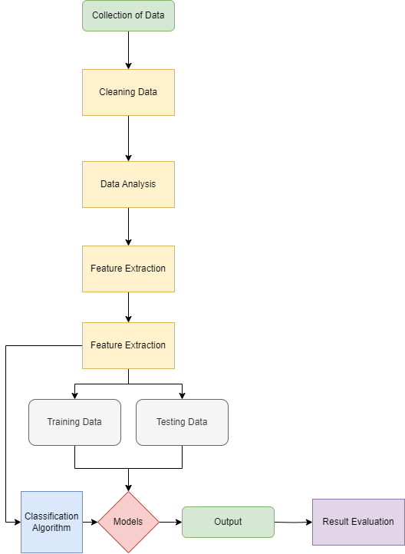
Methodology
11
Workflow Diagram
Through this workflow diagram, we can get an idea of how the performs tasks
Figure 2: Workflow Diagram

Slide 12
Results and Discussions
12
The performance of the models are given below sorted by higher precision to lower precision
Algorithm | Accuracy | Precision
KN Classifier | 0.900387 | 1.000000
Naïve Bayes | 0.959381 | 1.000000
 | 0.971954 | 1.000000
ExtraTrees Classifier | 0.972921 | 0.982456
Support Vector Machine | 0.972921 | 0.974138
AdaBoost Classifier | 0.961315 | 0.945455
Logistic Regression | 0.951644 | 0.940000
XGB Classifier | 0.970019 | 0.934959
GradientBoosting Classifier | 0.952611 | 0.923810
Bagging Classifier | 0.958414 | 0.862595
Decision Tree | 0.935203 | 0.838095
The higher level of precision and accuracy yielding models are superior in this case. We can see a few models having perfect precision and very high levels of accuracy. But changing number of features or size of the dataset might affect these results.

Slide 13
Conclusion
13
From the results of the models we can observe and give judgements on an few things.
Choice | Algorithm | Accuracy | Precision
Best Choice | Randomforest Classifier | 0.971954 | 1.000000
Worst Choice | Decision Tree | 0.935203 | 0.838095
So, from the table, the best performing algorithm in this case is Randomforest classifier with the highest sum of precision and accuracy. The worst algorithm to be used in this case is Decision Tree with lowest precision and low accuracy.

Slide 14
References
14
[1] B. Sullivan, “Complaints about spam texts were up 146% last year. now, the FCC wants to take action,” NPR, 19-Oct-2021. [Online]. Available: https://www.npr.org/2021/10/19/1047303425/complaints-about-spam-texts-fcc-robocalls. [Accessed: 03-May-2023].
[2]U. C. I. M. Learning, “SMS Spam Collection Dataset,” Kaggle, 02-Dec-2016. [Online]. Available: https://www.kaggle.com/datasets/uciml/sms-spam-collection-dataset. [Accessed: 03-May-2023].
[3] S. Gadde, A. Lakshmanarao, and S. Satyanarayana, “SMS SPAM detection using machine learning and Deep Learning Techniques,” 2021 7th International Conference on Advanced Computing and Communication Systems (ICACCS), 2021.
[4] M. Gupta, A. Bakliwal, S. Agarwal, and P. Mehndiratta, “A comparative study of spam SMS detection using machine learning classifiers,” 2018 Eleventh International Conference on Contemporary Computing (IC3), 2018.
[5] A. K. Jain, S. K. Yadav, and N. Choudhary, “A novel approach to detect spam and smishing SMS using machine learning techniques,” Research Anthology on Securing Mobile Technologies and Applications, pp. 267–285, 2021.
[6] V. A. Saeed, “A method for SMS SPAM message detection using machine learning,” Artificial Intelligence & Robotics Development Journal, pp. 214–228, 2023.

Slide 15
15
THANKS!
I HOPE THIS PRESENTATION WAS INFORMATIVE AND HELPFUL

