Slide 1
Web development basics
Basic knowledge

Slide 2
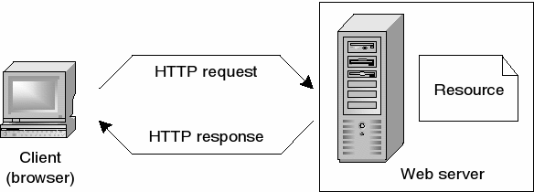
How does the web work?
Notes:
The web, or World Wide Web (WWW), is a system of interconnected documents and other resources, linked by hyperlinks and URLs. It allows users to access and share information using a web browser, such as Google Chrome, Firefox or Safari. When you type a URL, or web address, into your browser, it sends a request to a server. The server then sends back the requested information, which the browser displays in the form of a website. The website is made up of different types of files, such as HTML, CSS, and JavaScript, which work together to create the visual layout and interactive elements of the site. When you click on a link, it sends another request to the server for the new page or resource, and the process repeats. Web pages can also use other technologies like cookies and JavaScript to store information on your device and create a more personalized experience, like remembering your login info or shopping cart items on e-commerce website. Overall, the web is a vast network of interconnected documents and other resources that can be accessed by users through a web browser using a URL.

Slide 3
How to create a webpage?
Planning stage: Determine the purpose and goals of the website, create a content plan, and identify the target audience.
Design stage: Create a visual design, layout and wireframes for the website. This can include choosing colors, typography, and images that align with the overall aesthetic and goals of the website.
Frontend/Backend development: Write the code for the website using HTML, CSS, JavaScript and a programming language like Python or Ruby to create the frontend and backend logic.
Launch stage: Test the website for any bugs or errors, and make any necessary adjustments. Once the website is ready, it can be launched and made live for the public to access.

Slide 4
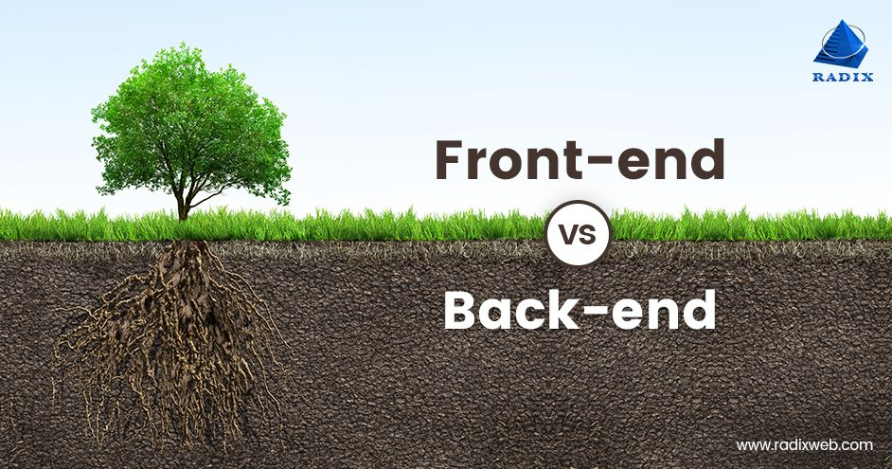
What is frontend?
Frontend refers to the part of web development that deals with the user interface and user experience of a website or application. It is the part of the website or application that the user interacts with and sees. It is typically made up of HTML, CSS, and JavaScript, which are used to create the layout, design, and interactivity of the website or application. Essentially, frontend is what the user sees, interacts and engage with on a website or application.

Slide 5
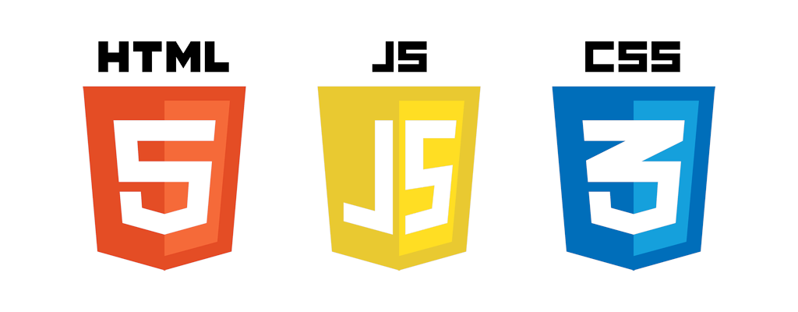
Frontend technologies
HTML (Hypertext Markup Language) is the standard language used to create web pages. It provides the structure and layout of a web page, including headings, paragraphs, images, and links.
CSS (Cascading Style Sheets) is used to add style and layout to web pages created with HTML. It allows for the separation of the presentation of a web page from its structure and content.
JavaScript is a programming language that is commonly used to create interactive and dynamic elements on web pages. It can be used to add interactivity and effects, such as animations, form validation, and dynamic content updates.
In summary, HTML provides the structure and content of a web page, CSS is used to add style and layout, and JavaScript adds interactivity and dynamic effects. Together, these three technologies are used to create the majority of websites on the internet.

Slide 6
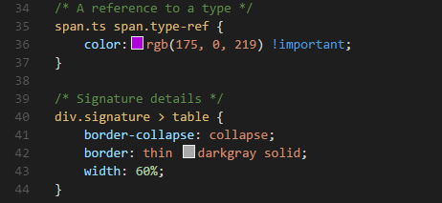
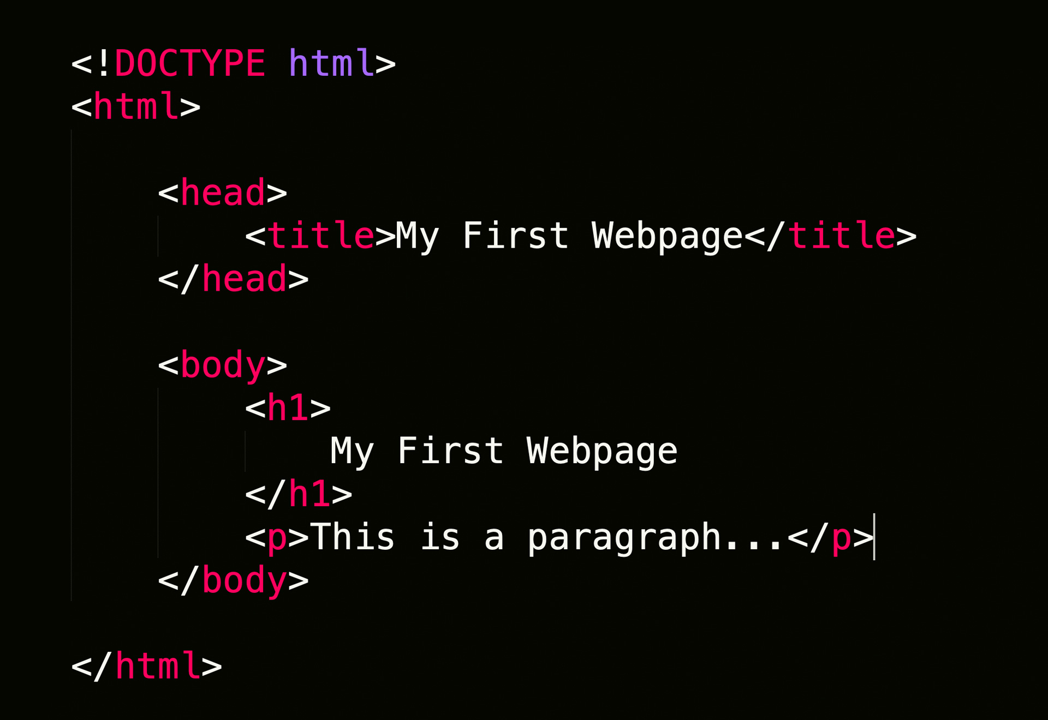
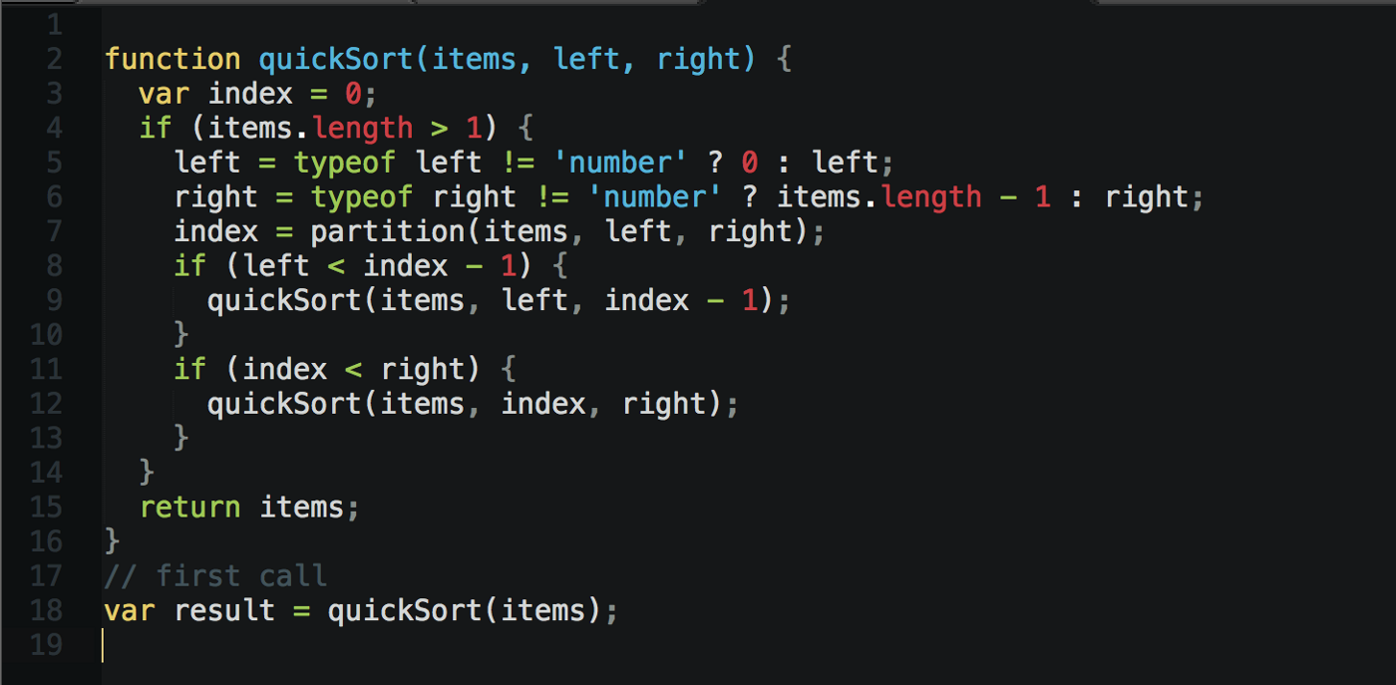
Syntax

Slide 7
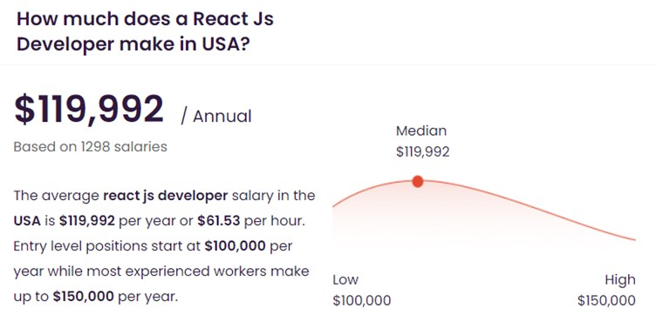
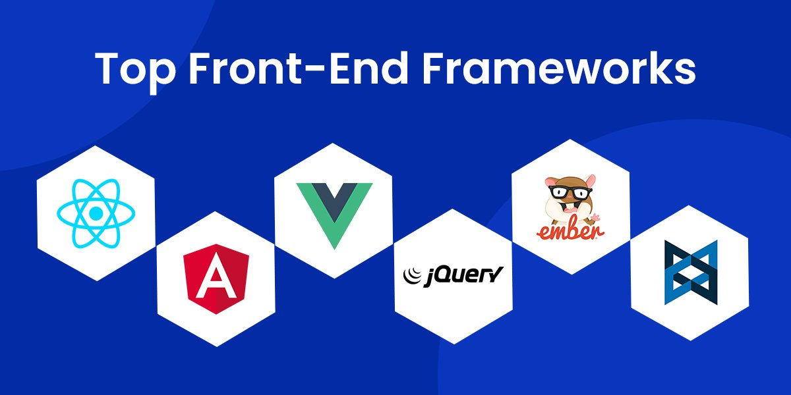
Frontend frameworks

Slide 8
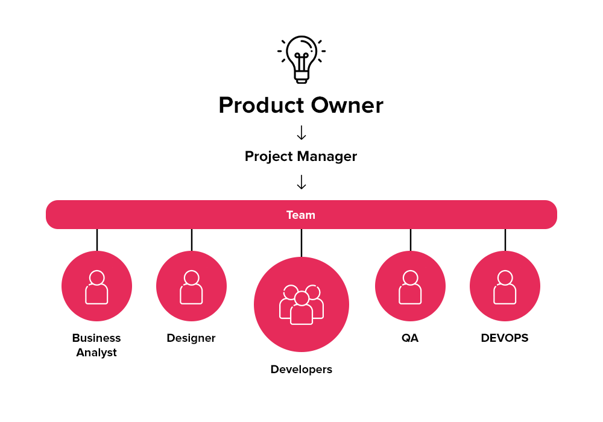
How does team look like?

Slide 9
Quiz
Question 1: What should you do during the planning stage of creating a website?
A) Write the code for the website
B) Determine the purpose and goals of the website
C) Launch the website
D) Choose colors and typography for the website

Slide 10
Quiz
Question 2: What programming languages can you use to create the frontend logic of a website?
A) HTML, CSS, and JavaScript
B) Python and Ruby
C) C++ and Java
D) PHP and SQL

Slide 11
Quiz
Question 3: What is HTML used for?
A) Adding style and layout to web pages
B) Creating interactive elements on web pages
C) Providing the structure and layout of a web page
D) None of the above

Slide 12
Quiz
Question 4: What is CSS used for?
A) Providing the structure and layout of a web page
B) Creating interactive elements on web pages
C) Adding style and layout to web pages created with HTML
D) None of the above

Slide 13
Quiz
Question 5: What is JavaScript used for?
A) Providing the structure and layout of a web page
B) Adding style and layout to web pages created with HTML
C) Creating interactive and dynamic elements on web pages
D) None of the above

Slide 14
Quiz
Question 6: What is the purpose of HTML, CSS, and JavaScript when used together?
A) To create the content of a website
B) To add interactivity and dynamic effects to a website
C) To add style and layout to a website
D) To create the majority of websites on the internet

Slide 15


How to start coding?
Install git
Windows
Mac (install from https://sourceforge.net/projects/git-osx-installer/, so you don't get to install it with xcode)
Install Visual Studio Code - link

Slide 16

What is git?
Git is a version control system that allows developers to keep track of changes made to their code. It allows them to collaborate on projects and revert to previous versions if needed.

Slide 17
Git commands
The most commonly used Git commands include:
"git init" : Initialize a new git repository on your local machine.
"git clone" : Make a copy of a remote repository (like GitHub) on your local machine.
"git add" : Add changes made to your files to the "staging area" before committing them.
"git commit" : Save changes to the git history, with a commit message describing the changes.
"git pull" : Download and merge changes from a remote repository with your local repository.
"git push" : Upload your changes to a remote repository.

Slide 18
Classwork
Register for a GitHub account at https://github.com/ if you don’t already have one.
Create a new repository by clicking the “New repository” button on your GitHub account’s homepage.
Give your repository a name, description, and choose whether you want it to be public or private.
Initialize the repository with a README file if desired.
Open Terminal on your local machine (f.e. Git Bash on windows, Terminal on Mac, or terminal in VSC)
Navigate to the directory where you want to store your local copy of the repository using the cd command.
Clone the repository to your local machine by typing the following command, replacing “username” with your GitHub username and “repo-name” with the name of your repository:

Slide 19



Classwork 2
8) Open cloned directory in VSC
9) Create index.html file with “Hello World” content
10) Save changes in file
11) In terminal navigate to directory, where you have created index.html file
12) Stage the changes with the following command:
13) Commit the changes with a message explaining what you did:
14) Push the changes to your remote repository on GitHub:

Slide 20
Homework
Finish classwork
Create new branch from main, make changes and push to github
In github merge new branch to master

