Slide 1
Web development basics
DOM manipulations + form validation

Slide 2
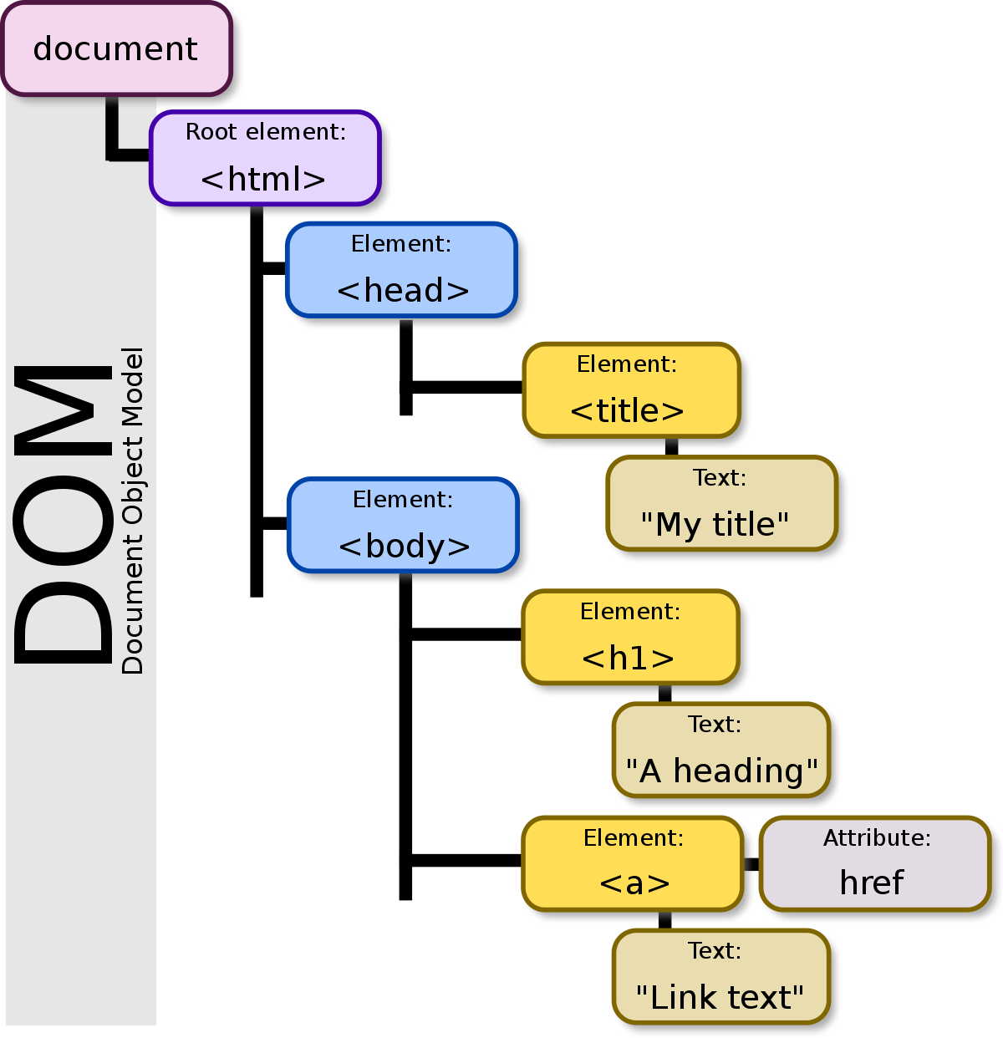
Introduction to DOM Manipulation
The Document Object Model (DOM) is a programming interface for HTML and XML documents. It represents the structure of a document as a tree-like hierarchy, with the document itself at the top (the "root" of the tree), and each element, attribute, and piece of text inside the document as a node in the tree.
JavaScript can be used to manipulate the DOM, which allows developers to change the structure and content of a web page in real time. For example, you can use JavaScript to add or remove elements from the page, change the text or styles of elements, or respond to user actions like clicks and hover events.

Slide 3
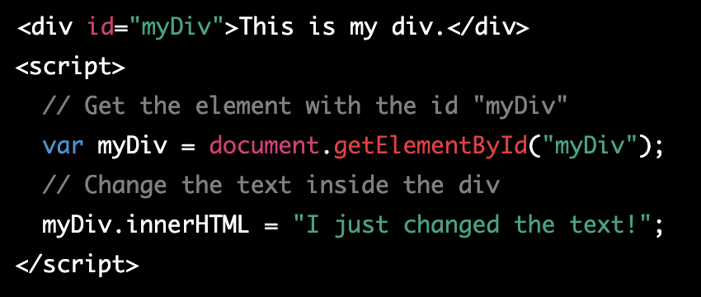
DOM and JS
The DOM can be accessed and manipulated using JavaScript methods and properties, such as getElementById, querySelector, and innerHTML.
This will change the text inside the div element with the id "myDiv" to "I just changed the text!".

Slide 4
DOM Access Methods
getElementById – search element by element id
getElementsByTagName – search element by tag name (e.g., span, div)
getElementsByClassName – search element by class name
getElementsByName – search element by name attribute
querySelector – returns the first element that matches the specified selector
querySelectorAll – returns elements that match the specified selector

Slide 5
Manipulating DOM Elements
There are several ways to manipulate DOM elements in JavaScript, some of the most common are:
Changing the content of an element: You can change the text or HTML inside an element by using the innerHTML property. For example, to change the text inside a <p> element with the id "myParagraph"

Slide 6
Manipulating DOM Elements 2
2) Changing the styles of an element: You can change the CSS styles of an element by using the style property. For example, to change the background color of a <div> element with the id "myDiv" to red
3) Adding and Removing classes: You can add or remove classes from an element by using the classList property. For example, to add a class "highlight" to a <p> element with the id "myParagraph"

Slide 7
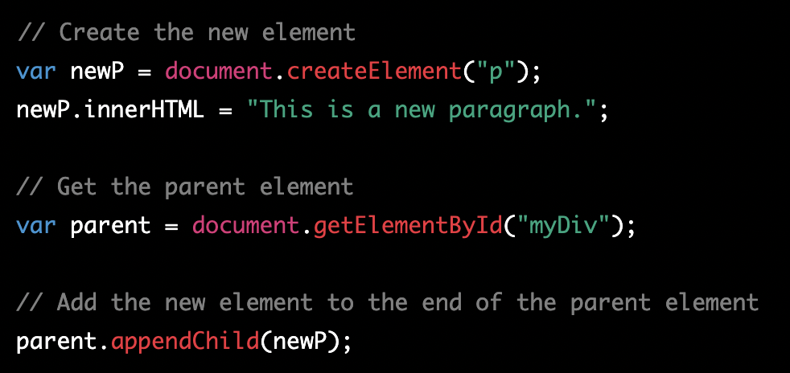
Creating Elements
In JavaScript, you can create new elements in the DOM using the document.createElement() method, and then add them to the page using the appendChild() or insertBefore() methods.

Slide 8
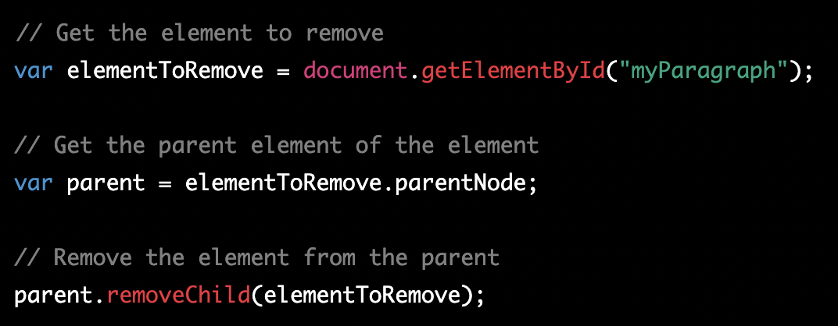
Removing Elements
To remove an existing element from the DOM, you can use the removeChild() method or the remove() method if the browser support it.

Slide 9
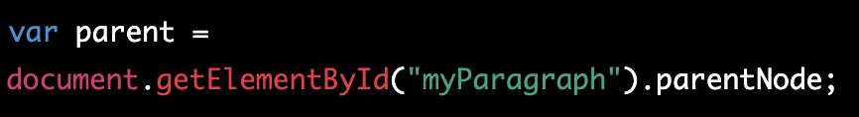
Traversing the DOM
In JavaScript, you can traverse the DOM to access parent, child, and sibling elements using the following properties and methods:
parentNode: This property returns the parent node of an element. For example, to get the parent element of a <p> element with the id "myParagraph", you can use this code

Slide 10
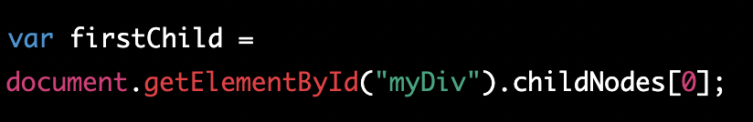
Traversing the DOM 2
2) childNodes: This property returns a NodeList of all the child nodes of an element, including text and comment nodes. To access a specific child element, you can use the childNodes property in combination with the [index] notation. For example, to get the first child element of a <div> element with the id "myDiv", you can use this code

Slide 11
Traversing the DOM 3
3) children: This property returns an HTMLCollection of all the child elements of an element, ignoring text and comment nodes. It's similar to childNodes but it's more efficient. For example, to get the first child element of a <div> element with the id "myDiv", you can use this code
Additional reading materials - https://zellwk.com/blog/dom-traversals/

Slide 12
Classwork about dom manipulation
Step 1: Create a simple HTML webpage with a <div> element and a button. Give the <div> element an id so that you can target it with JavaScript.
Step 2: Create a JavaScript file and link it to your HTML file. In the JavaScript file, use the getElementById() method to target the <div> element and the button.
Step 3: Create a function that generates a random color. You can use the Math.random() method to generate a random number between 0 and 1, and then use that number to generate a random color.
Step 4: Create an event listener for the button that listens for a click event. When the button is clicked, the function should change the background color of the <div> element to a random color.

Slide 13
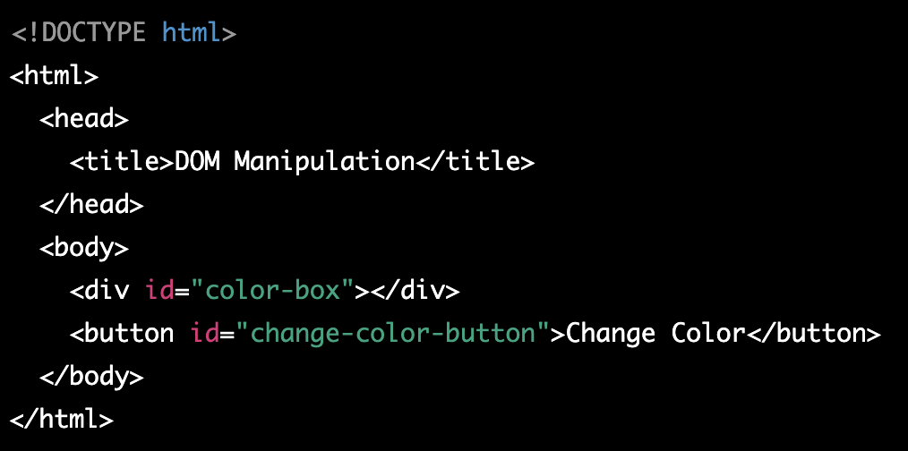

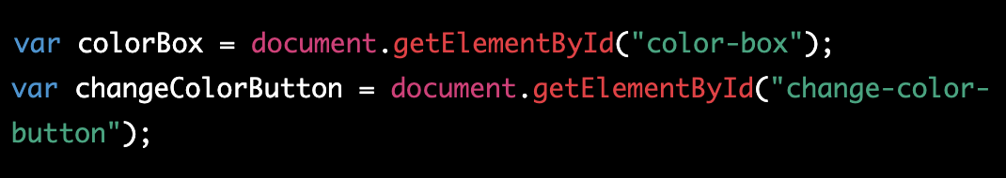
Classwork about dom manipulation - solution

Slide 14
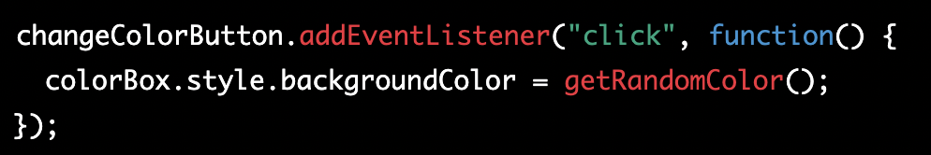
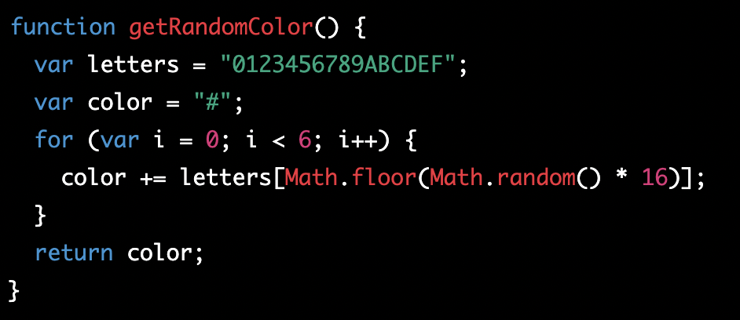
Classwork about dom manipulation - solution 2

Slide 15
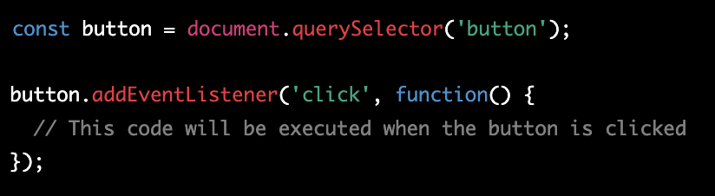
Event listeners
In JavaScript, events are actions or occurrences that happen in a web page or web application, such as a button being clicked, a mouse being moved over an element, or a page finishing loading. To respond to events in JavaScript, you can use event handlers. An event handler is a function that gets executed when a specific event occurs. You can attach an event handler to an element in your web page using the addEventListener method, like this:

Slide 16
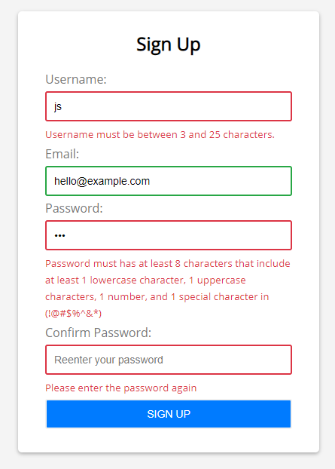
Introduction to Form Validation
HTML form validation is a process of checking that the user input in a form is complete, accurate, and secure before it is submitted to the server. It is typically done using JavaScript, and it helps to ensure that the form is filled out correctly and that all required fields are completed.
There are several reasons why HTML form validation is important for web development:
User experience: Form validation improves the user experience by providing immediate feedback on errors and ensuring that the form is filled out correctly before it is submitted.

Slide 17
Introduction to Form Validation
2) Data integrity: By validating user input, you can ensure that the data entered into the form is accurate and complete, which helps to maintain the integrity of the data stored on the server.
3) Security: Form validation can also help to prevent security risks by detecting and blocking malicious input, such as cross-site scripting (XSS) attacks.
4) Server load: By catching errors on the client-side, you can reduce the number of invalid submissions and save server resources.
5) Accessibility: Form validation can also help to make forms more accessible by providing clear error messages and highlighting invalid form fields.

Slide 18


Basic Form Validation
Basic form validation using HTML can be done using the following methods:
required attribute: This attribute is used on form elements such as <input> and <textarea> to make the field required. If the user leaves the field blank and attempts to submit the form, an error message will be displayed.
pattern attribute: This attribute is used to specify a regular expression that the input must match. If the input doesn't match the pattern, an error message will be displayed.

Slide 19

Basic Form Validation 2
3) min and max attribute: This attribute is used to specify the minimum and maximum value that the input can have. If the input is outside of the specified range, an error message will be displayed.
4) minlength and maxlength attribute: This attribute is used to specify the minimum and maximum number of characters that the input can have. If the input is outside of the specified range, an error message will be displayed.

Slide 20


Basic Form Validation 3
5) type attribute: This attribute is used to specify the type of input, such as text, email, number, etc. If the input does not match the specified type, an error message will be displayed.
6) step attribute: This attribute is used to specify the legal number intervals for an input field of type number. If the input is outside of the specified range, an error message will be displayed.

Slide 21

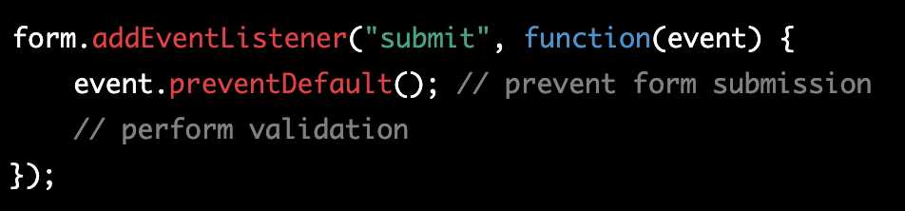
Custom Form Validation
For custom form validation using javascript, you need to prevent default form submit behaviour and apply custom validation. For that you need to:
Select the form element using JavaScript. This can be done using the getElementById() method or querySelector() method.
Next, you need to add an event listener to the form's submit event. This event listener will be called when the form is submitted, and it will be responsible for performing the validation.

Slide 22
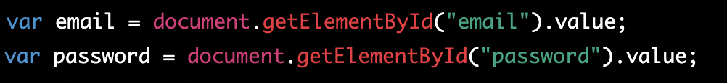
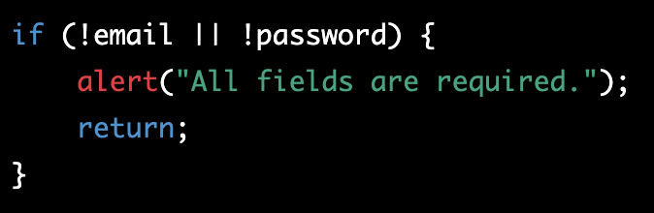
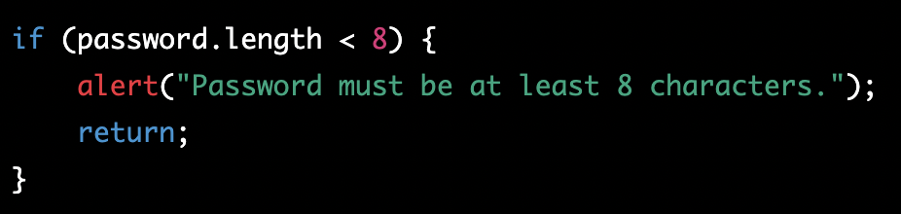
Custom Form Validation 2
3) Inside the event listener, you can use JavaScript to check the values of the form fields and determine if they are valid. For example, you can check if a required field is filled out, if an email address is in the correct format, or if a password meets a certain complexity requirement.

Slide 23
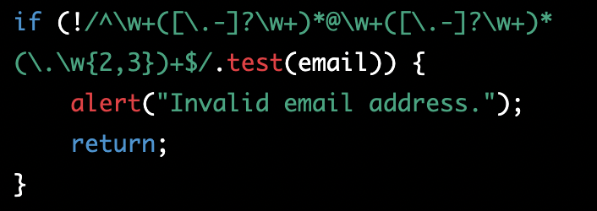
Using Regular Expressions
Regex, or regular expressions, are a powerful tool for matching patterns in text. In JavaScript, regular expressions can be used for form validation by testing whether a string of characters entered by a user matches a specific pattern. For example, a regular expression could be used to check that a user has entered a valid email address, phone number, or credit card number. The JavaScript method test() can be used to test whether a string matches a regular expression. If the string matches the pattern defined by the regular expression, test() returns true, otherwise it returns false.

Slide 24
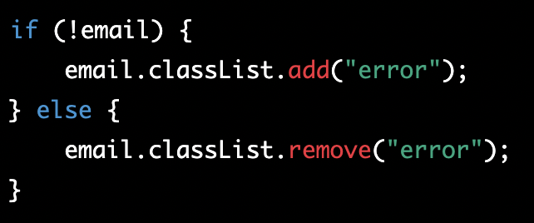

Form Submission
If the validation is successful, you can submit the form, otherwise you can display a message to the user indicating what went wrong. You can also change field styling to visually show to user, what went wrong

Slide 25
Client-side vs Server-side Validation
Client-side validation is the process of validating user input on the client (browser) using JavaScript before it is sent to the server. The main advantage of client-side validation is that it provides immediate feedback to the user, allowing them to correct errors before they submit the form. This can improve the user experience by reducing the number of round trips to the server. Additionally, it can reduce the load on the server by preventing invalid data from being sent in the first place.
Server-side validation, on the other hand, is the process of validating user input on the server using a server-side scripting language. The main advantage of server-side validation is that it can provide a higher level of security, as it is not possible for malicious users to bypass the validation by disabling JavaScript or manipulating the client-side code. Additionally, server-side validation can check for additional constraints that may not be possible to check on the client side, such as checking if a username is already taken or if a credit card number is valid.

Slide 26
Classwork about form validation
Create an HTML form Create an HTML form with two input fields: "email" and "password". Both fields should be required.with two input fields: "email" and "password". Both fields should be required.
Add a JavaScript file to your project and include it in your HTML file using a script tag.
Inside the JavaScript file, select the form element using the getElementById() method and add an event listener to the form's submit event.
Inside the event listener, use JavaScript to check the values of the form fields and determine if they are valid. For example, you can check if the email field is in the correct format using a regular expression and if the password is at least 8 characters long.
If the validation is successful, submit the form, otherwise display a message to the user indicating what went wrong.

Slide 27
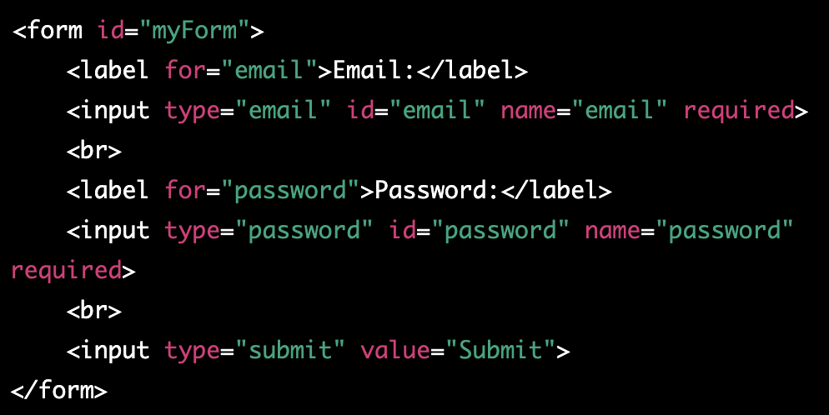
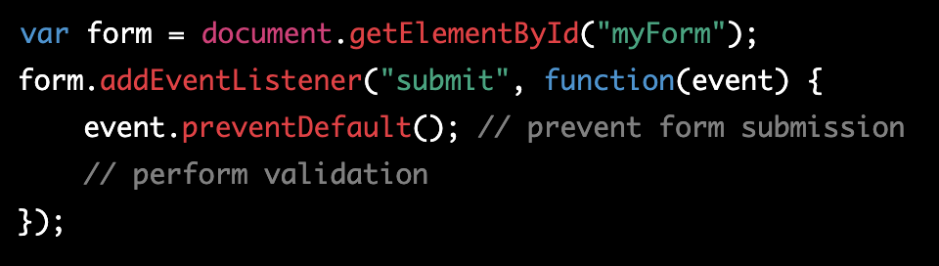
Classwork about form validation - solution

Slide 28
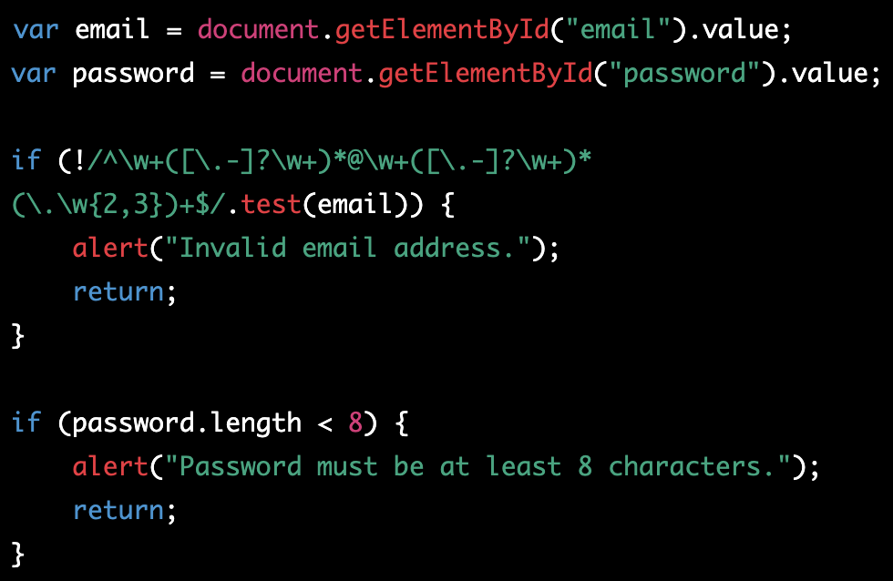

Classwork about form validation - solution 2

Slide 29
Final project
Create application using HTML, CSS and JS
Ideas:
Calculator application
Task manager (form to add new task, list with tasks, task complete and delete functionality)
Tic tac toe game
Simple blog. The blog should allow users to create new posts and delete posts. The blog should display a list of all posts and allow users to click on a post to read the full content.
Create shopping cart. The shopping cart should allow users to add and remove items, adjust quantities, and calculate the total price of the items.

