Slide 1
Web development basics
Css properties, Responsive Design and Animations

Slide 2
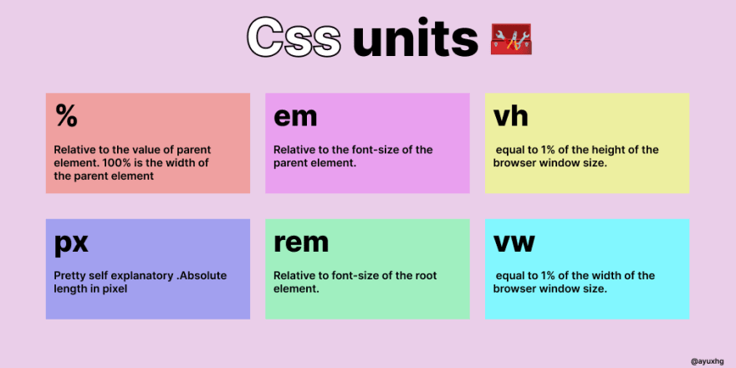
CSS Measurements

Slide 3
CSS Position
Static: This is the default value of the position property, and it means that the element is positioned according to the normal flow of the document. Elements with position: static are not affected by the top, right, bottom, and left properties.
Relative: This value positions the element relative to its normal position in the document flow. Setting top, right, bottom, or left properties will move the element in the respective direction from its original position.
Absolute: This value positions the element relative to its nearest positioned ancestor (ancestor elements with a position value other than static). If there is no positioned ancestor, then the element is positioned relative to the initial containing block (usually the <html> element).
Fixed: This value positions the element relative to the viewport (the visible area of the browser window). Fixed elements are always visible, even when the user scrolls the page.
Sticky: This value is a hybrid of relative and fixed positioning. A sticky positioned element is positioned relative to its nearest positioned ancestor or the viewport. However, it behaves like a fixed element when it reaches a certain threshold (specified with top, right, bottom, or left), and then it sticks to that position.

Slide 4
CSS Pseudo-Classes
https://developer.mozilla.org/en-US/docs/Web/CSS/Pseudo-classes

Slide 5
Responsive Design and Animation
Responsive design ensures that a website or application looks and functions correctly on a variety of devices, such as laptops, tablets, and smartphones. This is important because more and more people are accessing the internet on mobile devices, and a website that is not optimized for mobile may be difficult to navigate or use.
Animation can help to guide the user through the interface and make the experience more engaging. For example, animation can be used to highlight important information, provide feedback on user interactions, and create a sense of hierarchy on the page. Additionally, animation can make a website or application feel more dynamic and alive, which can lead to a more positive user experience.

Slide 6
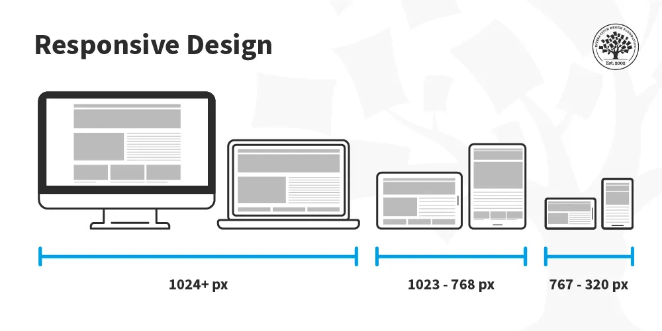
What is Responsive Design?
Responsive design is a method of designing and developing websites and applications that adapt to the size of the user's screen. This allows the website or application to look and function correctly on a variety of devices, such as laptops, tablets, and smartphones.
One key aspect of responsive design is the use of media queries, which are a way to apply CSS styles based on the characteristics of the device. Media queries allow designers to create different layouts for different screen sizes, so that the content can be rearranged and resized to fit the screen.

Slide 7
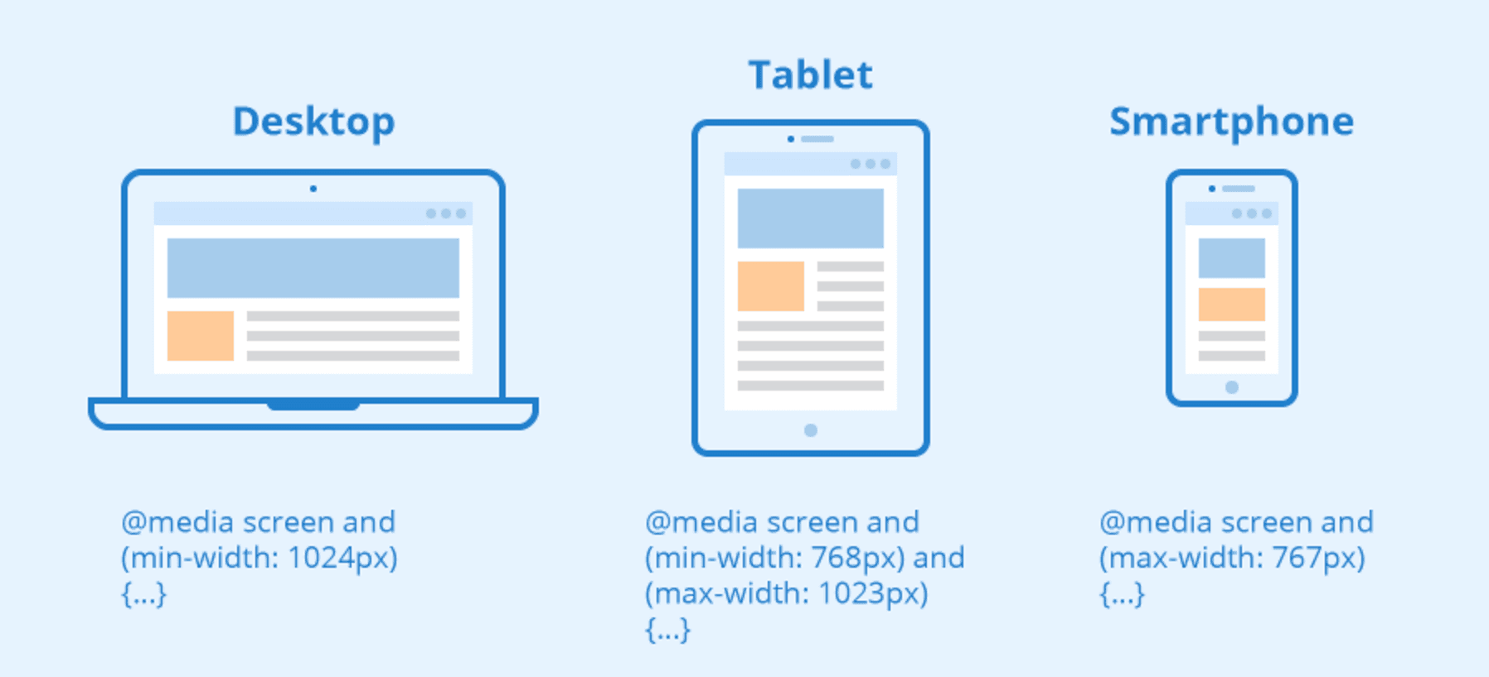
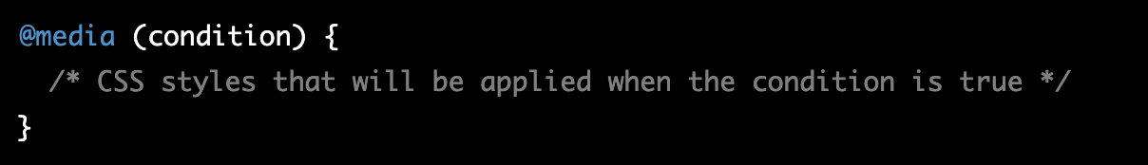
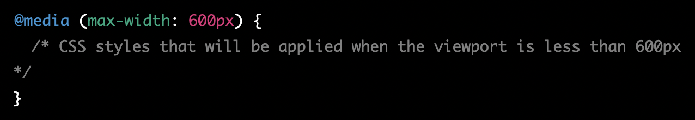
CSS media queries
By using media queries, designers can create websites and applications that adapt to the size of the user's screen, ensuring that the content is always easy to read and navigate, regardless of the device being used.

Slide 8
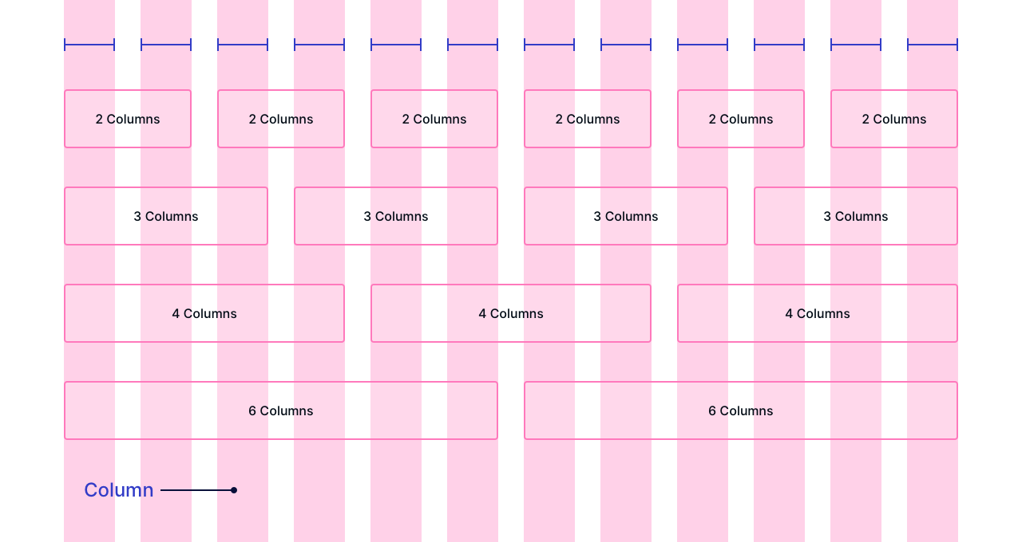
Fluid grids
Another important aspect of responsive design is the use of fluid grids, which are a way to create layouts that automatically adjust to the size of the screen. This is done by defining the layout in terms of relative units, such as percentages, rather than absolute units, such as pixels.
This allows the layout to automatically adjust to the size of the screen, so that the content can be rearranged and resized to fit the screen. Together, media queries and fluid grids allow designers to create websites and applications that adapt to the size of the user's screen, ensuring that the content is always easy to read and navigate, regardless of the device being used.

Slide 9
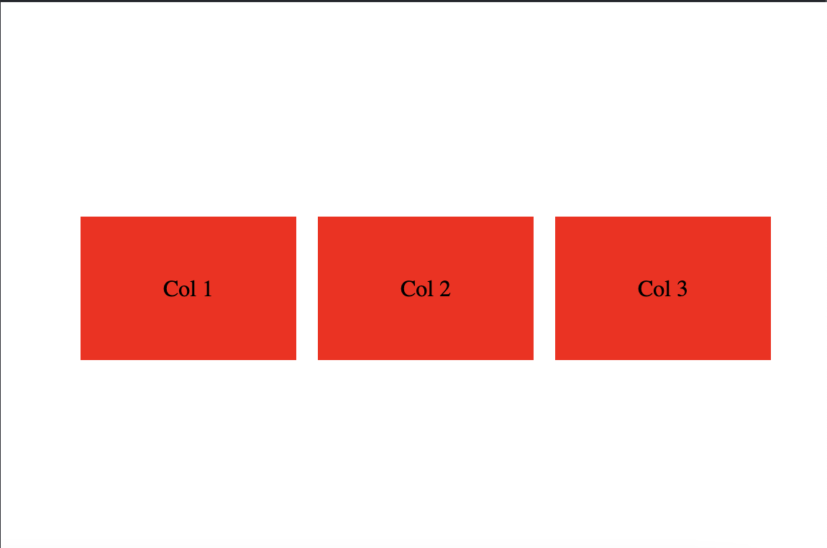
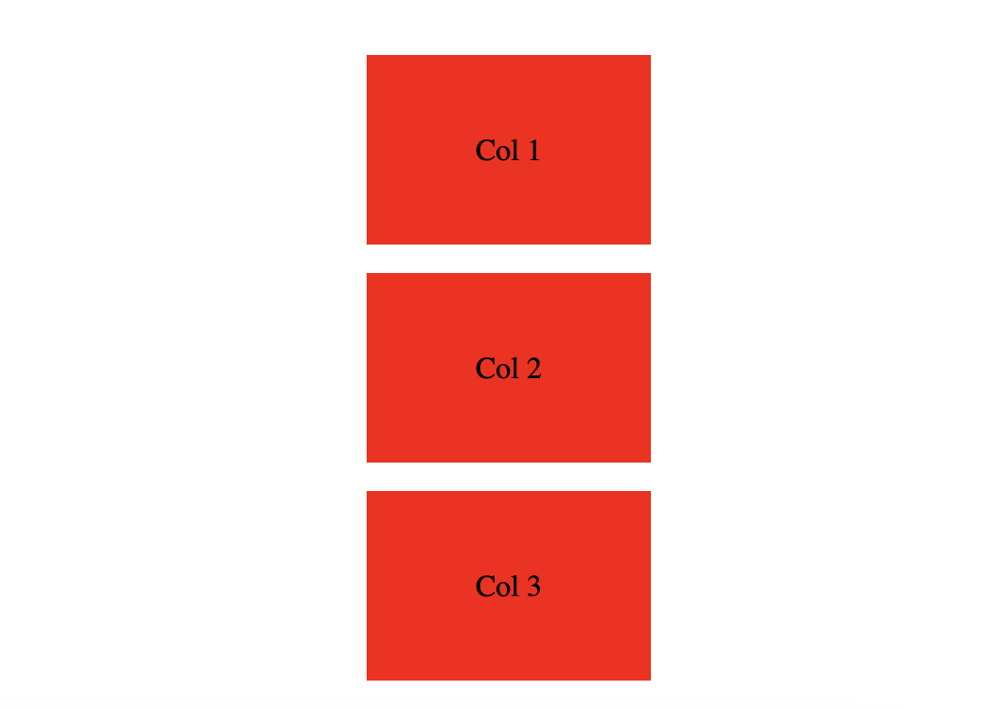
Using Media Queries to create Responsive Design
<div class="wrapper">
<div>Col 1</div>
<div>Col 2</div>
<div>Col 3</div>
</div>

Slide 10
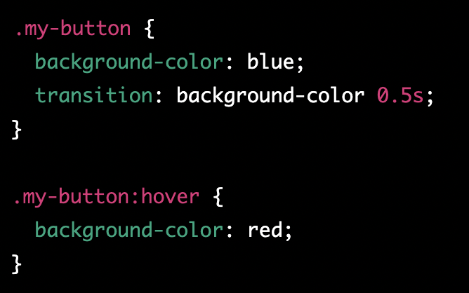
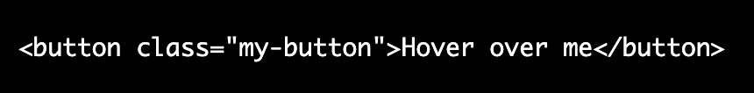
Creating Smooth Transitions with CSS
CSS transitions allow you to smoothly change the values of CSS properties over a given duration. They are used to add visual effects and make changes in the layout of a webpage look more natural.
https://www.w3schools.com/css/css3_transitions.asp

Slide 11
Introducing Animation to your website
Animation is the process of creating the illusion of motion by rapidly displaying a sequence of static images, called frames. When these frames are played back in quick succession, the human eye perceives them as a continuous motion. Animation can be used to create engaging and interactive user interfaces by providing visual feedback, guiding the user's attention, and creating a sense of motion and dynamism.

Slide 12
Animation use case examples
Animation can be used in a variety of ways to enhance the user experience. For example, an animation can be used to:
Provide visual feedback when a button is clicked or a form is submitted
Guide the user's attention by highlighting important elements on the page
Create a sense of motion and dynamism, making the interface feel more alive and engaging
…

Slide 13
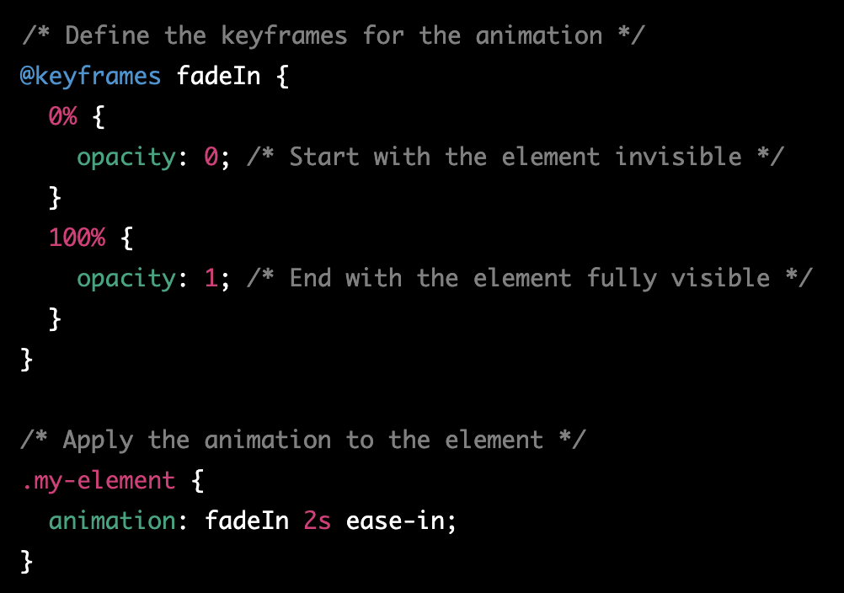
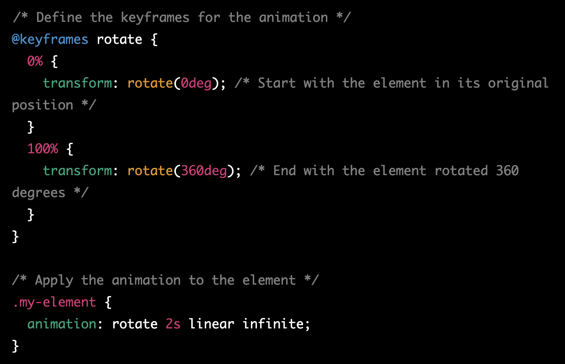
Creating Animations with CSS

Slide 14
Animations task
Task: Create a simple animation that makes a square move across the screen horizontally.
Steps:
Create the HTML structure for the square. In the body of your HTML file, add a div with the class "square"
In your CSS file, give the square a size and a background color
Define the keyframes for the animation. In your CSS file, create a new @keyframes rule called "move" that defines the starting and ending positions of the square:
Apply the animation to the square. Using the animation property, specify the animation name, duration, and timing function:
Test your animation by running the HTML file in a browser. The square should move horizontally across the screen from left to right over a duration of 2 seconds, using a linear timing function.

Slide 15
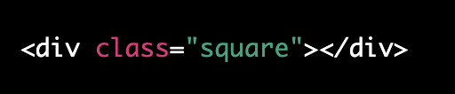
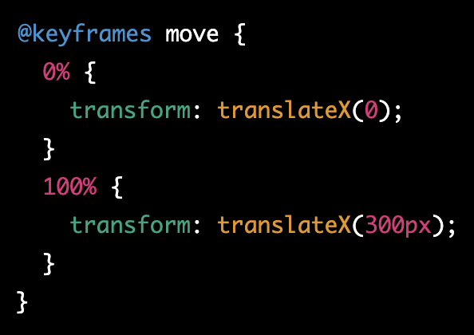
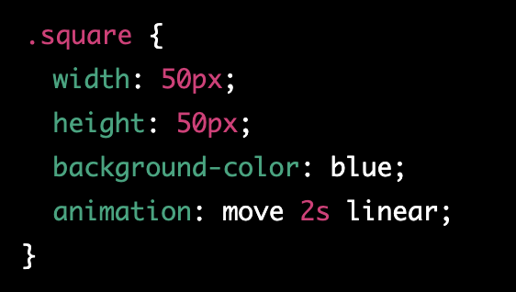
Animations task explanation

Slide 16

Tailwind CSS
Tailwind CSS is a utility-first CSS framework that makes it easy to build responsive, consistent, and highly customizable user interfaces. It provides a set of pre-defined CSS classes that can be used to quickly add styling to your HTML elements. One of the main advantages of Tailwind CSS is that it uses a set of utility classes that are designed to be composable. This means that you can easily build complex layouts and designs by combining multiple classes together.
https://tailwindcss.com/

Slide 17
Tailwind CSS 2
For example, if you want to create a button with a blue background and white text, you could use the classes "bg-blue-500" and "text-white" to achieve this:
In this example, "bg-blue-500" sets the background color to blue and "text-white" sets the text color to white. The "px-4" and "py-2" classes set the padding on the x and y axis respectively.

Slide 18
Tailwind CSS - Responsiveness
Tailwind CSS also provides a set of responsive classes that allow you to easily create responsive designs. These classes allow you to specify different styles for different screen sizes, so you can ensure that your design looks good on all devices. For example, you can use the class "sm:text-lg" to make text larger on small screens:

Slide 19
Tailwind CSS practice
Task: Create a simple webpage that displays a card with an image, title, and description.
Steps:
Create the HTML structure for the card. In the body of your HTML file, add a div with the class "card"
In your CSS file, include the Tailwind CSS styles. You can either include the pre-built CSS file that you can download from the Tailwind website or you can use the npm package
Use Tailwind CSS classes to style the card. To style the card, you can use the classes "w-full" and "bg-white" to set the width and background color of the card, respectively

Slide 20
Tailwind CSS practice 2
4) Style the image, title, and description. To style the image, you can use the class "w-full" to make the image take up the full width of the card. To style the title and description, you can use the classes "text-lg" and "text-gray-700" to set the font size and color
5) Add spacing to the card. To add padding and margin to the card, you can use the classes "py-4" and "px-6" to add padding on the y and x axis respectively and "my-4" and "mx-6" to add margin on the y and x axis respectively
6) Test your design by running the HTML file in a browser. The card should have a white background, the image should take up the full width of the card, and the title and description should be correctly styled

Slide 21
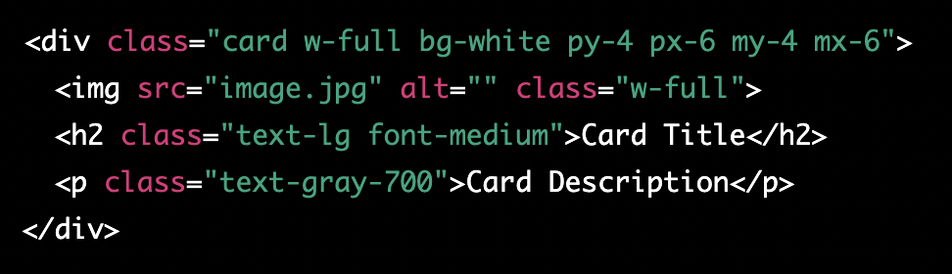
Tailwind CSS practice explanation

Slide 22
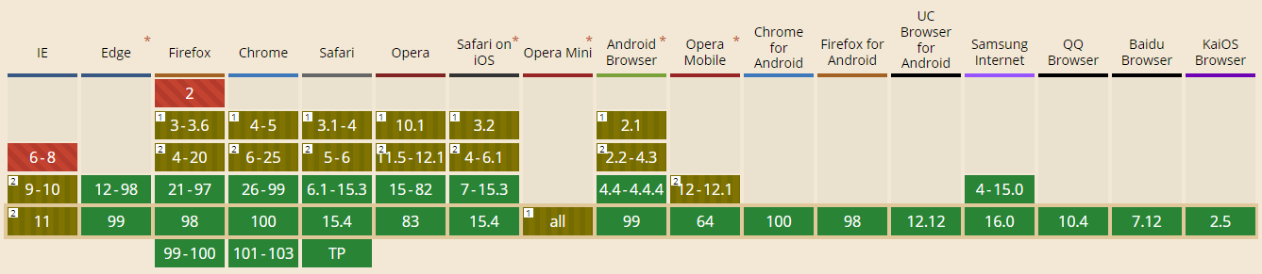
Can I use it?

Slide 23
Homework
Add responsiveness and transitions to created portfolio.
Play around with animations
Refactor application to use tailwindcss instead
Portfolio ideas - https://bashooka.com/html/free-html-css-portfolio-web-design-templates/

