Slide 1
Web development basics
HTML

Slide 2
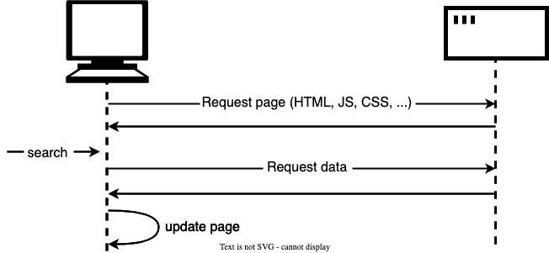
HTML Page rendering
The user enters a URL into their web browser, which sends a request to the server for the corresponding HTML page.
The server retrieves the HTML file and sends it back to the browser.
The browser begins parsing the HTML document, which is a process of converting the text into a structured format that the browser can understand.
As the browser parses the HTML, it also starts fetching any additional resources specified in the document, such as images and stylesheets.

Slide 3
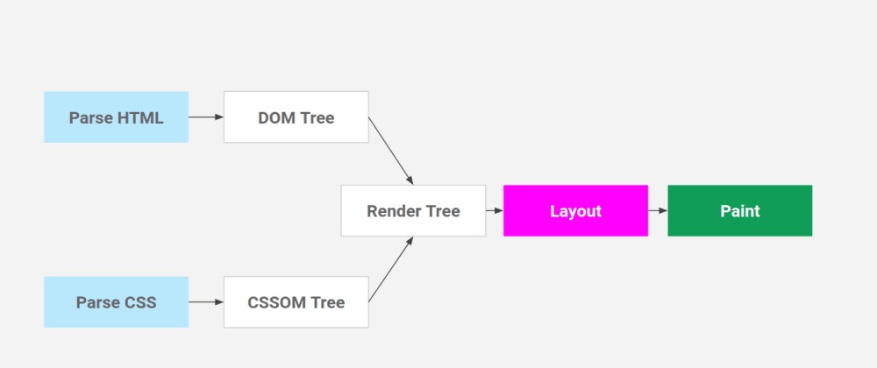
HTML Page rendering
5) Once all of the resources have been fetched and the HTML has been fully parsed, the browser begins rendering the page.
6) During rendering, the browser applies the CSS styles to the HTML elements, and lays out the elements on the screen according to the rules specified in the CSS.
7) Finally, the browser paints the visible elements onto the screen, which is the process of drawing the final pixels that the user sees on the screen.

Slide 4
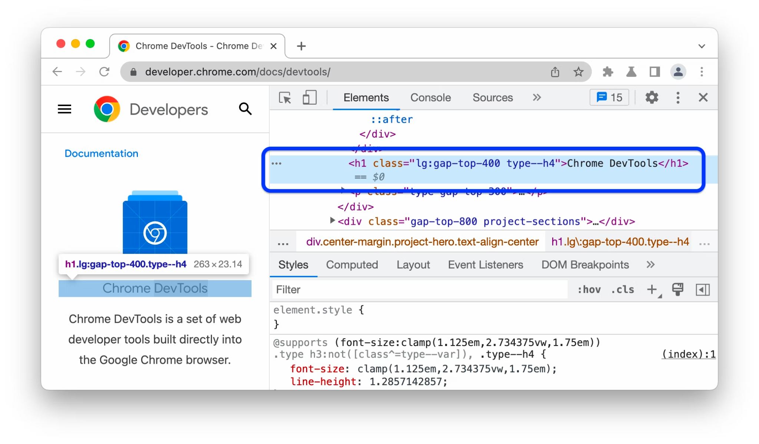
Devtools
https://developer.chrome.com/docs/devtools/

Slide 5
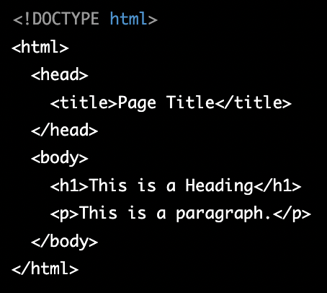
How to create HTML page
Open Visual Studio Code
Create empty index.html file
Start writing HTML code
Install Live Server extension (optional)
Open HTML file in browser:
Open HTML with live server
Or open file from file explorer

Slide 6
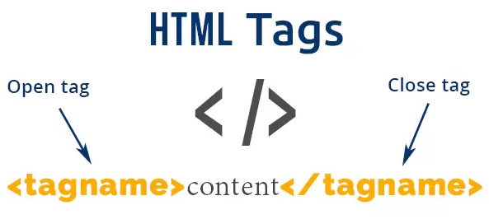
HTML tags
HTML tags are the building blocks of an HTML document. They are used to define the structure and content of a web page. There are many different types of HTML tags, but some common examples include:
<html>: This is the root element of an HTML document, and it contains all of the other elements on the page.
<head>: This element contains information about the document, such as the title of the page and any meta data.
<body>: This element contains the content of the page that is visible to the user.
<div>: This element is a container for other elements, and is often used to group elements together for styling purposes.
<p>: This element is used to define a paragraph of text.

Slide 7
HTML tags 2
<a>: This element creates a hyperlink to another web page.
<img>: This element is used to embed images in a web page.
<h1> - <h6>: These elements are used to define headings and subheadings on the page.
<ul> and <li>: These elements are used to create unordered lists.
<ol> and <li>: These elements are used to create ordered lists.
<form>: This element is used to create forms that allow users to input data and submit it to a server.
HTML tags are often paired, with a start tag and an end tag, and the content between the start and end tags is the content of the tag. For example, an <p> tag would be written as <p>This is a paragraph</p>, and the content inside the tags is "This is a paragraph"

Slide 8
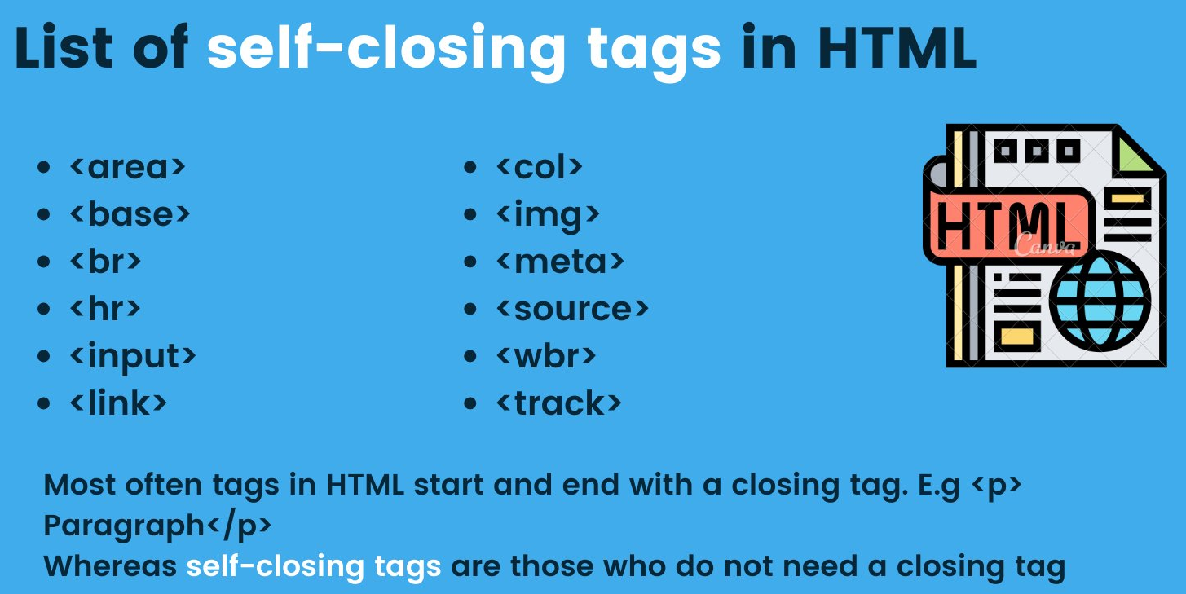
Self Closing Tags

Slide 9
What and Why HTML Semantic Elements
Semantic elements are needed for several reasons:
Improved accessibility: Semantic elements provide a clear structure to the content on a web page, making it easier for screen readers and other assistive technologies to understand and navigate the content.
Better SEO: Search engines use the structure of a web page to better understand its content and relevance to search queries. By using semantic elements, you can help search engines understand the hierarchy and importance of your content, improving its visibility in search results.
Better code readability and maintainability: Semantic elements make the code more readable and easier to maintain, as they provide a clear structure to the content. This makes it easier for developers to understand the content and make changes to it, improving the overall quality and maintainability of the code.
Improved user experience: Semantic elements help to make the content on a web page more intuitive and easy to understand for users, improving their overall experience and making it more likely that they will stay on the site and engage with the content.

Slide 10
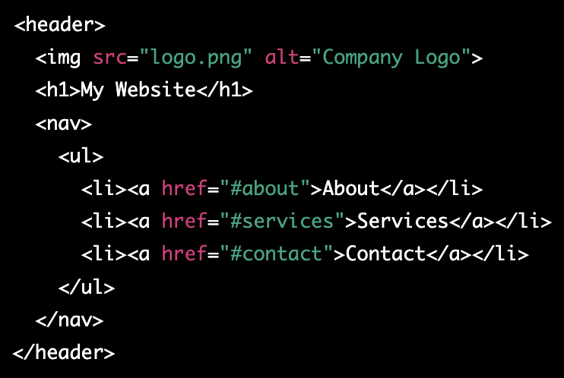
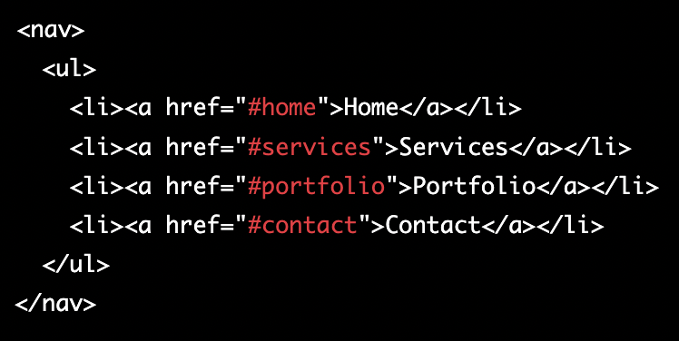
HTML Semantic Elements
Header element:
Nav element:

Slide 11
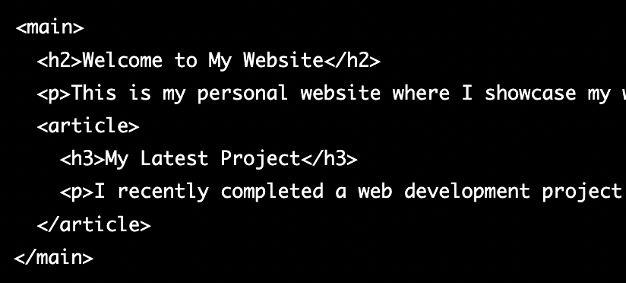
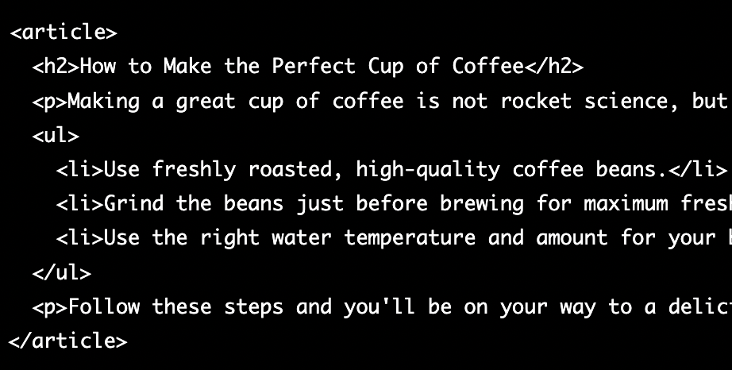
HTML Semantic Elements 2
Main element:
Article element:

Slide 12
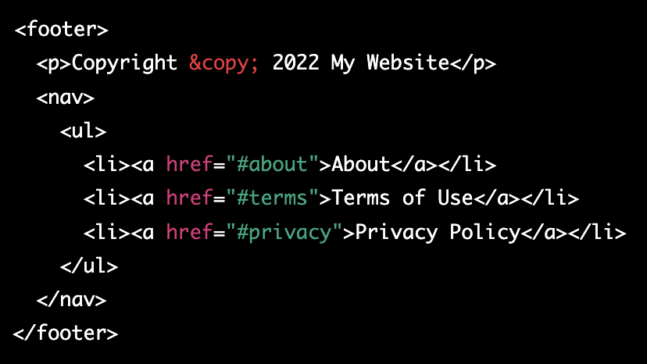
HTML Semantic Elements 3
Footer element:

Slide 13
Rest tags
https://www.w3schools.com/TAGS/default.asp

Slide 14
Classwork - small html project
Task: Create a simple HTML page that displays your personal information using various HTML tags.
Instructions:
Create an HTML file using a text editor and save it with a .html extension.
Add the following elements to your HTML page:
A header element with your name as the text.
A paragraph element that contains your brief introduction and personal details, such as your location, education, and interests.
An unordered list element that lists your hobbies.
An image element that displays your profile picture.
A link element that leads to your social media profile (optional).
3) Add a title to your HTML page and make sure that it accurately reflects the content of the page.
4) Preview the HTML page in a web browser to see the results.

Slide 15
HTML attributes
Attributes are additional information that can be provided for HTML elements to modify their behavior or appearance. Attributes are added to an HTML element in the opening tag and are specified as a name-value pair, such as attribute="value". Some common uses of attributes include:
Specifying the source of an element's content:
Modifying the appearance of an element:

Slide 16

HTML attributes 2
3) Providing additional information about an element:
4) Creating links:
5) Specifying form controls:
https://www.w3schools.com/html/html_attributes.asp

Slide 17
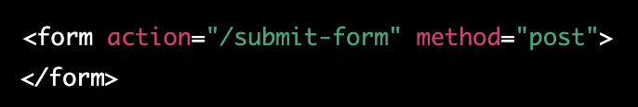
HTML forms
Forms are an essential part of many websites and web applications, allowing users to input data and interact with the site. To create a form in HTML, you can use several elements, including <form>, <input>, <select>, and <textarea>. Here is how you create sample form:
Use the <form> element to define the form. Add an action attribute to specify the URL where the form data will be sent and a method attribute to specify how the form data will be sent (usually "POST" or "GET").

Slide 18
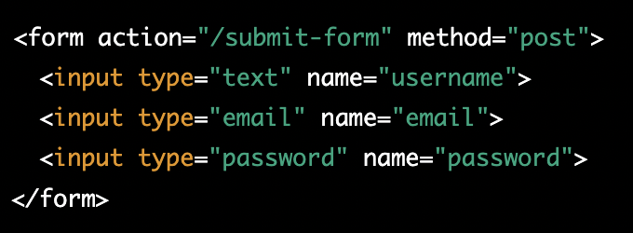
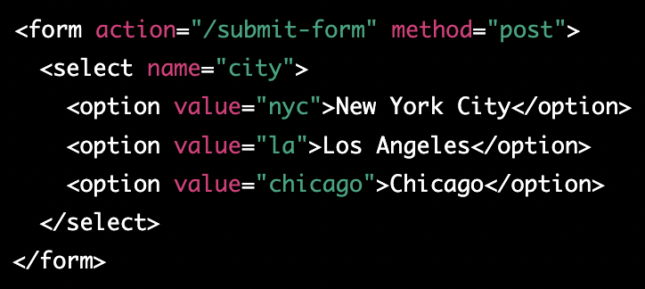
HTML forms 2
2) Use the <input> element to create form fields, such as text fields, checkboxes, and radio buttons. Add a type attribute to specify the type of input field, and a name attribute to identify the field.
3) Use the <select> element to create a drop-down list. Add options using <option> elements, and use the value attribute to specify the value that will be sent with the form.

Slide 19
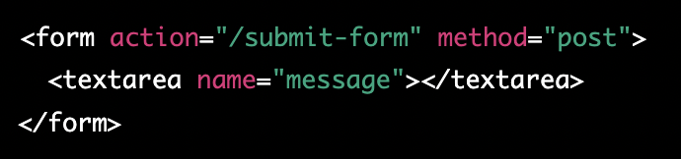
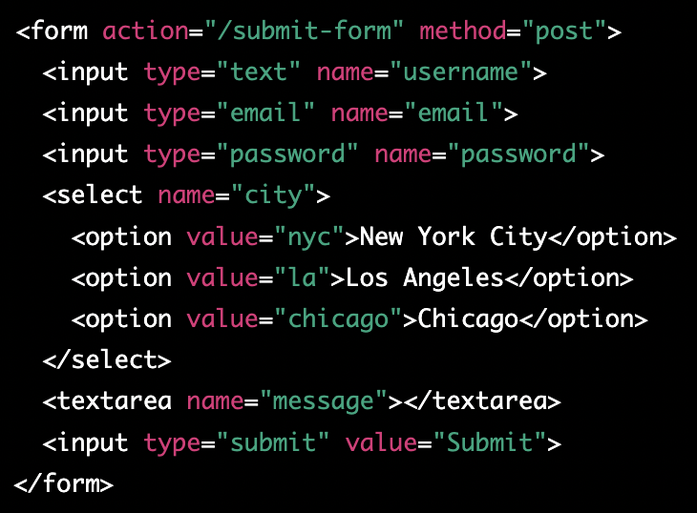
HTML forms 3
4) Use the <textarea> element to create a text area for users to enter a larger amount of text. Add a name attribute to identify the field.
5) Add a submit button to the form using an <input> element with a type attribute of "submit".

Slide 20
Classwork about HTML attributes & forms
Instructions:
Open a text editor and create a new HTML file.
Start with a basic HTML structure
Add a form to the body using the <form> element
Inside the form, add a text input field using the <input> element
Add a name attribute to the input field to identify it
Add a label for the input field using the <label> element
Add a password input field with a label
Add a submit button using the <input> element
Save the file and open it in a web browser to see your first HTML form.

Slide 21
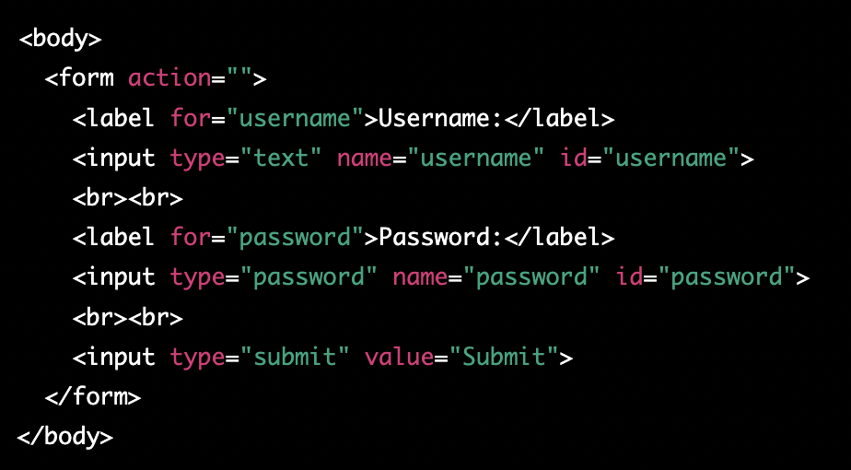
Classwork about HTML attributes & forms - solution

Slide 22
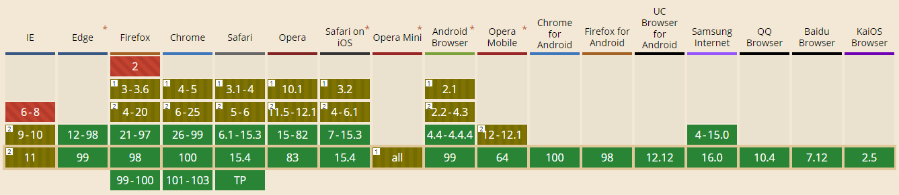
Can I use?

Slide 23
Quiz
Which tag is used to define a paragraph in HTML?
a. <p>
b. <br>
c. <a>
d. <div>
Which tag is used to add an image in HTML?
a. <img>
b. <picture>
c. <imgsrc>
d. <image>
What is the correct way to create a hyperlink in HTML?
a. <link href="url">link text</link>
b. <a href="url">link text</a>
c. <hyperlink href="url">link text</hyperlink> d
. <a src="url">link text</a>

Slide 24
Quiz
What is the correct way to add a background color to an HTML element?
a. <body color="red">
b. <div style="background-color:red;">
c. <background color="red">
d. <color="red">element</color>
Which attribute is used to specify the URL of the page the link goes to?
a. href
b. url
c. link
d. src

Slide 25
Quiz
What is the correct way to start an HTML document?
a) <!DOCTYPE html>
b) <html>
c) <head>
d) <!DOCTYPE html><html><head>
Which of the following is an example of an ordered list in HTML?
a) <ul> <li>Item 1</li> <li>Item 2</li> </ul>
b) <ol><li>Item 1</li> <li>Item 2</li> </ol>
c) <li>Item 1</li> <li>Item 2</li>
d) <dl> <dt>Item 1</dt> <dd>Description 1</dd> <dt>Item 2</dt> <dd>Description 2</dd> </dl>

Slide 26
Quiz
Which tag is used to create a form in HTML?
a) <input>
b) <form>
c) <select>
d) <textarea>
Which attribute is used to specify the type of form element in HTML?
a) class
b) id
c) type
d) name
Which of the following input types will create a text box in HTML?
a) text
b) checkbox
c) radio
d) select
Which tag is used to create a dropdown list in HTML?
a) <input>
b) <select>
c) <option>
d) <textarea>

Slide 27
Homework
Create HTML mockup for your personal portfolio, and push it to github
Advanced - add css styling to portfolio
Portfolio ideas - https://bashooka.com/html/free-html-css-portfolio-web-design-templates/

