Slide 1
Web development basics
Loops, functions

Slide 2
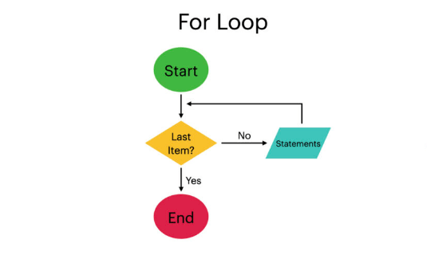
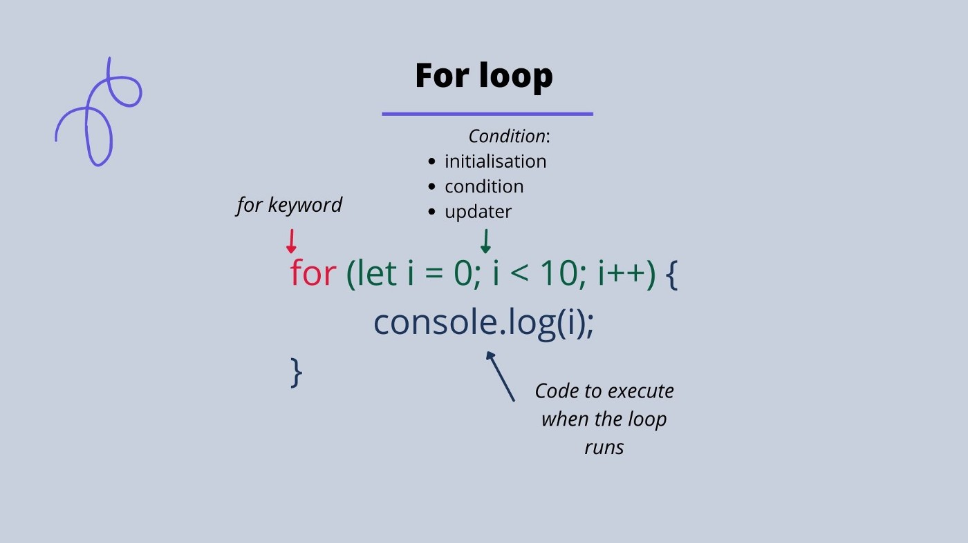
Loops (for)
In JavaScript, loops are used to execute a block of code repeatedly until a certain condition is met. There are several types of loops in JavaScript, including:
for loops: The for loop is used to execute a block of code a specific number of times.

Slide 3
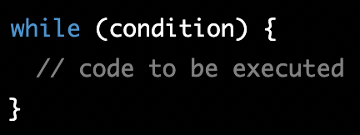
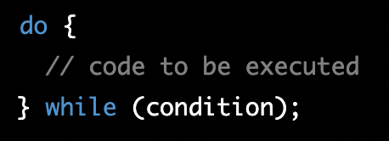
Loops (while, do-while)
while loops: The while loop is used to execute a block of code repeatedly while a certain condition is true.
do-while loops: The do-while loop is similar to the while loop, but the code inside the loop is executed at least once, regardless of whether the condition is true or false.

Slide 4
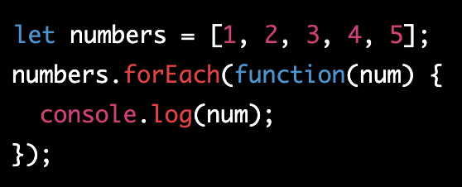
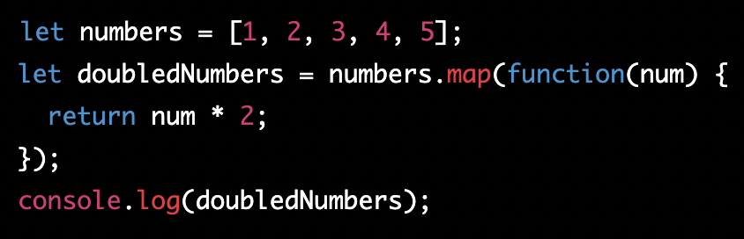
Other Loops (foreach,map)
There are many other loops in js, each used for specific scenario, most common ones are:
foreach - method allows you to execute a function on each element of an array. This method does not return a new array, it simply loops through the array and performs the function on each element.
map - method is similar to forEach(), but it returns a new array with the results of the function applied to each element.

Slide 5
Classwork - Loops
Using a for loop to print out the numbers 1 through 10
Using a forEach loop to print out the elements of an array
Using a map function to create a new array with the square of each element in an original array

Slide 6
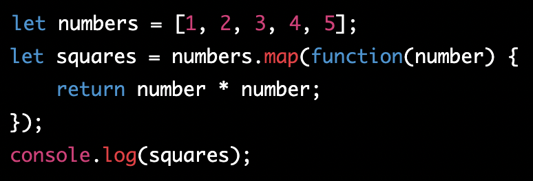
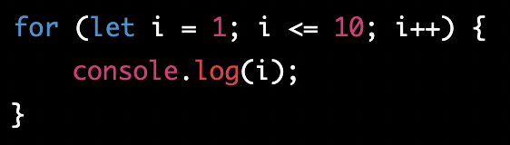
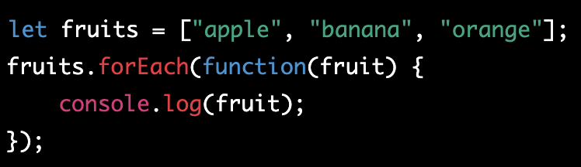
Classwork - Loops (solution)

Slide 7
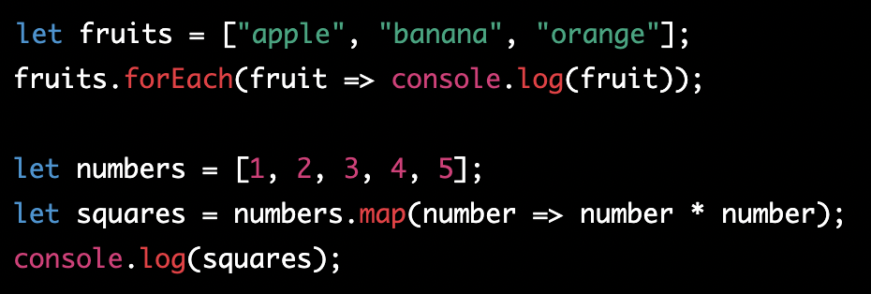
Classwork - Loops (solution 2)

Slide 8
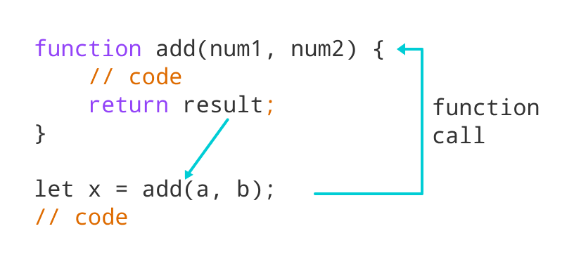
Functions
In JavaScript, a function is a block of code that can be reused multiple times. Functions can take input (called parameters) and return output (the result of the function).
To define a function, you use the keyword "function" followed by the function name, a set of parentheses for any parameters, and a set of curly braces for the code that will be executed when the function is called.

Slide 9
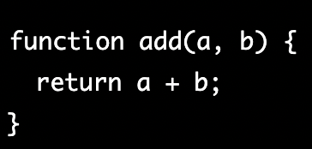
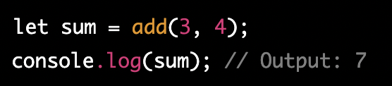
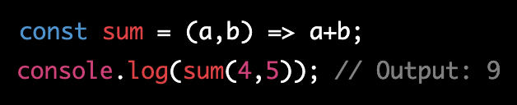
Functions 2

Slide 10
What is “this”?
https://dmitripavlutin.com/gentle-explanation-of-this-in-javascript

Slide 11
Homework
Read about context in JS
Create some array with CHATGPT, iterate over it and filter it for matching selection.

