Slide 1
Web development basics
HTML&CSS

Slide 2
What and Why HTML Semantic Elements
Semantic elements are needed for several reasons:
Improved accessibility: Semantic elements provide a clear structure to the content on a web page, making it easier for screen readers and other assistive technologies to understand and navigate the content.
Better SEO: Search engines use the structure of a web page to better understand its content and relevance to search queries. By using semantic elements, you can help search engines understand the hierarchy and importance of your content, improving its visibility in search results.
Better code readability and maintainability: Semantic elements make the code more readable and easier to maintain, as they provide a clear structure to the content. This makes it easier for developers to understand the content and make changes to it, improving the overall quality and maintainability of the code.
Improved user experience: Semantic elements help to make the content on a web page more intuitive and easy to understand for users, improving their overall experience and making it more likely that they will stay on the site and engage with the content.

Slide 3
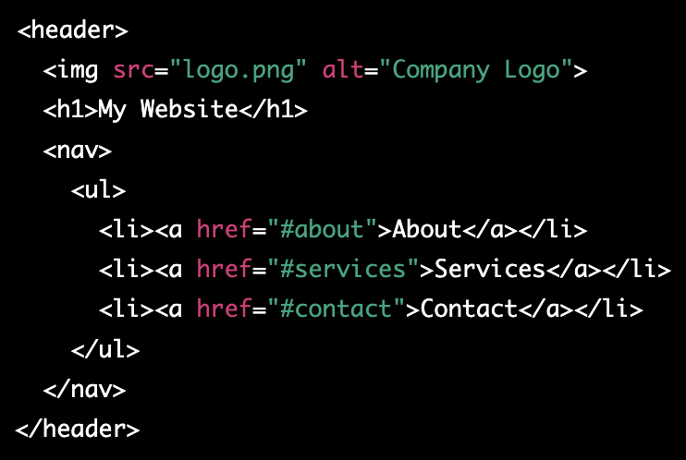
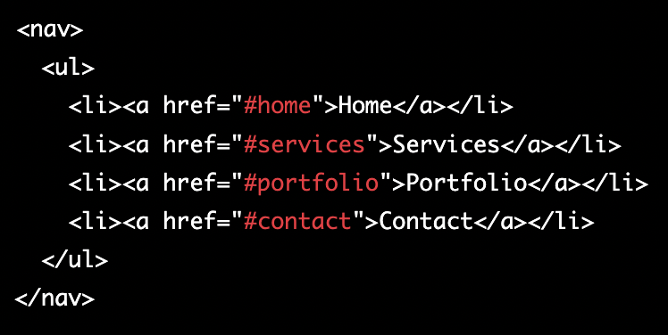
HTML Semantic Elements
Header element:
Nav element:

Slide 4
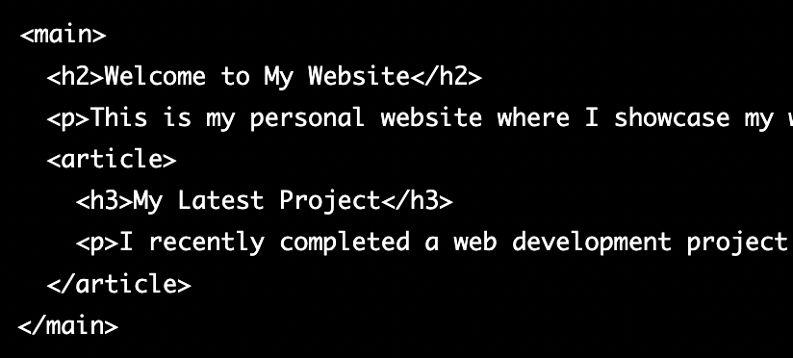
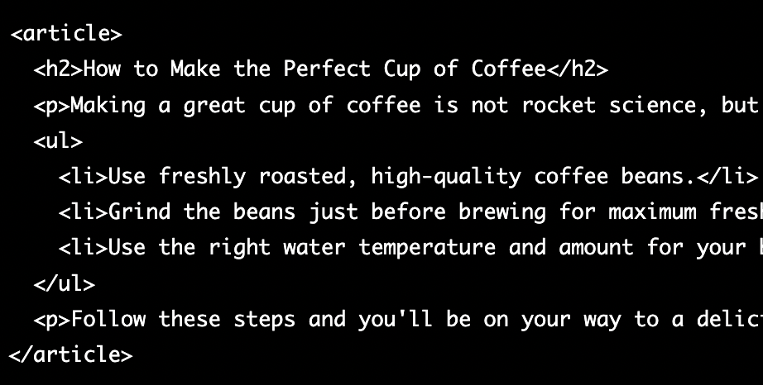
HTML Semantic Elements 2
Main element:
Article element:

Slide 5
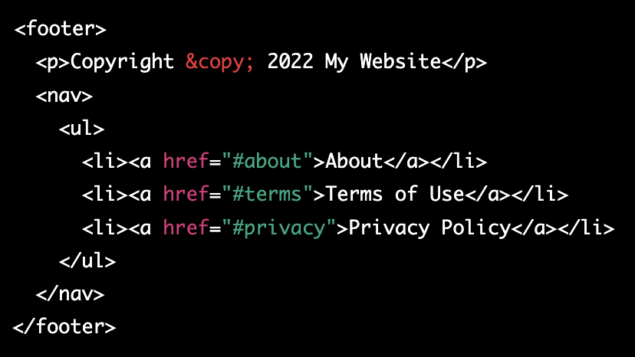
HTML Semantic Elements 3
Footer element:

Slide 6
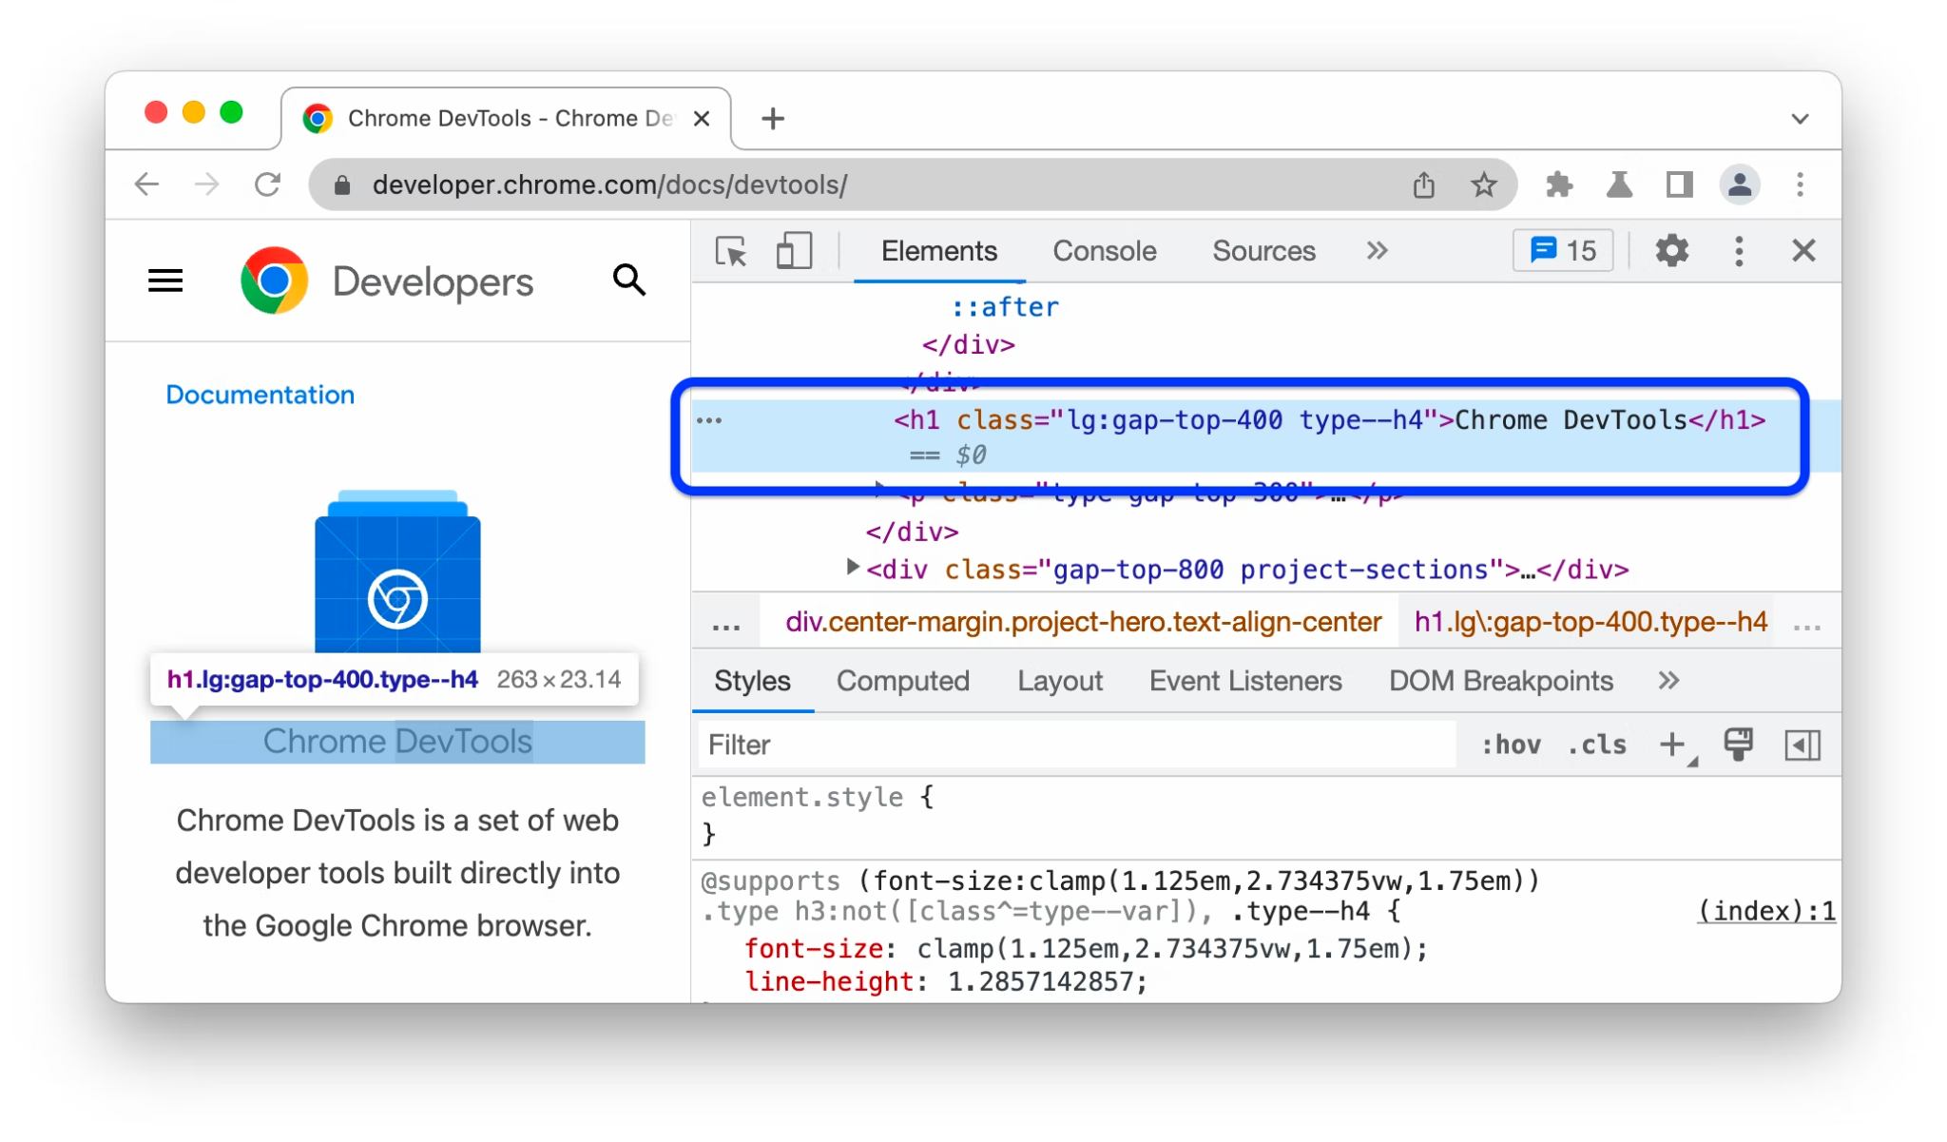
Devtools
https://developer.chrome.com/docs/devtools/

Slide 7
Quiz
Which tag is used to define a paragraph in HTML?
a. <p>
b. <br>
c. <a>
d. <div>
Which tag is used to add an image in HTML?
a. <img>
b. <picture>
c. <imgsrc>
d. <image>
What is the correct way to create a hyperlink in HTML?
a. <link href="url">link text</link>
b. <a href="url">link text</a>
c. <hyperlink href="url">link text</hyperlink> d
d. <a src="url">link text</a>

Slide 8
Quiz
What is the correct way to add a background color to an HTML element?
a. <body color="red">
b. <div style="background-color:red;">
c. <background color="red">
d. <color="red">element</color>
Which attribute is used to specify the URL of the page the link goes to?
a. href
b. url
c. link
d. src

Slide 9
Quiz
What is the correct way to start an HTML document?
a) <!DOCTYPE html>
b) <html>
c) <head>
d) <!DOCTYPE html><html><head>
Which of the following is an example of an ordered list in HTML?
a) <ul> <li>Item 1</li> <li>Item 2</li> </ul>
b) <ol><li>Item 1</li> <li>Item 2</li> </ol>
c) <li>Item 1</li> <li>Item 2</li>
d) <dl> <dt>Item 1</dt> <dd>Description 1</dd> <dt>Item 2</dt> <dd>Description 2</dd> </dl>

Slide 10
Quiz
Which tag is used to create a form in HTML?
a) <input>
b) <form>
c) <select>
d) <textarea>
Which attribute is used to specify the type of form element in HTML?
a) class
b) id
c) type
d) name
Which of the following input types will create a text box in HTML?
a) text
b) checkbox
c) radio
d) select
Which tag is used to create a dropdown list in HTML?
a) <input>
b) <select>
c) <option>
d) <textarea>

Slide 11

What is CSS
CSS stands for Cascading Style Sheets. It is a styling language used to describe the presentation of a document written in a markup language. With CSS, you can control the layout, colors, fonts, and other visual elements of a webpage. It is separate from the HTML, which is used to structure the content of the page. Using CSS, you can create visually appealing and consistent designs across multiple web pages.

Slide 12
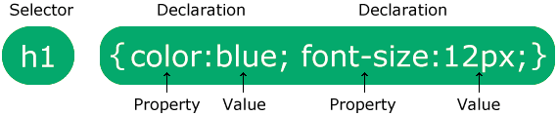
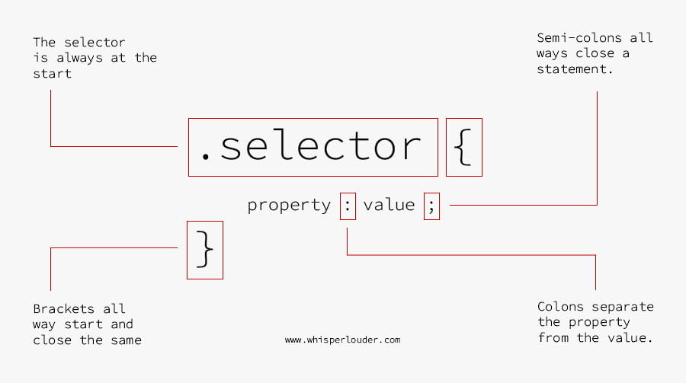
CSS syntax

Slide 13
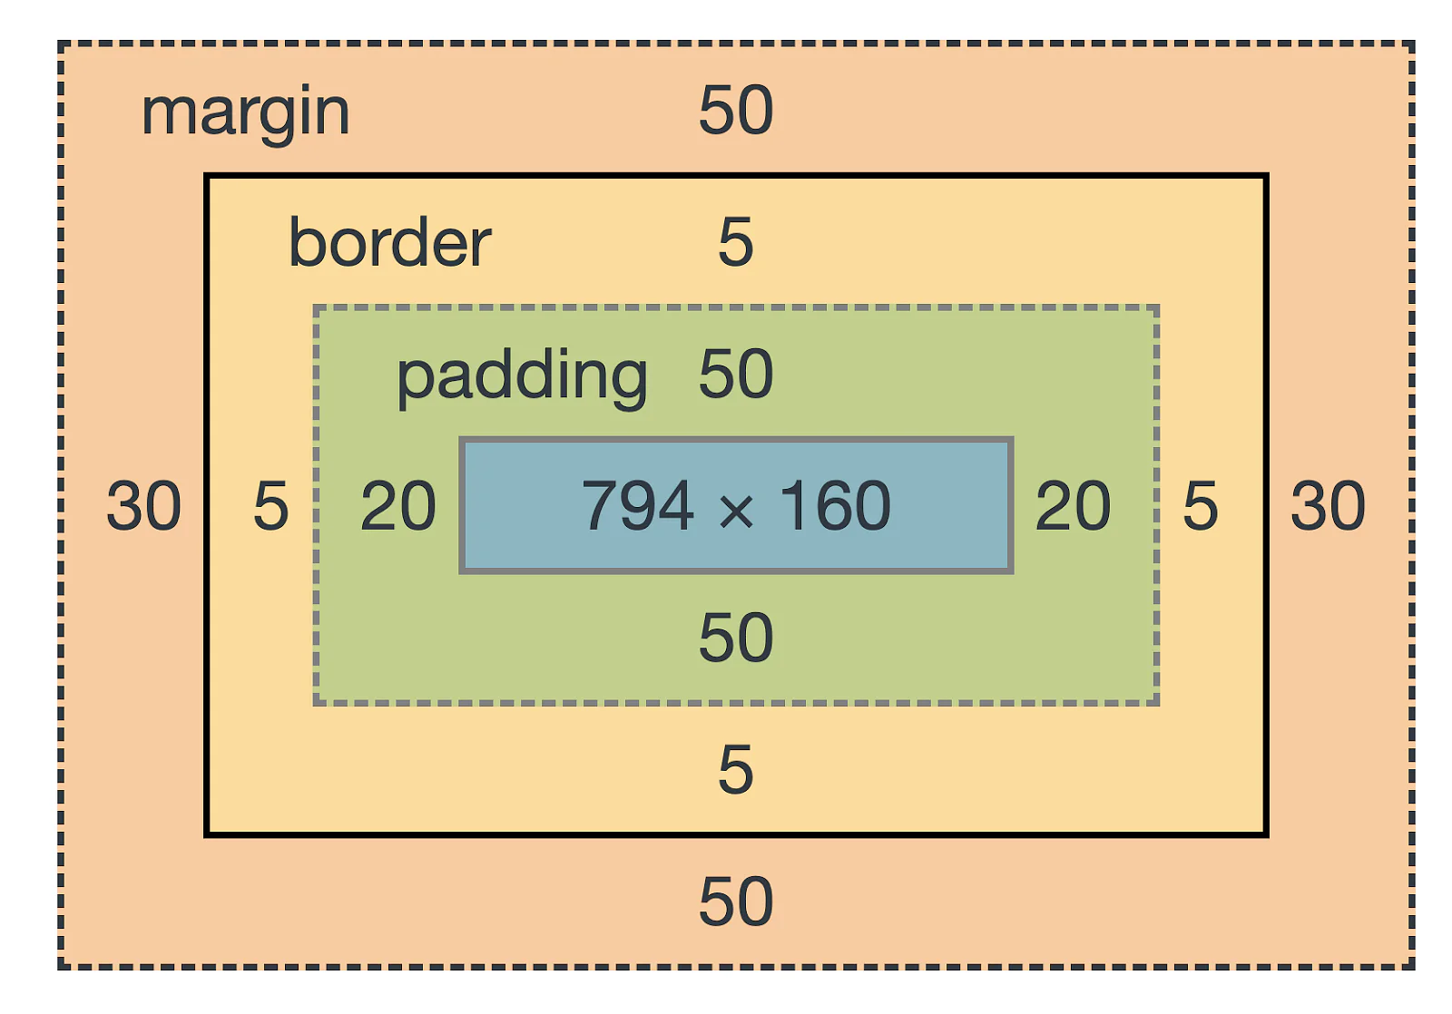
CSS box model
The CSS box model is a layout model that defines how the dimensions of elements on a web page are calculated. It describes how an element is sized, positioned, and rendered on a web page, including how the element's content, padding, border, and margin are handled. The box model consists of the following parts:
Content: This is the actual content of the element, such as text or images.
Padding: This is the space between the content and the border. It can be set using the padding property in CSS.
Border: This is a line that surrounds the padding and content. It can be set using the border property in CSS.
Margin: This is the space between the border and the other elements on the page. It can be set using the margin property in CSS.

Slide 14
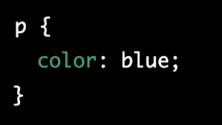
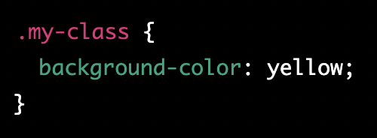
CSS selectors
CSS selectors are used to select the HTML elements that you want to style.
There are several types of selectors:
Element Selector: Selects all elements with the given tag name, for example "p" will select all the <p> elements on the page.
Class Selector: Selects all elements with the given class name, for example ".my-class" will select all elements with class name "my-class".

Slide 15
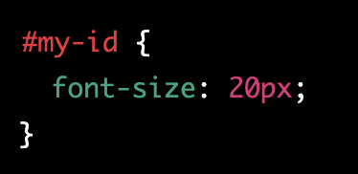
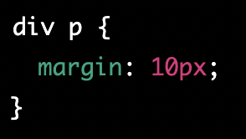
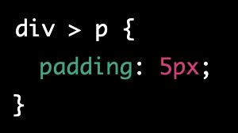
CSS selectors 2
3) ID Selector: Selects the element with the given ID, for example "#my-id" will select the element with id "my-id".
4) Descendant Selector: Selects all elements that are descendants of a given element. for example "div p" will select all <p> elements inside <div>
5) Child Selector: Selects all direct children of a given element. for example "div > p" will select all <p> elements that are direct children of <div>

Slide 16
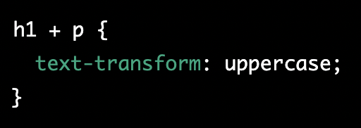
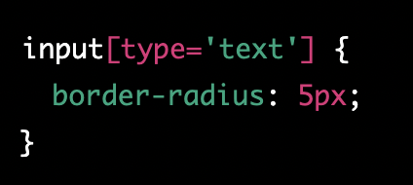
CSS selectors 3
6) Adjacent Sibling Selector: Selects all elements that are next to a given element. for example "h1 + p" will select all <p> elements that immediately follow an <h1>
7) Attribute Selector: Selects all elements with a given attribute, for example "[type='text']" will select all elements with an attribute "type" and value "text"
These are just a few examples of the many types of selectors available in CSS. Each selector has its own specific use cases and can be combined with other selectors to create more complex selectors.

Slide 17
Classwork for CSS selectors
Open a text editor and create two new files, one with the HTML extension and one with the CSS extension.
In the HTML file, create a basic HTML structure
Link the CSS file to the HTML file using the <link> element in the <head> section of the HTML file
Expected outcome: The HTML file should display a blue <h1> heading, green paragraphs, a yellow highlighted paragraph with a class of "highlight", and a special paragraph with larger font size and an id of "special".

Slide 18
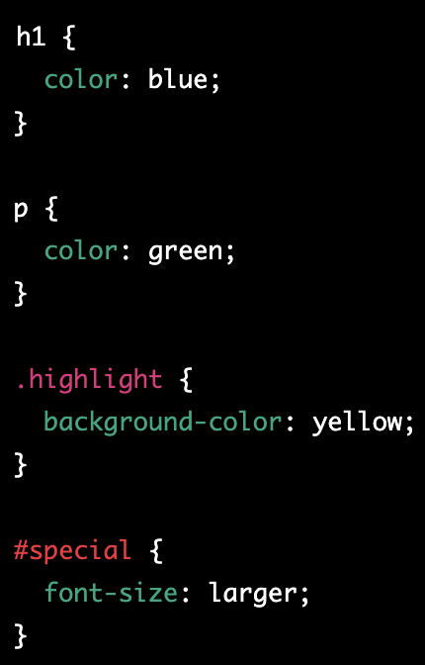
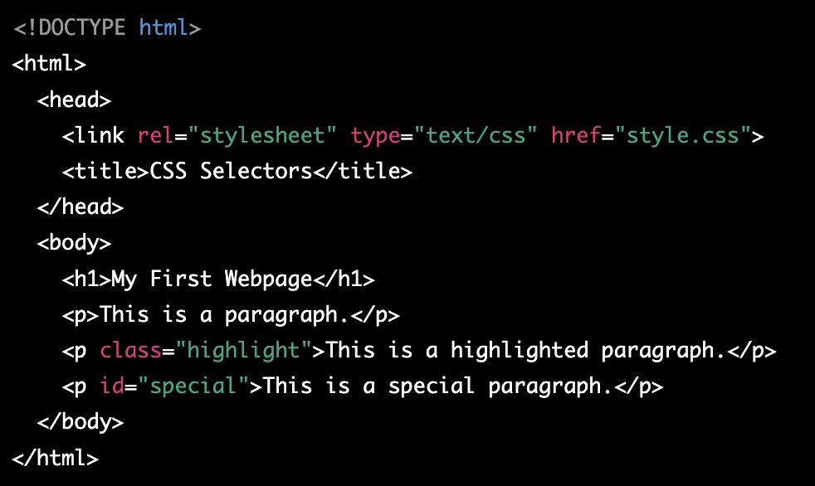
Classwork for CSS selectors - solution

Slide 19
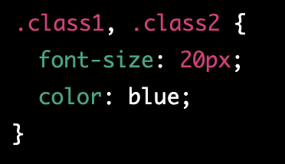
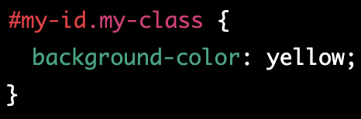
CSS selector combination
CSS allows you to combine selectors to create more specific and powerful styles. There are several ways to combine selectors, including:
Combining classes: You can combine multiple class selectors to apply the same styles to multiple elements. For example, you can use two classes to style two different elements in the same way
Class and ID: You can combine a class and an ID selector to apply styles to a specific element with a specific class. For example, you can use the following CSS to style a specific element with the ID "my-id" and the class "my-class"

Slide 20
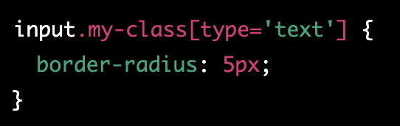
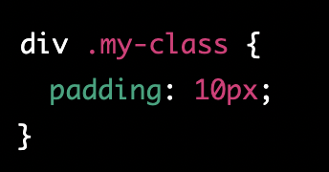
CSS selector combination 2
3) Class and attribute: You can combine a class selector and an attribute selector to apply styles to elements with a specific attribute and class. For example, you can use the following CSS to style all input elements with the class "my-class" and type attribute "text"
4) Descendant selector and class: You can combine a descendant selector and a class selector to select all elements with a specific class that are descendants of a specific element. For example, you can use the following CSS to select all <p> elements with the class "my-class" that are inside a <div> element

Slide 21
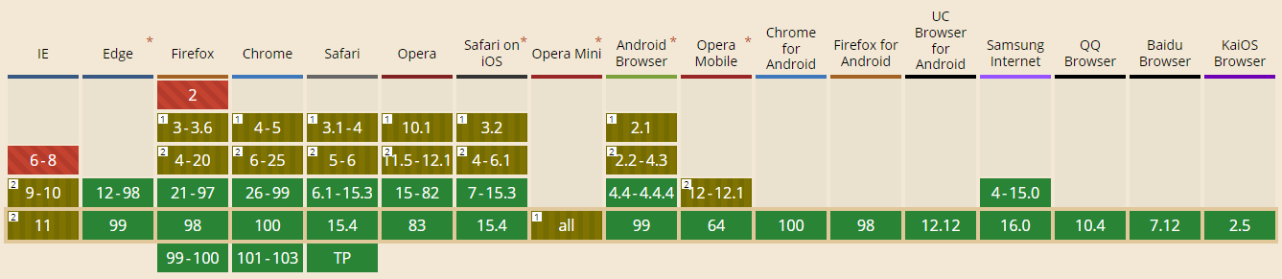
Can I use?

Slide 22
Homework
Add css styling to created portfolio
Add responsive design to portfolio
Portfolio ideas - https://bashooka.com/html/free-html-css-portfolio-web-design-templates/

