Slide 1
Project Proposal: Implementation of FreshDesk Ticketing System
Enhancing IT Support Operations
Presented by: Rubaet Mohammed, Date: 05/08/2024

Slide 2
Topics
1. Introduction
2. Project Overview
3. Current State (AS-IS) Analysis
4. Future State (TO-BE) Proposal
5. Key Features and Benefits
6. Implementation Plan
7. Risk Management
8. Recommendations
9. Q&A

Slide 3
Introduction
Objective: Introduce the purpose and scope of the project
Key Points:
Overview of the current system
The need for improvement
Expected outcomes of the project

Slide 4
Project Overview
Project Name: Implementation of FreshDesk Ticketing System
Goal: Develop a centralised system for tracking and handling customer requests
Objectives:
Improve operational efficiency by automating ticketing processes
Enhance customer satisfaction through timely resolution of issues
Implement Service Level Agreements (SLAs) to ensure timely responses and resolutions

Slide 5
Current State (AS-IS) Analysis
Content: Overview of the current AS-IS process for managing support tickets. This presentation will explore the existing workflows for both external clients and internal employees.
The goal is to identify inefficiencies and pain points in the current support processes.

Slide 6
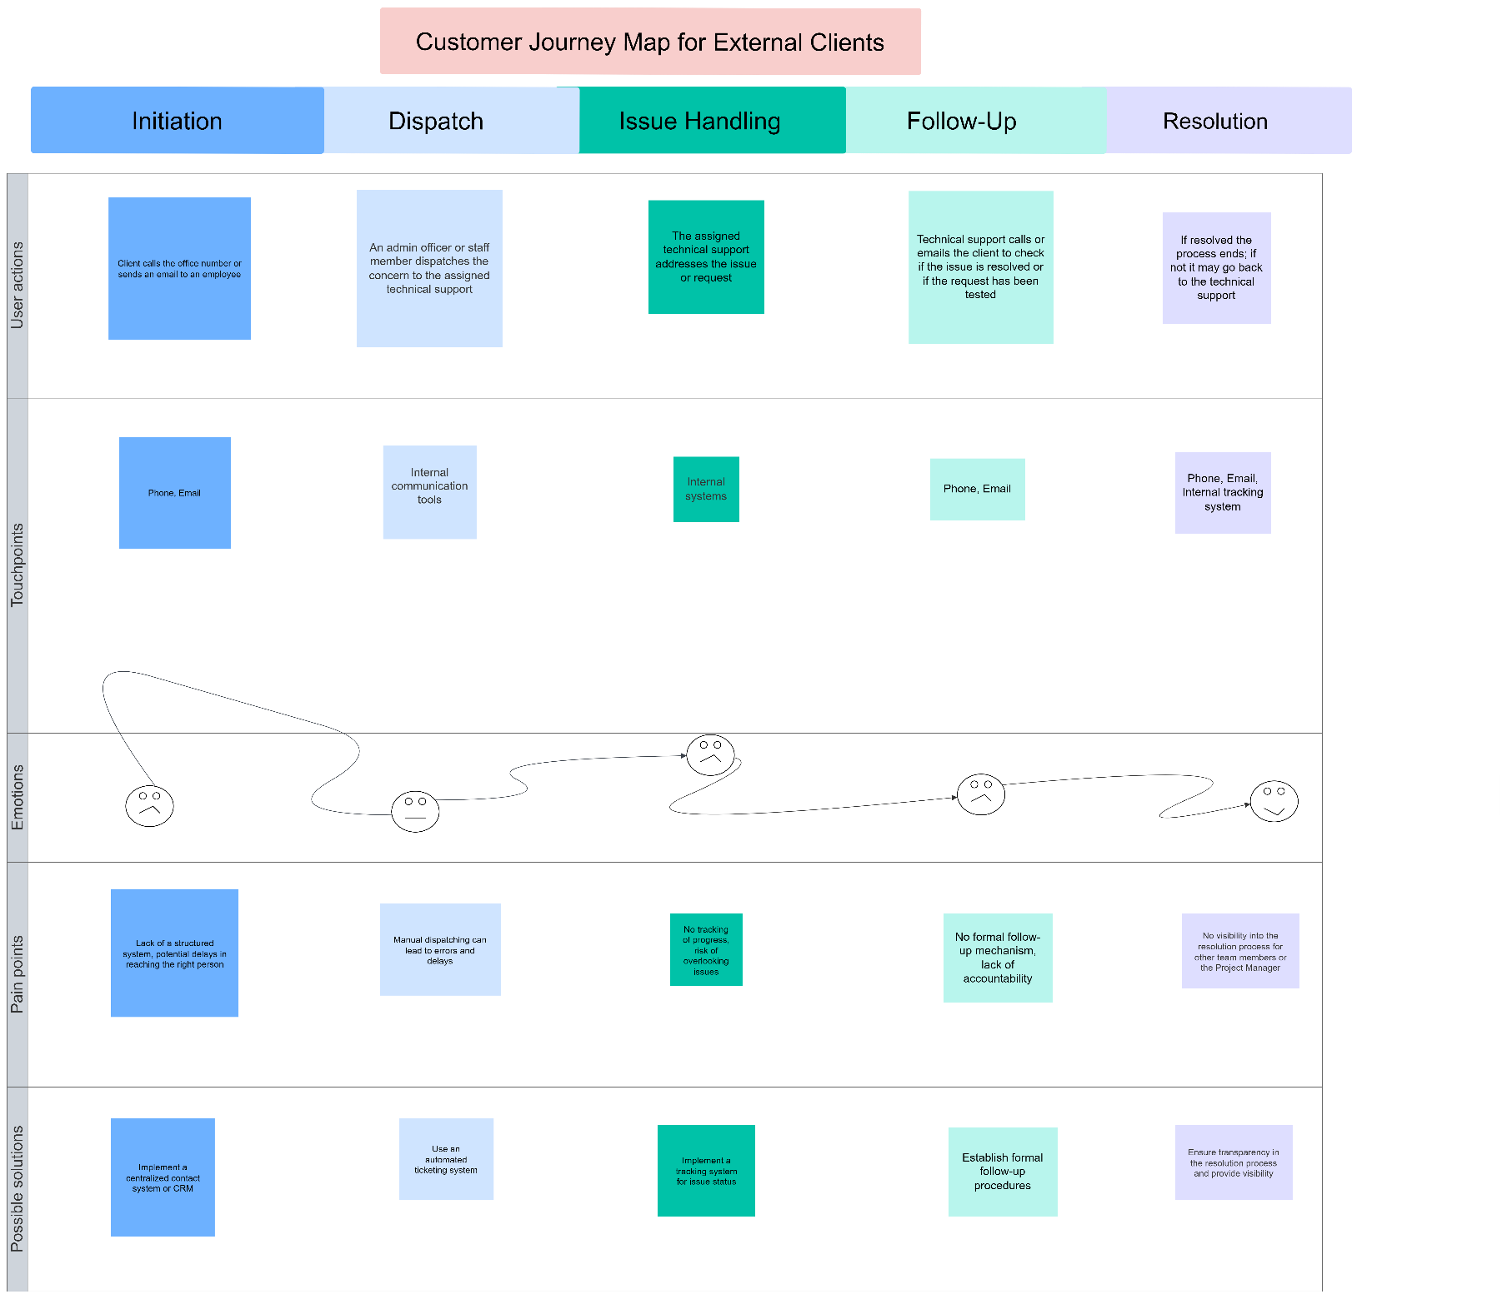

Slide 7
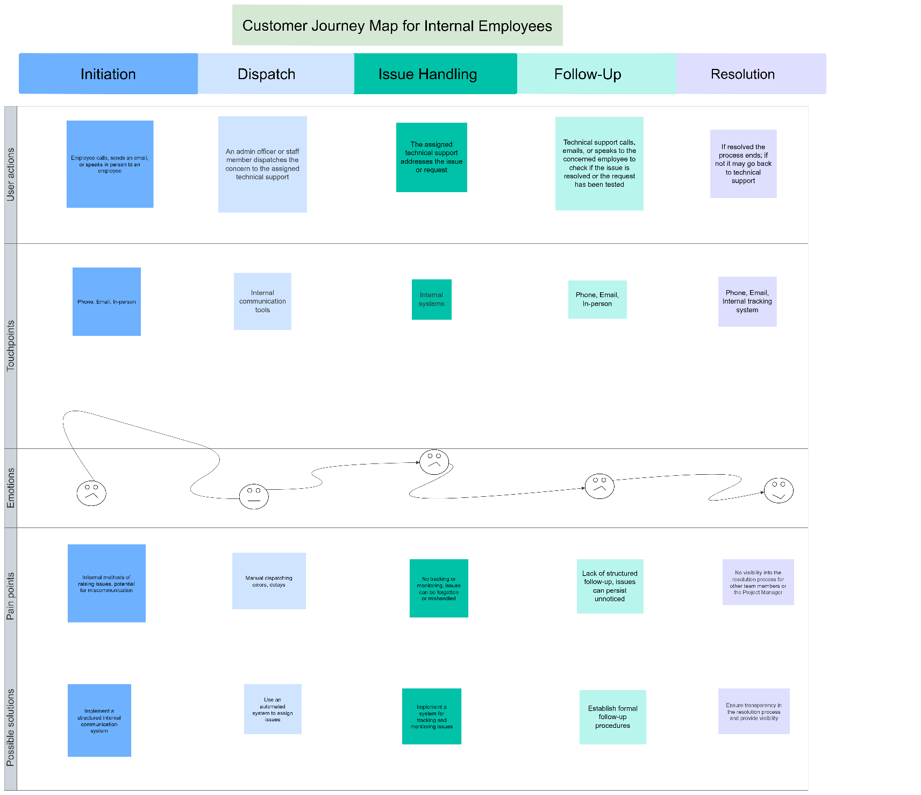

Slide 8
AS-IS Customer Journey Map
Current State Analysis
Key Pain Points:
Lack of structured system
Manual dispatching prone to errors
No formal tracking or follow-up mechanism

Slide 9
AS-IS Customer Journey Map
External Clients
Initiation
Process: Clients initiate contact by calling the office number or sending an email to an employee to report an issue or request support.
Pain Points:
Lack of structured system: Clients face frustration due to the absence of a formal process for raising issues.
Potential delays: The unstructured method leads to delays in reaching the appropriate support personnel, causing dissatisfaction.
Miscommunication: Without a standardized method, there's a risk of miscommunication, resulting in unclear or incomplete issue reporting.
Dispatch
Process: An admin officer or staff member manually dispatches the concern to the assigned technical support team.
Pain Points:
Manual process: The dispatching process is prone to human errors, which can result in issues being assigned to the wrong personnel or overlooked.
Delays: Manual dispatching can cause significant delays in issue resolution, impacting client satisfaction.

Slide 10
AS-IS Customer Journey Map
External Clients
Issue Handling
Process: The assigned technical support staff addresses the issue or request.
Pain Points:
No tracking system: The absence of a tracking mechanism means there is no visibility into the progress of the issue, increasing the risk of overlooking or forgetting issues.
Overlooked issues: Without monitoring, issues can be mishandled or neglected, leading to client frustration.
Follow-Up
Process: Technical support follows up with the client via calls or emails to check if the issue is resolved or if further action is needed.
Pain Points:
Informal follow-up: The lack of a formal follow-up mechanism results in inconsistent follow-ups, which can cause unresolved issues to persist.
Lack of accountability: Without a structured process, there is little accountability for ensuring issues are fully resolved.

Slide 11
AS-IS Customer Journey Map
External Clients
Resolution
Process: If the issue is resolved, the process ends. If not, it may go back to the technical support team for further action.
Pain Points:
No visibility: Other team members and the project manager have no visibility into the resolution process, leading to potential communication gaps and inefficiencies.

Slide 12
AS-IS Customer Journey Map
Internal Employees
Initiation
Process: Employees raise issues by calling, sending an email, or speaking in person to a colleague or support staff.
Pain Points:
Informal methods: The use of informal methods for raising issues can lead to miscommunication and incomplete issue reporting.
Frustration: Employees experience frustration due to the lack of a structured system, similar to external clients.
Dispatch
Process: An admin officer or staff member dispatches the concern to the assigned technical support team.
Pain Points:
Manual process: Similar to external clients, the manual dispatching process is prone to errors and delays.
Uncertainty: The manual nature of the process leads to uncertainty and inefficiency in handling issues.

Slide 13
AS-IS Customer Journey Map
Issue Handling
Process: The assigned technical support staff addresses the issue or request.
Pain Points:
No tracking system: The lack of tracking and monitoring means issues can be forgotten or mishandled.
Anxiety: Employees feel anxious about the progress of their issues due to the absence of visibility.
Follow-Up
Process: Technical support follows up with the employee to confirm if the issue is resolved or if further action is needed.
Pain Points:
Inconsistent follow-up: The informal follow-up process leads to inconsistent follow-ups, causing unresolved issues to persist unnoticed.
Dissatisfaction: Employees often do not receive timely updates, leading to dissatisfaction.

Slide 14
AS-IS Customer Journey Map
Resolution
Process: If the issue is resolved, the process ends. If not, it may go back to the technical support team for further action.
Pain Points:
Lack of transparency: The resolution process lacks transparency, leaving employees and other stakeholders frustrated and uninformed.

Slide 15
AS-IS Customer Journey Map
Key Issues Identified in the AS-IS Process
Initiation Stage:
External clients and internal employees face frustration due to a lack of structured systems for initiating contact.
Potential delays and miscommunication arise from informal methods and unstructured processes.
Dispatch Stage:
The manual dispatching process is prone to errors and delays, leading to uncertainty and inefficiency.
Both external clients and internal employees experience similar frustrations in this stage.
Issue Handling Stage:
There is no effective tracking system, resulting in anxiety and the risk of issues being overlooked or forgotten.
Lack of monitoring exacerbates the problem, particularly for internal employees.
Follow-Up Stage:
The absence of a formal follow-up mechanism causes frustration and a lack of accountability.
Both external clients and internal employees often do not receive timely updates, leading to dissatisfaction.
Resolution Stage:
The resolution process lacks transparency, leaving clients and employees frustrated.
Other team members and project managers do not have visibility into the resolution process, resulting in communication gaps.

Slide 16
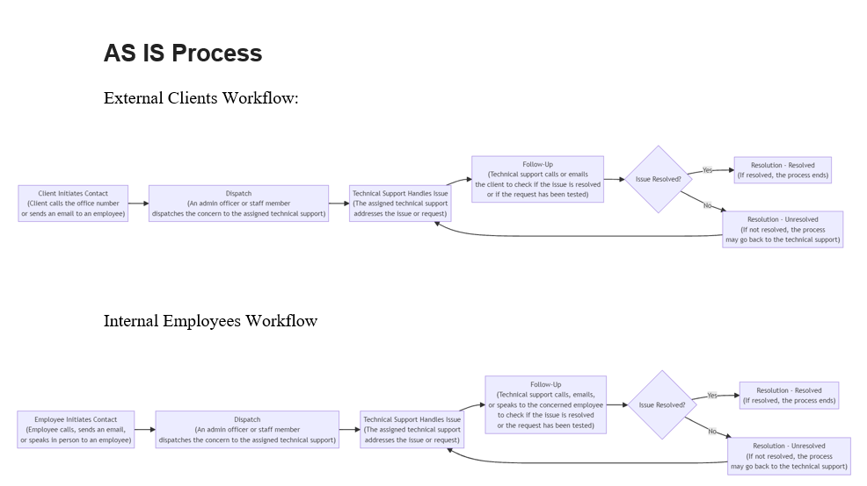

Slide 17
TO-BE Process Flow: Proposed Support Process

Slide 18
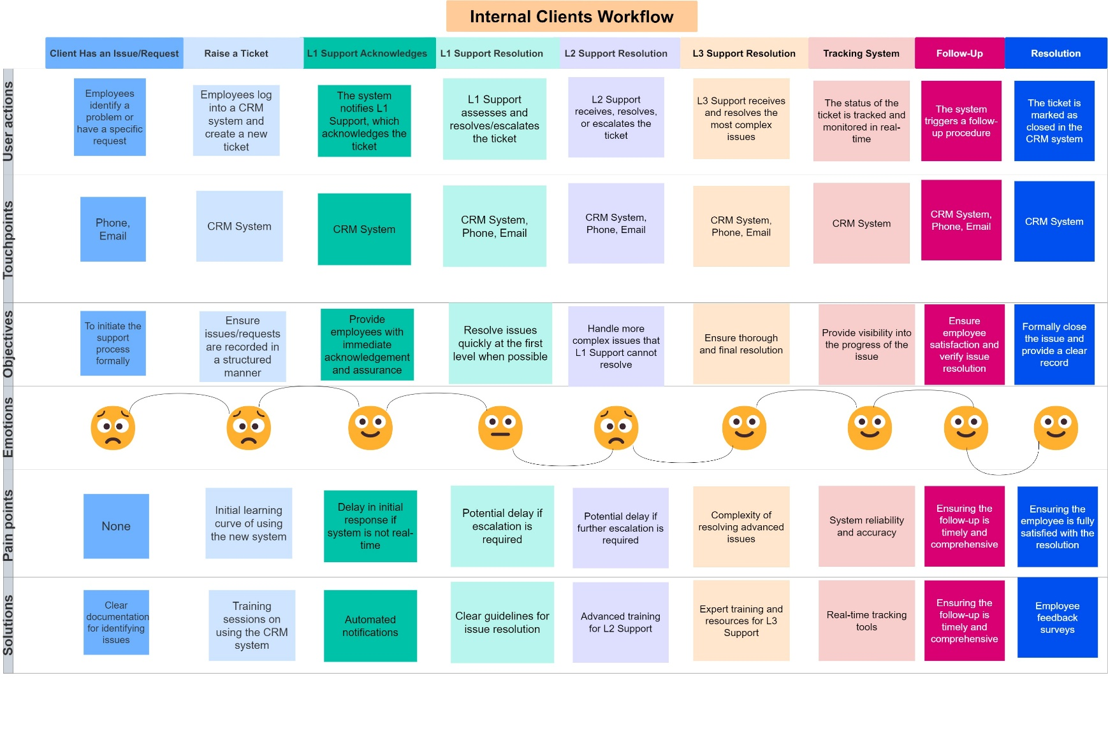

Slide 19
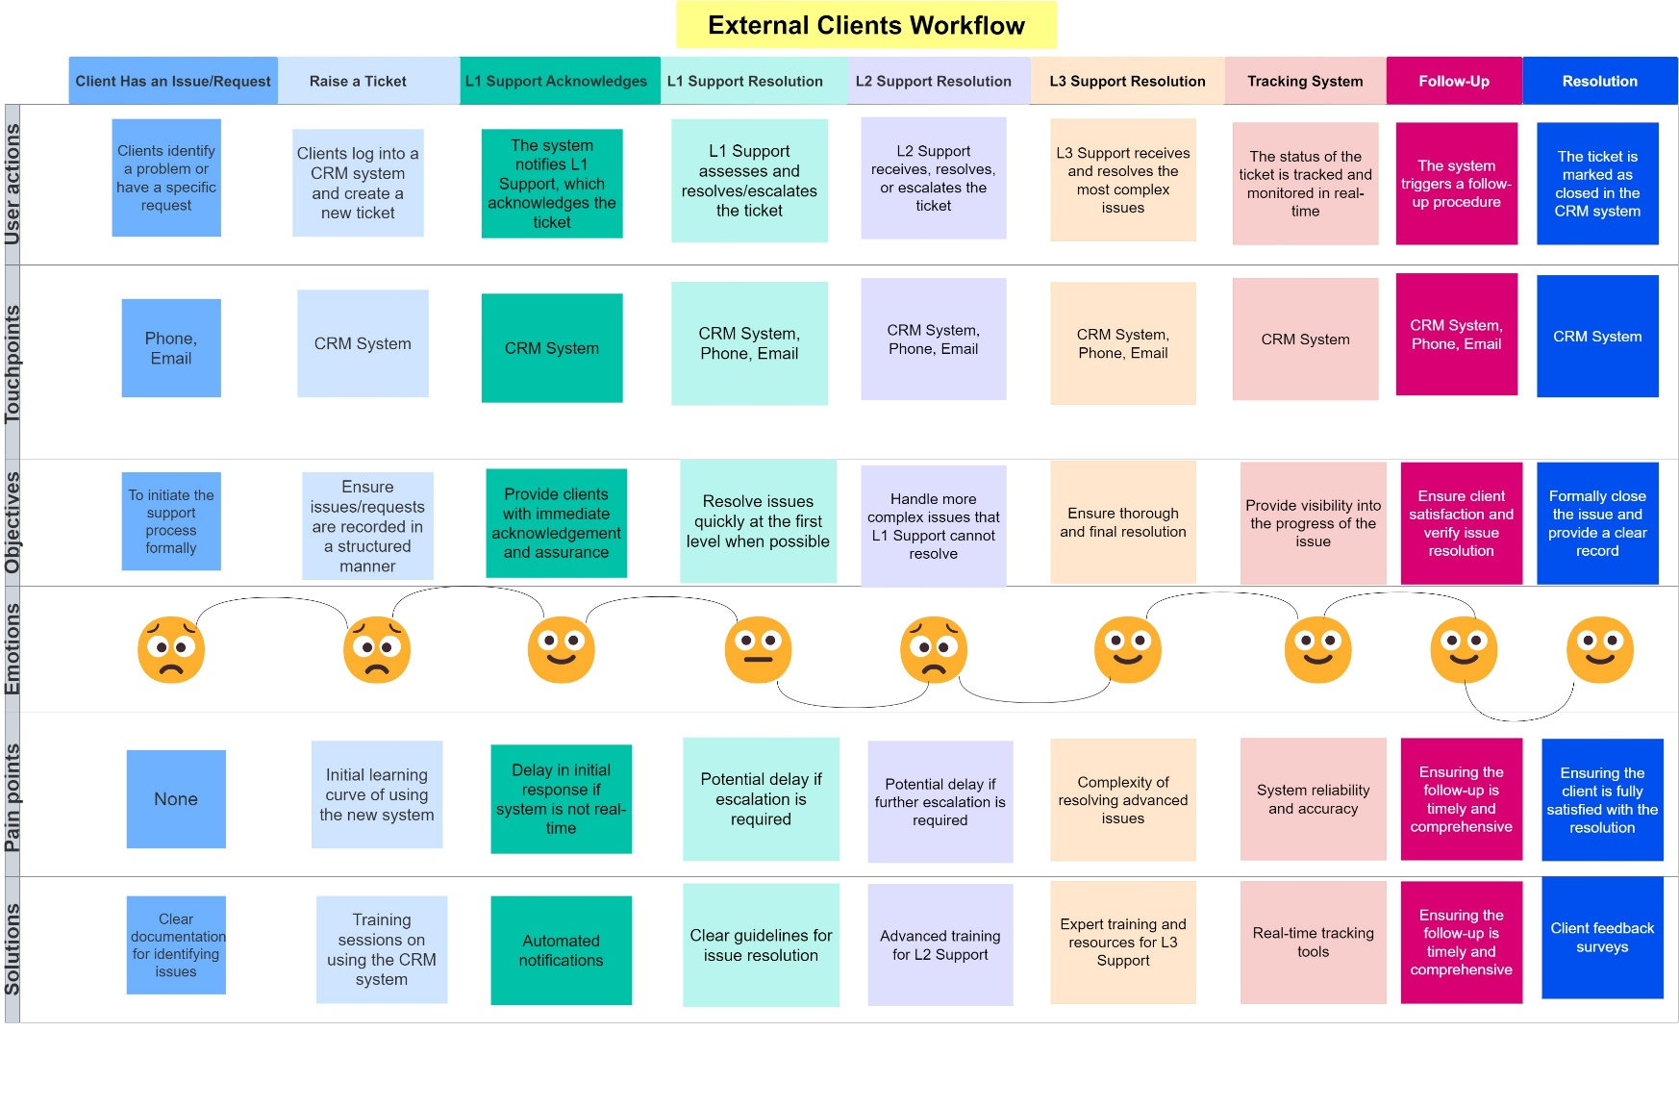

Slide 20
Introduction
Overview of the proposed TO-BE process using a centralized ticketing system.
This presentation will outline the future workflows for both external clients and internal employees using FreshDesk or a similar CRM.
The goal is to improve efficiency, accountability, and satisfaction.

Slide 21
TO-BE Process Flow for External Clients
Initiation: Clients log into a CRM system to raise a ticket.
Benefit: Structured, formalized process ensures all issues are logged.
Acknowledgment: The system automatically notifies Level 1 (L1) Support of the new ticket.
Benefit: Immediate acknowledgment provides assurance to clients.
L1 Support: L1 Support assesses and attempts to resolve the issue.
Benefit: Quick resolution at the first level whenever possible.
Escalation to L2/L3: If L1 cannot resolve, the issue escalates to Level 2 (L2) or Level 3 (L3).
Benefit: Structured escalation ensures complex issues receive expert attention.
Follow-Up: The system triggers automated follow-ups once the issue is resolved.
Benefit: Consistent follow-ups ensure client satisfaction.
Resolution and Closure: Ticket is marked as resolved in the CRM.
Benefit: Formal closure with a record of the resolution process.

Slide 22
TO-BE Process Flow for Internal Employees
Initiation: Employees log issues directly into the CRM system.
Benefit: Centralized logging for structured handling.
Acknowledgment by L1 Support: Immediate acknowledgment of new tickets.
Benefit: Employees receive instant confirmation.
L1 Resolution or Escalation: L1 attempts resolution or escalates to L2/L3.
Benefit: Efficient handling based on complexity.
Follow-Up: Automated follow-up by support staff to ensure satisfaction.
Benefit: Accountability and continuous feedback.
Resolution and Closure: Formal closure recorded in the CRM.
Benefit: Complete transparency and documentation.

Slide 23
Key Benefits of the TO-BE Process
Centralized System: Unified platform for all issues and requests.
Automated Ticketing: Reduces manual errors and ensures timely assignment.
Real-Time Tracking: Visibility into issue status for all stakeholders.
Structured Follow-Ups: Consistent communication with clients and employees.
Enhanced Accountability: Clear tracking of responsibilities and actions taken.
Improved Satisfaction: Efficient, transparent, and timely resolution of issues.

Slide 24
TO-BE Client Workflow
Client Raises Ticket: Through the CRM system.
Automatic Notification: L1 Support is immediately notified.
Issue Handling by L1/L2/L3: Structured handling based on complexity.
Automated Follow-Up: System prompts follow-up to ensure resolution.
Ticket Closure: Formal closure recorded, ensuring accountability and satisfaction.

Slide 25
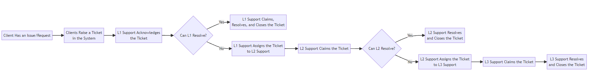
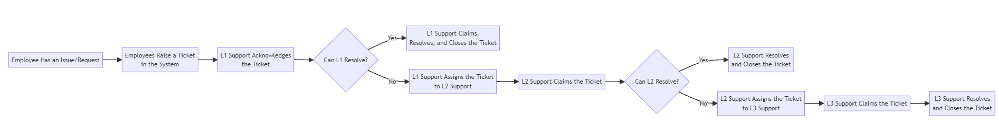
Internal Employees Workflow
External Clients Workflow

Slide 26
Key Features and Benefits
Features of FreshDesk
Automated ticket management
SLA monitoring and alerts
Real-time tracking and reporting
Seamless integration with communication channels

Slide 27
Implementation Plan
Project Milestones
Project Planning and Initiation: June 10, 2024
Requirements Gathering: June 15, 2024
System Design and Architecture: June 30, 2024
Development and Configuration: July 31, 2024
Integration and Testing: August 15, 2024
User Training and Documentation: August 25, 2024
Pilot Testing: September 10, 2024
Full Deployment: September 30, 2024

Slide 28
Risk Management
Potential Risks:
Delays in software acquisition or configuration
Resistance to change from users
Technical issues during integration
Mitigation Strategies:
Detailed project planning and scheduling
Comprehensive training programs
Robust testing and contingency plans

Slide 29
Recommendations
Final Recommendations
Adopt FreshDesk for centralised ticketing
Ensure thorough training for all users
Monitor and review performance regularly
Gather continuous feedback for improvements

Slide 30
Q&A
Questions and Answers
Open floor for questions from the audience

