Slide 1
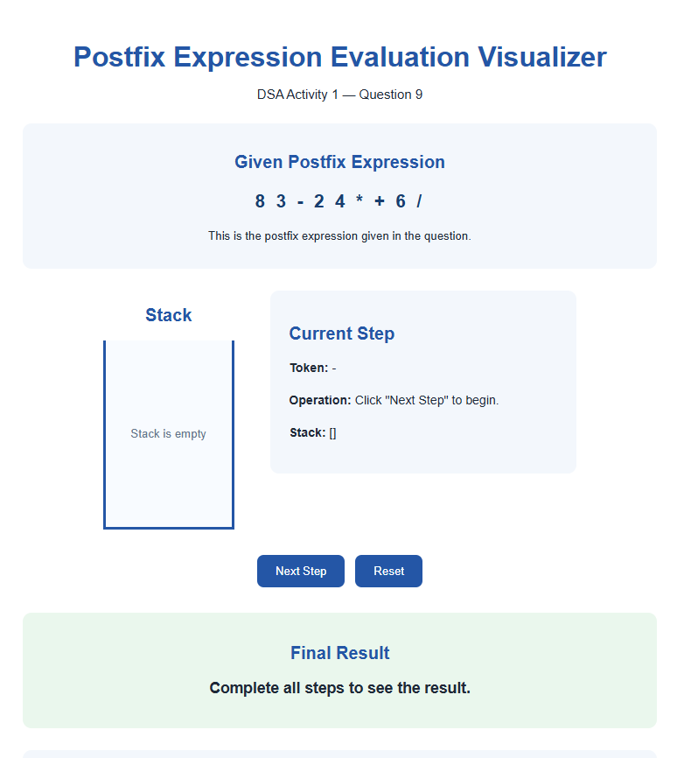
Visualization – Initial State
The given postfix expression is ready; the stack is initially empty.
Postfix Expression Evaluation Visualizer | DSA Activity 1 – Question 9 | 1

Slide 2
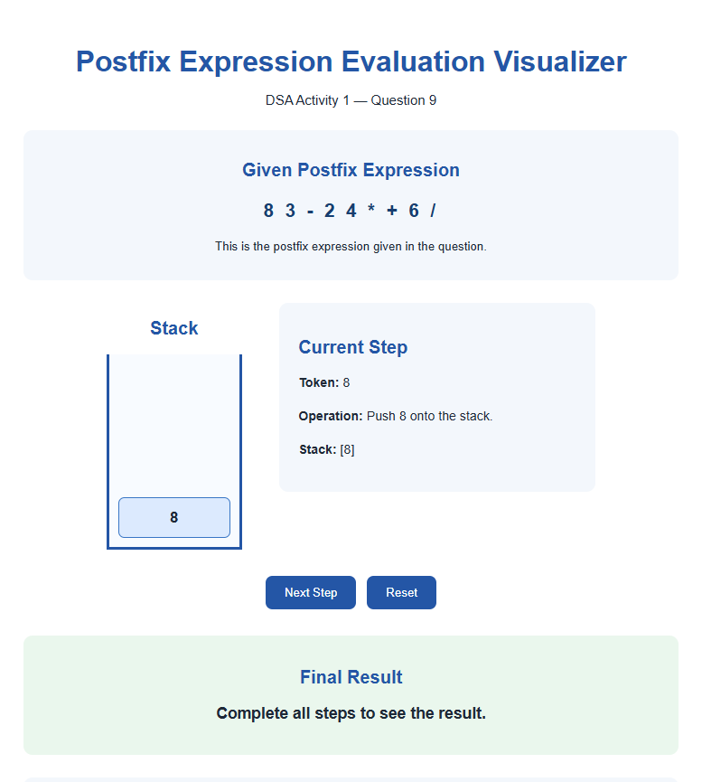
Visualization – Push First Operand
Operand 8 is pushed onto the stack.
Postfix Expression Evaluation Visualizer | DSA Activity 1 – Question 9 | 2

Slide 3
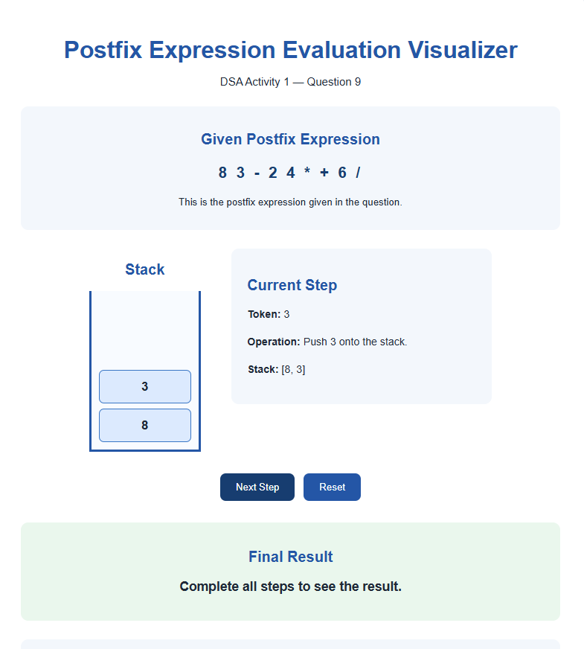
Visualization – Push Second Operand
Operand 3 is pushed onto the stack.
Postfix Expression Evaluation Visualizer | DSA Activity 1 – Question 9 | 3

Slide 4
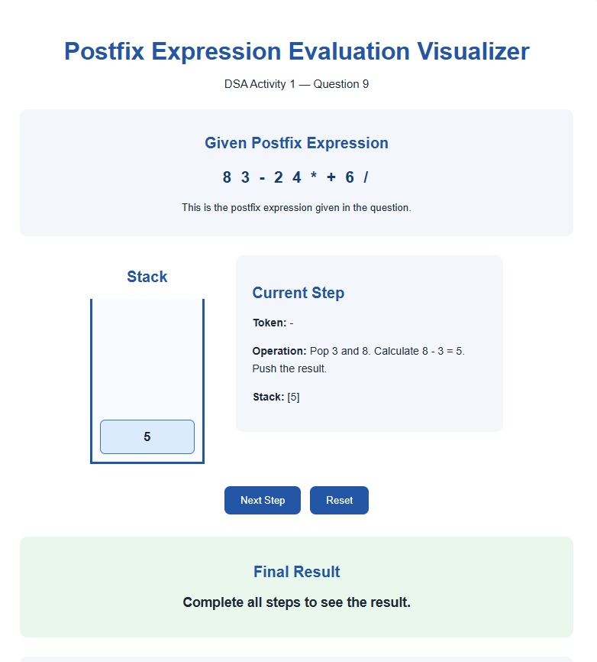
Visualization – Apply Subtraction
Operands 8 and 3 are popped, 8 − 3 = 5 is calculated, and 5 is pushed.
Postfix Expression Evaluation Visualizer | DSA Activity 1 – Question 9 | 4

Slide 5
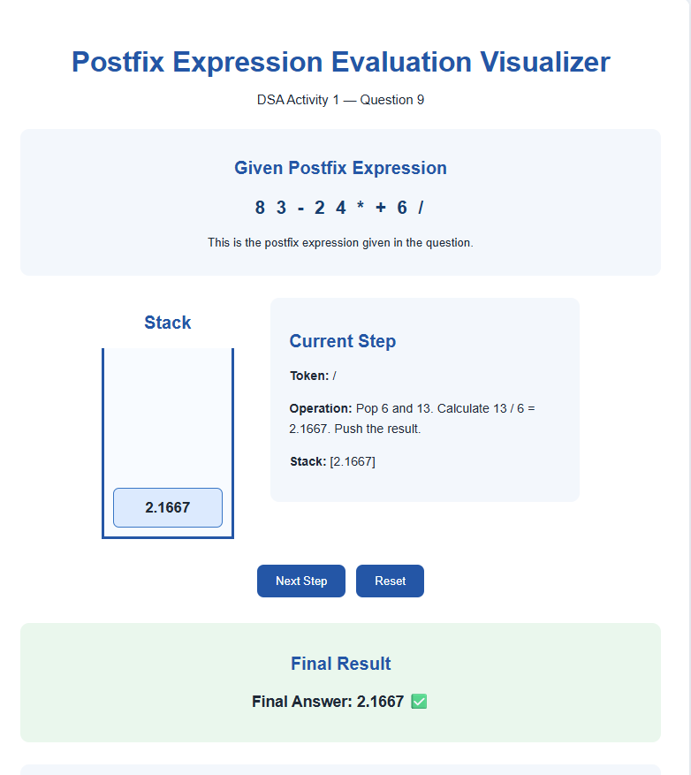
Visualization – Final Result
After completing all operations, the final result is 2.1667.
Postfix Expression Evaluation Visualizer | DSA Activity 1 – Question 9 | 5

