Slide 1



Online Secure Bank
Secure Software Development

Slide 2


TEAM
Our Dedicated Project Team
Awais Asif
Rubaiqa Pervez
Seemab Khan
Uw-23-cy-bs-010
Uw-23-cy-bs-020
Uw-23-cy-bs-005

Slide 3

Addressing Critical Security Gaps
Traditional banking systems often suffer from inherent vulnerabilities that expose customer data and financial assets to significant risks. Our project directly tackles these pervasive issues, laying the groundwork for a more secure digital banking future.
Weak Authentication: Exploitable login mechanisms.
Insecure Password Storage: Vulnerable user credentials.
Lack of Threat-Aware Design: Systems built without security in mind.
Increased Cyber Attack Risk: Banking systems are prime targets.

Slide 4
Project Objectives
1
Implement Robust Authentication
Ensure all user access is verified through strong, multi-factor mechanisms.
2
Protect Sensitive Data
Utilise advanced hashing techniques like SHA-256 for all critical information, ensuring data integrity and confidentiality.
3
Apply STRIDE Threat Modeling
Systematically identify and mitigate potential security threats throughout the development lifecycle.
4
Validate System Integrity
Thoroughly test all components using a comprehensive unit testing framework to guarantee reliability and security.
5
Adhere to Secure SDLC
Integrate security considerations into every phase of the Software Development Life Cycle.

Slide 5





System Overview: A Secure Foundation
Our Online Secure Bank project is primarily a backend-focused application, engineered from the ground up for maximum security. It establishes a secure environment where user authentication is paramount before any access to banking functionalities is granted.
Backend-Focused
Core logic and data handling are secured.
Mandatory Authentication
Users must authenticate before any access.
No Plaintext Passwords
All sensitive credentials are securely hashed.
Modular Architecture
Ensures maintainability and enhances security isolation.

Slide 6


Our Robust Technology Stack
We have carefully selected a technology stack that provides both power and security, ensuring our banking application is resilient against modern threats.
Programming Language: Python for its versatility, extensive libraries, and strong community support in secure development practices.
Security Implementation: SHA-256 hashing for all password storage, guaranteeing cryptographic strength.
Configuration Management: Utilisation of .env files to manage sensitive configurations and environment variables securely.
Testing Framework: Python's built-in Unit Testing Framework for comprehensive verification of all modules and functionalities.
Why Python?
Python's clear syntax and robust ecosystem make it ideal for secure application development, allowing for efficient implementation of complex security protocols.

Slide 7
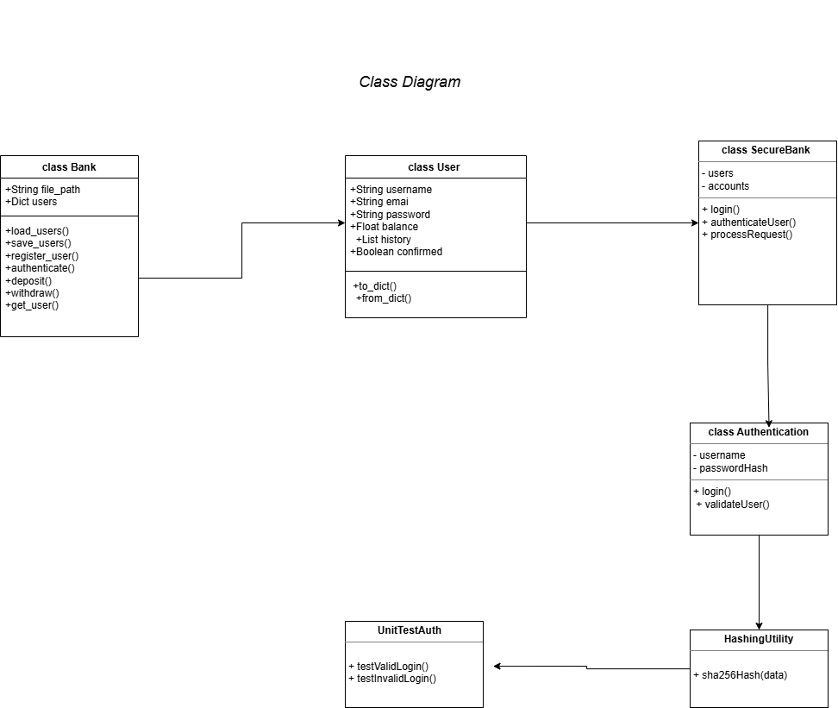
Layered System Diagrams:
Activity Diagram
Use Case Diagram
Class Diagram
Architecture Diagram

Slide 8
Core Modules: The Building Blocks of Security
The Online Secure Bank is composed of several tightly integrated modules, each designed with security and efficiency in mind. These modules collectively ensure a secure and functional banking experience.
Authentication Module
Hashing & Security Utilities
Business Logic Handling
Manages user login, session management, and access control.
Handles all cryptographic operations for data protection.
Processes core banking operations, like transfers and balance inquiries.
Environment Configuration
Unit Testing Module
Ensures secure handling of sensitive settings and variables.
Verifies the functionality and security of individual components.

Slide 9












SECURITY
STRIDE Threat Modeling: Proactive Defence
STRIDE is a fundamental methodology used to identify and categorise potential security threats within our system. By systematically evaluating each threat category, we ensure comprehensive mitigation strategies are in place.
Tampering
Spoofing
Protecting data from unauthorised modification.
Preventing identity impersonation.
Elevation of Privilege
Repudiation
Restricting unauthorised access rights.
Ensuring accountability for actions.
Denial of Service
Information Disclosure
Maintaining system availability and responsiveness.
Safeguarding sensitive information.

Slide 10
Results and Conclusion
Our project successfully delivered a secure banking application, demonstrating the practical application of secure software development principles. We are confident this system meets stringent academic security goals and provides a robust foundation for future enhancements.
1
2
3
Secure Authentication Implemented
Sensitive Data Protected
STRIDE Threats Mitigated
All critical data is safeguarded through advanced hashing.
Comprehensive strategies are in place to address all identified threats.
Multi-factor authentication protocols are fully functional.
4
5
Unit Tests Passed Successfully
Academic Security Goals Achieved
Rigorous testing confirms system reliability and security.
The project fulfills all requirements for secure software development.

Slide 11


Thank you

