Slide 1

Title :Construction of Web Accessibility Tool for Chrome Extension
Course Title: Research/Project
Presented by :
Sakil Ahmed
ID No : CE18033
Rubaiyat Razin Raha
ID No : CE18037
Course Code: CSE-5000
Supervisor:
Dr. Md. Sazzad Hossain
Professor
Department of CSE,MBSTU

Slide 2
Table of Content
Introduction
Motivation
Existing Tools
Web Accessibility Standards
Benefits of Accessibility Tools
Objective
Proposed Accessible Chrome Extension
Result
Conclusions
Future Works
References

Slide 3
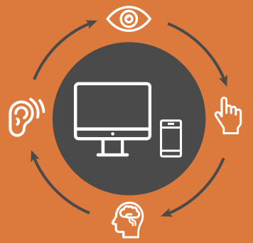
Introduction
Web Accessibility
Accessibility means people with disabilities can perceive, understand, navigate and interact with the web and they can contribute to the web.

Slide 4

Motivation
Web accessible tools are designed to remove these barriers and ensure that everyone can use the internet regardless of their abilities.

Slide 5
Existing Tools
Wave
AChecker
Known Problems
Likely Problems
Potential Problems
HTML Validation
CSS Validation
Aria
Features
Alert
Accessibility Errors

Slide 6
Limitation of Existing Tools
Tools Name | Limitation
Wave | Limited to automated testing
AChecker | Inability to Check Dynamically Generated Content

Slide 7
Web Accessibility Standards
- Web Content Accessibility Guidelines(WCAG) 2.0:
WCAG2A
WCAG2AA
WCAG2AAA

Slide 8

Benefits of Accessibility Tools
Improved user experience for people with disabilities, leading to increased engagement and satisfaction.

Slide 9
Objective
Create a accessible tools for chrome extension .
Accessibility Errors.
Alert.
Warning.

Slide 10
Methodology
Used a Public API
Create a simple server
Get an end point
Call the end point in a Extension

Slide 11
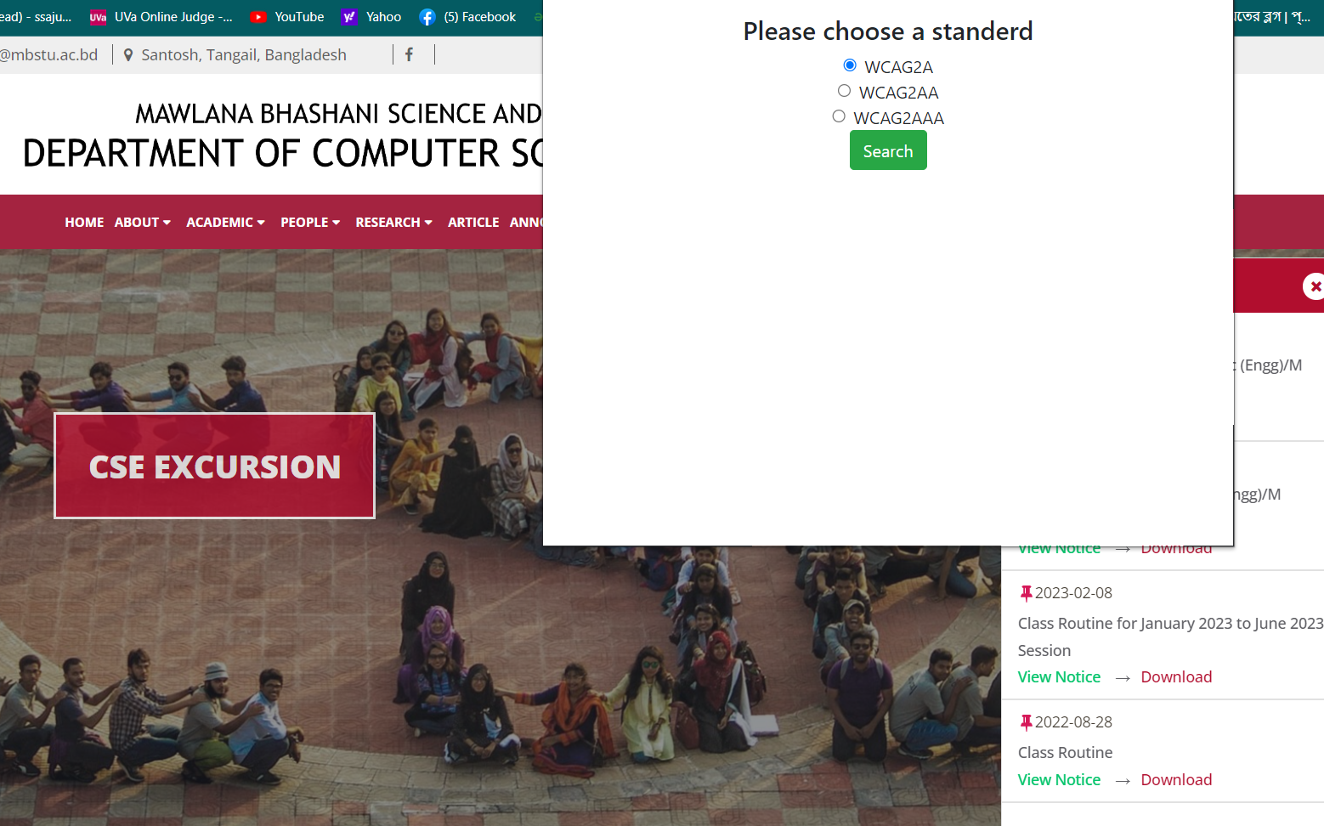
Proposed Accessible Chrome Extension

Slide 12
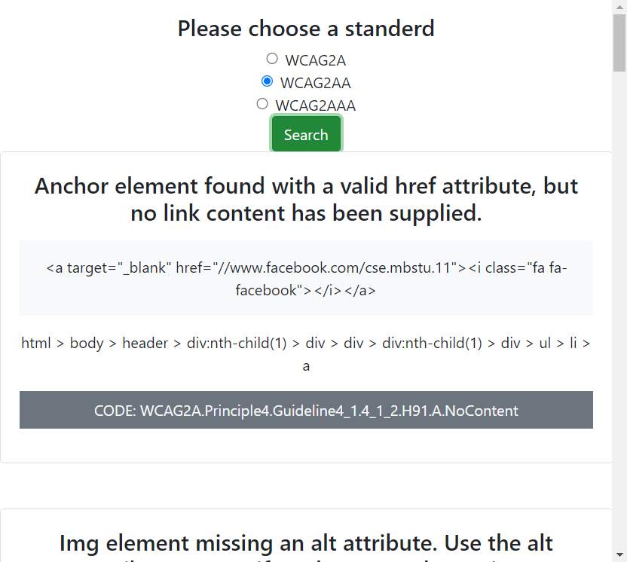
Result

Slide 13
Conclusions
This Extension is mainly designed for the Chrome browser.
This Chrome Extension find out error , warning , alert in a web page.
Show the error line in HTML code.

Slide 14
Future Works
Show the accessible error in Web page UI.
Make this chrome accessible extension tool more user friendly.
Make this accessible extension tool for other browsers(Microsoft Edge, Mozilla Firefox) .

