Slide 1
CAR RENTAL APPLICATION
Created by:
Anuj Monga
Jatinderpal Singh
Jatinder Mann
Sahil Sachdeva

Slide 2
Key Features :
List of Customers
Create , Delete and Modify Customer
List of Cars
Create , Delete and Modify Cars
Transactions : Rent or Reserve a Car

Slide 3
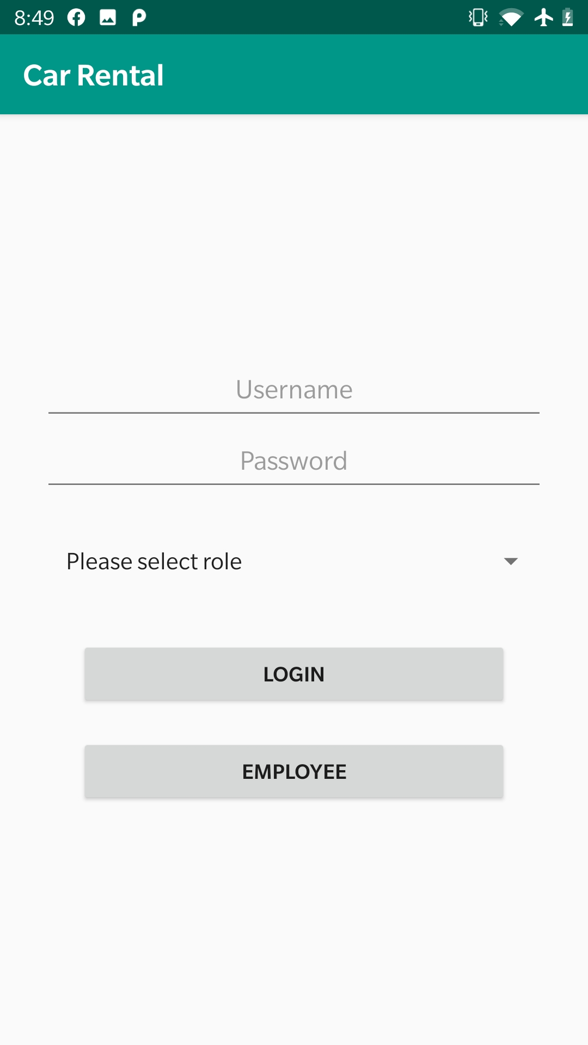
Login page

Slide 4
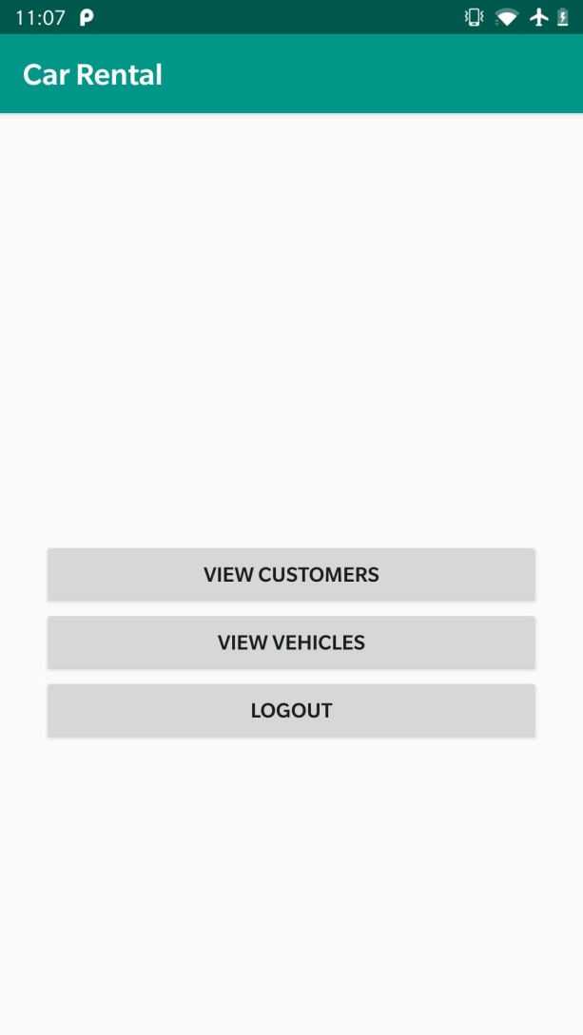
Employee Functions

Slide 5
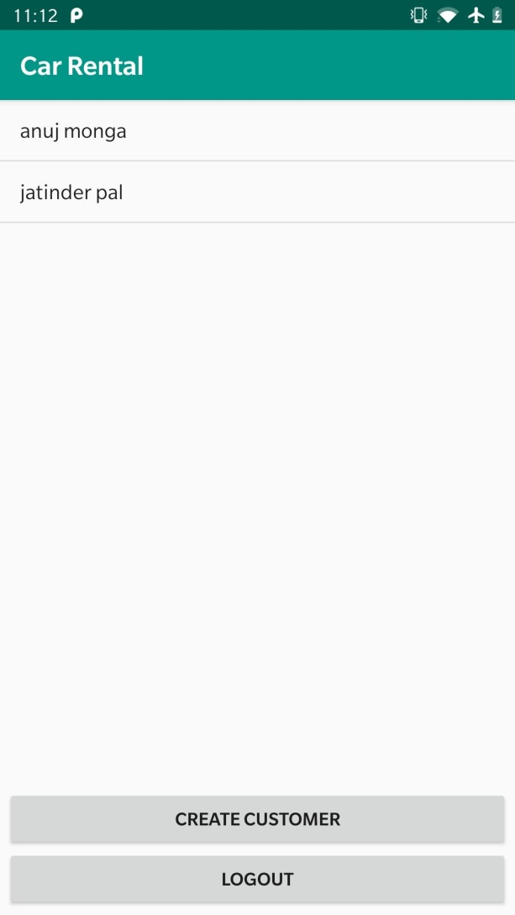
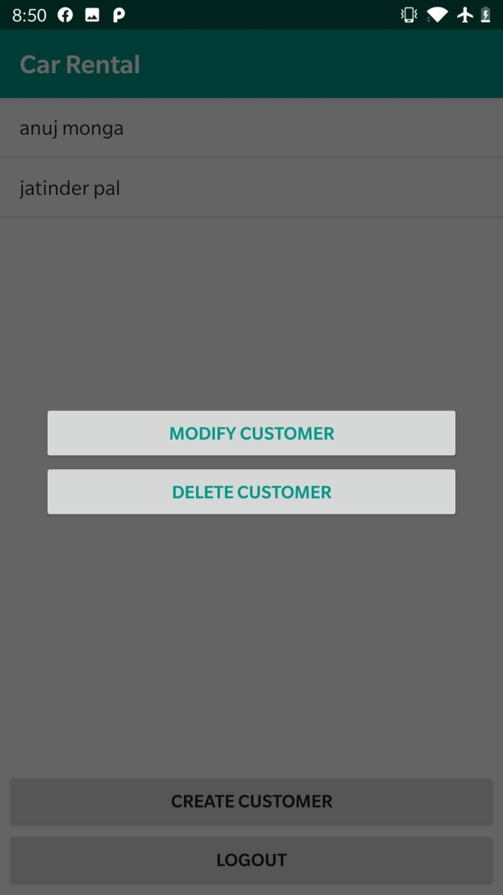
View Customers

Slide 6
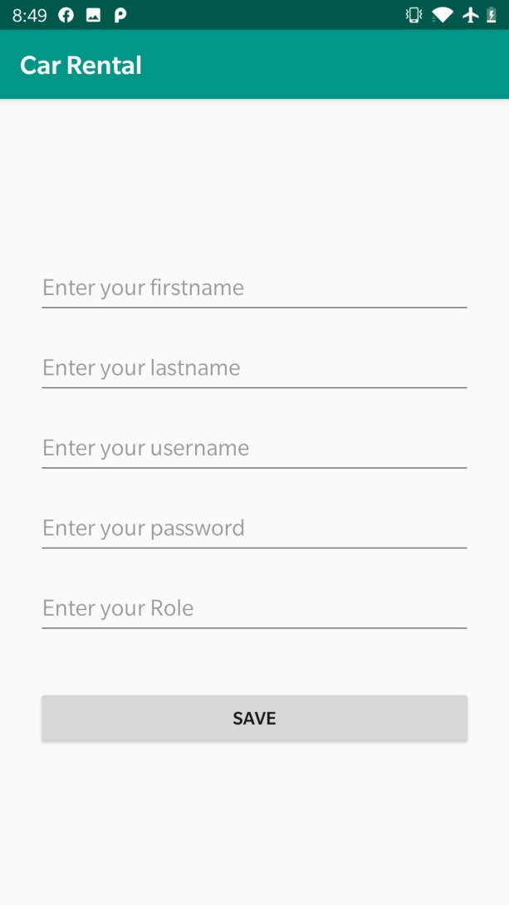
Create Customer

Slide 7
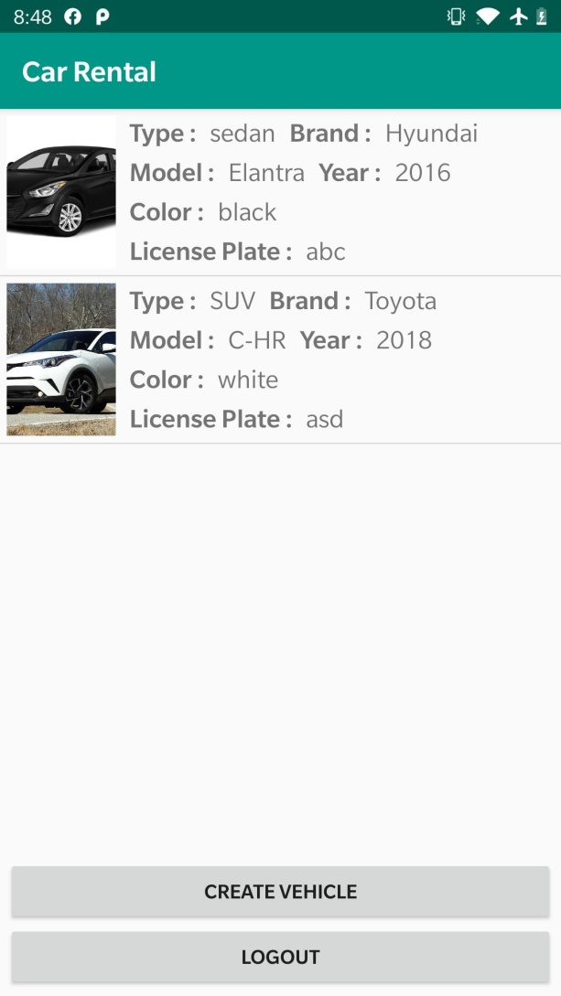
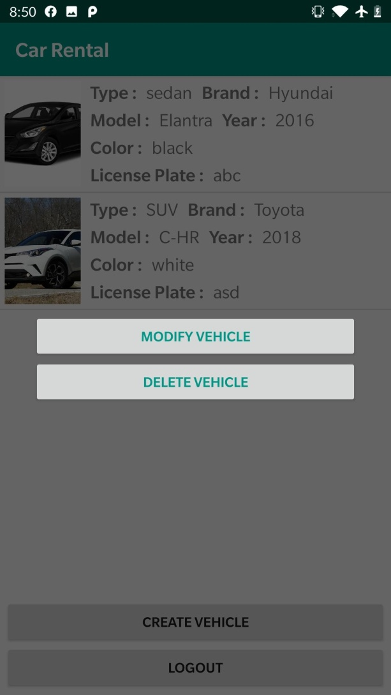
View Vehicles

Slide 8
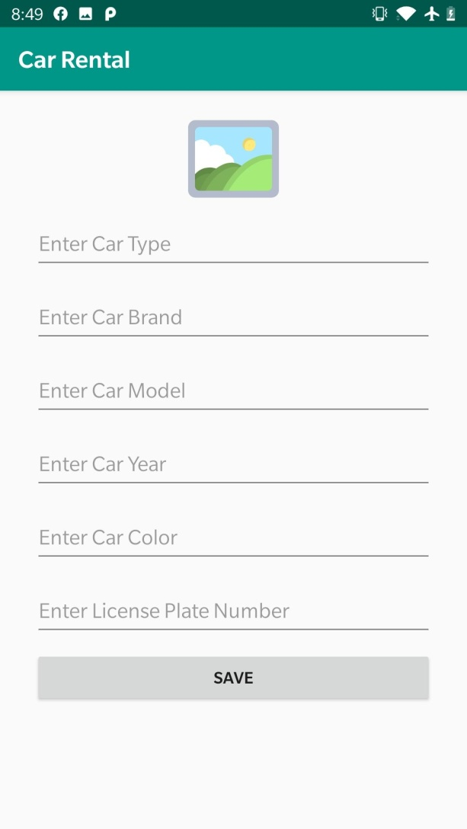
Create Vehicle

Slide 9
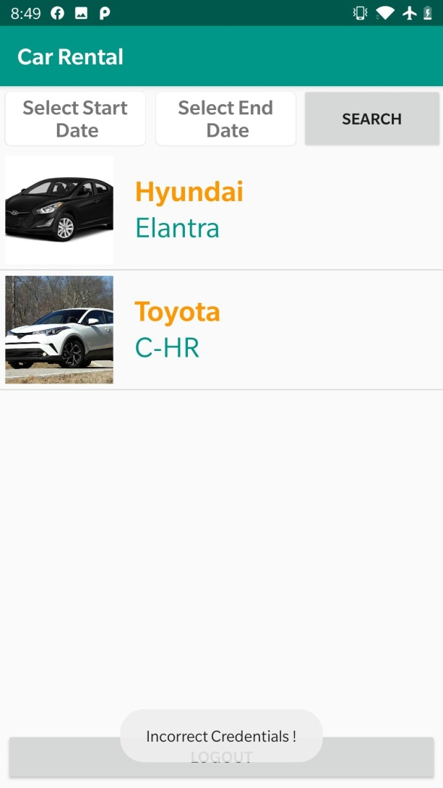
Customer Page

Slide 10
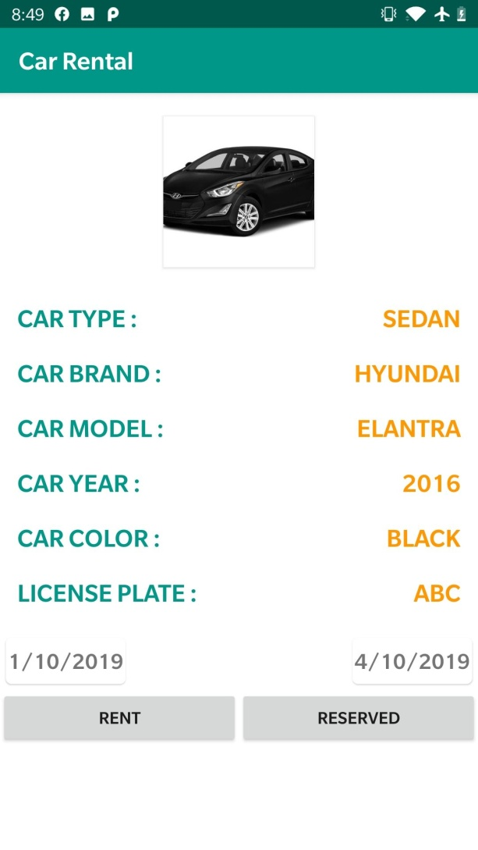
Car Details

Slide 11
Thanks

